Slide 1
NPM module installation
Hiroyasu Nishiyama

Slide 2

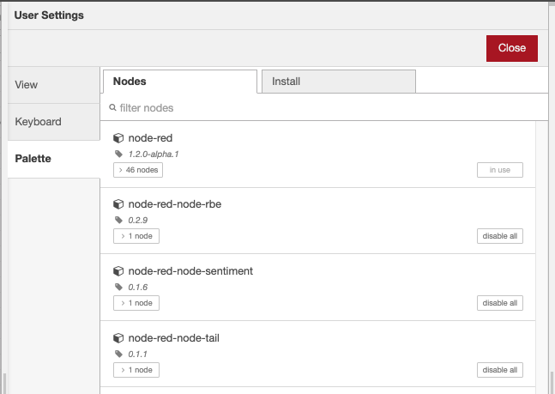


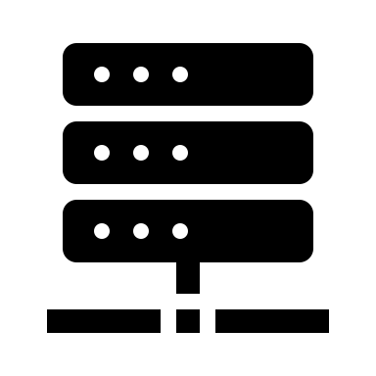
NPM installation method
Rethinking about NPM installation method for Function node
Considering failure of automatic installation and/or N/W access limitation, I think manual mode installation scheme in addition to automatic mode (included in current design)
However, if Function node is used within Exportable SUBFLOW, we can not access settings interface of the Function node.
So, I would like to add management interface of the NPM modules to editor. - Users can install/uninstall NPM module (including one required from Function node within exportable SUBFLOW) from editor "Manage Palette" menu.
module X
Node-RED runtime
Manage Palette
(load/update/delete npm)
require X
SUBFLOW definition (not accessible if exportable SUBFLOW)
load/update/delete

Slide 3
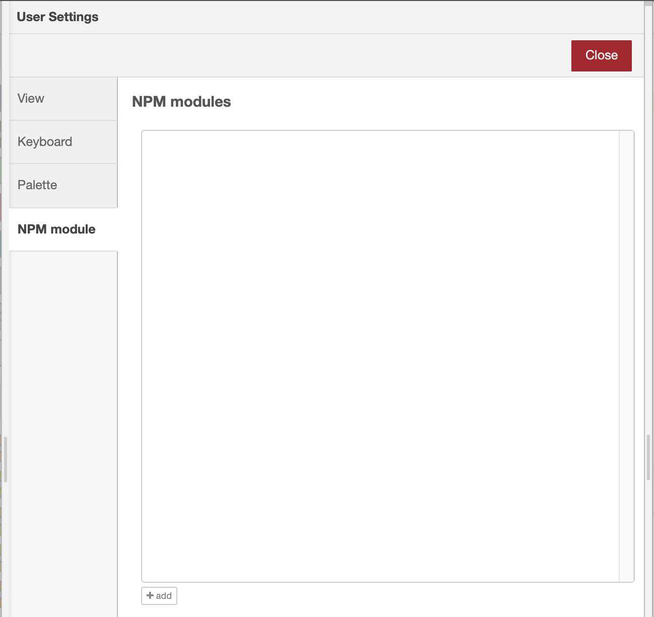
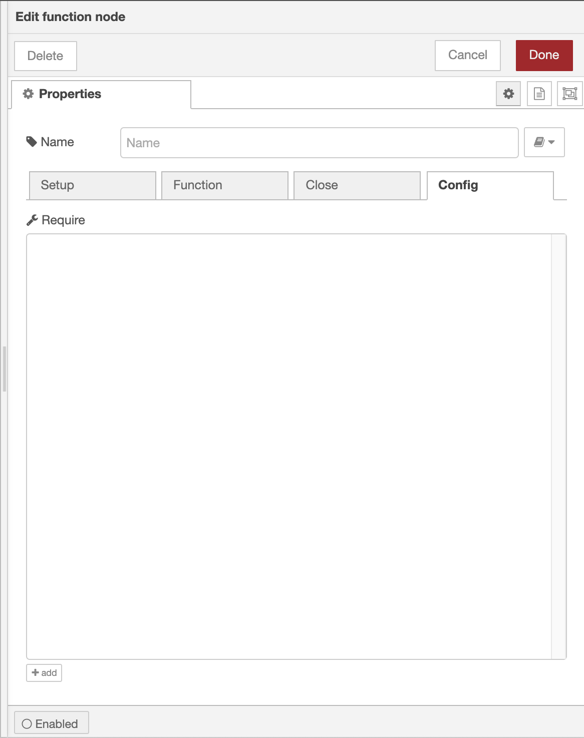

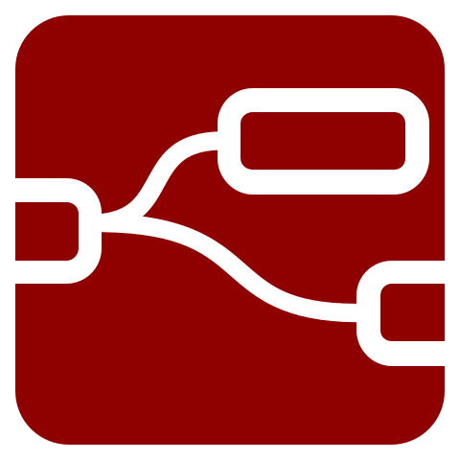
Module Installation Process
NPM module name
manual install/
uninstall/update
loaded module object
module
auto
ins..
del..
upd..
variable name in
VM environment
install automatically
var
NPM module
auto
▼
select from list of NPM modules
notify used
module info
User Settings/NPM module
list of installed
NPM modules
Runtime
install NPM module under
lib/node_modules
Function node settings panel

