Slide 1
NPM module installation
Hiroyasu Nishiyama

Slide 2

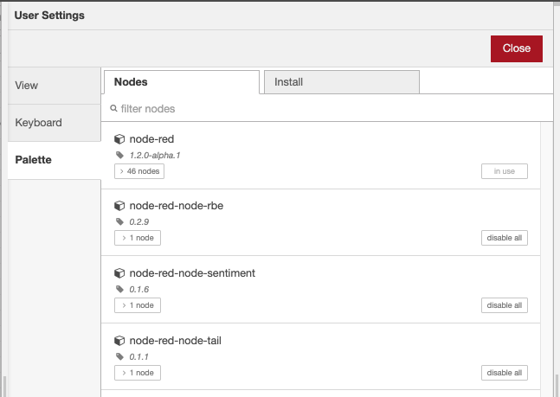


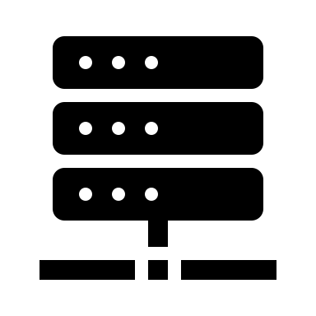
NPM installation method
Rethinking about NPM installation method for Function node
Considering failure of automatic installation and/or N/W access limitation, I think manual mode installation scheme in addition to automatic mode (included in current design)
However, if Function node is used within Exportable SUBFLOW, we can not access settings interface of the Function node.
So, I would like to add management interface of the NPM modules to editor. - Users can install/uninstall NPM module (including one required from Function node within exportable SUBFLOW) from editor "Manage Palette" menu.
module X
Node-RED runtime
Manage Palette
(load/update/delete npm)
require X
SUBFLOW definition (not accessible if exportable SUBFLOW)
load/update/delete

