Slide 1
Line break support for node labels
Yuma Matsuura
Notes:
本資料では、フローテストの実行コマンドの仕様、詳細処理を共有する

Slide 2
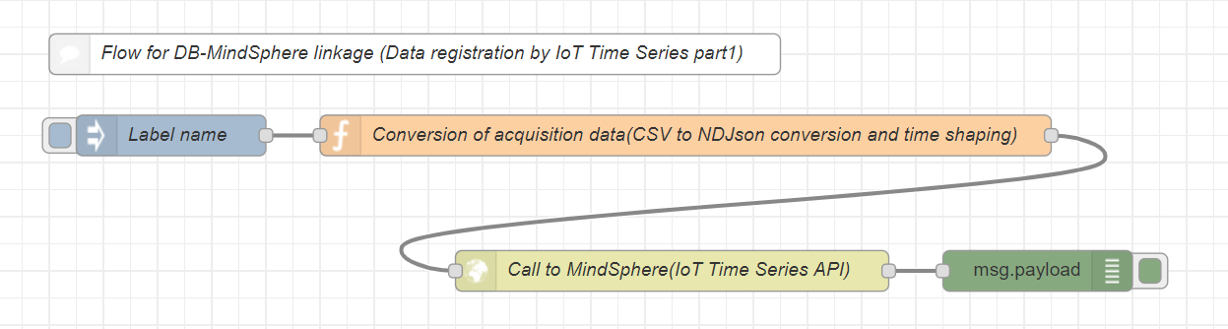
Background
[Request] Insert a line break in the label of a node.
[Problem] A node with a long name gets long sideways and looks bad.
We sometimes write long sentences on labels.
But a node with a long name gets long sideways and look bad.
For example, We want to insert a line break like this.
Reshape the data
1. Transform to NDJson
2. Date format
Notes:
mochaで並列実行できるのであればそうしたい
現状はシングル

Slide 3
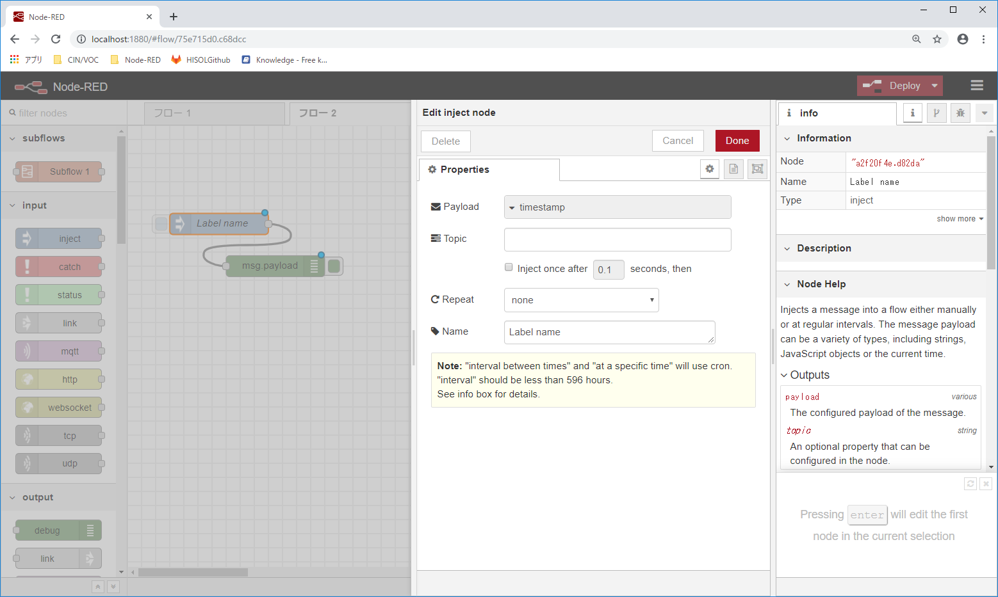
Task
Support a line break at 3 places.
③
①
②

Slide 4



Question
How to specify a line break in a label?
We considered the following 3 ways.
① Changing “<input type=‘text’> “ to “<textarea></textarea>” tag
② Regarding “\n” as a line break
③ Regarding “<br/>” as a line break

Slide 5
Node installation from other than public site
Kazuhiro Ito

Slide 6
Node installation from other than public site
■Summary
It is under consideration to install a self-made node from other than the public site, such as a local environment, using the "Manage palette" > "Palette" > "Install ".
■Function
１．Search for a self-made node in palette management
We can change the URL referring to a catalog.json, which contains node's information, in the settings.js
２．A Self-made node installation from a private npm registry.
Set the use of private npm registry by "npm set config".
3． A Self-made node installation from a Git site.
Plans to consider that Node-RED will support.
Support for installation with Git URL (ex. npm install <git:// url>)
■Question matters
If you have a tool for creating a catalog.json, please provide it as a reference.

Slide 7
Timeout Function
Kazumi Yoshida

Slide 8
Timeout Function
<Background>
We received the following request:
Node-RED should timeout and respond in case of no responding in a communication, etc. Instead of waiting indefinitely. Examples below:
- case1: Executing SQL statements and queries take a long time.
- case2: No response returned when sending a request to a web service with "http-
request" node.
- case3: The flows between "http-in" and "http-out" nodes take a long time.
Apps which sent a request to Node-RED would be kept waiting. Desirably, "http-out" node replies an error after the elapse of a certain period of time.
<Current situation>
We are considering the processing ways to support timeout based on Nishiyama-san's idea which is described in the following URL.
Node Messaging API
https://github.com/node-red/node-red/wiki/Design%3A-Node-Messaging-API

Slide 9
Timeout Function
<Points to note>
figure 1
1.syncFunc() might return a value after timeout.
2.Maintaining consistencies among node's behaviours.
3.Existing nodes must have the timeout function without any enhancements.
We are considering using setTimeout() function, and getting the timeout value in the setting.js. After timeout, automatically node.error() will be called behind a node.
module.exports = function(RED) {
function aNode(config) {
RED.nodes.createNode(this,config);
var node = this;
node.on('input', function(msg) {
msg.payload = msg.payload.aNode();
var a = syncFunc();
node.send(msg);
});
}
RED.nodes.registerType("a node",aNode);
}
waiting for return value from syncFunc();

