Slide 1
Subflow Extensions
Hiroyasu Nishiyama

Slide 2
Current Status & Plan
Thinking about moving forward as follows:
Integration to Node-RED 1.0
We would like to integrate basic SUBFLOW UI definition feature to Node-RED 1.0.
Currently creating a branch for merging to current dev branch. Expecting to make PR within this week.
Support of Dashboard Module
Currently under consideration (see next slides)
Support of exporting a node from a SUBFLOW node

Slide 3
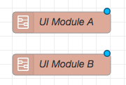
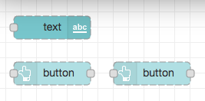
UI Module(Compound Widget)
Current Node-RED Dashboard do not provide a mechanism for installing multiple widgets as UI Module (compound widget).
Provide mechanism for creating UI Module as SUBFLOW and layout subflow as single widget in dashboard layout list.
Widget
Layout of Tab
> Home
> Group
...
□ UI Module A
□ UI Module B
...
UI Module
> UI module
□ text
□ button
□ button
Layout in UI Module
UI Module as subflow

Slide 4
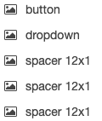
SUBFLOW extensions for UI Module
[SUBFLOW extensions]
Make "Dashboard Group" can be specified in SUBFLOW UI definition.
"Dashboard Group" can be selected in settings panel and stored to environment variable.
Make widgets layout to be specified for each SUBFLOW, if Dashboard is available and the SUBFLOW contains UI widgets.
[Dashboard extensions]
When adding a UI widget in SUBFLOW, if environment variable "_UI_GROUP" is defined make it as target of registration.
When layouting widgets to Dashboard, place SUBFLOW containing layout as one UI widget
10 x 10
Layout Edit Panel
SUBFLOW Settings Panel

