Slide 1
Dashboard UI Widgets

Slide 2
New Dashboard Widgets
Creating new dashboard UI widget nodes
ui_table – display table
ui_vega – display data in various kinds of forms using JSON specification
We would like to these nodes to be included in node-red-ui-nodes as of ui_list.

Slide 3
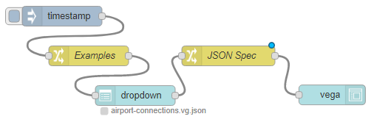
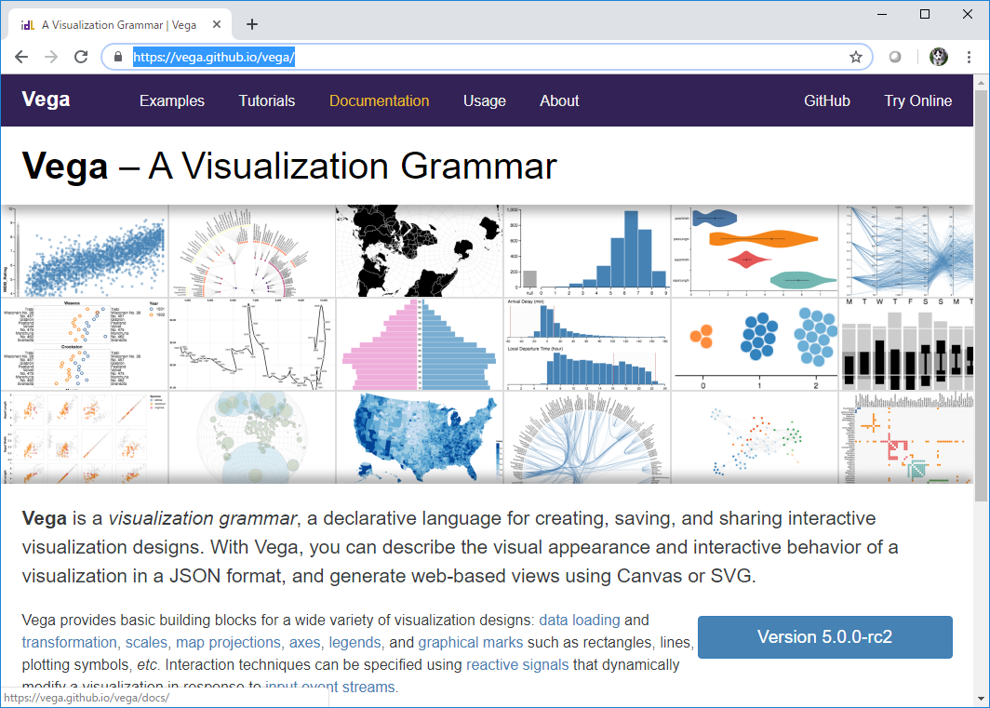
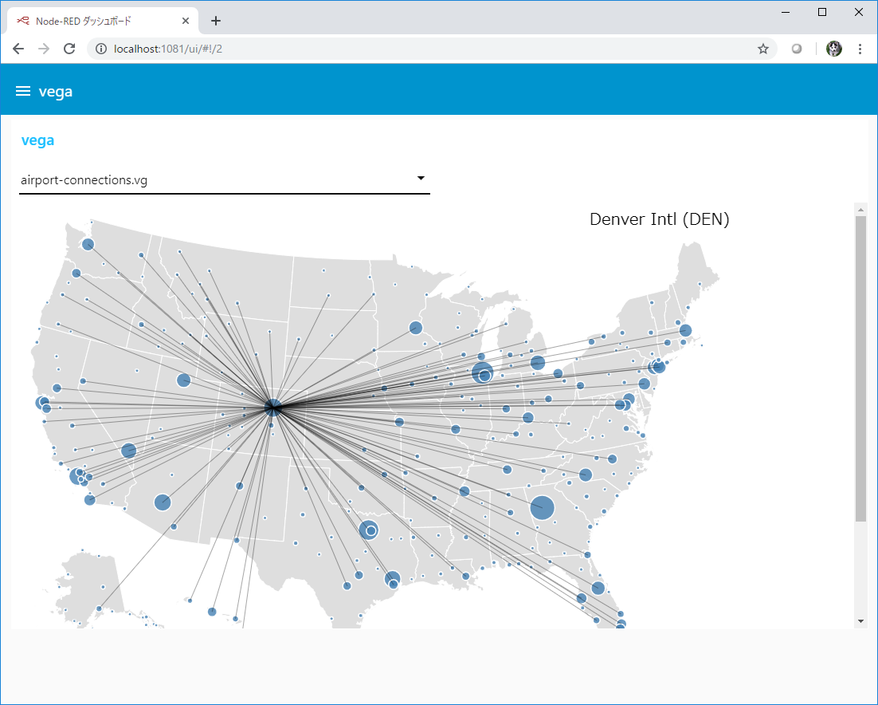
Vega (Visualization Grammar) Node
Vega node allow data visualization to be specified using JSON based visualization grammar (https://vega.github.io/vega)
[DEMO]
vega node

