Slide 1
Exporting SUBFLOW as Node
Hiroyasu Nishiyama

Slide 2
1. Background 2. Subflow as Redistributable Node 4. Subflow Enhancements 5. Summary

Slide 3
1. Background 2. Subflow as Redistributable Node 4. Subflow Enhancements 5. Summary

Slide 4
Background
Node-RED is a highly effective tool for rapid creation of new solutions.
On the other hand, we would like to create basis for sharing common solution patterns (or templates) useful for creating new custom solutions by novice IT users.
Problem
Solution
New Problem
Prototype
Abstract & Refactor
Customize &
Apply
Common
Solution
Pattern

Slide 5
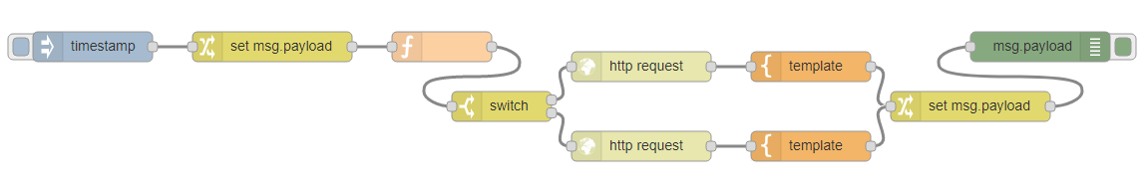


Abstracting Solution Patterns
Abstraction using FLOW, SUBFLOW or npm module is not sufficient
 | Creation | Customization
FLOW | easy (visual editor) | difficult (no specific customization point)
SUBFLOW | easy (visual editor) | difficult (no specific customization point)
new node | difficult (HTML+JS) | easy (node settings UI)
Problem
Solution
New Problem
Prototype
Abstract & Refactor
Customize &
Apply
Common
Solution
Pattern

Slide 6
1. Background 2. Subflow as Redistributable Node 4. Subflow Enhancements 5. Summary

Slide 7
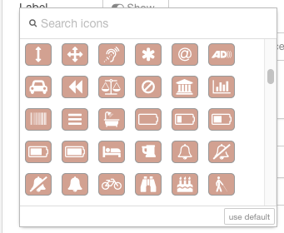
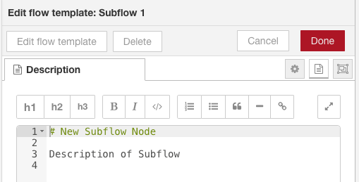
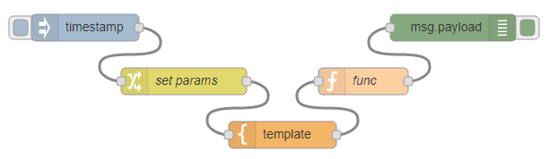
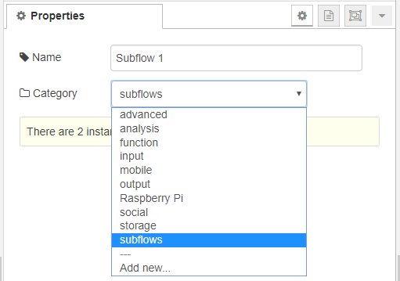
Customizing Subflow
By adding customization capability to Subflow, Subflow can define similar functionality to normal Node using Node-RED editor GUI.
No. | Item | Node | Subflow (ToBe)
1 | Icon | Any Picture, Icon Font (via GUI) | Icon Font (via GUI)
2 | Info Text | HTML, Markdown (via GUI) | Markdown (via GUI)
2 | Logic | JavaScript | Flow (via GUI)
3 | Settings UI | HTML | None → via GUI
4 | Color | Any Color | None → via GUI
5 | Category | Any Category | Any Category (via GUI)

Slide 8
Current Use of Subflow in Flow Creation
SUBFLOW in current Node-RED can be reused in the belonging flow and can be redistributed as part of the flow.
Flow format is handy for sharing among users because it is represented by JSON format.
Create Flow
Create Subflow
Distribute Subflow as part of flow

Slide 9
Creating Node in npm module from Subflow
Create Node in npm module from Subflow.
Node npm module is shared using npm repository. → npm creation/redistribution/etc. are difficult for novice users. → unknown node appear if SUBFLOW node is not installed. → Installation of a node is needed for flows that uses the node.
Install npm module
npm
repository
Node(npm)
from Subflow
Difficult for novice users
Create Flow
Create Subflow
Distribute Subflow as part of flow

Slide 10
Exporting Node in JSON from Subflow
Export Node in JSON format from Subflow.
Node npm module is shared using JSON (text) format. → Can be redistributed as part of a flow (eliminates unknown nodes) → npm repository and explicit node installation is not needed.
Install npm module
npm
repository
Node(npm)
from Subflow
Difficult for novice users
Create Flow
Create Subflow
Distribute Subflow as part of flow
Node(JSON) from SUBFLOW
Easy for novice users
copy & paste JSON data

Slide 11
Flow Format Extension
Current FLOW export format in JSON is represented as an array of node specifications.
Proposal:
Introduce new object-style FLOW/SUBFLOW representation which include meta-data for describing properties of exported JSON data
Current array-style flow representation will be used for compatibility
Add properties for flow data type, hiding flow details, etc.
Various kinds of data can be exported/imported using new format
[
{ id": "...", type: "...", ... },
{ id": "...", type: "...", ... },
...
]
{
type: "flow",
sealed: true,
flow: [
{ id: "...", type: "...", ... },
{ id: "...", type: "...", ... },
...
]
}
nodes
definition
meta-data
Current FLOW format
New FLOW format

Slide 12
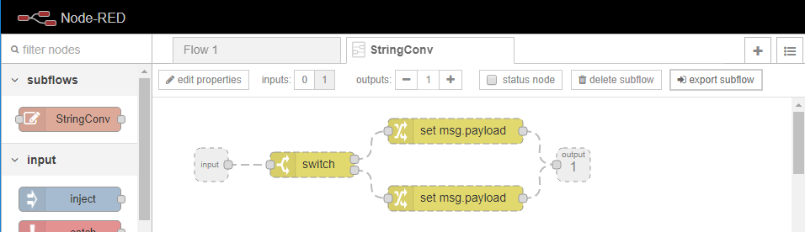
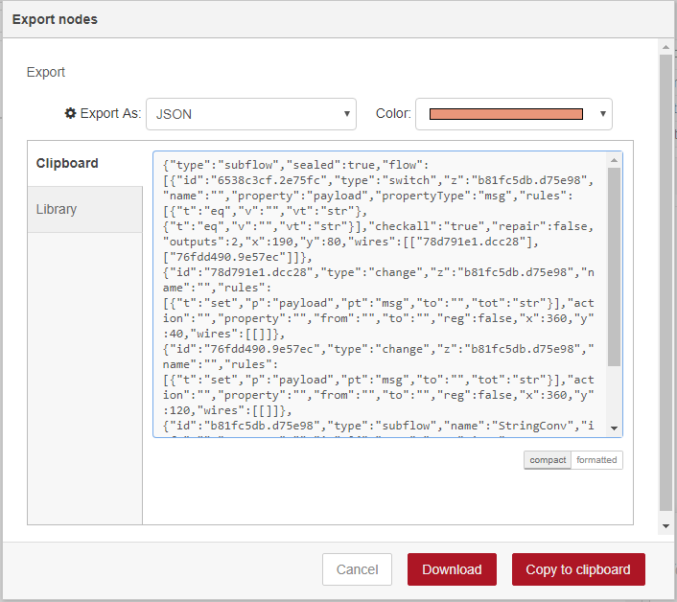
Exporting SUBFLOW
Add 「export subflow」button to SUBFLOW template
Use new FLOW format for distributing SUBFLOW:
type = "subflow"
sealed = true: hide details of exported subflow
flow: array of SUBFLOW node & nodes definitions in its template
How do we deal with nested SUBFLOW?
only export single level - current prototype implementation
include all called nodes in exported nodes list
{
type: "subflow",
sealed: true,
flow: [
{ id: "<ID>", type: "subflow", ... },
{ id: "...", z: "<ID>", type: "...", ... },
...
]
}

Slide 13
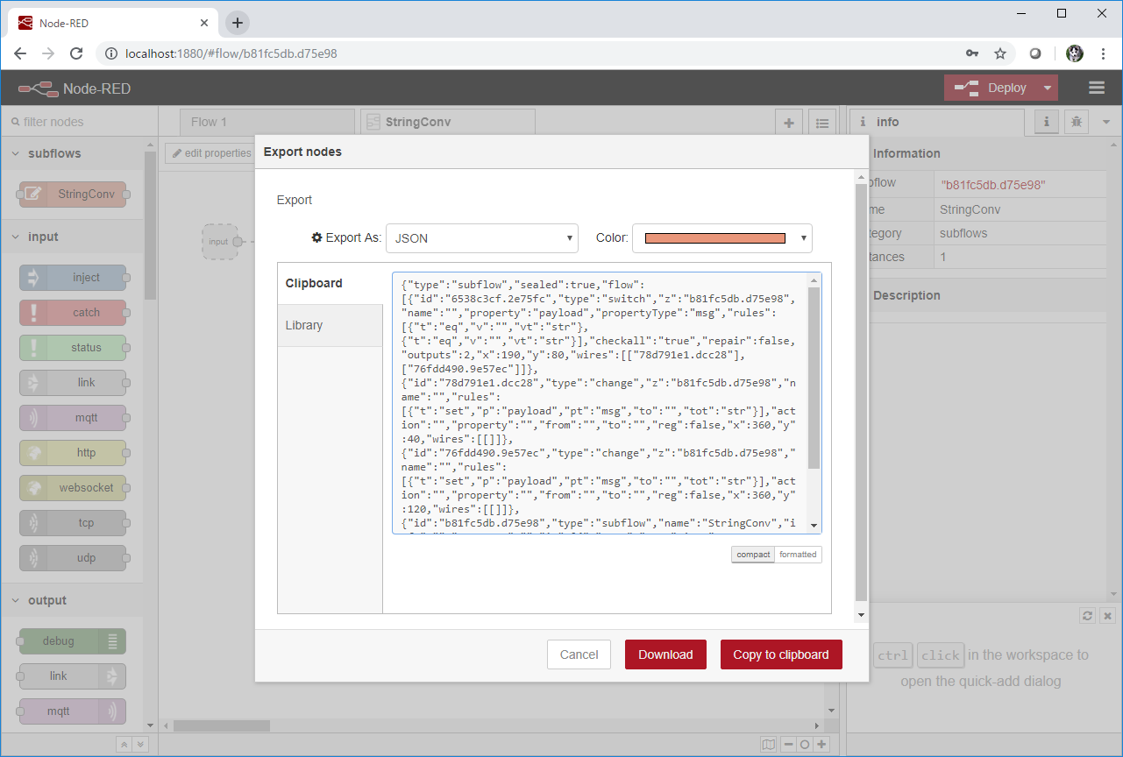
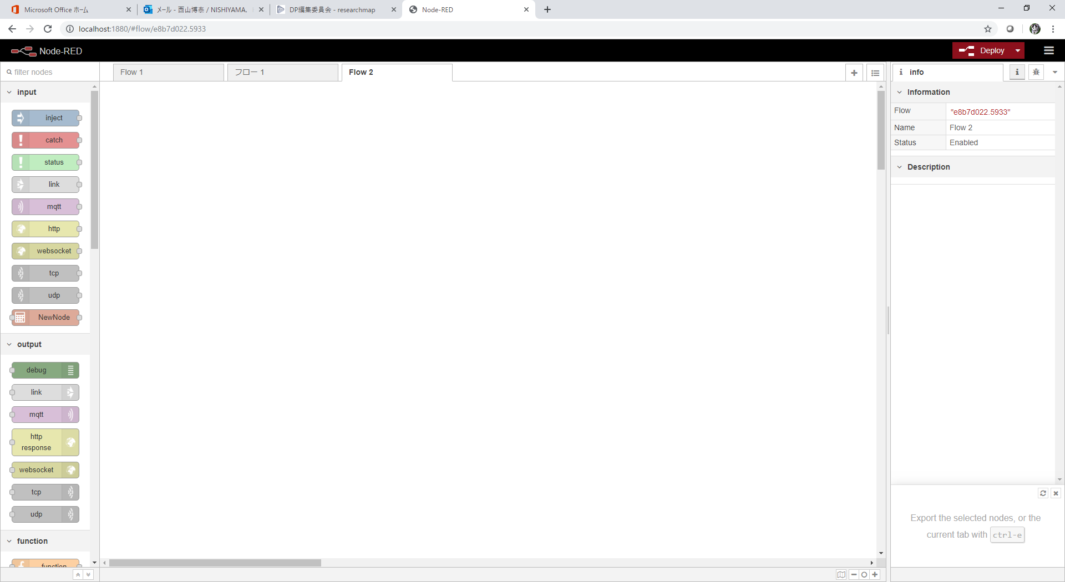
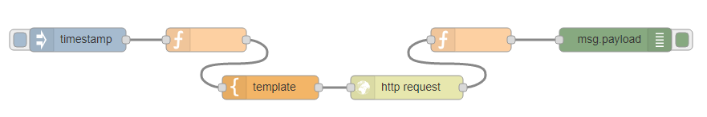
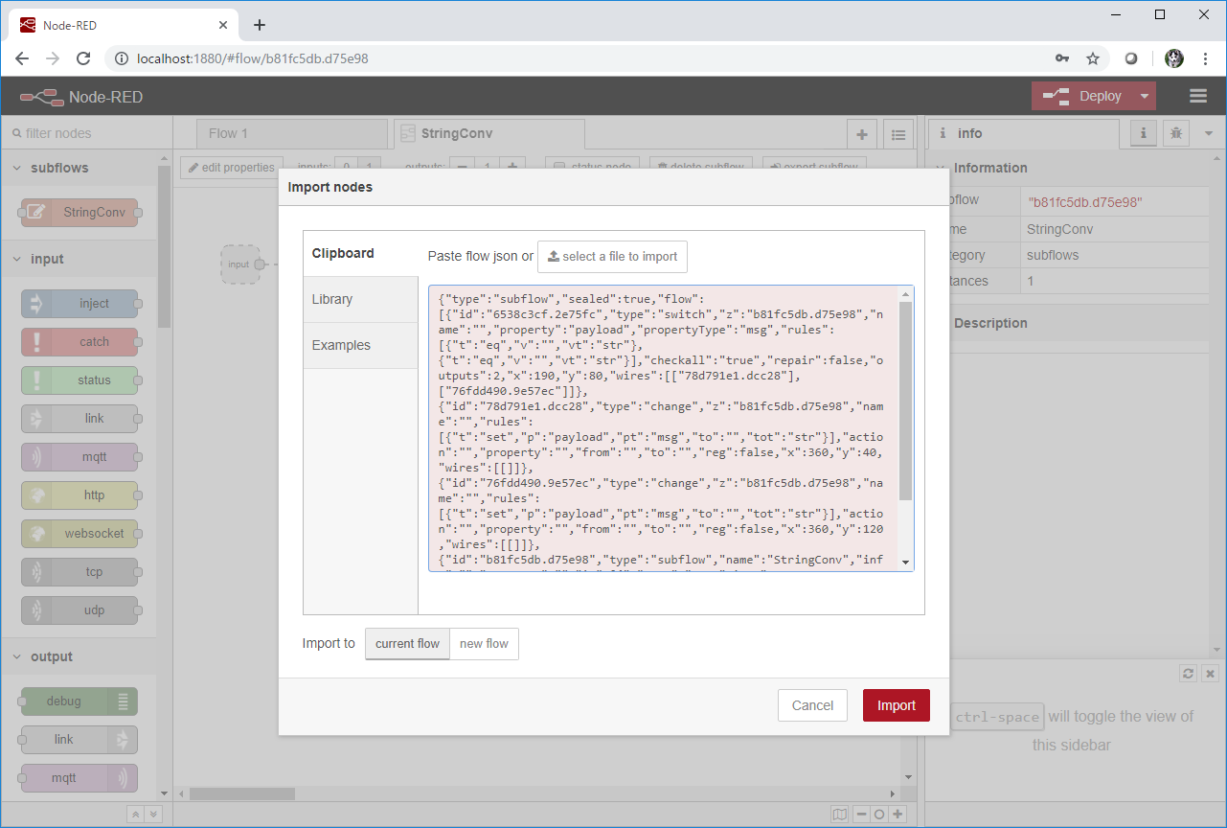
Encrypting FLOW
In some cases, we want to hide details of FLOW/SUBFLOW because it may contain intellectual property
By using new flow format, we can encrypt FLOW/SUBFLOW for distribution and decrypt it on installation. Details of FLOW/SUBFLOW can be marked hidden by sealed property.
install
encrypted
flow
re-export
not allowed
proprietary algorithms
{
type: "subflow-enc",
sealed: true,
flow: "W3siaWQiOiI2NTM..."
}
Exporting Node-RED
Importing Node-RED
Encrypted FLOW format

Slide 14
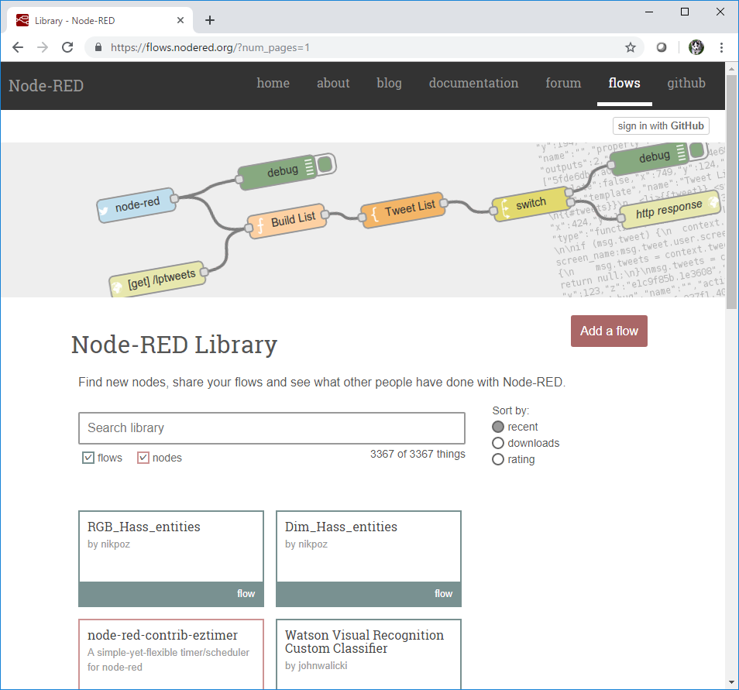
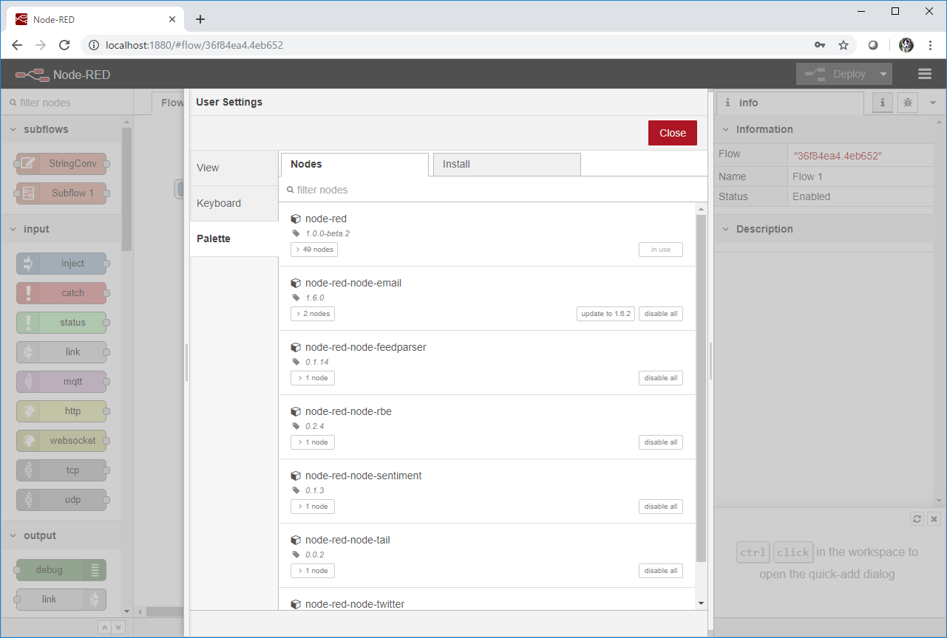


Exporting SUBFLOW as NPM Module
Current node distribution uses NPM module as its format
If we allow JSON based node (SUBFLOW) representation, redistributing SUBFLOW as NPM module may be useful:
automatic detection of node update,
embedding example flows,
listing in flow library by crawling npm repository,
...
Allow exporting SUBFLOW as NPM module, or command to create NPM module from SUBFLOW JSON data
NPM repositry
download
Exporting Node-RED
Node-RED Library
Installing Node-RED
npm module

Slide 15
Demo
DEMO

Slide 16
Discussions on new JSON representation
Updating/Deleting imported SUBFLOW
update/delete interface on manage palette
how to check SUBFLOW equality (node id sufficient?)
How do we deal with nested SUBFLOW?
only export single level - current prototype implementation
include all called subflows in exported nodes list
For exporting encrypted FLOWs, sealing (hiding) all flow details is not appropriate (e.g., flow injection, examples). Introduction of sealing attribute to each tab is needed?
Need runtime extension of APIs for encrypted SUBFLOW/FLOW not re-exported in decoded form.
Interface for specifying encryption key.

Slide 17
1. Background 2. Subflow as Redistributable Node 4. Subflow Enhancements 5. Summary

Slide 18
Customizing Subflow
By adding customization capability to Subflow, Subflow can define similar functionality to normal Node using Node-RED editor GUI.
No. | Item | Node | Subflow (ToBe)
1 | Icon | Any Picture, Icon Font (via GUI) | Icon Font (via GUI)
2 | Info Text | HTML, Markdown (via GUI) | Markdown (via GUI)
2 | Logic | JavaScript | Flow (via GUI)
3 | Settings UI | HTML | None → via GUI
4 | Color | Any Color | None → via GUI
5 | Category | Any Category | Any Category (via GUI)

Slide 19
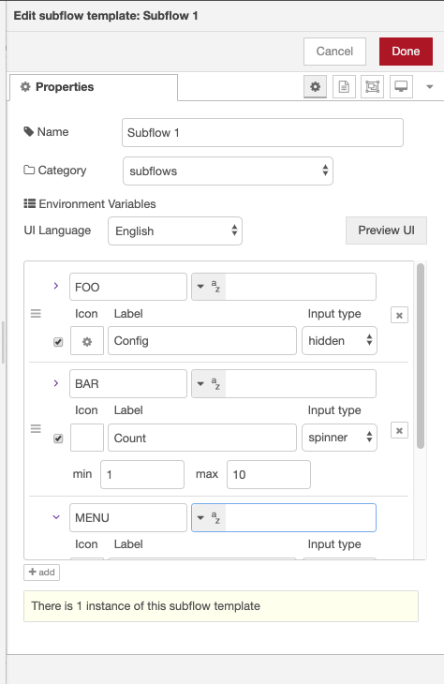
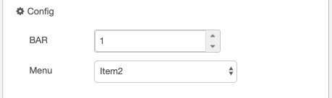
Defining Parameter Input UI for Subflow
Made PR to for UI definition in SUBFLOW settings. And rewriting based on your review.
An UI for environment variables can be specified in SUBFLOW template. UI input type can be specified using environment variable extension - checkbox, spinner, menu, label only (no input), and typedInput input from selected types are supported
UI Definition for Rows
SUBFLOW UI Definition
Generated Input UI

Slide 20
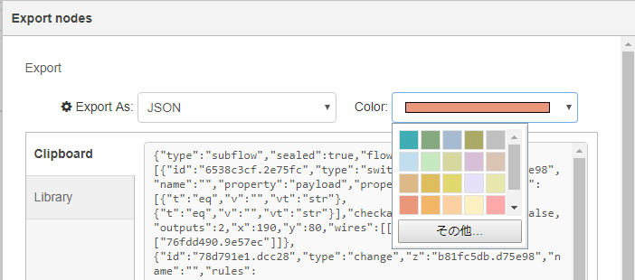
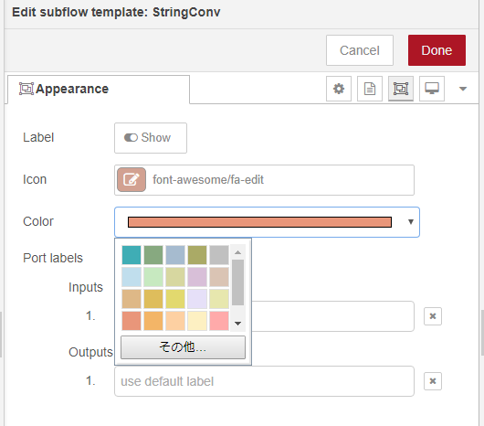
Node Color Specification
When exporting SUBFLOW as NODE, we would like to change colors of exported SUBFLOW node.
Following two approaches are possible:
specify color on export dialog
specify color on node appearance tab
We think (b) is natural extension of node appearance specification. But may needs discussion because it may allow changing color of every node types.
Specifying Color in Export Dialog
Specifying Color in Node Appearance Tab

Slide 21
Demo: UI definition
DEMO

Slide 22
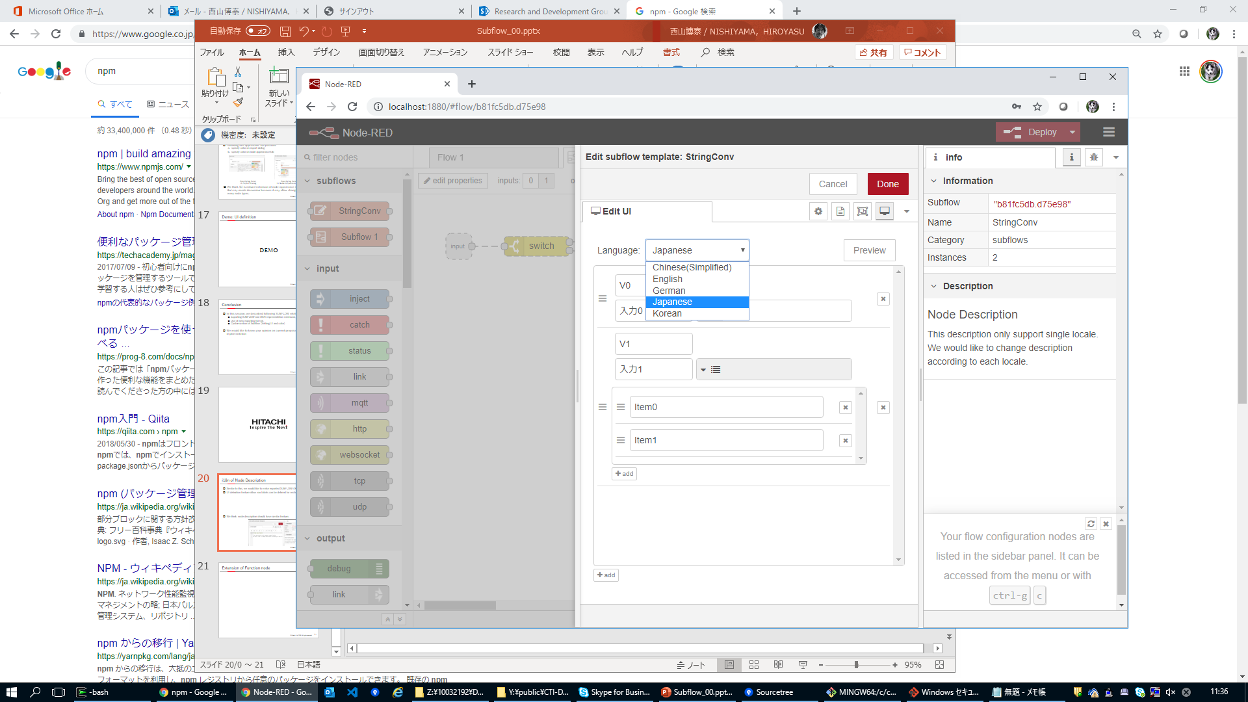
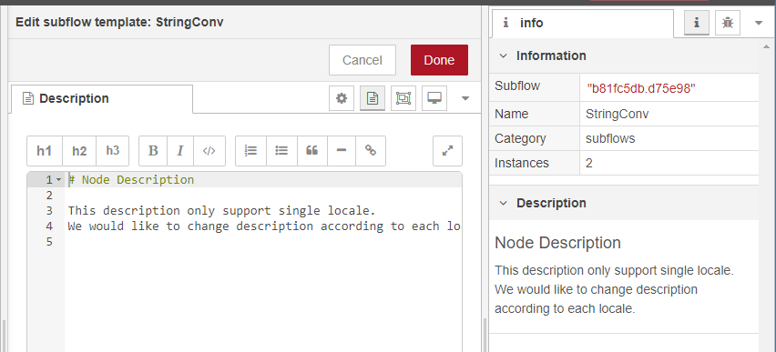
i18n of Node Description
Similar to this, we would like to make exported SUBFLOW i18 ready.
UI definition feature allow row labels can be defined for each locales.
We think node description should have similar feature.
locale selector

Slide 23
Extension of Function node
When describing logic in SUBFLOW, function node plays a central role for expressing complex algorithms
It has following problems:
Can't use external libraries without modifying settings.js,
Execution of function body is performed in VM environment (incur overhead),
Function body is executed each time message is received. So, describing common initialization or shutdown code is difficult.
Proposal:
Add setting to allow use of external libraries and execution without VM module.
Add interface to add npm module,
Add tab to define initialization & shutdown code.
(1)(2) should be disabled or partially enabled by settings.js for safety

Slide 24
1. Background 2. Subflow as Redistributable Node 4. Subflow Enhancements 5. Summary

Slide 25
Summary
In this session, we described following SUBFLOW related extensions:
Exporting SUBFLOW and JSON representation extension,
Use of new exporting format,
Customization of Subflow (Setting UI and color)
We would like to know your opinion on current proposal and implementation

Slide 27
Exporting SUBFLOW
Add 「export subflow」button to SUBFLOW template
Use extended array-style FLOW format for distributing SUBFLOW:
[
{ id: "...", type: "subflow",
sealed: true,
flow: [
{ id: "...", type: "...", ... },
{ id: "...", type: "...", ... },
...
],
....
}
]

Slide 28
Flow Format Extension
Instead of using new object-style JSON format, extend array-style JSON format for exporting subflow
Subflow template contains meta-data including contained nodes.
If new object-style of subflow is imported in old version of Node-RED, meta-data is simply ignored.
{
type: "flow",
sealed: true,
flow: [
{ id: "...", type: "...", ... },
{ id: "...", type: "...", ... },
...
]
}
[
{ id: "...", type: "subflow",
sealed: true,
flow: [
{ id: "...", type: "...", ... },
{ id: "...", type: "...", ... },
...
],
....
}
]
meta-data
meta-data
object-style JSON format
extended array-style JSON format

Slide 29
Meta-data in exported subflow
Following meta-data will be included in subflow template
 | name | type | description
1 | flow | array/string | array of contained nodes/string of encrypted flow
2 | sealed* | bool | subflow template is not editable
4 | name* | string | name of subflow as a node
5 | color* | string | color of subflow
6 | version* | string | version of exported subflow
7 | author* | string | author of exported subflow
8 | license* | string | license of exported subflow
9 | keywords* | array | array of keywords of exported subflow
10 | description* | string | simple description of exported subflow
11 | url* | string | source url of this JSON file (needs consistency with library design)

Slide 30
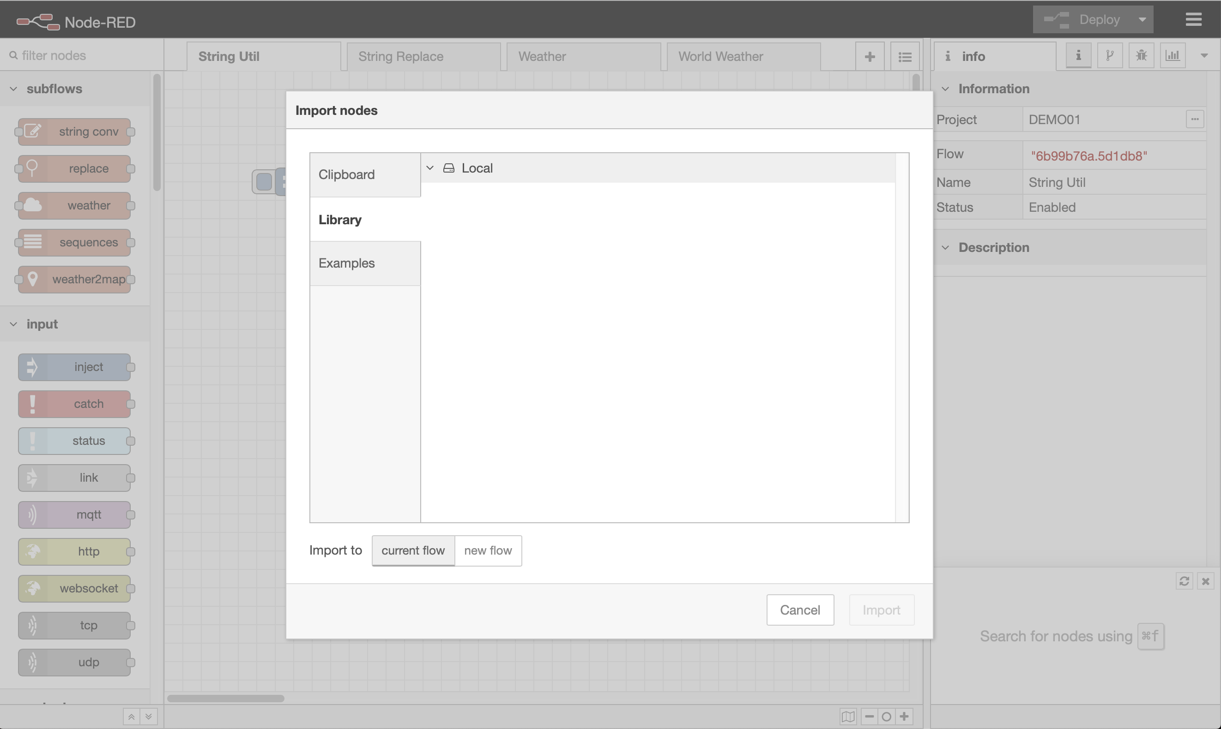
Update/Deletion of SUBFLOW
Since sealed SUBFLOW node do not have edit template tab, manage node palette is enhanced to allow update/delete of SUBFLOW node.
Library interface of Node-RED Editor is also updated to be able to access shared location to in order to locally share exported nodes.
can use shared location (e.g. NFS/samba) to share nodes
update is checked for installed nodes
imported subflow
listed here
enhanced
library interface

Slide 31
Node Color Specification
When exporting SUBFLOW as NODE, color of an exported SUBFLOW node is specified in export dialog of the subflow.
Specifying Color in Node Appearance Tab

Slide 32
Exporting SUBFLOW as NPM Module
Allow exporting SUBFLOW as NPM module via plugin of node-gen for library interface of Node-RED editor
Consideration is needed on consistency with existing UI for exporting flows
NPM repositry
download
Exporting Node-RED
Node-RED Library
Installing Node-RED
npm module

Slide 33
Node-RED Library Enhancements
Node-RED Library will be enhanced to support adding exportable SUBFLOW node.
export &
add
install
Exporting Node-RED
Node-RED Library
Installing Node-RED
Node Catalogue

Slide 34
i18n of Node Description
Node description will be updated to support i18n description.
extension of nodes
 | property | type | description
1 | info | string | description in English
2 | infoI18n* | object | i18n descriptions (key=locale, value=description for the locale)

Slide 35
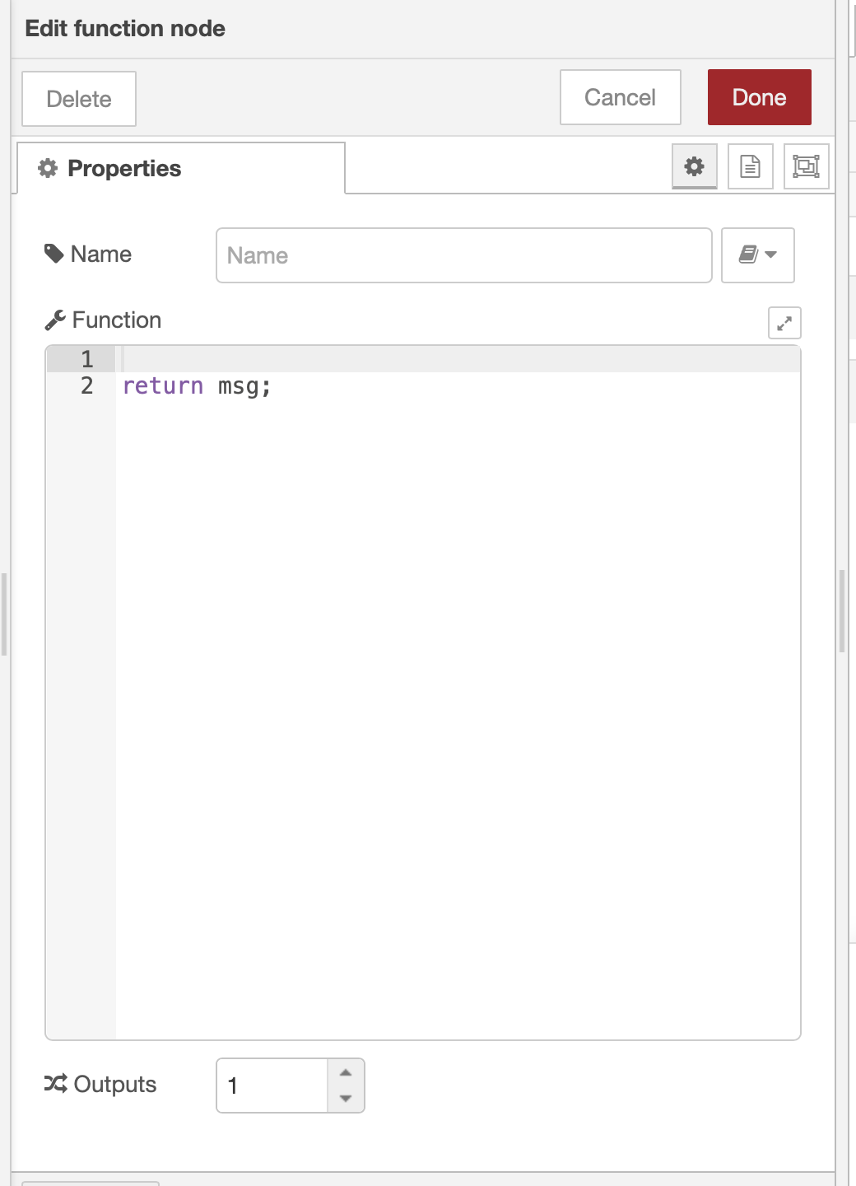
Extension of Function node#1
Enhancements to function node or new advanced function node supports following features:
Proposal:
Add setting to allow use of external libraries and execution without VM module.
Add interface to add npm module,
Add tab to define initialization & shutdown code.
(1)(2) should be disabled or partially enabled by settings.js for safety
show advanced
menu
 | name | package
1 | fs | fs-ext
2 | crypt | crypt-js
3
install
Init
Shutdown
Library
update
delete
initialization
code
shutdown
code
advanced

Slide 36
Extension of Function node#2
Library tab defines dependent npm module used in function node
it allow npm modules to be installed/updated/deleted.
when installing flow which contain a function node with uninstalled libraries. The dependent libraries will be installed automatically (default setting should be selectable).
「use VM」checkbox that specify use of VM module will be added if performance problem exists.

Slide 37
Setting values that do not accept env. var
Some input types in node setting menu do not accept environment variable (e.g. spinner, menu, ...)
Initial specification tried to solve this by specifying internal parameter name of target node. But we ended up this was difficult to use by users. Because users usually do not have knowledge on implementation of a node.
Is there better way to solve this?

Slide 38

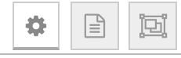

Subflow UI Editing[initial proposal]
Edit UI
push
add button
name
label
type
tgt. type
target
type specific inputs
Added UI items are shown in node settings UI from top to bottom
default item type is label
HTML tag can be used for label
tgt. type specifies env var or node property
target specifies env var or node property to be set
i18n is realized by specifying label for each language
add
UI Edit Panel
label
type
tgt. type
target
en-US
Text with <b>HTML tag</b>
type
type ::= str | num | ...
tgt.
tgt ::= env var | node property
Common UI to set target node property (T.B.D.)
[tgt = env var]
[tgt = node property]
name of env var
<node id>.<property name>
...

Slide 39


Encrypting SUBFLOW
Use encrypted property of a SUBFLOW to encode internal of the SUBFLOW
Use-cases of SUBFLOW encryption
[
{ id: "...", type: "subflow",
sealed: true,
encrypted: true,
flow: "<encrypted flow string>",
....
}
]
Flow Developer
encrypted
flow
Export
encrypted
flow
online/offline
decrypted
flow
Flow Developer
Theif
User

Slide 40
Action Items:
review current implementation (IBM)
detailed design
exporting subflow (HITACHI)
pluggable library interface (IBM)
flow library enhancements (IBM)
i18n UI (HITACHI)
function node enhancements (HITACHI)
encryption use-cases & design (HITACHI)
solution for UI that can't specify env var (?)

Slide 41
Grouping Nodes in Workspace
Box Group of node is conceptually similar to SUBFLOW
Box Group may be represented as a special kind of SUBFLOW
has no node representation, template interface
only single instance exists
But difficulty exists on meaning of z property of nodes
Other possibility is introducing config node that holds list of contained nodes
 | Feature | SUBFLOW | Box Group
1 | Contain nodes | ○ | ○
2 | Multiple instances | ○ | ×
3 | UI | ○ | ×
4 | Export | ○ | △(part of flow)
5 | Environment variables | ○ | may be
Action Items:
use-cases (HITACHI)
detailed design (IBM or HITACHI)

