Slide 1
Miscellaneous Topics
Hiroyasu Nishiyama

Slide 2
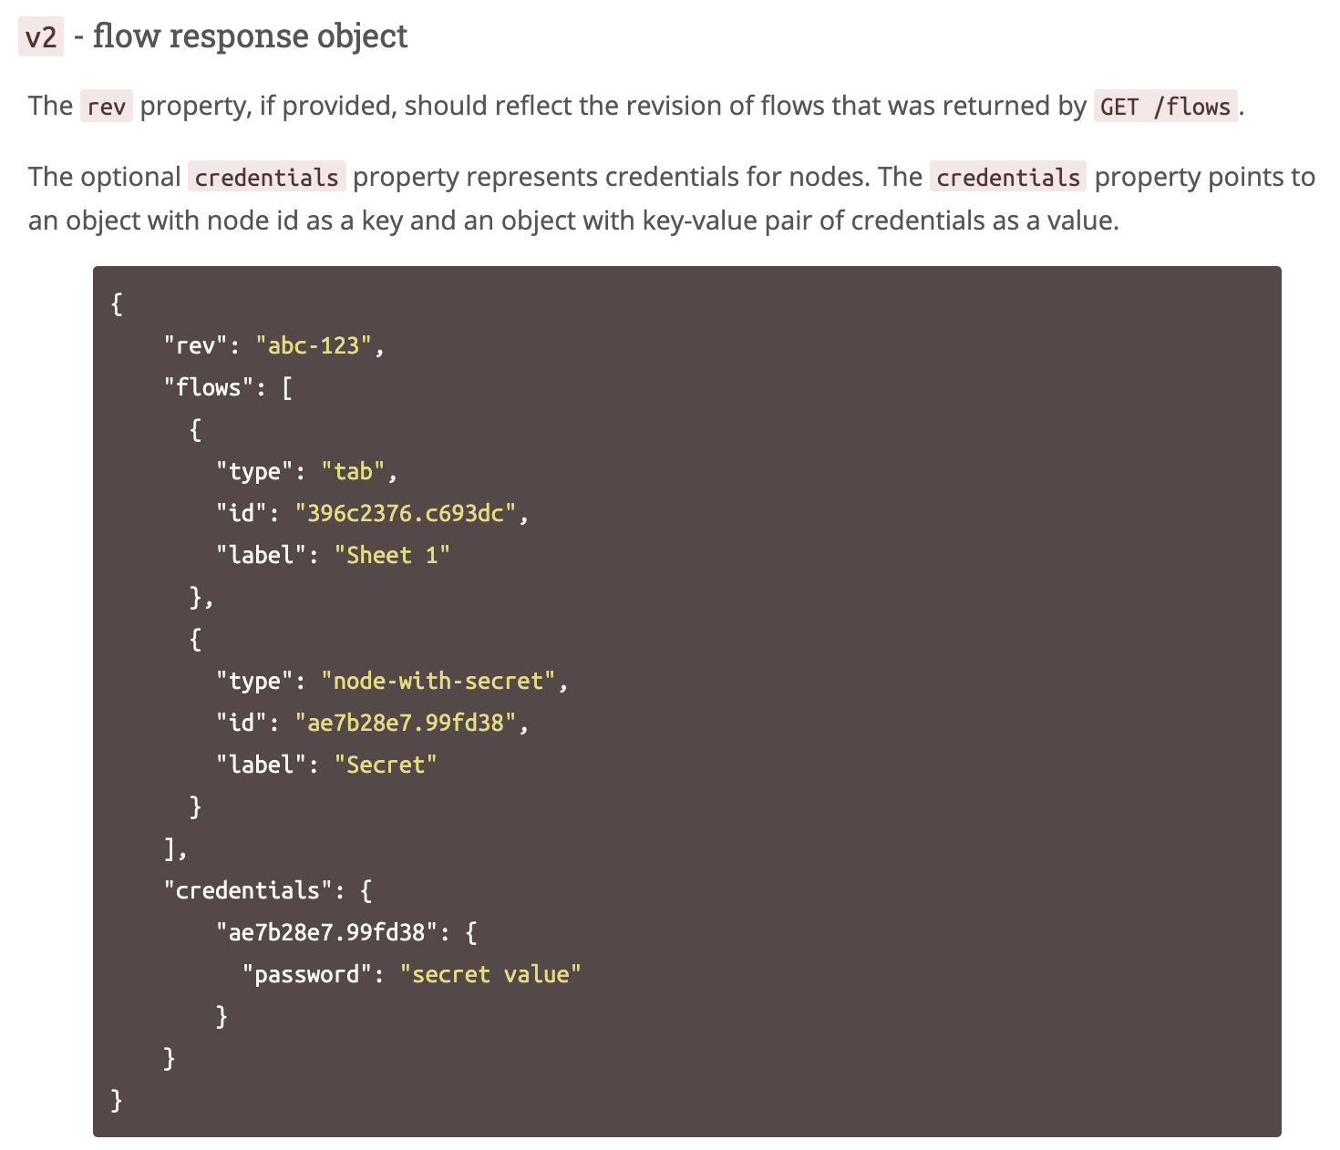
New Admin API for Flow Creation
I have made a PR on new admin POST /flows API to create new flows with credentials. (https://github.com/node-red/node-red/pull/2414)
Is there any possibility that new Node-RED including this feature released in near future? (we would like to include and use this feature in our system)
Nick-san will review & make comments

Slide 3
Send/Receive Metric
We would like to know elapsed time processing a message (receive – send)
Before 1.0 release, it can be estimated by duration of metric logs between receive and send.
After 1.0, it can not because of async message send.
Can we move metric logging location as below?
<sender>.send
↳ ...
metric("send", ...)
...
<node>.reveive(msg)
↳ ...
metric("receive", ...)
...
<node>.emit("input", msg)
↳ message handler callback
↳ P: do some work
<node>.send(...)
↳ ...
metric("send", ...)
async after 1.0 (other callbacks may be executed)
move to here?
- Nishiyama will register issue (done).
- Summarize requirements for metrics
elapsed time?

Slide 4
[N]Metrics Usage Scenarios
# | Purpose | Used Metrics | Metrics Usage | Desc.
1 | Capture Elapsed Time | send receive | <elapsed time>=<time of recv>-<time of send> | - processing between recv and send must be synchronous or new metrics that logs transfer of control is required
2 | Trace Message Processing | send, receive, done | use message ID to create directed graph to capture execution path | - send and done must contain ID of contributing input messages
3
currently supported metrics:
[Node] send, receive, [function] duration
[httprequest] duration.millis, size.bytes
[http in] response.time.millis, response.content-length.size

Slide 5
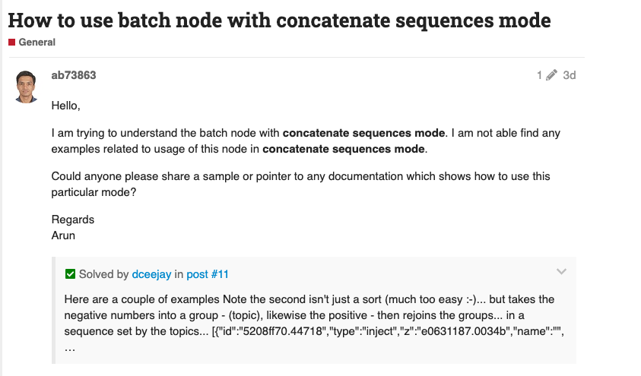
Examples of Standard Node-RED Nodes
Node-RED supports node example flows to be supplied in library menu
But core node do not have mechanisms for adding example flows
Is there any reason on this? Or, can we add this feature? I think it would be useful to add the cookbook example to the library
Add this feature

Slide 6
[N]Making multiple PRs that has dependency
Use small PR that contain independent changes except changes are trivial
Making PR that contains changes in other PR is OK.

Slide 7
[N]Overwriting values in settings.js#1
In some cases, users want to change default value in settings.js without modifying it
use environment variable
add startup options that specify a value in settings.js
For values that control experimental features change its value from constant value to environment variable reference.
Add startup option to overwrite values in a setting.js. -D <property-path>=<JSON-value> -D @<path-to-JSON-file> First option type overwrites specified property in the settings.js by the specified value. Second option type overwrites properties in the settings.js by contents of the specified JSON file. Other properties are untouched. The settings.js file is not modified with this option.

Slide 8
[N]Overwriting values in settings.js#2
examples
-Deditor.theme.projects.enables=true
-DfunctionGlobalContext={ os: require("os"), fs: require("fs") }
-D@context.json
{
os: require("os"),
fs: require("fs")
}

Slide 9
Effect of Leap Year on Node-RED
Our customer willing to know the effects of leap years on their Node-RED flows because this year (2020) is leap year.
Do you know any possibility that causes unexpected execution of Node-RED flow by leap year?

