Slide 1
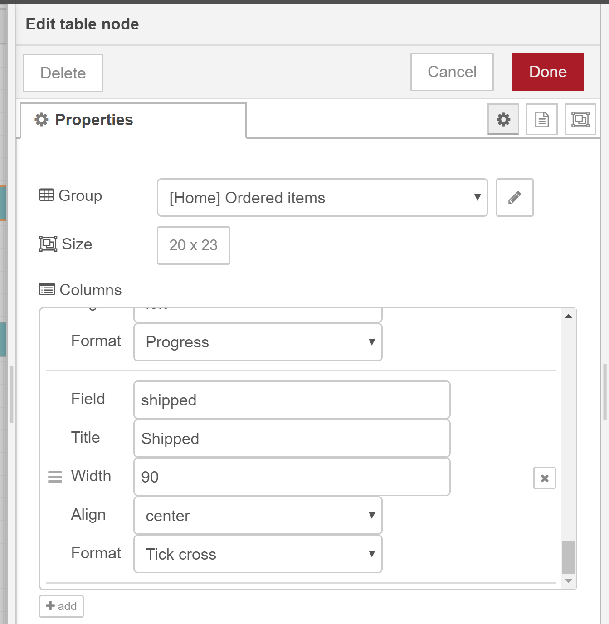
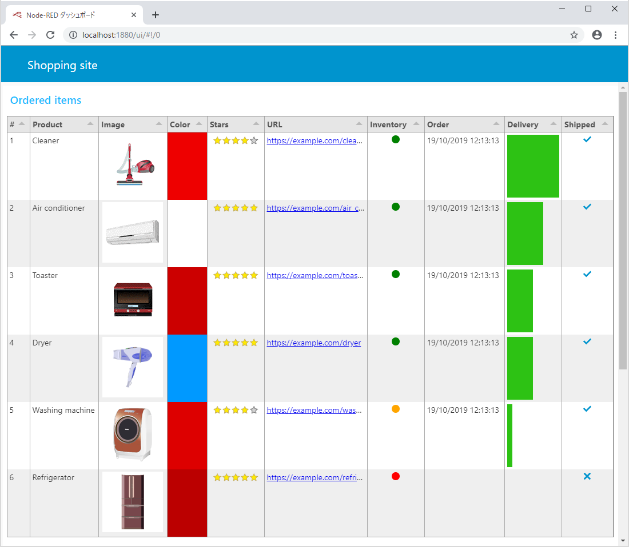
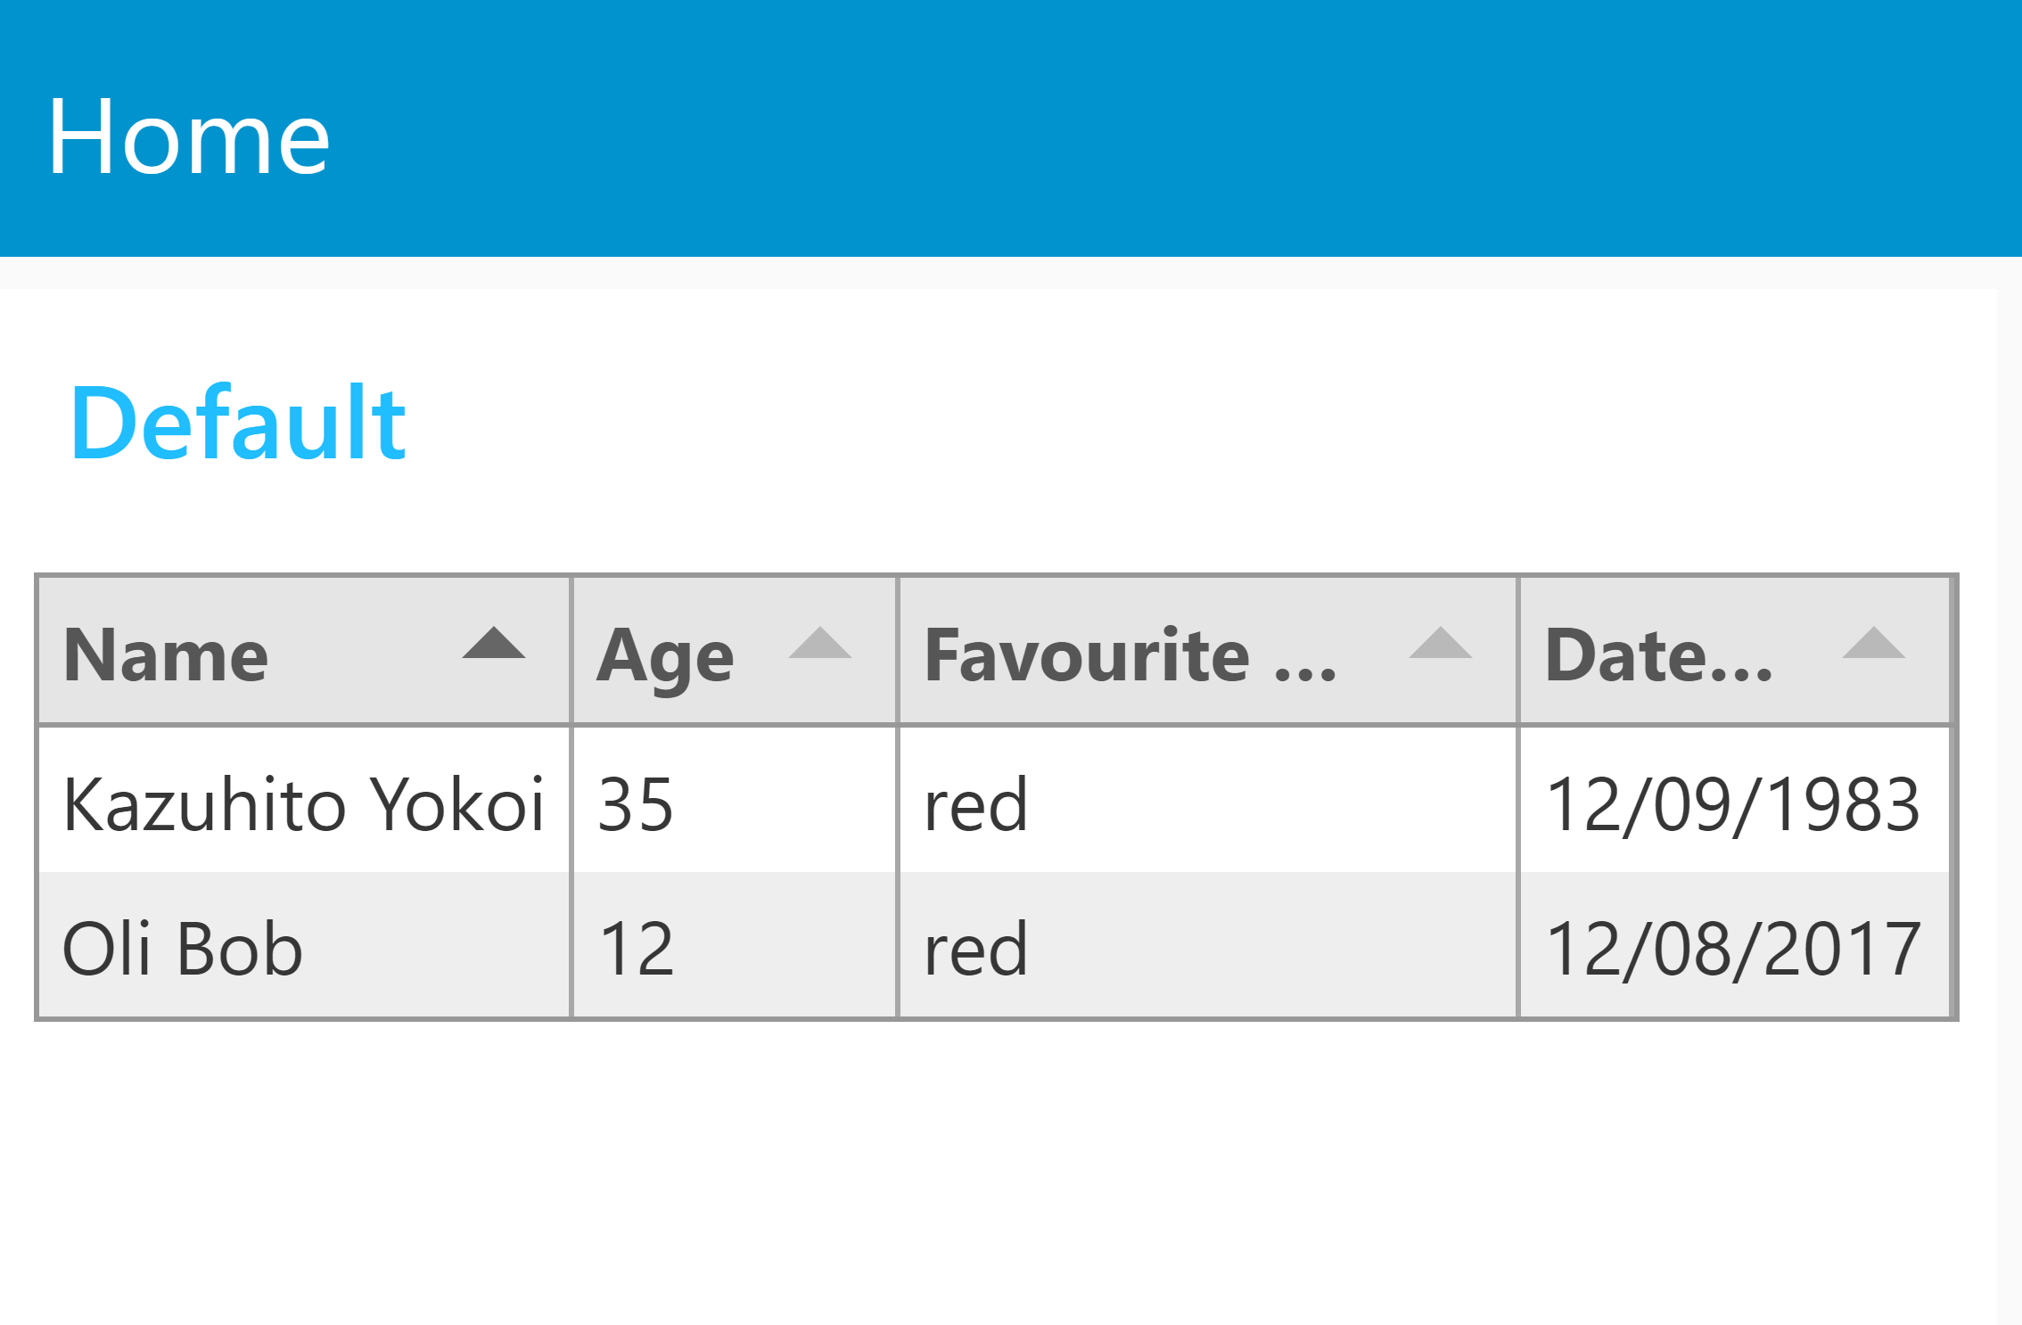
Table node for Node-RED dashboard
We developed new node to show table on Node-RED dashboard.
Demonstration1: Normal table Demonstration2: Custom table
# | Questions
1 | Can I add the table node under “node-red-ui-nodes” repository?
Columns which are
generated automatically
Users can set column settings
on node property manually

Slide 2
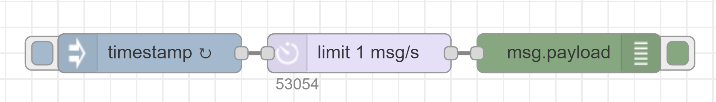
Enhancement of delay node
Currently, we are trying to realize resource control using delay node.
While the investigation, I found that delay node has improvement points.
# | Questions
1 | Can I add msg.rate property into delay node?
2 | Can I add handling to throw exception to catch node the queue reach nodeMessageBufferMaxLength in setting.js?
Users want to change the rate limit value using flow message dynamically
Node.js will be crashed when the queue is full

Slide 3
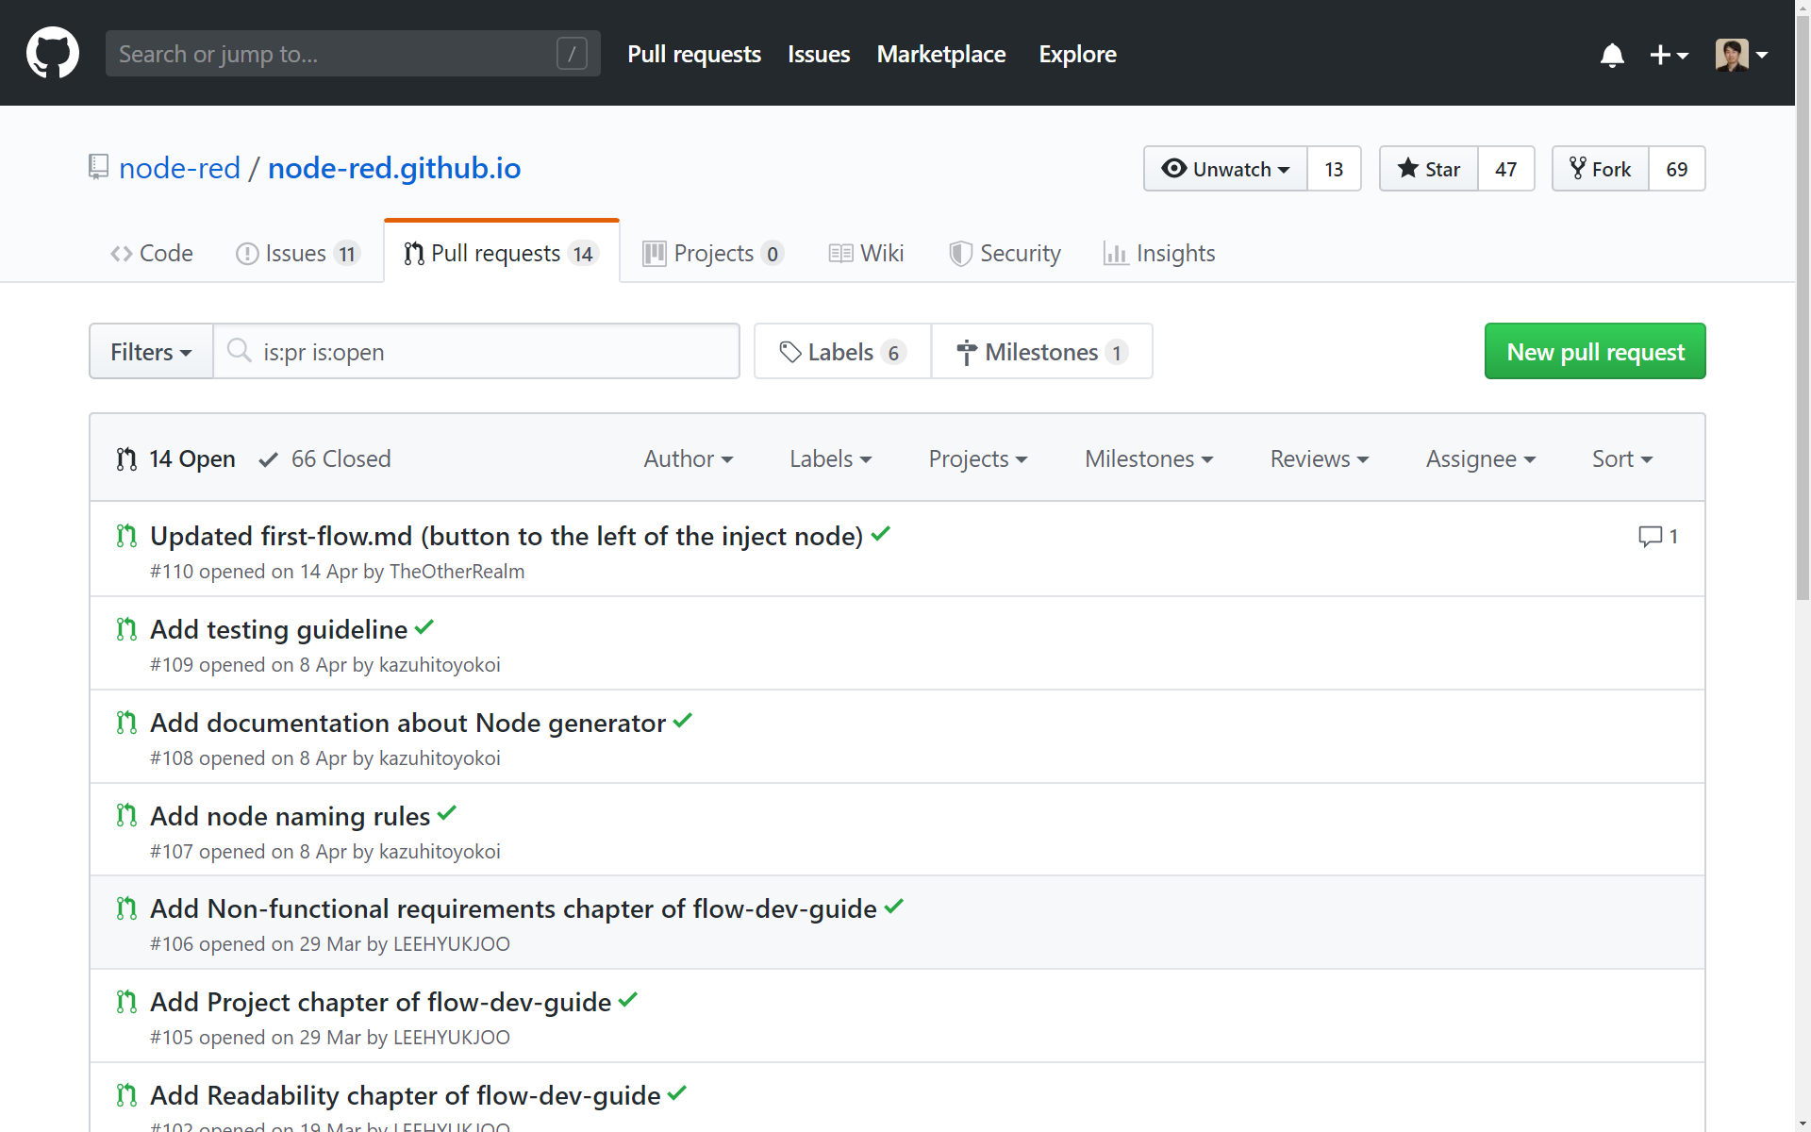
Flow and node development guideline
We submitted pull requests about guidelines for Node-RED website.
# | Questions
1 | Could you review the Pull requests?

