Slide 1
Add features for UI Module
Kazuhiro Ito

Slide 2
Addition of functions for UI Module
The following functions are lacking in supporting the functions of the UI Module, so we are considering countermeasures.
Getting subflow information from the display widget
- Function addition contents
Supports acquisition of subflow instance information with API of server side RED.nodes.getNode () (* temporary).
- Background (overview)
I want to get the subflow information from the ID of the subflow instance that the widget node has in the process in the ui.add () function of node-red-dashboard, but the current API returns a NULL value and the information cannot be obtained.
* The widget is supposed to get the Config node information added for UI Module based on the subflow information.
Node ID remapping on flow import
- Function addition contents
Defaults HTML definition extension adds definition of subflow node-to-node relationships.
*Reference Node property typing #37(https://github.com/node-red/designs/pull/37)
- Background (overview)
The Config node for the UI Module has a one-to-one reference with the subflow.
Get a reference to the UI Module Config node based on the subflow instance ID that the widget has.

Slide 3
1. Getting subflow information from the display widget
In design note “Add design note for UI Module #24”(https://github.com/node-red/designs/pull/24) i considered the config nodes (ui_subgroup_t, ui_subgroup_i) for handling the widget nodes placed in the subflow as UI modules.
When displaying UI Module on the dashboard, the widget placement is done by retrieving the information of the configuration node for the UI Module for each node instantiated from the flow template by the subflow mechanism.
The subflow instance ID of the instantiated widget nodes refer to the information of the configuration nodes for the UI module, but the APIs currently provided by Node-RED do not allow you to get subflow information by subflow instance ID.
Node-RED Flow Editor
Node-RED Dashboard
Subflow Instance
Instance1
Widget Instance
SubflowTemplate
Widge1-1
Widget1
Widget2-1
Can't get a sub-flow definition from
an instance of the dashboard display.
Widget2
Widget Instance
Widget1-2
Subflow Instance
Instance2
Widget2-2

Slide 4
1. Getting subflow information from the display widget
Specifically, we want to use the I/F equivalent of the RED.node.getNode() function in the node-red-dashboard ui.add() function called at the time of widget instance creation to get information about the subflow instance.
In the display of a UI module, we need information on which sub-flow instances (back to the topmost parent) the widgets belonging to the UI module belong to, so we need to be able to get values like the following.
RED.nodes.getNode() to get the subflow value :
var subflow = RED.nodes.getNode(< Subflow Instance ID >)
subflow={
:
path: ・・/< Parent Subflow Instance ID >/< Subflow Instance ID >
:
};
I'm investigating, but I've confirmed that I can get the value of the subflow instance by modifying RED.nodes getNode ().
# Described in the prototype version document (attached to the appendix of this document)

Slide 5
2. Node ID remapping on flow import
For the problem where the IDs of some keys are not properly updated during flow import in the config node for the UI module, the application of the node‘s defaults object was considered in line with the design note “Node property typing #37”( https://github.com/node-red/designs/pull/37)
Subgroup template has an array of the arrangement order of multiple widget nodes.
Use any type of multi-node notation in the proposal in design notes “Node property typing #37”.
widgetOrder : { type: “:any[]” }
(2) Subgroup templates have a reference to the subflow template.
Refer to the subflow template in the following notation.
subflow: { type: “subflow”}
(3) Subgroup instances have a reference to the subflow instance.
Refer to the subflow instance in the following notation.
subflow: { type: “subflow:”}
* The actual operation is the recognition that needs to be handled by the RED.nodes.import () function.

Slide 6
2. Node ID remapping on flow import
- Apply to subgroup template (ui_subgroup_t)
<script type="text/javascript">
RED.nodes.registerType('ui_subgroup_t',{
category: 'config',
defaults: {
name: {value: 'subgroup'},
widgetOrder: {type: ':any[]'},
width: {value: 1},
height: {value: 1},
subflow: {type: 'subflow'}
},
:
→ Arbitrary node (array of widget nodes)
* There is a description of the design note
→ Refer to subflow template *NEW
- Apply to subgroup instance (ui_subgroup_i)
<script type="text/javascript">
RED.nodes.registerType('ui_subgroup_i',{
category: 'config',
defaults: {
name: {value: 'subgroup'},
group: {type: 'ui_group', required:false},
order: {value: 0},
subflow: {type: 'subflow:'},
subgroup: {type: 'ui_subgroup_t', required:true}
},
:
→ Refer to subflow instance * NEW

Slide 7
Appendix .
Prototype documents are attached.

Slide 8
Extracted issues
The following problems were identified in the operation verification of the prototype version.
When displaying the dashboard, information on the Subflow instance to which the widget to be displayed belongs is required, but the information cannot be obtained.
Importing ui_subgroup_t and ui_subgroup_i nodes does not update some node properties.

Slide 9
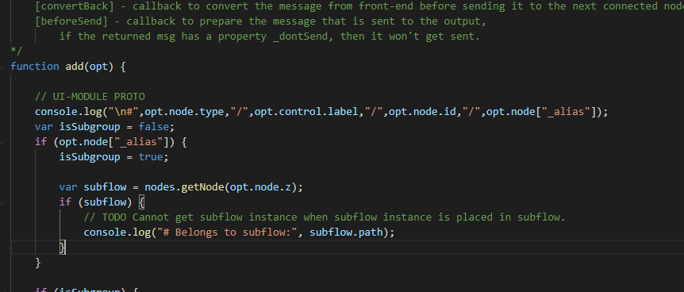
Extracted issues ＃１
When displaying the dashboard, information on the Subflow instance to which the widget to be displayed belongs is required, but the information cannot be obtained.
I want to get the information of the subflow to which the widget belongs from
the widget information of the add (opt) argument opt of ui.js and use it,
but in the RED.nodes.getNode () method, the "null" value is returned.
* The following functions are available in RED.nodes.
createNode(), getNode(), eachNode(), addCredentials(), getCredentials(), deleteCredentials(), registerType()
・getNode() ・・・Get node instance information
・eachNode() ・・・Get node definition information

Slide 10
Extracted issues ＃１
By modifying RED.nodes getNode (), it became possible to get a Subflow instance.
$ diff -c node-red-1.1.3/packages/node_modules/@node-red/runtime/lib/nodes/flows/Flow.js
node-red-test/packages/node_modules/@node-red/runtime/lib/nodes/flows/Flow.js
*** node-red-1.1.3/packages/node_modules/@node-red/runtime/lib/nodes/flows/Flow.js 2020-08-05 22:59:25.000000000 +0900
--- node-red-test/packages/node_modules/@node-red/runtime/lib/nodes/flows/Flow.js 2020-09-10 16:19:08.590920800 +0900
***************
*** 26,31 ****
--- 26,33 ----
var nodeCloseTimeout = 15000;
var asyncMessageDelivery = true;
+ var subflow_instaces = {}; // UI-MODULE TEST
+
/**
* This class represents a flow within the runtime. It is responsible for
* creating, starting and stopping all nodes within the flow.
***************
*** 208,213 ****
--- 210,218 ----
node
);
this.subflowInstanceNodes[id] = subflow;
+
+ subflow_instaces[id] = subflow; // UI-MODULE TEST
+
subflow.start();
this.activeNodes[id] = subflow.node;
***************
*** 371,376 ****
--- 376,387 ----
// Node not found inside this flow - ask the parent
return this.parent.getNode(id);
}
+
+ node = subflow_instaces[id]; // UI-MODULE TEST
+ if (node) { // UI-MODULE TEST
+ return node; // UI-MODULE TEST
+ } // UI-MODULE TEST
+
return undefined;
}
Save the generated subflow instance before calling the widget
node ui.add ().
RED.nodes.getNode (<subflow instance ID>) can be used to
get it.
Log output example in prototype version
# Belongs to subflow: f380c40.ec0534/db1d9ba1.94a228
From the path of the Subflow instance, the path (red part) of
the parent-child relationship of the subflow instance to which
the widget belongs can be obtained and can be used to specify
the position when laying out the module.

Slide 11
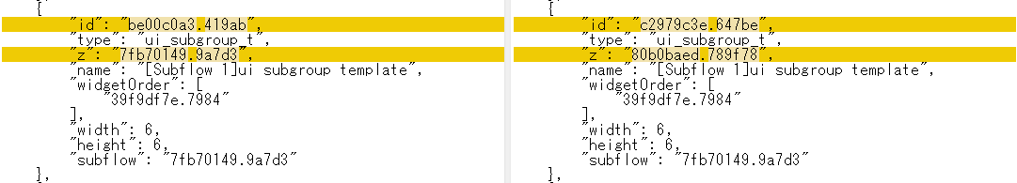
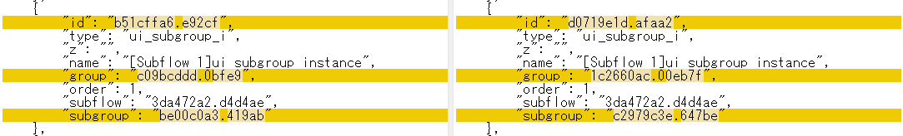
Extracted issues # 2
When importing ui_subgroup_t and ui_subgroup_i nodes, the IDs of some renumbered node properties are not updated.
* This is because the RED.nodes.import () function does not support ID update (remap) of widget node and subflow node references, and it may be necessary to support it.
[ ui_subgroup_t flow JSON ]
Before import
After import
Widget ID of widgetOrder and
ID of Subflow template are not
updated.
[ ui_subgroup_i flow JSON ]
Before import
After import
The ID of the Subflow instance
is not updated.
* Since "subgroup" is a config node, it was possible to update the ID.

