Slide 1
Collaboration Scheme

Slide 2
Collaboration Scheme
We need (periodic) scheme for sharing development status: IBM⇄HITACHI in order to make Node-RED development efficient. Proposal:
Period: Bi-weekly
Where: HITACHI channel on slack and/or Kanban on GitHub
Expected Topics:
Development Status
Task Status
Problems to be solved
Release Schedule
...

Slide 3
Collaboration Scheme (cont’d)
Method for review and discussion of Design Notes
Current method (using GitHub Wiki) has following problem:
Can’t preserve editing history.
Difficult to discuss about specific part of documents.
To embed images in page, we have to place images on other site and link to it because we have no push permission to Wiki folder.
Do you have any idea for the method?
For example, W3C working group uses GitHub Pages to make document.
Documents are written in HTML (see. https://github.com/w3c/wot-thing-description/blob/master/index.html)
Using Issues/Pull requests for discussion about document
(Though W3C provides some useful helper tool (ReSpec.js), writing HTML directly is cumbersome.)

Slide 4
Subflow Extensions
Hiroyasu Nishiyama

Slide 5
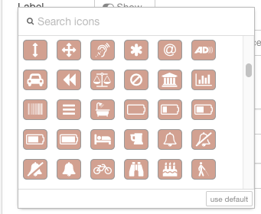
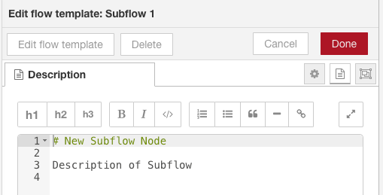
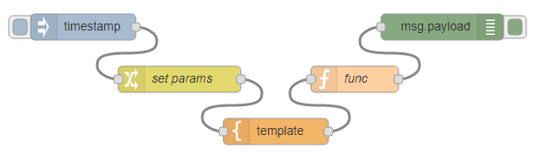
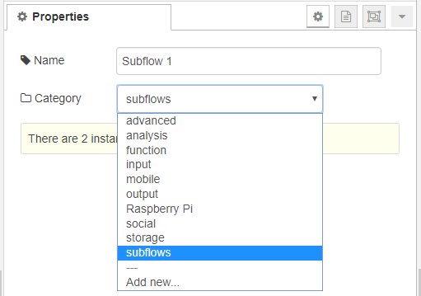
Customizing Subflow
By recent enhancements to Node-RED, functionalities similar to Nodes can be implemented with Subflow using GUI. However, following differences exists:
No. | Item | Node | Subflow
1 | Icon | Any Picture, Icon Font (via GUI) | Icon Font (via GUI)
2 | Info Text | HTML, Markdown (via GUI) | Markdown (via GUI)
2 | Logic | JavaScript | Flow (via GUI) (some restriction [e.g. use of external NPM libraries])
3 | Settings UI | HTML | None
4 | Color/Align | Any Color/Left-Right | None/None
5 | Category | Any Category | Any Category (via GUI)

Slide 6
Creating Node from Subflow
By adding customization capability of Subflow, Subflow can define similar functionality to normal Node using Node-RED editor GUI.
#3: Prototype by Nishiyama
#4: Prototype by Yokoi-san
No. | Item | Node | Subflow (ToBe)
1 | Icon | Any Picture, Icon Font (via GUI) | Icon Font (via GUI)
2 | Info Text | HTML, Markdown (via GUI) | Markdown (via GUI)
2 | Logic | JavaScript | Flow (via GUI)
3 | Settings UI | HTML | None → via GUI
4 | Color/Align | Any Color/Left-Right | None → via GUI/Auto
5 | Category | Any Category | Any Category (via GUI)
equivalent

Slide 7
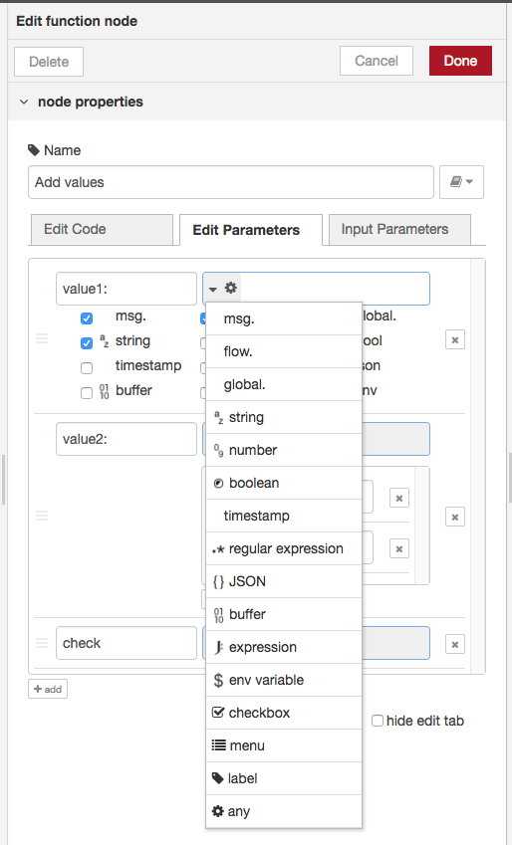
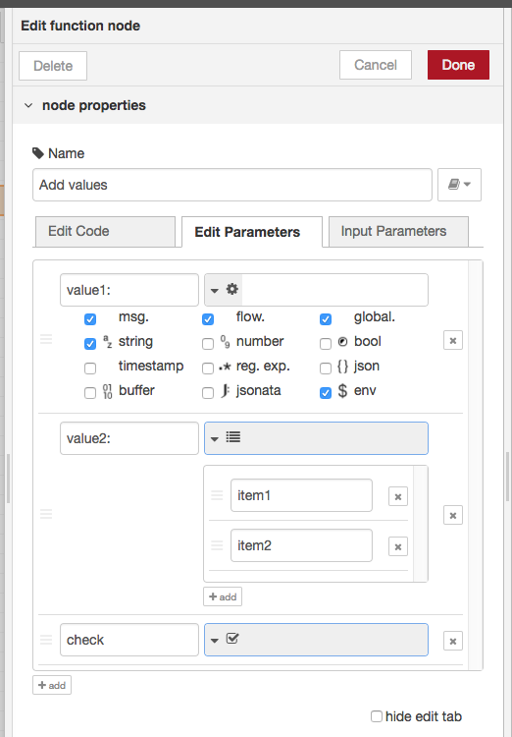
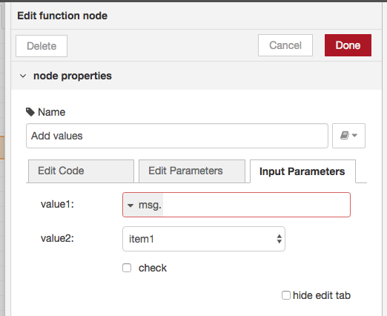
Defining UI for Subflow
Allow UI to be defined by "Edit Parameters" tab of Subflow.
An UI item can be added by "add" button at bottom. It can define label, type, and initial value (if any).
UI item's input type can be specified using TypedInput interface. In addition to specific input types (e.g. msg., string, JSONata expression, ...), following special type is provided:
- checkbox, menu, label (no input), any (input from selected types)
item type selector
any type
generated settings UI
menu type
checkbox type

Slide 8
DEMO

Slide 9

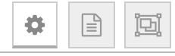

Discussion
push
add button
Locale specification for labels
Intarface of specifying node property (extension of TypedInput interface)
Edit UI
name
label
type
tgt. type
target
type specific inputs
Added UI items are shown in node settings UI from top to bottom
default item type is label
HTML tag can be used for label
tgt. type specifies env var or node property
target specifies env var or node property to be set
i18n is realized by specifying label for each language
add
UI Edit Panel
en-US
Text with <b>HTML tag</b>
Enumerating all locales is cumbersome:
add interface that allow adding new locale
specify set of usable locales (in settings.js)
only allow EN+browser locale
Common UI to set target node property (extension of TypedInput)
[tgt = node property]
<node id>.<property name>
...

Slide 10
Other Discussion Items

Slide 11
Discussion Items
File-out node
We are planning to release new Curry system based on Node-RED 0.19.X. Because corruption of multi-byte string output affects our users, is there a possibility that 0.19.6 is released with multi-byte string fix?
Node Messaging API Can we expect this to be included in 0.20 line or postponed to 0.2X?

