Slide 1
Flow Testing
Hiroyasu Nishiyama

Slide 2
New Flow Testing Proposal
Thank you for creating node-red-flow-tester repository.
I have created a new phase 1 design note of flow testing support for discussion on Issue of the repository. https://github.com/node-red/node-red-flow-tester/issues/1
We would appreciate if you could let us know your thoughts on this.

Slide 3
Summary of Phase 1 Proposal
Phase 1 design covers simple flow testing but not includes:
command line testing,
single node testing,
SUBFLOW testing,
Dashboard testing.
(1)~(3) will be added by following phases, and we would like to add (4) as an another design note.
Flow test is described as set of test suites. It contains set of test cases.
Each test case are described by actions for predefined events.
Test Case
Test Suite

Slide 4
Test Events & Actions#1
Following are list of currently proposed test events & actions. We definitely need to refine these events & actions.
Test Events
Common Events
1 | setup | triggered at start of the test case
2 | cleanup | triggered at end of the test case
Node Events
3 | receive | triggered at receive of incoming message by the node
4 | stub | triggered after receive event instead of message processing of the node
5 | send | triggered after sending message from the node to output port

Slide 5
Test Events & Actions#2
Test Actions
Common Actions
1 | wait | wait for specified time
2 | function | write complex testing using JavaScript code
Test Case Actions
3 | set | set context or environment variables
Node Actions
4 | match | match message property or context with specified value or expression
5 | set | set message property or context
6 | send | send message to output port
7 | recv | receive message from input port

Slide 6
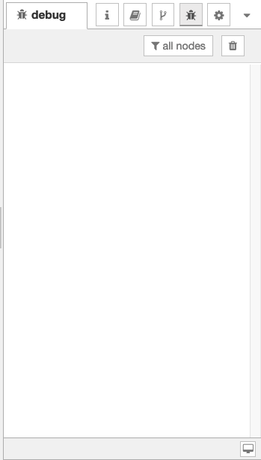
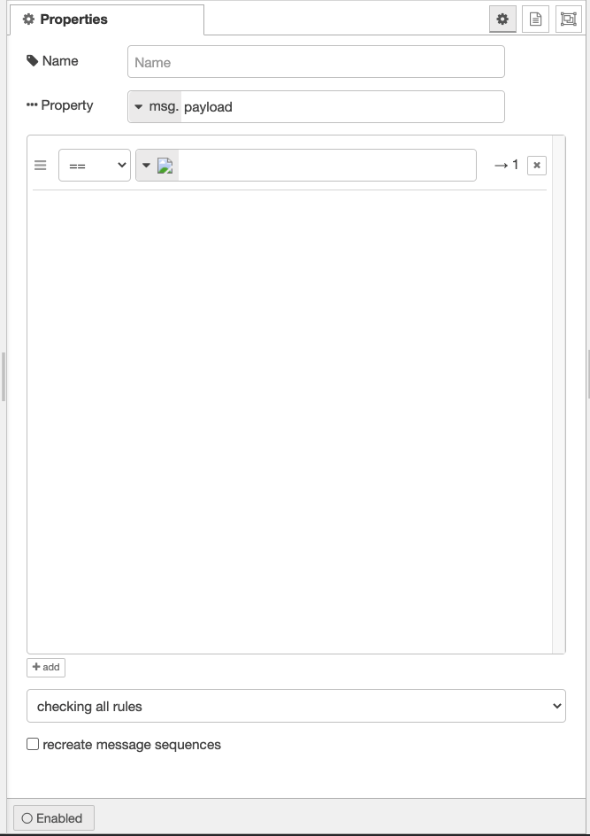
Sidebar UI for Managing Test Cases
🔧 Test
🔧 Setup&Cleanup
Run Tests
select test case
add new scenario
Event & Actions
▲
△
Suite1/Scenario2
☑️ Test Suite1
+ add
setup
cleanup
☑️ Scenario1
□ Scenario2
config
http-in
http-resp
✔️
×
▲
set
▲
context
▲
{...}
open config
flow
{}
▲
set
▲
env
▲
New Env
$
{}
config
inject
function
debug
✔️
×
✔️
△
□ Test Suite2
□ Test Suite3
△
+ add
list of actions
add new action
add new test suite
+ add
Test Sidebar
Test Setup & Cleanup Settings Tab

Slide 7
Node Settings UI
🔧 Test
🔧 new
select test case
Event & Actions
▲
Suite1/Scenario2
receive
stub
send
▲
match
▲
payload
▲
{...}
msg
{}
▲
set
▲
topic
▲
New Topic
msg
{}
▲
pass
+ add
list of actions
add new action
Test Settings Tab

Slide 8
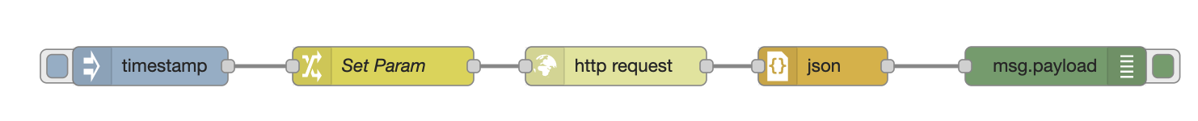
Example of Test Cases#1
Case #1: Test HTTP Request Flow
Case #2: Test Exec flow using stubbed execution
1. [setup] recv { payload: ... }
3. [send] match { payload: ... }
4. [send] match { payload: ... }
2. [send] match { payload: ... }
1. [setup] recv { payload: ... }
3. [send] match { payload: ... }
4. [send] match { payload: ... }
2. [stub] send to port#1 { payload: ... }

Slide 9
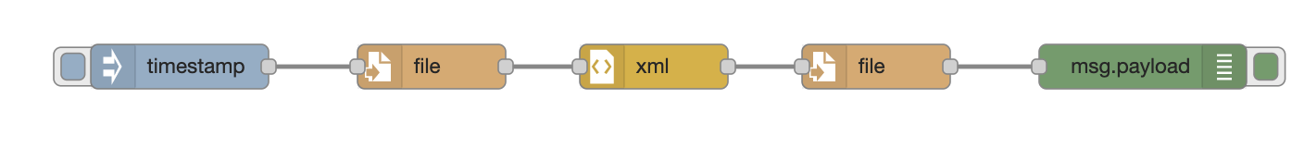
Example of Test Cases#2
Case #3: Test File I/O using setup & cleanup events
1. [setup] function: prepare input data file
2. [setup] recv { payload: ... }
4. [send] match { payload: ... }
5. [send] match { payload: ... }
3. [send] match { payload: ... }
6. [cleanup] function: check output data file

