Slide 1
Environment Variable Support for Node Groups & Tabs
Hiroyasu Nishiyama

Slide 2
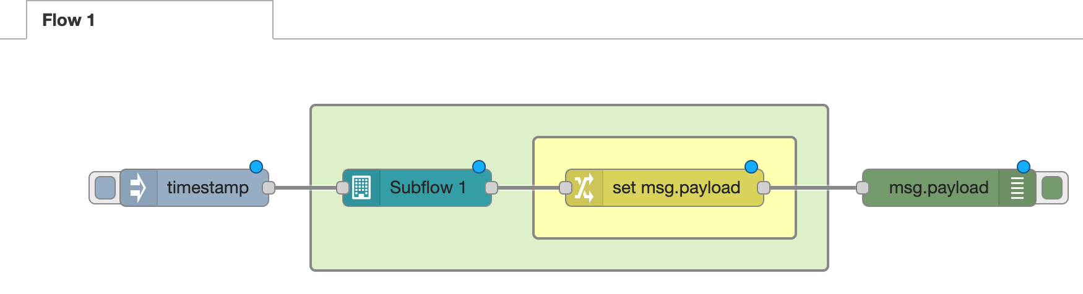
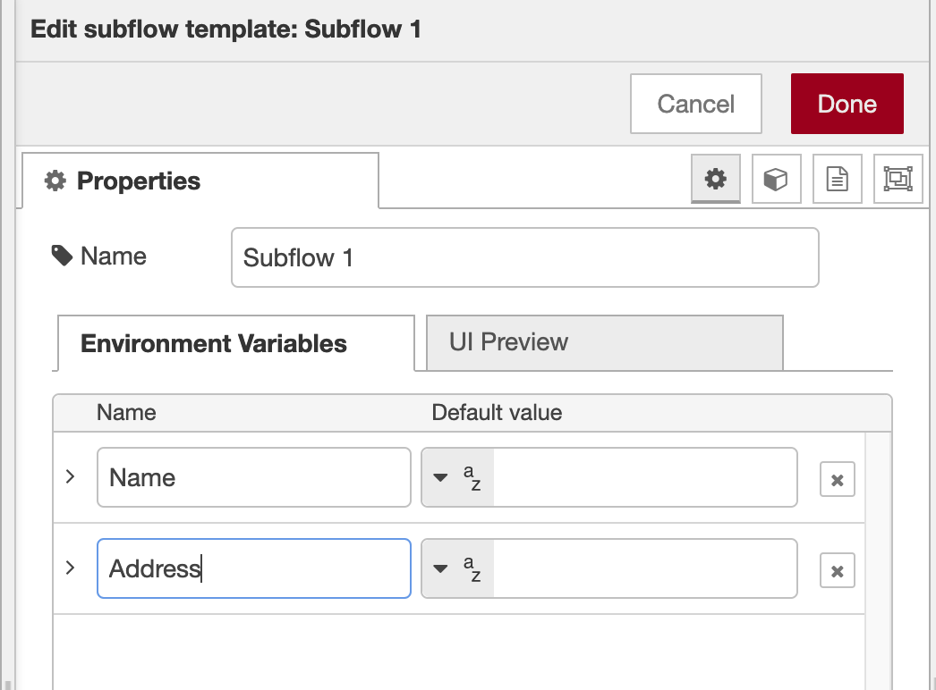
Extending Environment Variable#1
Environment variable is useful for customizing SUBFLOW’s behavior.
Supports hierarchical propagation from upper to lower in SUBFLOW definition.
Setting the same value for multiple SUBFLOW instances is difficult without nesting.
No direct means for specifying top-level values except OS environment variable.
We’d like to add feature for specifying environment variables to top-level nodes including SUBFLOW. This will be useful for customizing flows & developing SUBFLOWs.
Add support to environment variable setting interface to groups & tabs,
Support of UI definition feature may not be needed.
Env. Var. defs
for group
Env. Var. defs
for tab

Slide 3
Extending Environment Variable#2
We’d like to add feature for specifying environment variables to top-level nodes including SUBFLOW.(cont.)
Environment variables are looked up in the following order:
[additionally] editing feature of env. var. (e.g. JSONata expression) may be useful.
OS
Tab
Tab
Tab
Lookup
Group
Gr.
Gr.
S.F.
S.F.
S.F.
S.F.
S.F.
S.F.
Gr.
Gr.
Gr.
Node
N.

