Slide 1
Editor Support of Exporting SUBFLOW
Hiroyasu Nishiyama

Slide 2
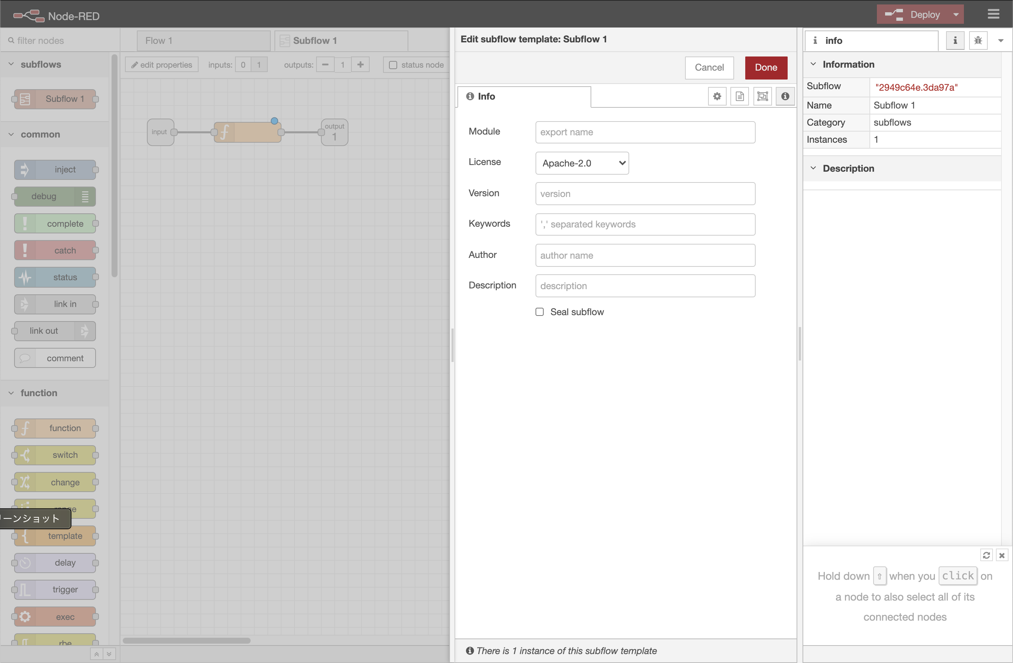


Exporting SUBFLOW
Currently Node-RED supports importing SUBFLOW module. But need manual process to make importable module.
Export SUBFLOW as JSON,
Create SUBFLOW module files from #1 and templates,
npm pack
We have created a Node-RED node that supports this (node-red-contrib-subflow2node) and added support to node-generator.
But, this feature should be provided as a feature of Node-RED editor for ease of use of novice users.
export
SUBFLOW+ metadata
manual,
w. subflow2node/ node-generator
templates
import
SUBFLOW module
directly export SUBFLOW module
tgz(npm)

Slide 3
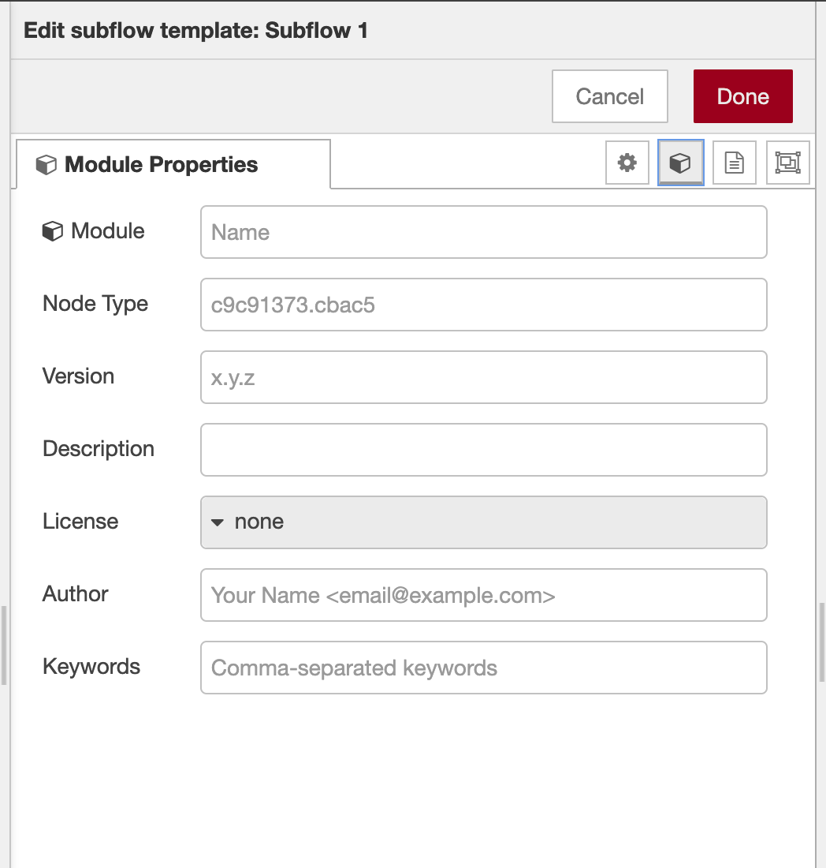
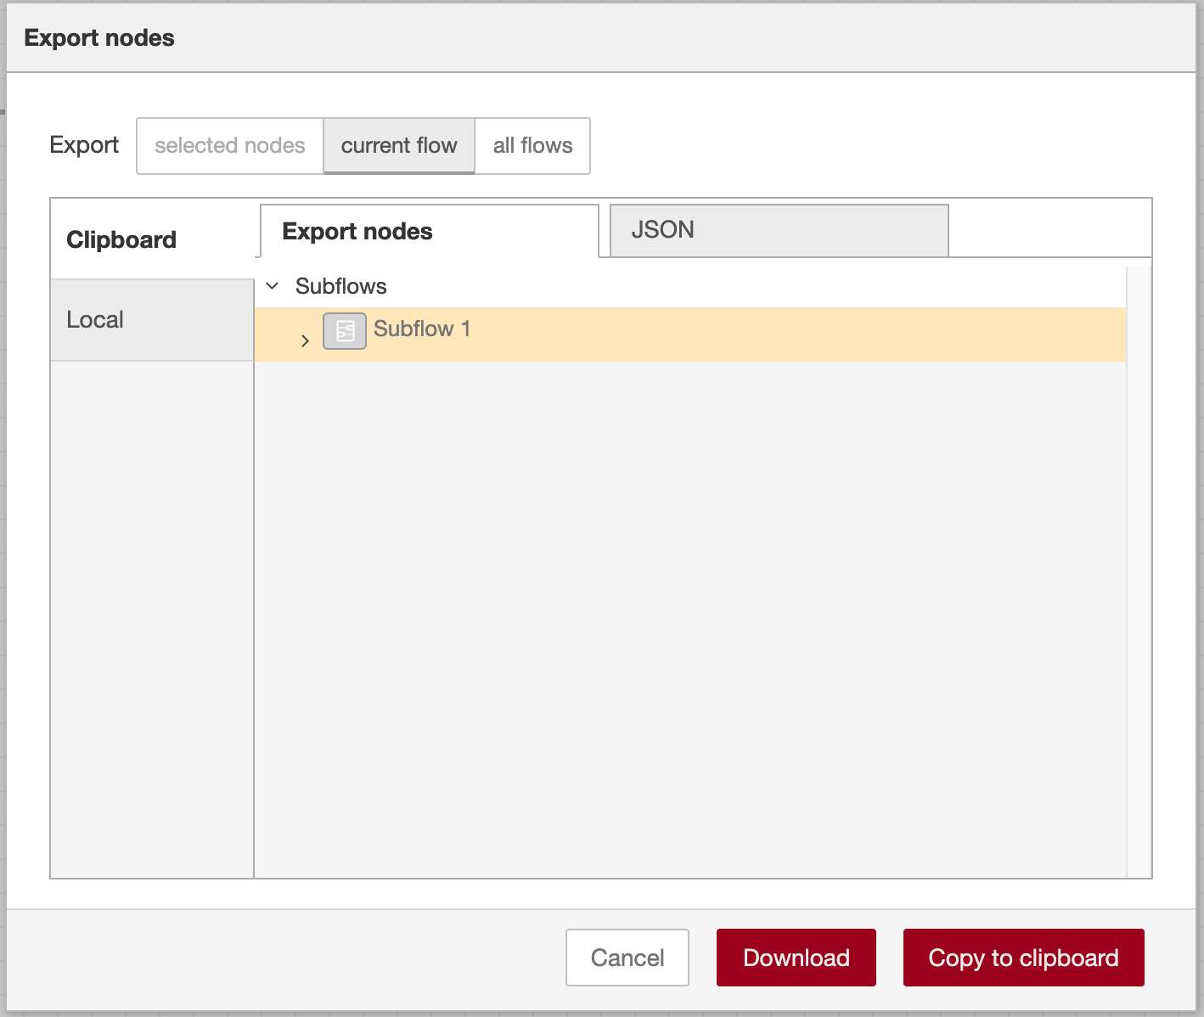
Editor Support Proposal#1
Possible point to add SUBFLOW export support in Node-RED editor:
Module Properties tab of of SUBFLOW template, and/or
Export nodes UI of export menu
#1(left fig.) seems better because users need to modify module properties when required information is not supplied.
add “Download NPM” button
Download NPM
Download NPM

Slide 4
Editor Support Proposal#2
Possible approach for implementing export feature:
call node generator from runtime,
add new supporting code to runtime,
independent of #1/#2, whether to use plugin feature or not
Regarding #1 and #2, I think #2 is preferable because #1 adds adds large amount of dependencies with most of them not used. Maybe useful for adding conversion to NPM module from other specifications but have no good idea on it.
Regarding #3, I think adding this as a default feature make sense because it will be useful for many novice users as a default feature.

Slide 5
Encoding JSON
Current template for SUBFLOW module of subflow2node contains encoding/decoding support as described in the following design of SUBFLOW JSON. - https://github.com/node-red/designs/pull/26
I think this feature will be candidate for plugin feature.
default encoding/decoding feature, additional scheme
but, may need additional plugin APIs for interaction between plugins?
add via plugin
Encoding
AES
Key
Download NPM

