Slide 1
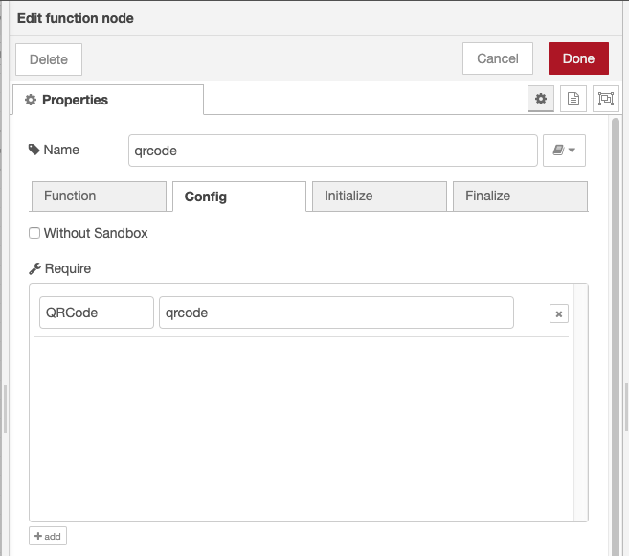
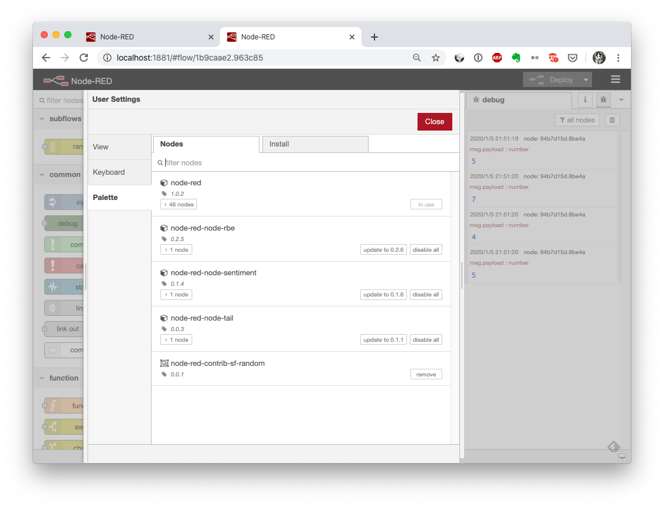
[2] Importing External NPM Module
require A, B
Install
☐ module A
☑ module B
npm install B

Slide 2
[N] Lifecycle Model of Function Node
Create Func Node (code, dynamicModuleList, and require list)
Deploy
register required list to runtime in node constructor (before execution)
assign module objects to VM environment var
New API (registerRequiredModules)
get required list
filter required list using black/white list to ensure only allowed modules are installed
if auto-install-mode is on then automatically install required module
return list of module objects. undefined if not loaded.
stop flow
Initialize
execute initialization code
Execute
execute function code
Editor
show list of npm modules in settings panel.
npm modules can be installed/removed/updated from this panel
Finalize
execute finalization code

