Slide 1
UI Module layout and dashbord display
Kazuhiro Ito

Slide 2
Summary
■UI Module prototype
Design note
Add design note for UI Module #24
https://github.com/node-red/designs/pull/24
Prototype version
[Draft] UI Module prototype #621
https://github.com/node-red/node-red-dashboard/pull/621
I created a prototype version for the purpose of validating the design notes of the UI module.This prototype has unimplemented features.
□Implemented ・ Add Config node for UI module
・ UI module support for existing features □Unimplemented
・UI Module layout function
・UI Module dashboard display
Consider implementing the above two unimplemented functions.

Slide 3
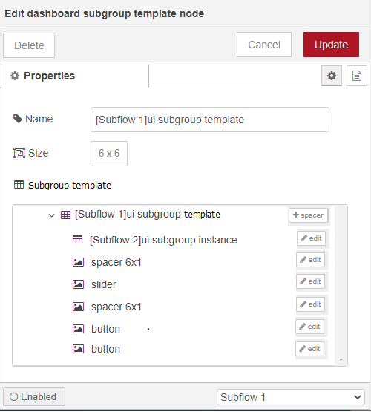
UI Module layout function
■Subgroup template node layout function
Consider adding the ability to edit widget orders to subgroup templates.
This allows you to edit the order of the node IDs stored in the widgetOrder set in ui_subgroup_t.
* In this study, we will not support the layout editor and prioritize the implementation of the display function on the dashboard.
Specify the width and height.It cannot be set automatically.
Subgroup template layout
Launch the layout editor screen* Not implemented this time.
layout
Add ui_spacer node
Open the edit screen for each node.
You can change the order of widgets under subgroup.

Slide 4
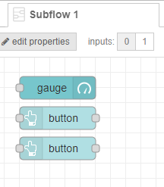
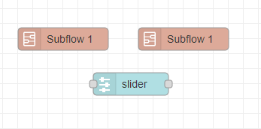
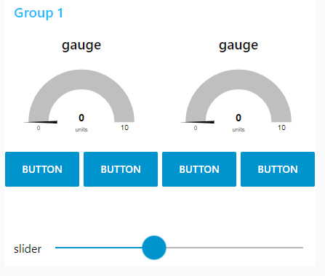

UI Module dashboard display
■ Dashboard display function
Place the instantiated widget of the subflow on the dashboard based on the information in the subflow template.
The placement is based on the information of the subgroup instance (ui_subgroup_i) and subgroup template (ui_subgroup_t), which are the config nodes for dashboard display that are automatically generated in pairs with the subflow instance and subflow template.
In addition, the subflow placed in the subflow is also displayed.
Editor
Subflow template
(Subgroup template)
Subflow instance
(Subgroup instance)
Dashboard
Place the widget on the dash
according to the order of
the subflow template.

Slide 5
Others
□ Improvement of UI Module function update opportunity
In the prototype version, the functionality is built into ensureDashboardNode() only for ease of implementation.
Therefore, the UI module function is updated only when the tab on the dashboard is pressed.
Consider incorporating it into editSaveEventHandler(), nodesAddEventHandler(), nodesRemoveEventHandler() for updates synchronized with node placement.
□ About AngularJS 1.8.x LTS period AngularJS 1.8.x LTS will end on December 31, 2021. https://docs.angularjs.org/misc/version-support-status
Please let us know if you have any plans for future support.

