Slide 1


NODEFONY
Node.js
WEB FRAMEWORK
SYMFONY LIKE

Slide 2
NODEFONY
Introduction
Présentation du Framework
Hello Word
Demo web classique
Command Line Interface (CLI)
Architecture Logiciel Global
Librairie Cliente Javascript
Introduction au Temps réel
Demo Temps réel
Introduction webRTC
Demo webRTC

Slide 3
INTRODUCTION
Solution Global pour créer une application web en node.js
Gestionnaire de packages communautaire NPM
Philosophie de développement et Design Pattern
Courbe d'apprentissage rapide pour un développeur web Symfony
Solution Web temps réel simple
Commande Line interface (CLI) pour le Scripting, les Tests, la Génération
Monitoring de l'application et débugage simple
Langage de Développement client et serveur identique
Librairie Cliente

Slide 4
Présentation du Framework
BUNDLES
NODEFONY
BUNDLE
Framework
KERNEL
Events
BUNDLES
SERVICES
EVENTS
security
http
App
SYSLOG
Services
onBoot
onBoot
monitoring
READER
onReady
Contrôleurs
Assetic
Container
Services
injection
onTerminate
Routes
FINDER
onRequest
realTime
onError
Resources
SERVICES
Config
REQUESTS
ROUTEUR
MVC
REPONSES
vues
HTTP
CONTROLLER
VIEW
Public
ORM
VIEW
HTTPS
ACTIONS
I18N
WEBSOCKET
VIEW
Firewall
VIEW
Commandes
CLI
Translation
Real Time

Slide 5
Routeur / MVC Présention du Framework
BUNDLE FRAMEWORK
REQUESTS
URI
ROUTEUR
MVC
REPONSES
FRONT
CONTROLLER
URI
MATCHER
RESOLVER
CONTROLLER
VIEW
ROUTES
VIEW
ACTIONS
VIEW
VIEW
Configuration Basique des Routes routing.yml
ROUTES
MVC
Default:
pattern: /
defaults:
controller: frameworkBundle:default:index
documentation:
pattern: /documentation/{id}
defaults:
controller: frameworkBundle:default:doc
requirements:
method: GET,POST
login:
pattern: /login
defaults:
controller: frameworkBundle:default:login
PATTERN
URI
CONTROLLER
VIEWS
DYNAMIQUE VARIABLES
URI
ACTIONS
TWIG
RENDERING
REQUIERMENTS
STREAMING
HTML
METHOD
REDIRECT / FORWARD
HOST
MODEL
XML
CROSS DOMAIN

Slide 6
Injections de dépendances services Présention du Framework
Services
Services
Container de services
KERNEL
Services
SCOPES
Services
CONTAINER KERNEL
INJECTEUR DE SERVICES
Syslog
Finder
Routeur
Reader
Configuration Basique des services services.xml
HTTP
SCOPE
Request
<?xml version="1.0" ?>
<container xmlns="http://nodefony.com/schema/dic/services"
xmlns:xsi="http://www.w3.org/2001/XMLSchema-instance"
xsi:schemaLocation="http://nodefony.com/schema/dic/services http://nodefony.com/schema/dic/services/services-1.0.xsd">
<services>
<service id="httpKernel" class="{{httpKernel}}">
<argument type="service" id="container" />
<argument type="service" id="serverStatic" />
<call method="boot"></call>
</service>
</container>
HTTPS
WebSocket
Firewall
statics
RealTime
Less
Sessions
Translation

Slide 7
Securité Présention du Framework
FIREWALL
REQUESTS
BUNDLE SECURITY
BUNDLE FRAMEWORK
REPONSES
AREAS
Cross-Domain
Manager
FIREWALL
ROUTEUR
SECURE
SECURE
FRONT
CONTROLLER
SECURE
SECURE
AREAS
ROUTES
RESOLVER
SESSIONS
HTTP
Authentification
MVC
Autorisation
CONTROLLER
VIEW
Sessions Check
ACTIONS
VIEW
Providers
DB
Memory
VIEW
Anonyme
Users
VIEW
Authentification
MD5,BASIC

Slide 8
Solution Globale ARCHITECTURE LOGICIEL
CONSOLE CLI
REMOTE
SERVERS
Commandes
Clustering
NODEFONY SERVER
SERVERS
SERVEURS
FIREWALL
FRAMEWORK
SERVICES
OPENSIP
HTTP
S
E
C
U
R
E
A
R
E
A
CROSS
DOMAIN
ROUTEUR
REALTIME
MAIL
FRONT
CONTROLLER
UPNP
HTTPS
SESSIONS
ROUTES
LESS
JABBER
Websocket
RESOLVER
PROVIDERS
MVC
I18N
INTERNATIONALISTAION
Websocket
Secure
ACCESS
CONTROL
CONTROLLER
VIEW
DB
ACTIONS
VIEW
Statics
AUTHENTIFICATION
VIEW
ORM2
VIEW
SQLITE
MYSQL

Slide 9
Librairie javascript cliente
VENDORS
JQUERY
BOOTSTRAP
IO
Common
Data Struct
UI
Notifications Center
FIFO LIFO
RealTime
FIFO LIFO
Templating (twig)
RealTime
Ajax
SYSLOG
RING STACK
Widget
WebSocket
Plugins
TOOLS
MEDIA
Poll
I18N
XML
User Media
Long Poll
THEME
XSLT
WEB AUDIO API
Ajax Dowload
Ajax Upload
CRYPTO
VIDEO
Protocole
HERITAGE
WEBRTC
XMPP
SIP
Authentification

Slide 10
Fichiers de Configurations kernel Présention du Framework
Fichiers de Configurations de type yaml ou xml
#
# NODEFONY FRAMEWORK
#
# KERNEL CONFIG
#
#
name: "N O D E F O N Y"
system:
version: "1.0"
domain: nodefony.com
httpPort: 5151
httpsPort: 5152
statics: true
security: true
realtime: true
monitoring: true
locale: "fr_fr"
projectName: "NODEFONY"
authorName: myName
authorMail: myName@domain.com
date: null
dateYear: null
log:
active: true
messages: "/tmp/nodefony.log"
error: "/tmp/errorNodefony.log"
services: "/tmp/servicesNodefony.log"
rotate: false

Slide 11
Hello Word
Registration du bundle hello
Bundle hello
appKernel.js
nodefony.register("appKernel",function(){
var appKernel = function(type, environment, debug, loader){
// Kernel constructor
var kernel = this.$super;
kernel.constructor(environment, debug, loader, type)
/*
* Bundle to register in Application
*/
this.registerBundles([
"./src/bundles/helloBundle",
]);
/*
* SERVERS
*/
if (type === "SERVER"){
this.listen(this,"onReady", function(){
// create HTTP server
var http = this.get("httpServer").createServer();
}.bind(this));
};
}.herite(nodefony.kernel);
return appKernel;
}) ;
helloBundle.js
nodefony.registerBundle ("hello", function(){
var hello = function(kernel, container){
this.mother = this.$super;
this.mother.constructor(kernel, container);
}
return hello ;
});
Controller et Actions
defaultController.js
nodefony.registerController("default", function(){
/**
* The class is a **`default` CONTROLLER** .
*/
var defaultController = function(container, context){
this.mother = this.$super;
this.mother.constructor(container, context);
};
defaultController.prototype.indexAction = function(){
return this.render('helloBundle:default:hello.html.twig',{name: 'Hello Word'});
} ;
return defaultController ;
});
Configuration de la route /hello
Template de Vue html
hello.html.twig
<!DOCTYPE html>
<html>
<head>
<meta http-equiv="content-type" content="text/html; charset=UTF-8">
<title> Welcome NODEFONY FRAMEWORK ! </title>
</head>
<body>
<h1>{ % name %} </h1>
</body>
</html>
Routing.yml
index:
pattern: /hello
defaults:
controller: helloBundle:default:index

Slide 12
Serveurs Web Présention du Framework
Lancement des serveurs mode production ou développement
          Serveurs HTTP HTTPS WEBSOCKET
          Serveurs Fichiers statiques
SERVEURS
http
MacBook-Pro-de-Christophe:nodefony cci$ ./nodefony
N O D E F O N Y
SERVER Version : 1.0 PLATFORM : darwin PROCESS PID : 45520
Mon Feb 23 2015 17:01:47 DEBUG HTTP KERNEL : Add static route ===> /Users/cci/repository/nodefony/web/
Mon Feb 23 2015 14:55:47 DEBUG KERNEL : EVENT KERNEL READY
Mon Feb 23 2015 14:55:47 INFO SERVER WEBSOCKET : Server is listening on DOMAIN : 192.168.100.246 PORT : 5151
Mon Feb 23 2015 14:55:47 INFO SERVER HTTP : HTTP Server is listening on DOMAIN : 192.168.100.246 PORT : 5151
...
https
websocket
Websocket
Secure
Statics

Slide 13
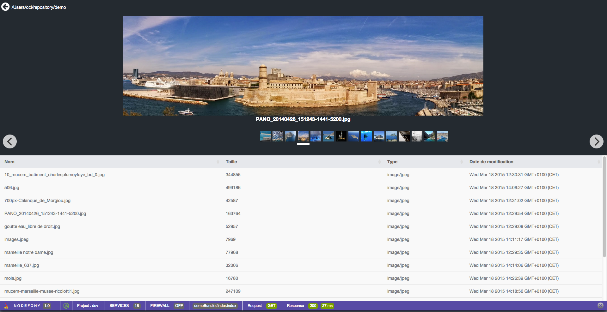
DEMO WEB CLASSIQUE

Slide 14
CLI Command Line Interface
Nodefony peut fonctionner en mode « console » CLI
Le framework permet de créer des commandes dans les bundles.
./console -h
N O D E F O N Y
CONSOLE Version : 1.0 PLATFORM : darwin PROCESS PID : 53668
Usage: node console
-h, --help
-v, --version show version
Commands : [arguments]
framework
generate:bundle nameBundle path Generate a Bundle directory in path directory
generate:controller nameController path Generate a controller js file in bundle path
generate:command nameCommand path Generate a command js file in bundle path
generate:service nameService path Generate a service js file in bundle path
router:generate:routes Generate all routes
router:generate:route routeName Generate one route
router:match:url url Get route who match url
assetic
assets:install Installs bundles web assets under a public web directory
less:render Less CSS compilateur
less:compile Less CSS compilateur
minification:compile [compilateur] Minificaton javascript compilateur : google / yahoo
security
encoders:MD5 login password [realm] Generate encoding keys digest MD5
orm2
ORM2:fixtures:load Load data fixtures to your database
ORM2:fixture:load bundleName:fixtureName Load a specific data fixture to your database
ORM2:generate:entity connectionName entityName Generate an Entity
ORM2:generate:bundleEntity bundleName:entityName Generate Bundle Entity
ORM2:generate:entities Generate All Entities
ORM2:database:create Create a database
ORM2:entity:show show Entities
ORM2:connections:state view connections states
App
server:run Run Application

Slide 15
INTRODUCTION TEMPS REEL
Le bundle realTime :
SERVICES
NODEFONY
WEB GATEWAY REAL TIME
#
# NODEFONY FRAMEWORK
#
# REALTIME BUNDLE CONFIG
#
#
system:
reconnect:
handshake: true
connect: true
services:
random:
type: tcp
port: 1315
domain: nodefony.com
dmsg:
type: tcp
port: 1316
domain: nodefony.com
Random
Service Realtime
FRAMEWORK
Controller
realTime
Socket
TCP
1315
Sockets
Clientes
Manager
de
connections
Subscribe
Close
open
Encapsulation
Protocole
Bayeux
Protocole
JSON RPC
DMSG
Socket
TCP
1316
Désencapsulation
Protocole
TEXTE

Slide 16
DEMO WEB TEMPS REEL

Slide 17
INTRODUCTION WebRTC
STUN/TURN
DEVICES
BROWSERS
WEBRTC
ICE
Medias
PROXY SIP
OPENSIP
Port 5060
NODEFONY
WEB GATEWAY REAL TIME
Services
Realtime
Real Time
Pile
SIP
transport
Sip
over
Bayeux
over
Websocket
Websocket
Protocole
PSTN
SIP
Protocole
Encapsulation/
Désencapsulation
Transport
Bayeux
Bayeux
Socket
IMS
WEBRTC
Utilisateurs
Protocole
Audio
Peer to Peer
SRTP
Video
BROWSER
IP PHONE

Slide 18
DEMO SIP WebRTC

