Slide 1
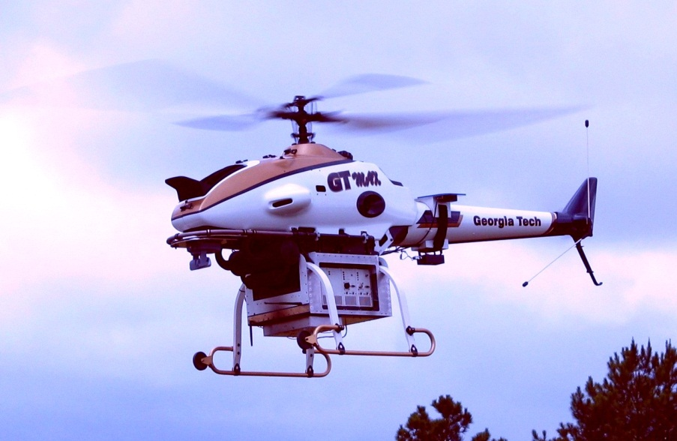

Slide 2
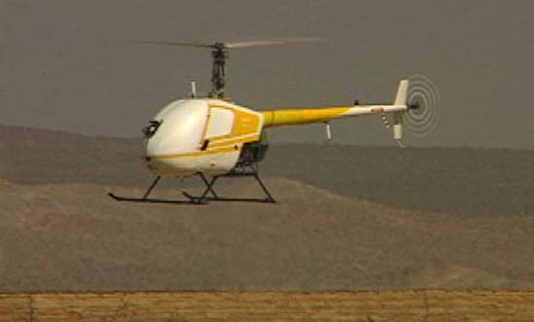
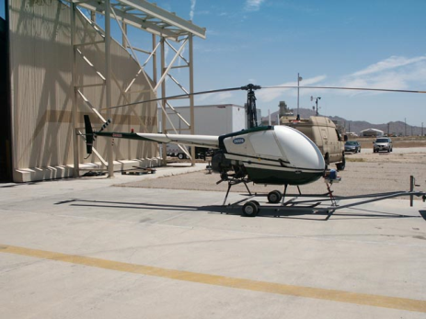

Slide 3
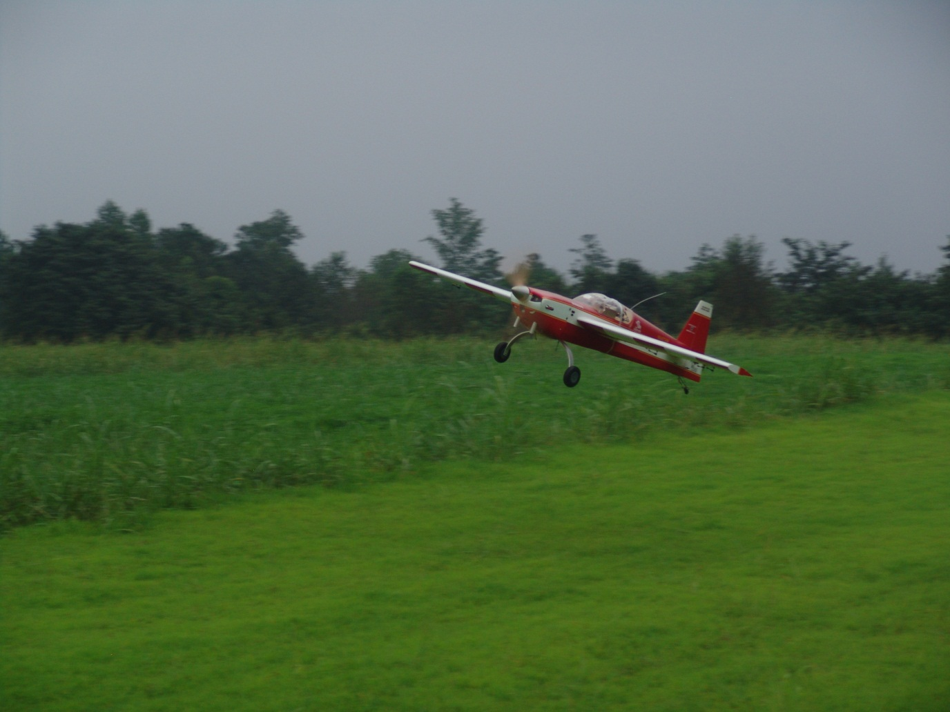

Slide 4



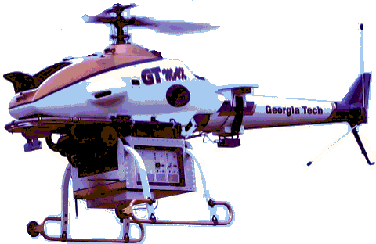








Outer Loop
Hedge
Inner Loop
Hedge
Outer
Loop
Inner
Loop
Adaptive Element

Slide 5




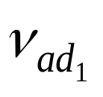
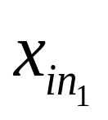

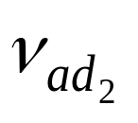
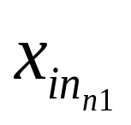
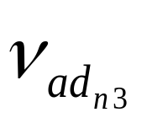
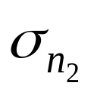

Slide 6


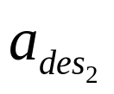


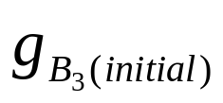



Slide 7
















Outer-Loop
Hedge
Inner-Loop
Hedge
Outer Loop
Reference Model
Inner Loop
Reference Model
Outer Loop
Approx
Inversion
Inner Loop
Approx
Inversion
+
+
Outer-Loop
PD
Inner-Loop
PD
OUTER LOOP
INNER LOOP
Adaptive Element

Slide 8
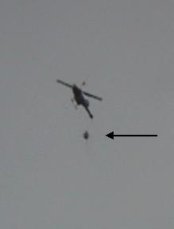

Slide 9









Inner/Outer Loop Architecture
Hedge Actuator & Innerloop Dynamics
Hedge Actuator Dynamics
Outer
Loop
Inner
Loop
Plant
Adaptive Element

