Slide 1
Web Framework Project
CPSC 593 – Web Application Development
Spring 2012

Slide 2
Overview
System block diagram
Use cases
Sequence Diagrams
Technology choices

Slide 3
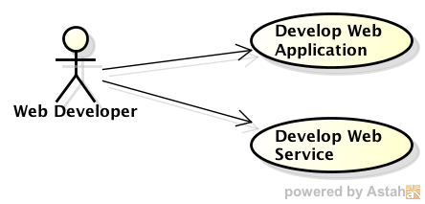
Use Cases
Web application developer uses the web framework to develop web applications and/or web services

Slide 4
No Superordinate Systems Identified
Web Framework
No Peer Systems Identified
Actors
Web App Developer
Uses
User Interface
Configuration
Server
- request/response handler
- child listeners
Logging
Model
- Worker process
View
view template
Testing
- Admin Site
No Subordinate Systems Identified

Slide 5
Components
User interface - handles user interaction with the framework
Configuration – handles initialization activities
Model – handles model objects
View – handles view
Server – handles requests/responses; spawns child listeners that handle requests
Logging – handles logging functions
Testing – contains testing logic/modules

Slide 6
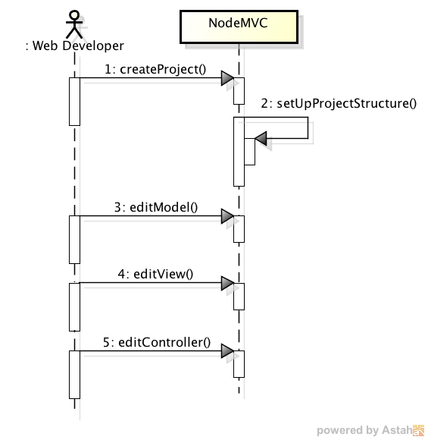
Create New Project Sequence Diagram

Slide 7
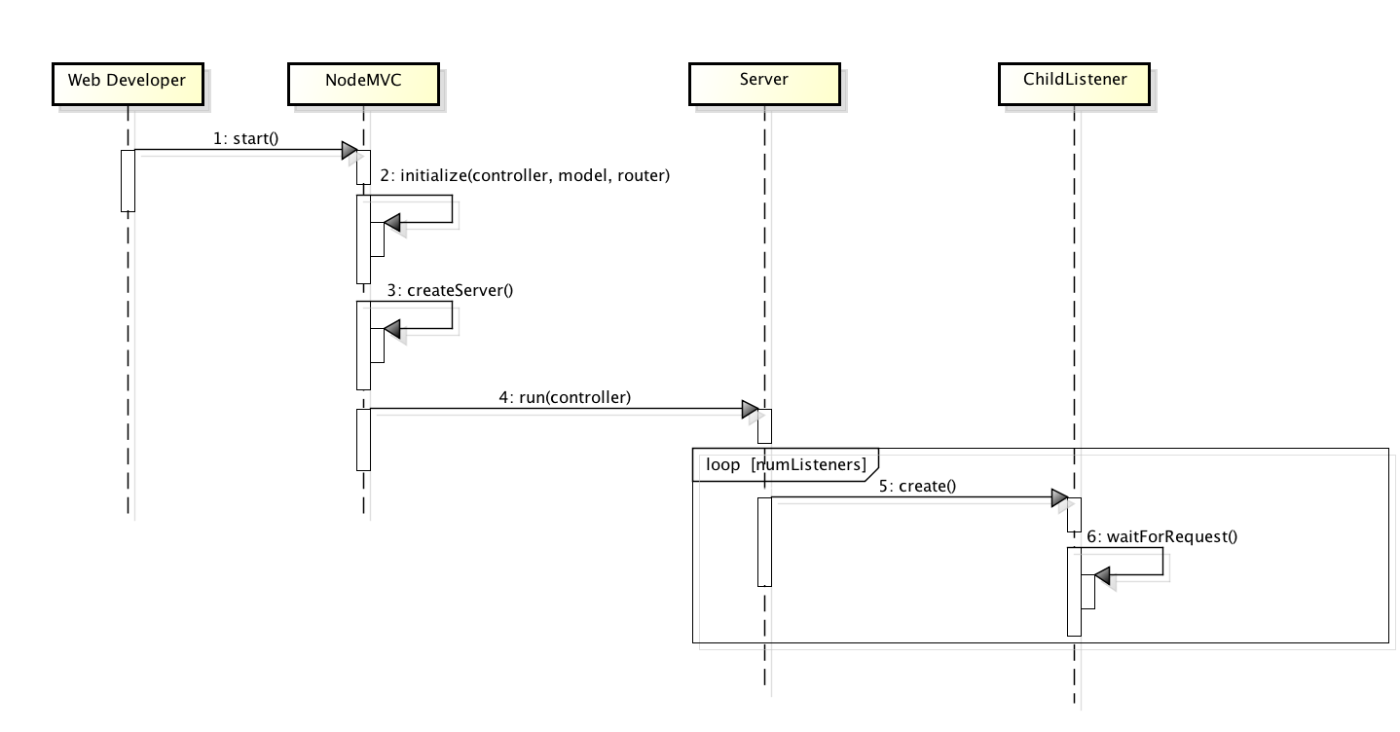
Startup Sequence Diagram

Slide 8
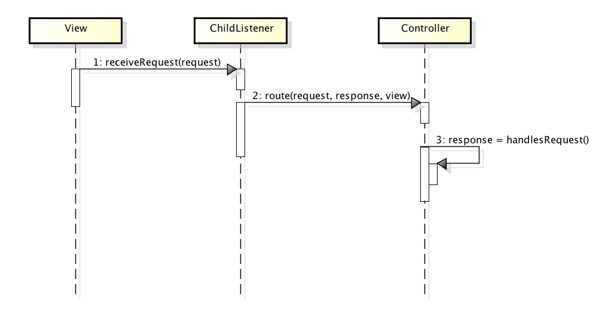
Receive Request Sequence Diagram

Slide 9
Technologies
Node.js – development environment
JavaScript, HTML
Git – version control
Templating
Patterns
Functional inheritance
Model-View-Controller
Database – future release?

