Slide 1
NodeMVC Web Framework Project
Kevin Cain, Quy Le, Rochelle Palting, and Qikai Zhou
CPSC 593 – Web Application Development
Spring 2012

Slide 2
Overview
Requirements 1 min
System architecture & design 3 min
Demo 12 min
Code Walkthrough 10 min
Testing & Analysis 3 min
Summary 3 min
Q&A 3 min

Slide 3
Requirements
Develop web framework with the minimum features:
Templating
Configurable request routing
Request/response handling
Logging
Support for Model View Controller
Reference application suite that demonstrates functionality

Slide 4
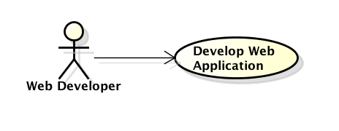
Use Cases
Software developer uses the web framework to develop web applications.

Slide 5
Functional Block Diagram
NodeMVC
Server
Router
Controller
Template
Model
Logging
TemplateParser
HTMLHelper
Notes:
Server – receives/sends HTTP requests/responses between user interface (web browser or command line)
Router – sends request to appropriate controller
Controller
Template -
Model – contains base model that user model implements
Logging – console.log(…) and Common Log Format

Slide 6
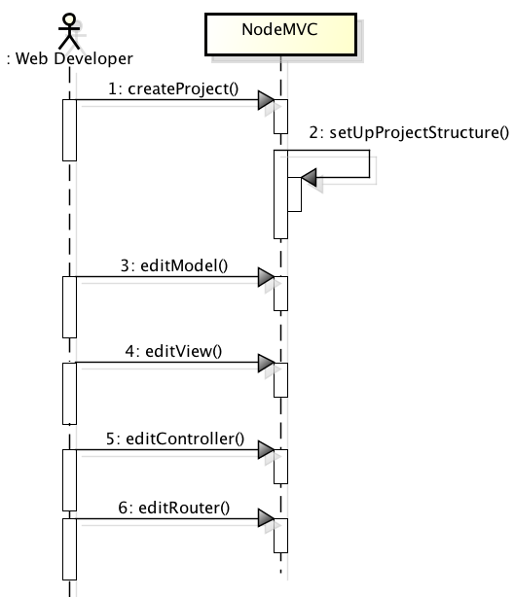
User Creates Web Application
Notes:
User
Creates model(s) – extend base Model object
Create view(s)
Create controller – extend base Controller object; specify actions, specify model
- Update table that maps URL to controller action

Slide 7
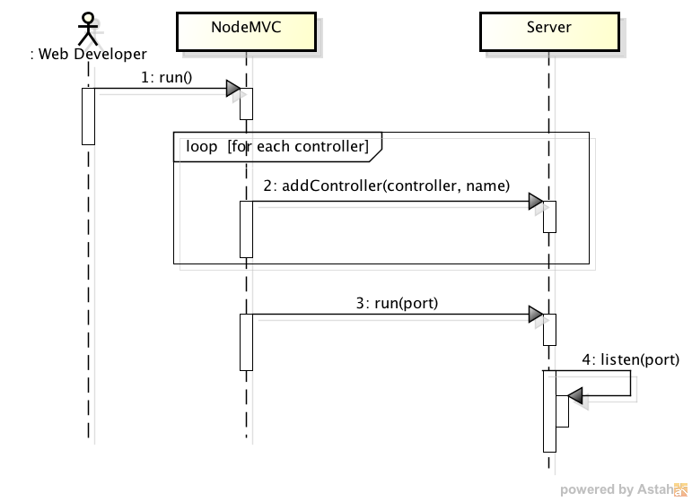
User Starts NodeMVC

Slide 8
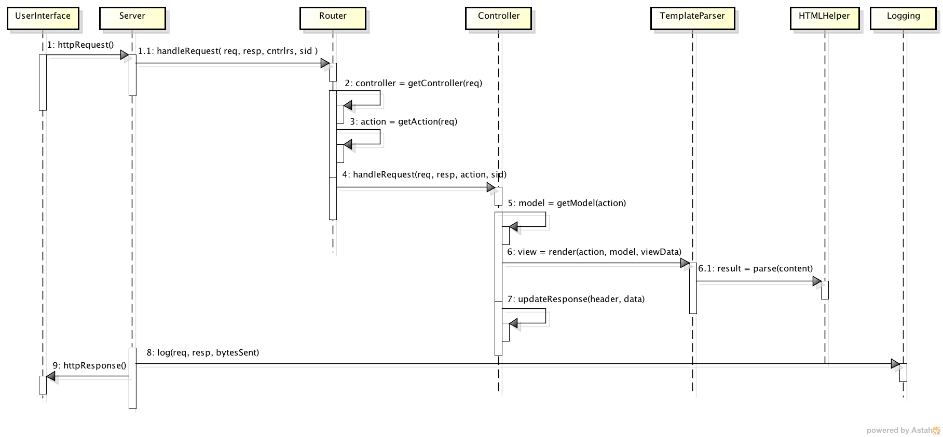
NodeMVC Handles Request

Slide 9
Demo
Web developer creates and tests project.
Notes:
Kevin

Slide 10
Testing & Analysis
Components were tested individually while being developed, and then integration tested with entire system.
Functional testing with sample model, view, controller
Analysis
Pros about our design, implementation
MVC support → separation of concerns, code reuse
Cons about our design, implementation
Basic functionality
Usability

Slide 11
Summary (1 of 2)
Technologies
Development environment: Node.js
System: JavaScript
Views:
HTML
Templating
Version control: Git
Patterns
Functional inheritance
Model-View-Controller
Notes:
Quy

Slide 12
Summary (2 of 2)
Lessons learned
Very helpful to look at existing web application frameworks for ideas
Known issues/bugs
Future features
Automated initial project configuration
Additional HTML template helpers
Static file request support

Slide 13
Backup Slides Beyond this Point

Slide 14
Functional Components
Server – receives/sends HTTP requests/responses between user interface (web browser or command line)
Router – sends request to appropriate controller
Controller
Template -
Model – contains base model that user model implements
Logging – console.log(…) and Common Log Format

