Slide 1
NodeMVC Web Framework Project
Kevin Cain, Quy Le, Rochelle Palting, and Qikai Zhou
CPSC 593 – Web Application Development
Spring 2012

Slide 2
Overview
Requirements
System architecture & design
Demo
Technologies Used
Summary

Slide 3
Requirements
Develop web framework
TODO – complete this

Slide 4
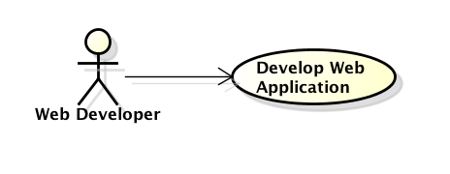
Use Cases
Web application developer uses the web framework to develop web applications.

Slide 5
Functional Block Diagram
NodeMVC
Server
Router
Controller
Template
Model
Logging
TemplateParser
HTMLHelper

Slide 6
Functional Components
Server – receives/sends HTTP requests/responses between user interface (web browser or command line)
Router – sends request to appropriate controller
Controller
Template -
Model – contains base model that user model implements
Logging – console.log(…) and Common Log Format

Slide 7
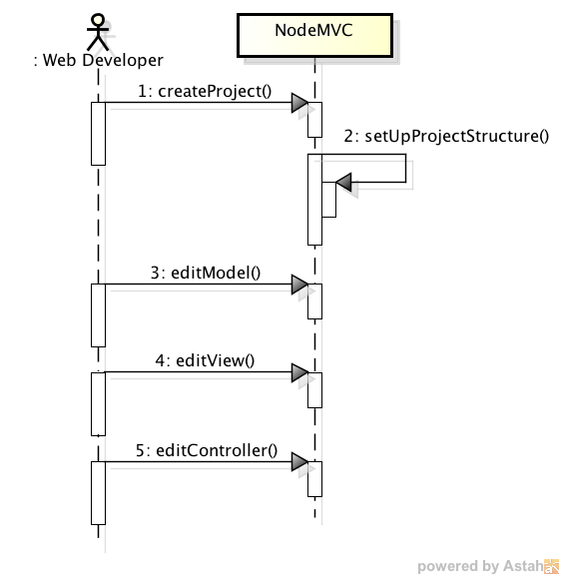
User Creates Web Application Sequence Diagram
TODO: Need to update. Add notes to notes section.

Slide 8
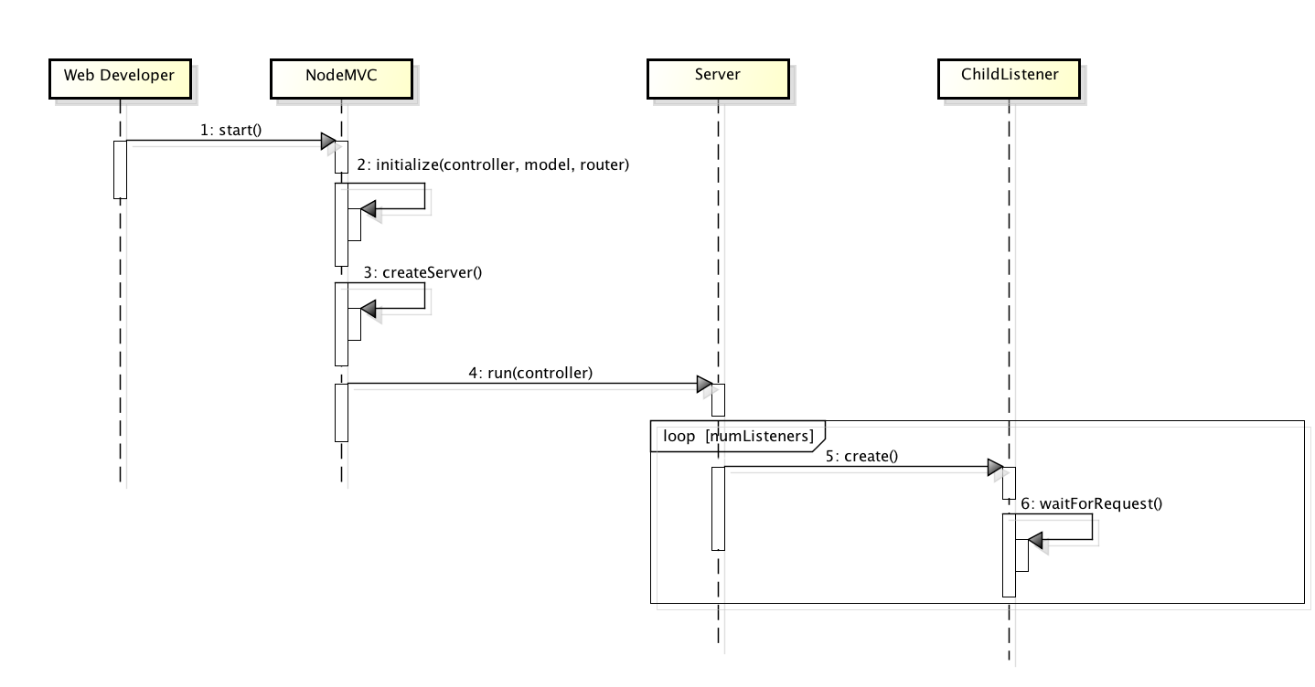
Startup Sequence Diagram
TODO: Need to update. Add notes to notes section.

Slide 9
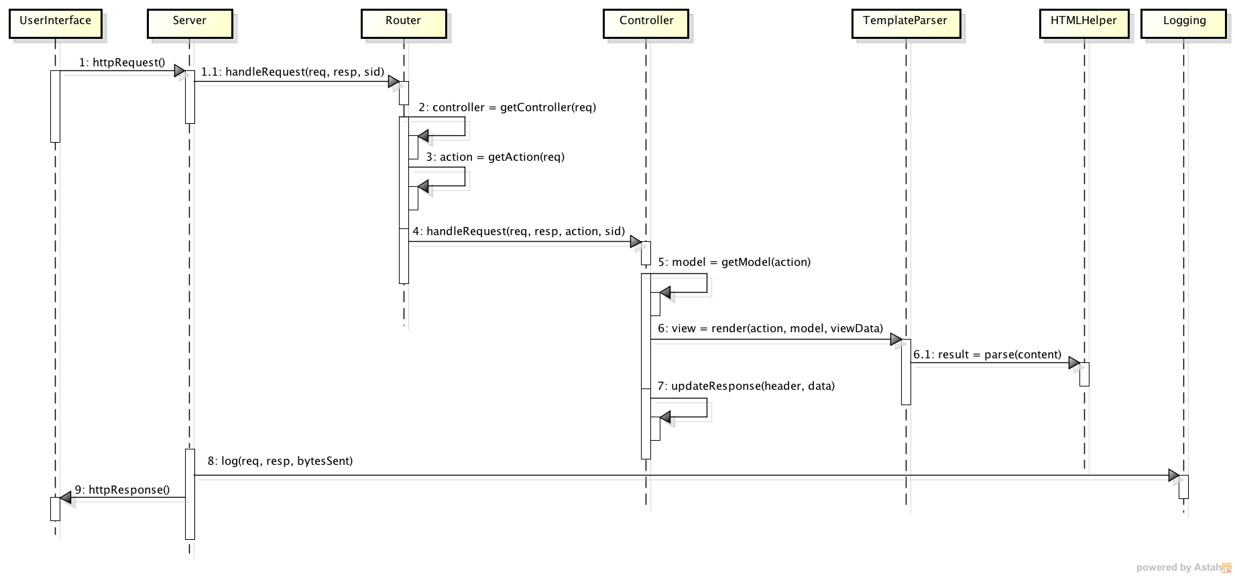
Process Request Sequence Diagram

Slide 10
Demo

Slide 11
Technologies
Development environment: Node.js
System: JavaScript
Views:
HTML
Templating
Version control: Git
Patterns
Functional inheritance
Model-View-Controller

Slide 12
Summary
Lessons learned
TODO
Known issues/bugs
TODO
Future features
TODO

