Slide 1
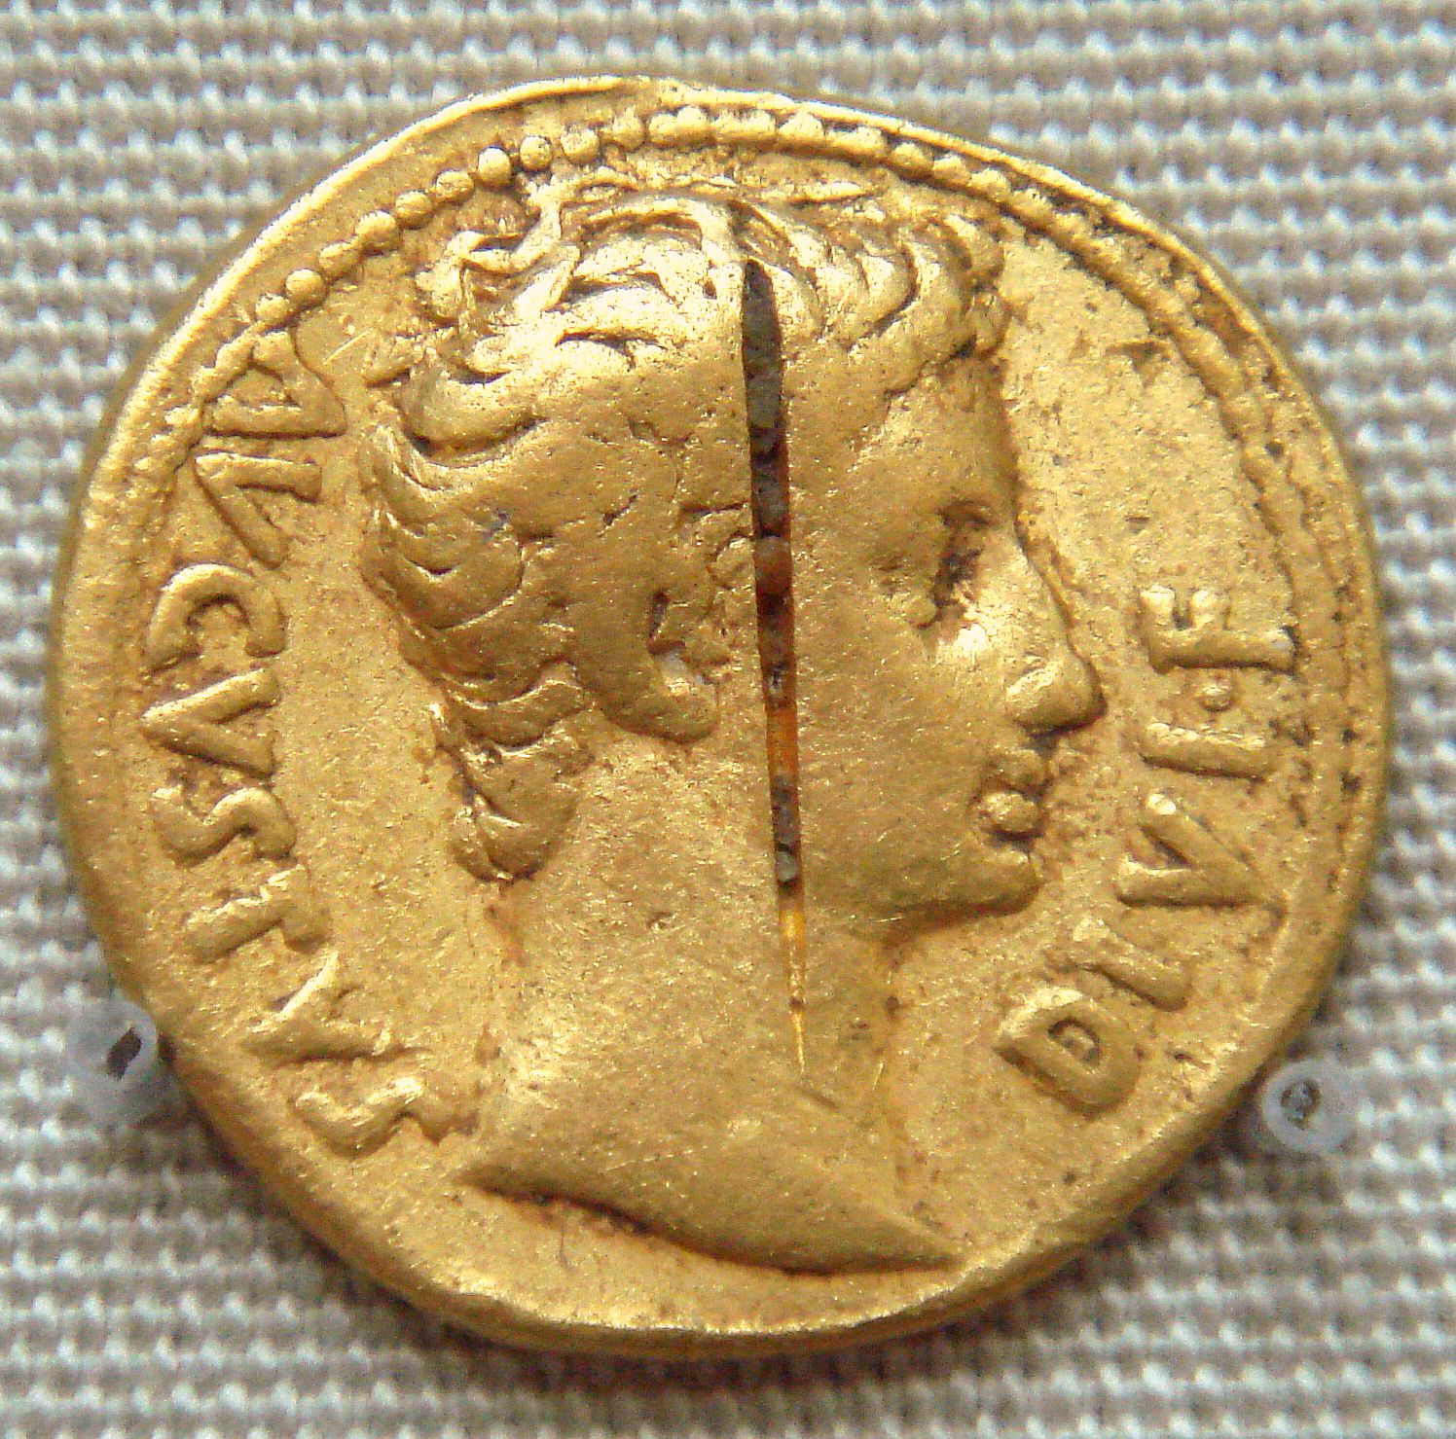
Augustus
23 September 63 BC - 19 August 14 AD

Slide 2
Historians typically refer to him simply as Octavius (or Octavian) between his birth in 63 until his adoption by Julius Caesar in 44 BC (after Julius Caesar's death)
In 59 BC, when he was four years old, his father died. His maternal great-uncle Julius Caesar was assassinated in 44 BC, and Octavius was named in Caesar's will as his adopted son and heir, then known as Octavianus (Anglicized as Octavian). Historians typically refer to him simply as Octavius (or Octavian) between his birth in 63 until his adoption by Julius Caesar in 44 BC (after Julius Caesar's death). In 42 BC, Octavian began the Temple of Divus Iulius or Temple of the Comet Star and added Divi Filius (Son of the Divine) to his name in order to strengthen his political ties to Caesar's former soldiers by following the deification of Caesar, becoming Gaius Julius Caesar Divi Filius. Aware of his deteriorating relationship with Octavian, Antony left Cleopatra; he sailed to Italy in 40 BC with a large force to oppose Octavian, laying siege to Brundisium. To further cement relations of alliance with Mark Antony, Octavian gave his sister, Octavia Minor, in marriage to Antony in late 40 BC. He was established in Sicily and Sardinia as part of an agreement reached with the Second Triumvirate in 39 BC. Lepidus was driven into exile and stripped of his position, and Antony committed suicide following his defeat at the Battle of Actium by Octavian in 31 BC.

Slide 3
In 27 BC, following his defeat of Mark Antony and Cleopatra, the Roman Senate voted new titles for him, officially becoming Imperator Caesar Divi Filius Augustus
In 27 BC, following his defeat of Mark Antony and Cleopatra, the Roman Senate voted new titles for him, officially becoming Imperator Caesar Divi Filius Augustus. It is the events of 27 BC from which he obtained his traditional name of Augustus, which historians use in reference to him from 27 BC until his death in AD 14. Such orders, had they been given, would have been considered a breach of the Senate's prerogative under the Constitutional settlement of 27 BC and its aftermathi.e., before Augustus was granted imperium proconsulare maiusas Macedonia was a Senatorial province under the Senate's jurisdiction, not an imperial province under the authority of Augustus. After the death of Marcellus in 23 BC, Augustus married his daughter to Agrippa. He failed to encourage enough senators to finance the building and maintenance of networks of roads in Italy in 20 BC, but he undertook direct responsibility for them. In 19 BC, the Senate granted Augustus a form of 'general consular imperium', which was probably 'imperium consulare maius', like the proconsular powers that he received in 23 BC. On 16 January 27 BC the Senate gave Octavian the new titles of Augustus and Princeps. Augustus (Latin: Impertor Caesar Dv Flius Augustus; 23 September 63 BC 19 August 14 AD) was the founder of the Roman Principate and considered the first Roman emperor, controlling the Roman Empire from 27 BC until his death in AD 14.

Slide 4
In reality, however, he retained his autocratic power over the Republic as a military dictator
After the early deaths of both Lucius and Gaius in AD 2 and 4 respectively, and the earlier death of his brother Drusus (9 BC), Tiberius was recalled to Rome in June AD 4, where he was adopted by Augustus on the condition that he, in turn, adopt his nephew Germanicus. Augustus died in AD 14 at the age of 75. On 19 August AD 14, Augustus died while visiting Nola where his father had died. Antony and Octavian then sent 28 legions by sea to face the armies of Brutus and Cassius, who had built their base of power in Greece. With Rome's civil wars at an end, Augustus was also able to create a standing army for the Roman Empire, fixed at a size of 28 legions of about 170,000 soldiers. He, Mark Antony, and Marcus Lepidus formed the Second Triumvirate to defeat the assassins of Caesar. In reality, however, he retained his autocratic power over the Republic as a military dictator. By law, Augustus held a collection of powers granted to him for life by the Senate, including supreme military command, and those of tribune and censor.

Slide 5
Sextus Pompeius was the son of First Triumvir Pompey and still a renegade general following Julius Caesar's victory over his father
He was succeeded as Emperor by his adopted son (also stepson and former son-in-law) Tiberius. Early life His father, also named Gaius Octavius, had been governor of Macedonia. The following year he was put in charge of the Greek games that were staged in honor of the Temple of Venus Genetrix, built by Julius Caesar. Heir to Caesar Upon his adoption, Octavius assumed his great-uncle's name Gaius Julius Caesar. Roman citizens adopted into a new family usually retained their old nomen in cognomen form (e.g., Octavianus for one who had been an Octavius, Aemilianus for one who had been an Aemilius, etc.). Sextus Pompeius was the son of First Triumvir Pompey and still a renegade general following Julius Caesar's victory over his father.

Slide 6
First settlement Octavian was no longer in direct control of the provinces and their armies, but he retained the loyalty of active duty soldiers and veterans alike
In the autumn of 40, Octavian and Antony approved the Treaty of Brundisium, by which Lepidus would remain in Africa, Antony in the East, Octavian in the West. War with Pompeius As Lepidus and Octavian accepted the surrender of Pompeius' troops, Lepidus attempted to claim Sicily for himself, ordering Octavian to leave. The Roman dominions were now divided between Octavian in the West and Antony in the East. At the same time, Octavian could not simply give up his authority without risking further civil wars among the Roman generals and, even if he desired no position of authority whatsoever, his position demanded that he look to the well-being of the city of Rome and the Roman provinces. First settlement Octavian was no longer in direct control of the provinces and their armies, but he retained the loyalty of active duty soldiers and veterans alike. Moreover, command of these provinces provided Octavian with control over the majority of Rome's legions.

Slide 7
Octavian became the most powerful political figure in the city of Rome and in most of its provinces, but he did not have sole monopoly on political and martial power
The provinces not under Octavian's control were overseen by governors chosen by the Roman Senate. Octavian became the most powerful political figure in the city of Rome and in most of its provinces, but he did not have sole monopoly on political and martial power. However, the Senate had control of only five or six legions distributed among three senatorial proconsuls, compared to the twenty legions under the control of Octavian, and their control of these regions did not amount to any political or military challenge to Octavian. It was a title of religious authority rather than political authority. His new title of Augustus was also more favorable than Romulus, the previous one which he styled for himself in reference to the story of the legendary founder of Rome, which symbolized a second founding of Rome. Princeps had also been a title under the Republic for those who had served the state well; for example, Pompey had held the title. This was a surprise to many who believed Augustus would have named an heir to his position as an unofficial emperor. This desire, as well as the Marcus Primus Affair, led to a second compromise between him and the Senate known as the Second Settlement.

