Slide 1
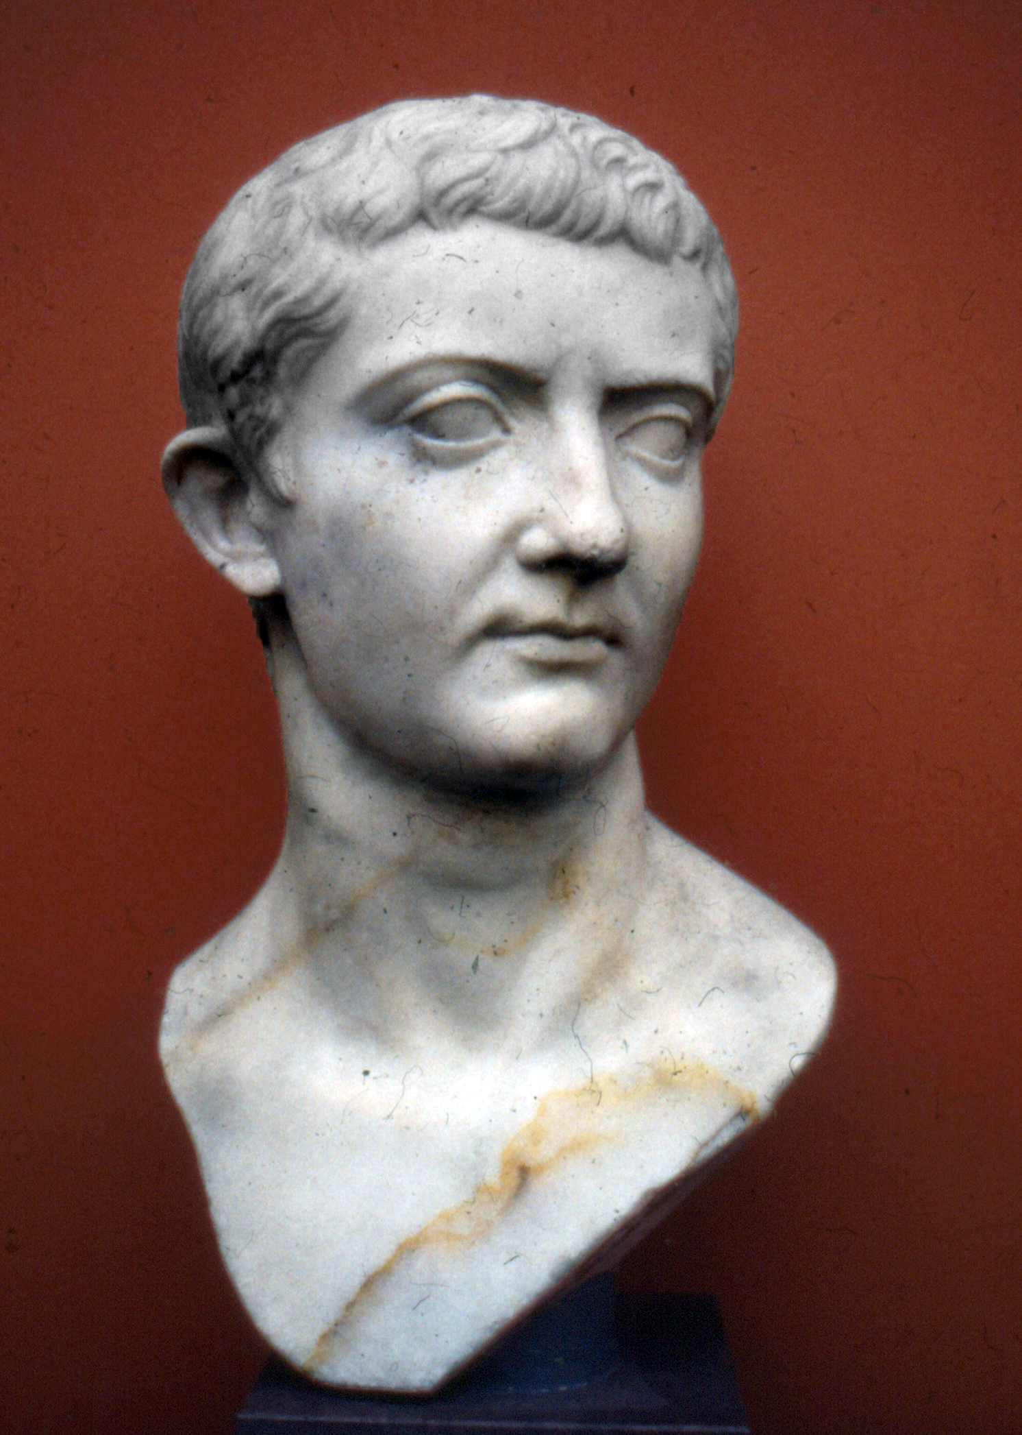
Augustus
23 September 63 BC - 19 August 14 AD

Slide 2
Augustus (Latin: Imperātor Caesar Dīvī Fīlius Augustus; 23 September 63 BC – 19 August 14 AD) was the founder of the Roman Principate and considered the first Roman emperor, controlling the Roman Empire from 27 BC until his death in AD 14. Augustus (Latin: Impertor Caesar Dv Flius Augustus; 23 September 63 BC 19 August 14 AD) was the founder of the Roman Principate and considered the first Roman emperor, controlling the Roman Empire from 27 BC until his death in AD 14. His maternal great-uncle Julius Caesar was assassinated in 44 BC, and Octavius was named in Caesar's will as his adopted son and heir, then known as Octavianus (Anglicized as Octavian). He, Mark Antony, and Marcus Lepidus formed the Second Triumvirate to defeat the assassins of Caesar. He was succeeded as Emperor by his adopted son (also stepson and former son-in-law) Tiberius.

Slide 3
Historians typically refer to him simply as Octavius (or Octavian) between his birth in 63 until his adoption by Julius Caesar in 44 BC (after Julius Caesar's death). It is the events of 27 BC from which he obtained his traditional name of Augustus, which historians use in reference to him from 27 BC until his death in AD 14. His father, also named Gaius Octavius, had been governor of Macedonia. In 59 BC, when he was four years old, his father died. Antony and Octavian then sent 28 legions by sea to face the armies of Brutus and Cassius, who had built their base of power in Greece.

Slide 4
Sextus Pompeius was the son of First Triumvir Pompey and still a renegade general following Julius Caesar's victory over his father. He was established in Sicily and Sardinia as part of an agreement reached with the Second Triumvirate in 39 BC. To further cement relations of alliance with Mark Antony, Octavian gave his sister, Octavia Minor, in marriage to Antony in late 40 BC. As Lepidus and Octavian accepted the surrender of Pompeius' troops, Lepidus attempted to claim Sicily for himself, ordering Octavian to leave. The Roman dominions were now divided between Octavian in the West and Antony in the East.

Slide 5
Octavian was no longer in direct control of the provinces and their armies, but he retained the loyalty of active duty soldiers and veterans alike. Moreover, command of these provinces provided Octavian with control over the majority of Rome's legions. Octavian became the most powerful political figure in the city of Rome and in most of its provinces, but he did not have sole monopoly on political and martial power. On 16 January 27 BC the Senate gave Octavian the new titles of Augustus and Princeps. It was a title of religious authority rather than political authority.

Slide 6
Princeps had also been a title under the Republic for those who had served the state well; for example, Pompey had held the title. This was a surprise to many who believed Augustus would have named an heir to his position as an unofficial emperor. This desire, as well as the Marcus Primus Affair, led to a second compromise between him and the Senate known as the Second Settlement. Such orders, had they been given, would have been considered a breach of the Senate's prerogative under the Constitutional settlement of 27 BC and its aftermathi.e., before Augustus was granted imperium proconsulare maiusas Macedonia was a Senatorial province under the Senate's jurisdiction, not an imperial province under the authority of Augustus. The Senate granted Augustus a form of general imperium proconsulare, or proconsular imperium (power) that applied throughout the empire, not solely to his provinces.

Slide 7
During the second settlement, Augustus was also granted the power of a tribune (tribunicia potestas) for life, though not the official title of tribune. In these situations, Augustus would have power as part of his tribunician authority but his constitutional imperium within the Pomerium would be less than that of a serving consul. In addition, the credit was given to Augustus for each subsequent Roman military victory after this time, because the majority of Rome's armies were stationed in imperial provinces commanded by Augustus through the legatus who were deputies of the princeps in the provinces. Nevertheless, there were some who were concerned by the expansion of powers granted to Augustus by the Second Settlement, and this came to a head with the apparent conspiracy of Fannius Caepio. In 19 BC, the Senate granted Augustus a form of 'general consular imperium', which was probably 'imperium consulare maius', like the proconsular powers that he received in 23 BC.

