Slide 1
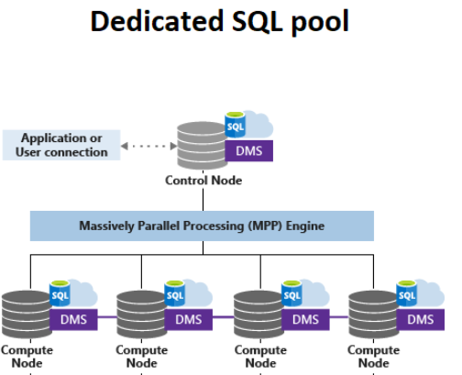
DISTRIBUTION
ROUND_ROBIN
Id, amount, county
1, 100 , IN
2, 200 , IN
3, 300 , USA
4, 400 , CA
5, 500 , USA
6, 600 , CA
7, 700 , USA
select * from sales
-- Control node shall send queries to
all compute nodes, parallel execution
Collect result from all nodes
Merge the results return results to query engine
Will have impact due to performance
Select * from sales country=‘IN’
Select country,sum(amount) from sales
Group by (country)
-- Control node shall send queries to
all compute node, parallel execution
1, 100 , IN
2, 200 , IN
3, 300, USA
4, 400 , CA
5, 500 , USA
6, 600 , CA
7, 700 , USA

Slide 2
DISTRIBUTION
REPLICATE
Id, amount, county
1, 100, IN
2, 200, IN
3, 300 , USA
4, 400 , CA
5, 500, USA
6, 600, CA
7, 700 , USA
select * from sales
Easy for control node.
Send query one compute node
whose is free
Get result from one compute node, return result to query engine
Id, amount, county
1, 100, IN
2, 200, IN
3, 300 , USA
4, 400 , CA
5, 500, USA
6, 600, CA
7, 700 , USA
Id, amount, county
1, 100, IN
2, 200, IN
3, 300 , USA
4, 400 , CA
5, 500, USA
6, 600, CA
7, 700 , USA
Id, amount, county
1, 100, IN
2, 200, IN
3, 300 , USA
4, 400 , CA
5, 500, USA
6, 600, CA
7, 700 , USA
Id, amount, county
1, 100, IN
2, 200, IN
3, 300 , USA
4, 400 , CA
5, 500, USA
6, 600, CA
7, 700 , USA

Slide 3
DISTRIBUTION
HASH (country)
Id, amount, country
1, 100, IN
2, 200, IN
3, 300 , USA
4, 400 , CA
5, 500, USA
6, 600, CA
7, 700 , USA
8, 800, UK
9, 900, DE
10, 1000, DE
Given same country, the same
Compute node is used to store the data
Deterministic
select * from sales
Send queries to nodes that has the data, not ALL node
Select * from sales where country=‘IN’ –
Query send to compute node 1
1
2
3
4
Id, amount, county
1, 100, IN
2, 200, IN
Id, amount, county
3, 300 , USA
5, 500, USA
7, 700 , USA
Id, amount, county
4, 400 , CA
6, 600, CA
9, 900, DE
10,1000,DE
Id, amount, county
8, 800, UK

Slide 4
Dimension tables
Master Tables
REPLICATION
Countries
Products, categories few 100 to 10000
Orders table
Fact Table - OLAP
Transaction – OLTP
State/Depart/product category/product code
Grows every day
Click stream table
Fact Table - OLAP
Region/country
Grows every day
When we see a deterministic column, which may be used most of time in the query
Either in where, group by..
Hash distribution for the fact
If no deterministic column, then go by default round robin

