Slide 1

Rockbuster Stealth: Launch Strategy Analysis
Brandon Lu 07/16/2024

Slide 2

Introduction
Rockbuster Stealth LLC:
Movie rental company that used to have stores around the world
Faces major competition from Netflix and Amazon Prime
Plans to launch online video rental service to stay competitive

Slide 3
KEY Questions
● Which movies contributed the most/least to revenue gain?
● What was the average rental duration for all videos?
● Which countries are Rockbuster customers based in?
● Where are customers with a high lifetime value based?
● Do sales figures vary between geographic regions?

Slide 4
General statistics
Total Revenue: $61,312
Total Customers: 599
Average Revenue/Customer: $102.36
Average Rental Duration: 5 days
Average Rental Rate: $3.00
Average film length: 115 min

Slide 5
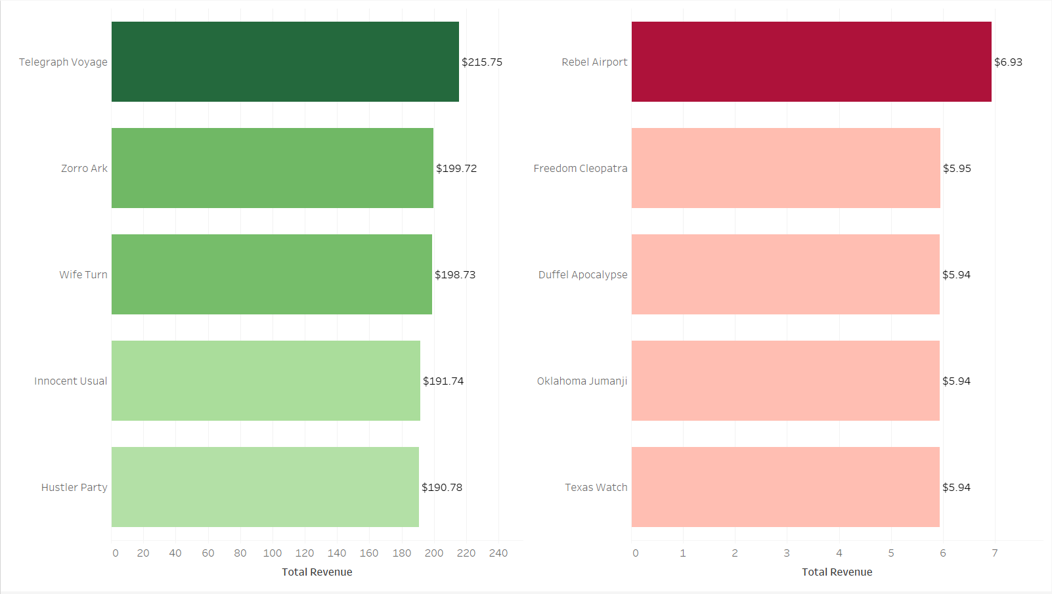
Movies with the Highest/Lowest revenues
Highest
Lowest

Slide 6
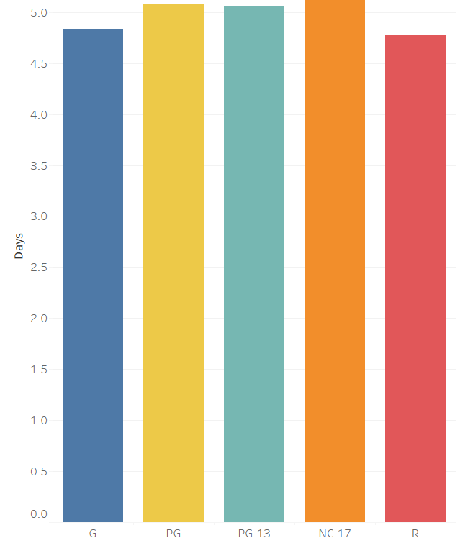

Average rental duration by mpaa rating
The average rental duration across all ratings is 5 days.

Slide 7
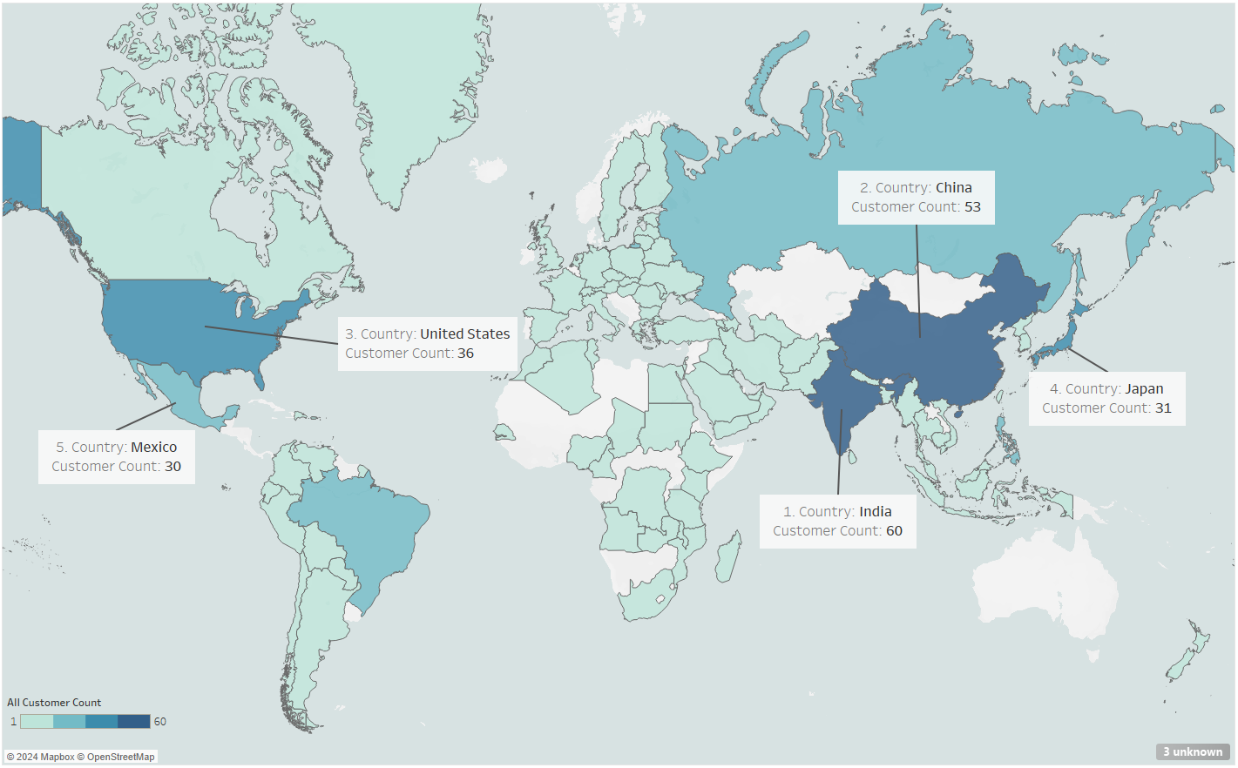

Customers by country
India has the most customers with 60.

Slide 8
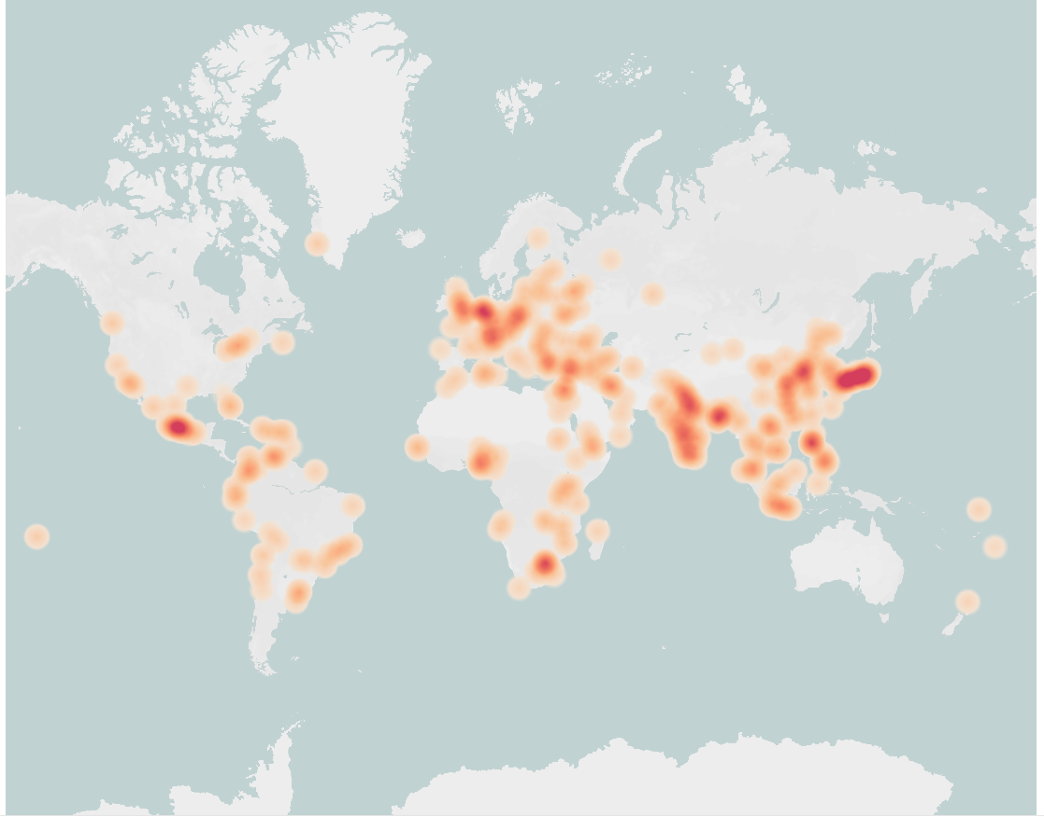
High value customer Density map
Eastern Europe
Eastern China/Japan
Customer value is determined by their spending amount.
Dark red represents more customers with higher spendings.
Lighter colors represent less customers with lower spendings.
Mexico
India
Southern Africa

Slide 9
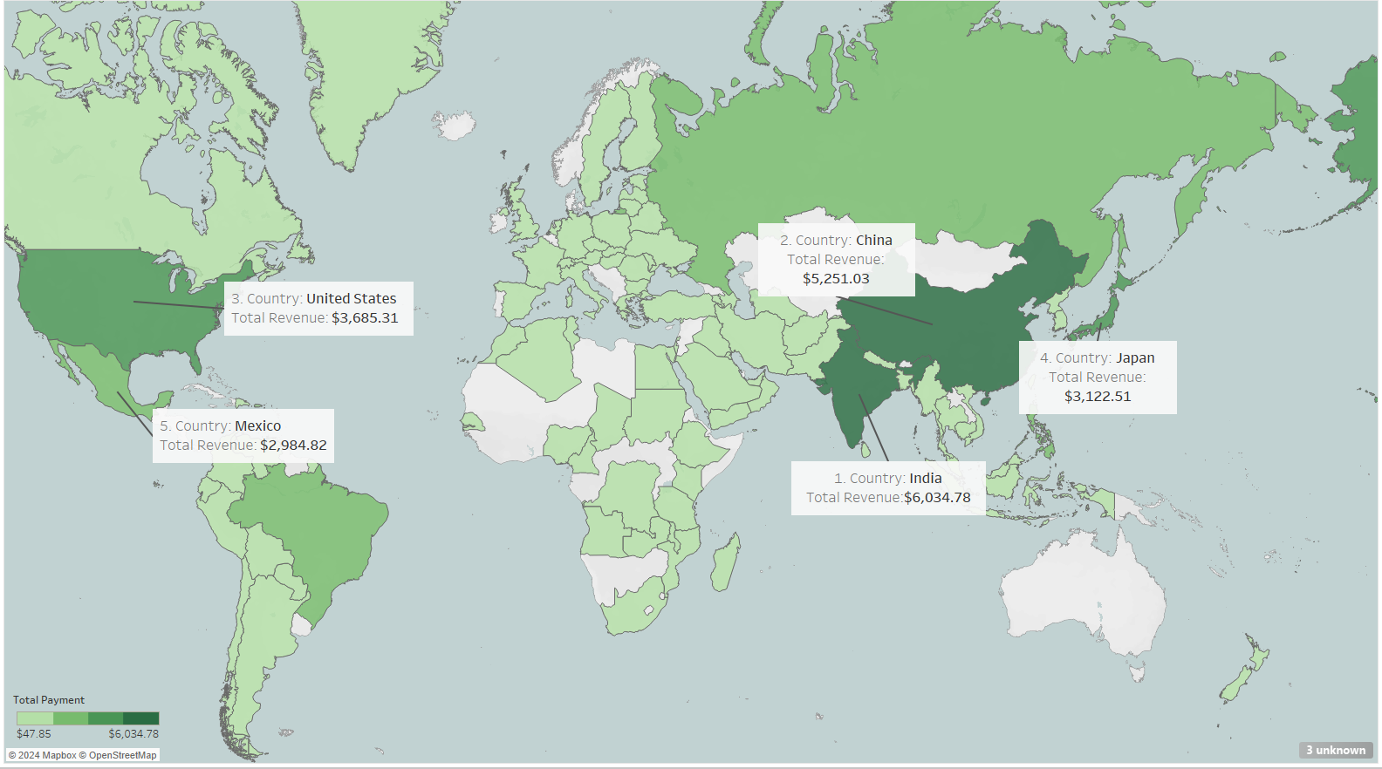

Revenue by country
India has the most revenue at $6,034.78.

Slide 10
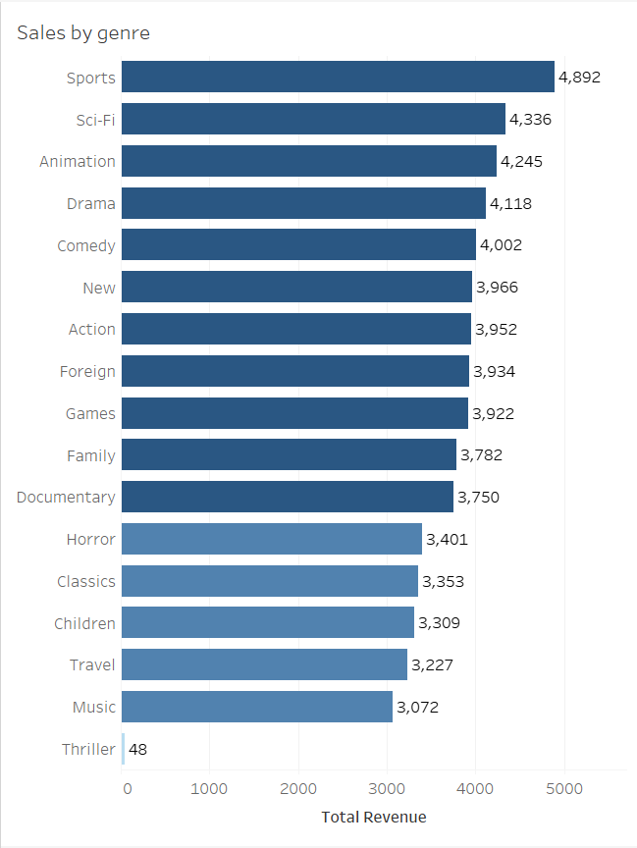
Sales by genre
Top 3 Genres:
1. Sports
2. Sci-Fi
3. Animation
Worst 3 Genres:
1. Thriller
2. Music
3. Travel

Slide 11
insights
The average amount spent per customer ($102.36) is low, suggesting that many purchases are small and minimal.
The top 5 countries: India, China, United States, Japan and Mexico account for 40% of all revenue.
There are 42 films with no revenue.
*Each insight will correlate with one recommendation.

Slide 12
Recommendations
Retarget marketing campaign
1
Allocate all marketing resources to top 3 countries: India, China and United States
Revenue at $60,000 is too low to advertise worldwide
Focus on increasing customer activity and retention
2
R&D for a more user-friendly app with comps like Netflix and Amazon Video
Implement customer loyalty rewards and milestone rewards
Reassign budget for movie licenses
3
Remove movies with no sales in the worst 3 genres: Thriller, Music and Travel
Use new budget to acquire movies in top 3 genres: Sports, Sci-fi and Animation

Slide 13

Questions
Link to tableau: https://public.tableau.com/app/profile/brandon.lu3005/viz/RockbusterVisuals_17211637212500/HIghestRevenue?publish=yes

