Slide 1
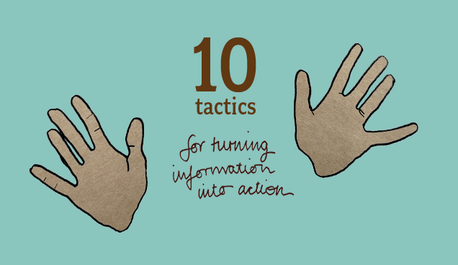

Notes:
Here you could add your logo perhaps.
http://www.tacticaltech.org
http://twitter.com/Info_Activism
http://vimeo.com/tacticaltech

Slide 2
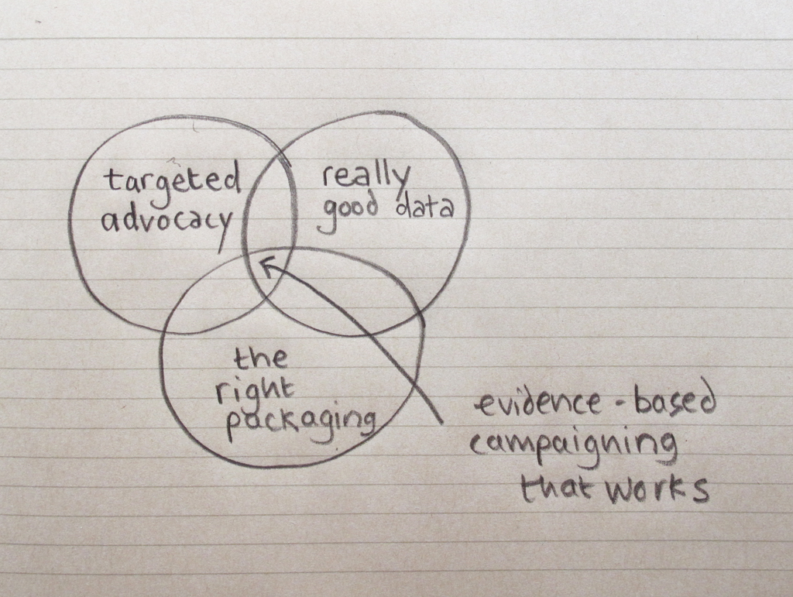
Notes:
2
2
10 tactics was produced by the international NGO, Tactical Technology Collective (Tactical Tech).
Tactical Tech is an international NGO which helps human, environmental and social rights advocates use information, communications and digital technologies to maximise the impact of their advocacy work. Tactical Tech has been working in countries where fundamental freedoms are most at risk for seven years. It has offices in the UK and India and has regional staff in South Africa, Jordan and the Philippines.
This diagram illustrates the focus of Tactical Tech's work: it is centred on bringing together targeted advocacy efforts, good information and data and then packaging and presenting information in an appealing way. This point where these three areas intersect is what Tactical Tech refers to as info-activism.

Slide 3
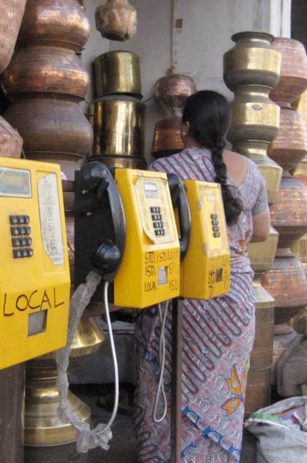

Notes:
3
3
Info-Activism is what happens when rights advocates turn information about their issue into action that will address it.
Within this concept we talk about both tools and tactics.
Tactics are the approaches that are used to strategically address a goal.
Tools are a media vehicle – they are what you use to implement your tactics.
10 tactics, the film you are about to watch, is focused on how you use specific tools and tactics in a strategic way to achieve your goals.
3

Slide 4






toolkits & guides
Notes:
4
4
This is not the first set of support materials Tactical Tech have produced for rights advocates.
Tactical Tech has produced many toolkits and guides over the years. All of them are designed with and for rights advocates and technologists. All of Tactical Tech’s toolkits come with Free and Open Source Software to ensure advocates have access to tools to carry out info-activism.
Tactical Tech's toolkits and guides are all licensed with Creative Commons licenses to ensure they can be easily adapted, re-mixed and translated to meet different needs.

Slide 5
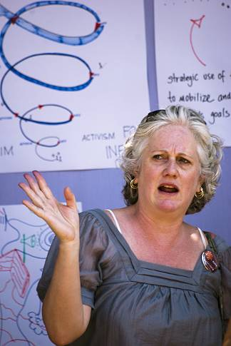
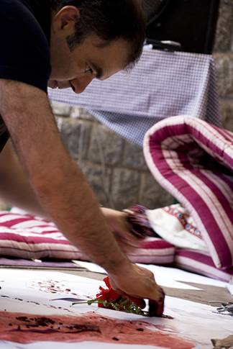
events which bring together rights advocates, technologists, designers
Notes:
5
5
The other key thing that Tactical Tech does is attend and organise large-scale training events for rights advocates.
In 2009 Tactical Tech organised its first Info-activism Camp held in Bangalore India. This followed on from many successful ‘Source Camp’ events held around the world.
The camp was an intensive seven day hands-on workshop that brought together 130 advocates, technologists and designers from 35 countries, at a remote retreat style venue outside of Bangalore, India. The event aimed to enable advocates to creatively implement digital advocacy tactics by connecting them with others facing similar challenges, showcasing examples of successful tactics, helping them find the right solutions to meet their needs and giving them the necessary skills to implement ideas.
The 10 tactics project evolved out of this camp. Co-founder of Tactical Tech, Stephanie Hankey, says “we knew all the participants had really interesting stories to tell about how they had turned information into action using digital technologies. So we decided to document and explore people's stories throughout the camp. When we had finished we knew that what we had collected was pretty remarkable.” These stories from the camp have provided most of the content for the cards and video stories in 10 tactics.
5

Slide 6
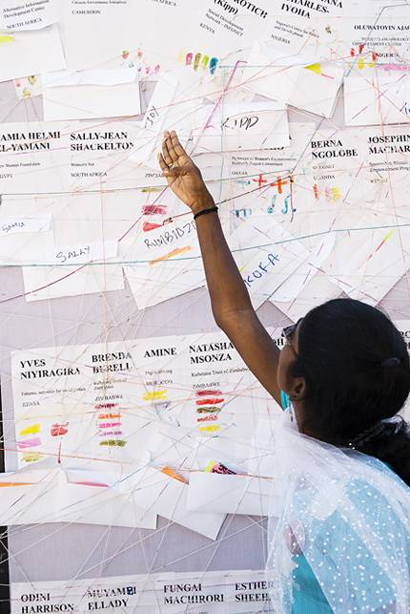
support info-activism networks
Notes:
6
6
Finally, Tactical Tech aim to support networks that can help rights advocates use information and communication technologies for social change. That is why they are supporting screenings of 10 tactics. The hope here is that these screenings will enable new conversations about info-activism and this will establish new and grow existing networks that support info-activism whether at local, regional or global levels.
6

