Slide 1
Lab. 2 (May 2nd)
Modify the multithreaded JAVA code we practiced in Lab. 1 to C code with pthread library.
Pthread library works in UNIX environment.
Use cygwin for programming
You may use Text editor : nano or vim
Compiling “> gcc ex1.c” will generate a.exe
Execute : “> ./a.exe”

Slide 2
Exercise 1 : ex1.java
Modify following JAVA code ex1.java to C code with pthread library for Thread Creation and Execution
class C extends Thread {
int i;
C(int i) { this.i = i; }
public void run() {
System.out.println("Thread " + i + " says hi");
System.out.println("Thread " + i + " says bye");
}
}
class ex1 {
public static void main(String[] args) {
System.out.println("main thread start!");
for(int i=1; i <= 5; ++i) {
C c = new C(i);
c.start();
}
System.out.println("main thread end!");
}
}

Slide 3
Exercise 1 : lab2_ex1.c
Sample C code with pthread library
#include <pthread.h>
#include <stdio.h>
void *c(void* i) {
printf("Thread %d says hi\n",i);
printf("Thread %d says bye\n",i);
}
int main (int argc, char *argv[]) {
pthread_t threads[20];
int rc, t;
printf("main thread start\n");
for(t=1; t<=20; t++){
rc = pthread_create(&threads[t], NULL, c, (void *)t);
if (rc) {
printf("ERROR code is %d\n", rc);
exit(-1);
}
}
printf("main thread end\n");
pthread_exit(NULL);
}

Slide 4
Exercise 2 : parallel summation
Modify following multithreaded JAVA code ex2.java to C code with pthread library
class SumThread extends Thread {
int lo, hi; // fields for communicating inputs
int[] arr;
int ans = 0; // for communicating result
SumThread(int[] a, int l, int h) {
lo=l; hi=h; arr=a;
}
public void run() {
// insert your code here
}
}
class ex2 {
private static final int NUM_END = 10000;
private static final int NUM_THREAD = 4; // assume NUM_END is divisible by NUM_THREAD
public static void main(String[] args) {
int[] int_arr = new int [NUM_END];
int i,s;
for (i=0;i<NUM_END;i++) int_arr[i]=i+1;
s=sum(int_arr);
System.out.println("sum=" + s) ;
}
static int sum(int[] arr) {
// insert your code here
}
}

Slide 5
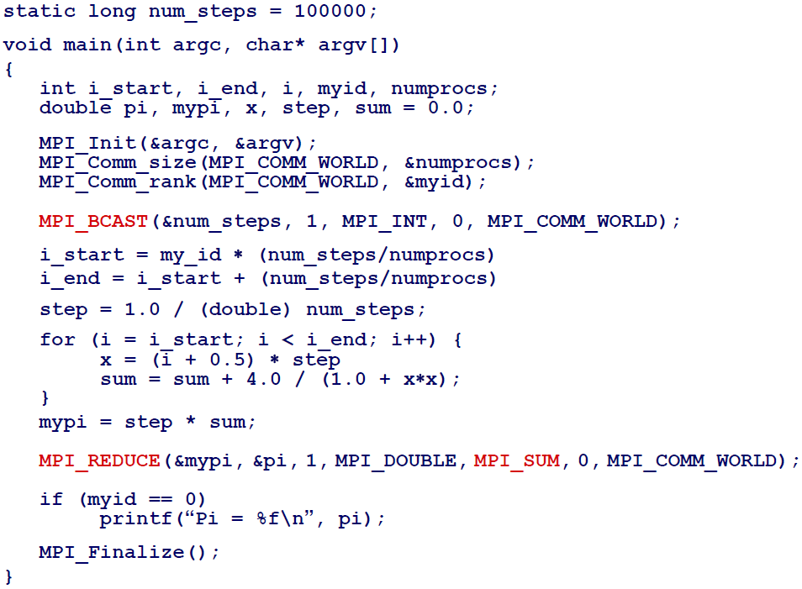
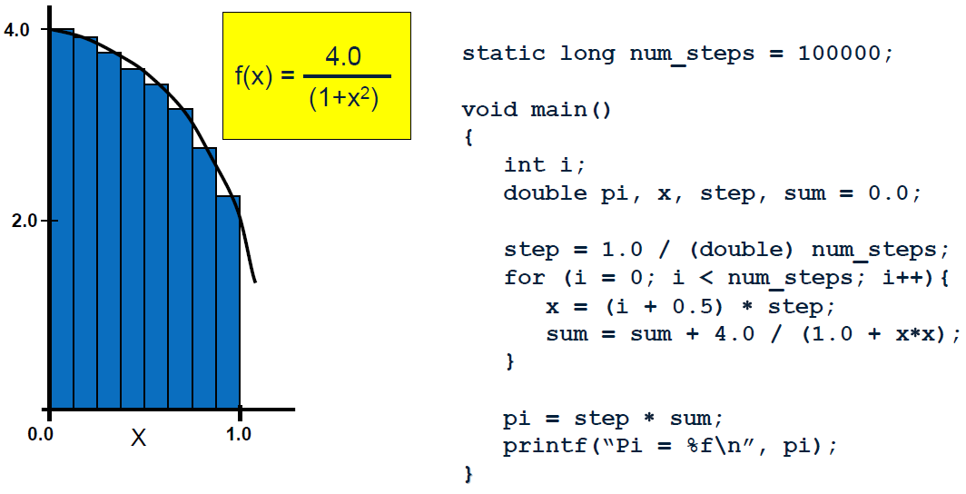
Exercise 3 : parallel integration
Modify your multithreaded JAVA code ex3.java to C code with pthread library

Slide 6
Exercise 4 : Prime numbers
Modify your multithreaded JAVA code ex4.java to C code with pthread library
class ex4_serial {
private static final int NUM_END = 100000;
public static void main(String[] args) {
int counter=0;
int i;
long startTime = System.currentTimeMillis();
for (i=0;i<NUM_END;i++) {
if (isPrime(i)) counter++;
}
long endTime = System.currentTimeMillis();
long timeDiff = endTime - startTime;
System.out.println("Execution Time : "+timeDiff+"ms");
System.out.println("1..."+(NUM_END-1)+" prime# counter=" + counter +"\n");
}
private static boolean isPrime(int x) {
int i;
if (x<=1) return false;
for (i=2;i<x;i++) {
if ((x%i == 0) && (i!=x)) return false;
}
return true;
}
}

Slide 7
Exercise 5 : Garage Parking Simulation
Modify multithreaded JAVA code (lecture4-1) to C code with pthread library
The actual state of a parking garage is defined by the number of free parking places.
Cars are modelled by thread whereby a car can enter or leave the parking garage
each of these methods changes the actual state of the garage:
  When a car enters, the number of free places is decremented; leaving implies incrementing the free places.
  The number of free places can not be decremented, if the parking garage has become full (free places == 0)
  A parking garage can simultaneously be used by more than one car (each changing the state), therefore methods enter() and leave() have to be marked as synchronized.

Slide 8
Example Java Code
class ParkingGarage {
private int places;
public ParkingGarage(int places) {
if (places < 0)
places = 0;
this.places = places;
}
public synchronized void enter() { // enter parking garage
while (places == 0) {
try {
wait();
} catch (InterruptedException e) {}
}
places--;
}
public synchronized void leave() { // leave parking garage
places++;
notify();
}
}

Slide 9
Example : Garage Parking
class Car extends Thread {
private ParkingGarage parkingGarage;
public Car(String name, ParkingGarage p) {
super(name);
this.parkingGarage = p;
start();
}
public void run() {
while (true) {
try {
sleep((int)(Math.random() * 10000)); // drive before parking
} catch (InterruptedException e) {}
parkingGarage.enter();
System.out.println(getName()+": entered");
try {
sleep((int)(Math.random() * 20000)); // stay within the parking garage
} catch (InterruptedException e) {}
parkingGarage.leave();
System.out.println(getName()+": left");
}
}
}

Slide 10
Example : Garage Parking
public class ParkingGarageOperation {
public static void main(String[] args){
ParkingGarage parkingGarage = new ParkingGarage(10);
for (int i=1; i<= 40; i++) {
Car c = new Car("Car "+i, parkingGarage);
}
}
}

Slide 11
Example : Garage Parking
output
$ java ParkingGarageOperation
Car 38: entered
Car 21: entered
Car 12: entered
Car 22: entered
Car 23: left
Car 5: entered
Car 32: entered
Car 28: entered
Car 18: entered
Car 5: left
Car 37: entered
Car 22: left
Car 35: entered

