Slide 1

Portfolio Slide Deck
By Noe

Slide 2




Site Map
About
Index
Portfolio
Blog
Contact

Slide 3
Design
Simple and hopefully professional
Use of animaton and icons so it is not too boring
Layout
Use of CSS Grid
1 column design for the viewports of smart phones and tablets
Multi column layout for computer screens with nav and side bar moved from top and bottom to left and right
Two columns inside main for portfolio and blog posts

Slide 4
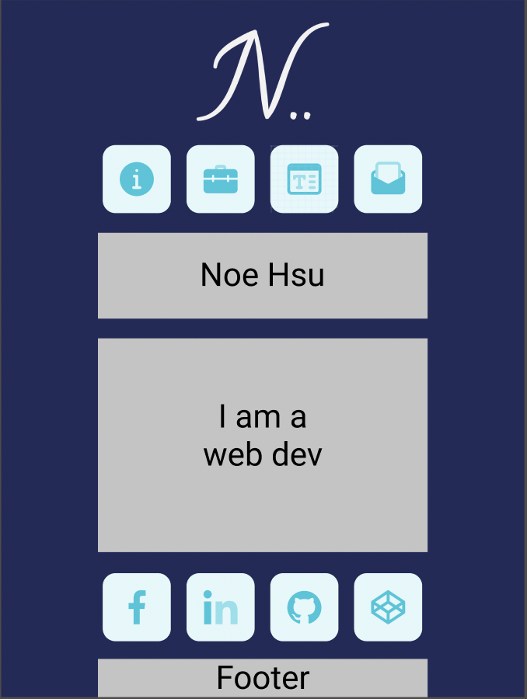
Components Used
Shared components:
Header – logo
Nav bar – links to other pages
Page title
Side bar – links to social media
Footer – copy right

Slide 5
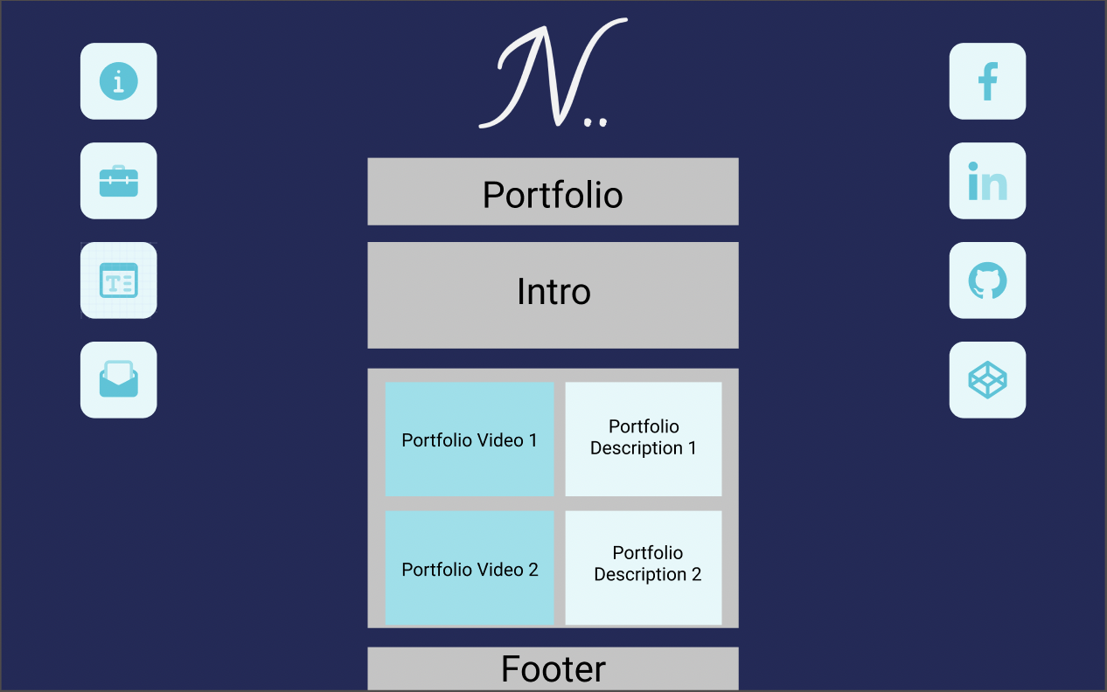
Components Used
Use of Grid to:
Break up <main> into sections of .intro and .main-content
Divs for each portfolio and blog post

Slide 6
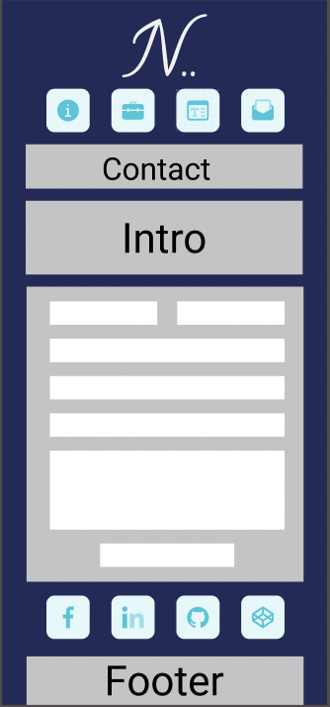
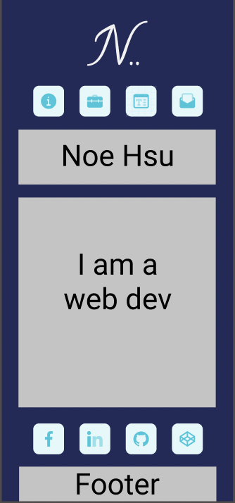
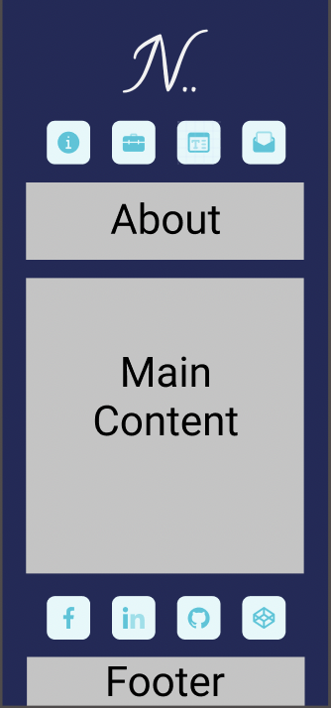
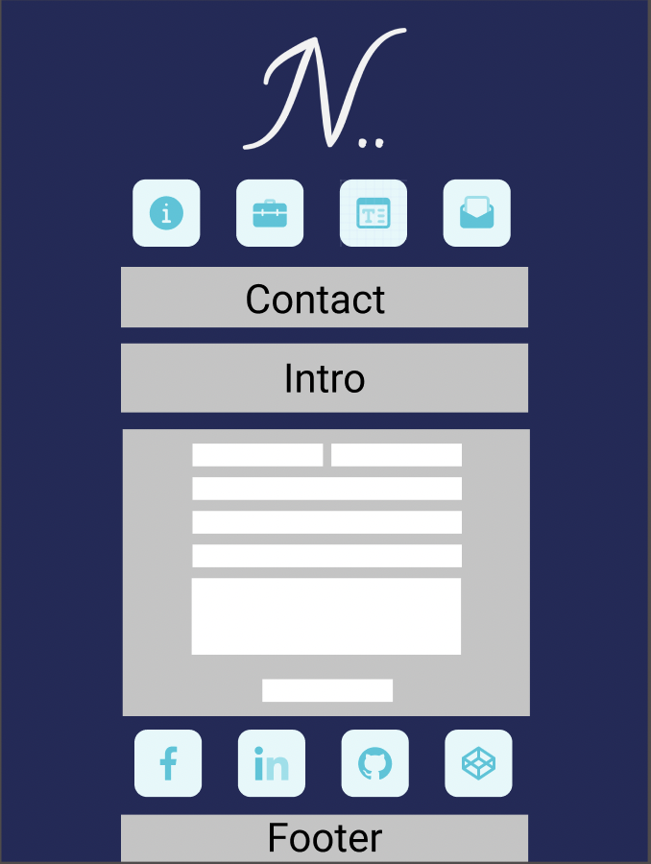
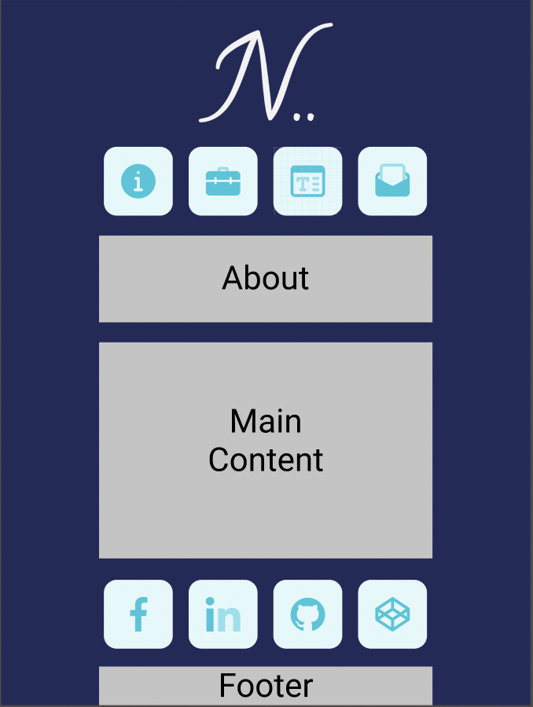
Wireframes @ lower than 1024px
Contact
Home
About

Slide 7
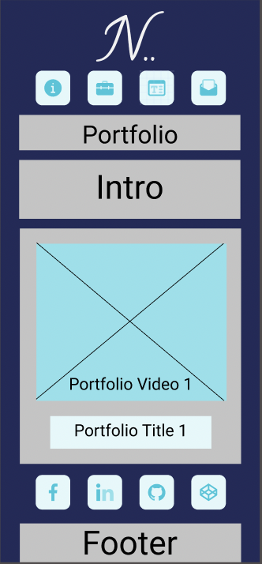
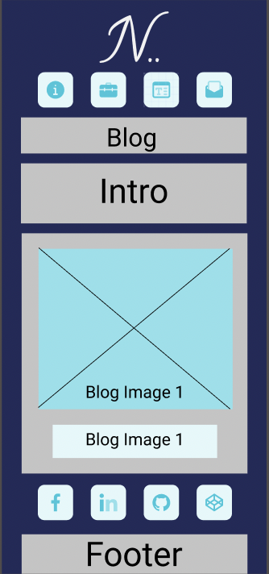
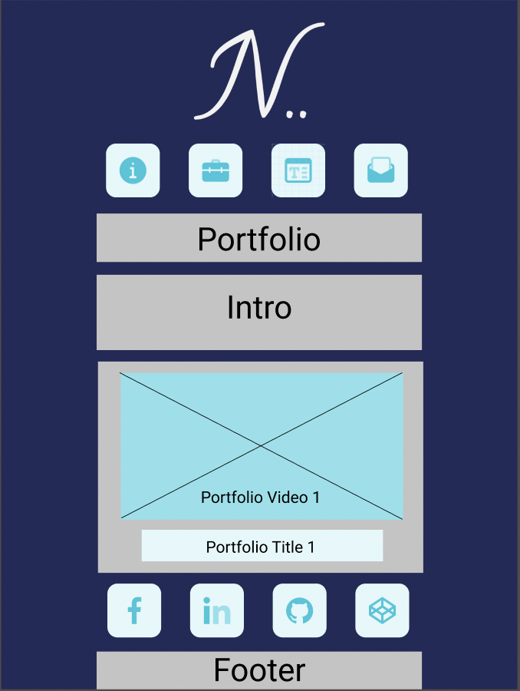

Wireframes @ lower than 1024px
Portfolio
Blog

Slide 8
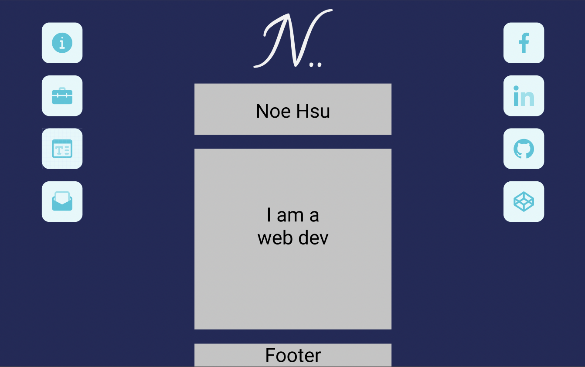
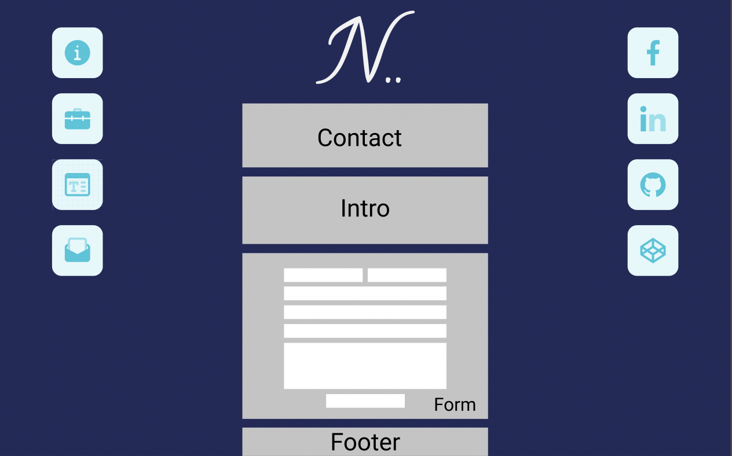
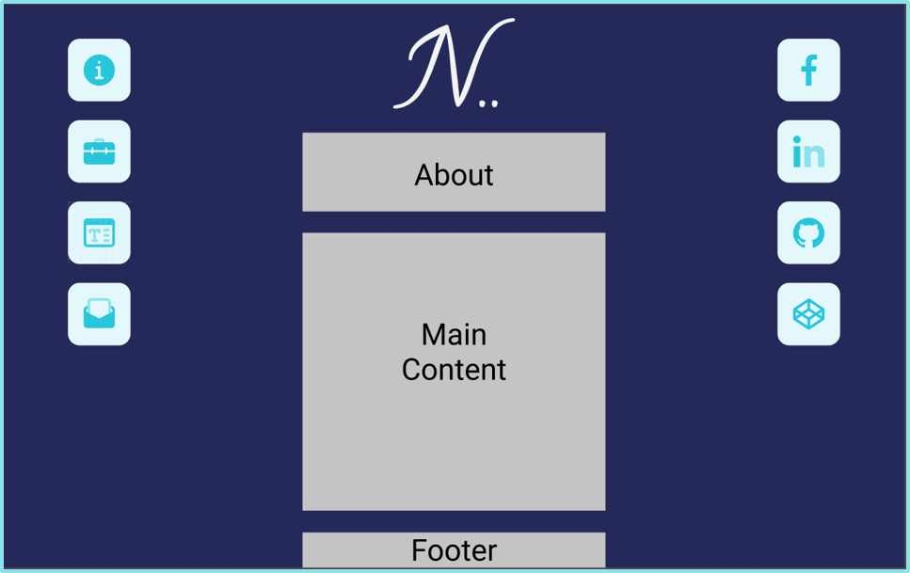
Wireframes @ 1024px or higher
Contact
Home
About

Slide 9
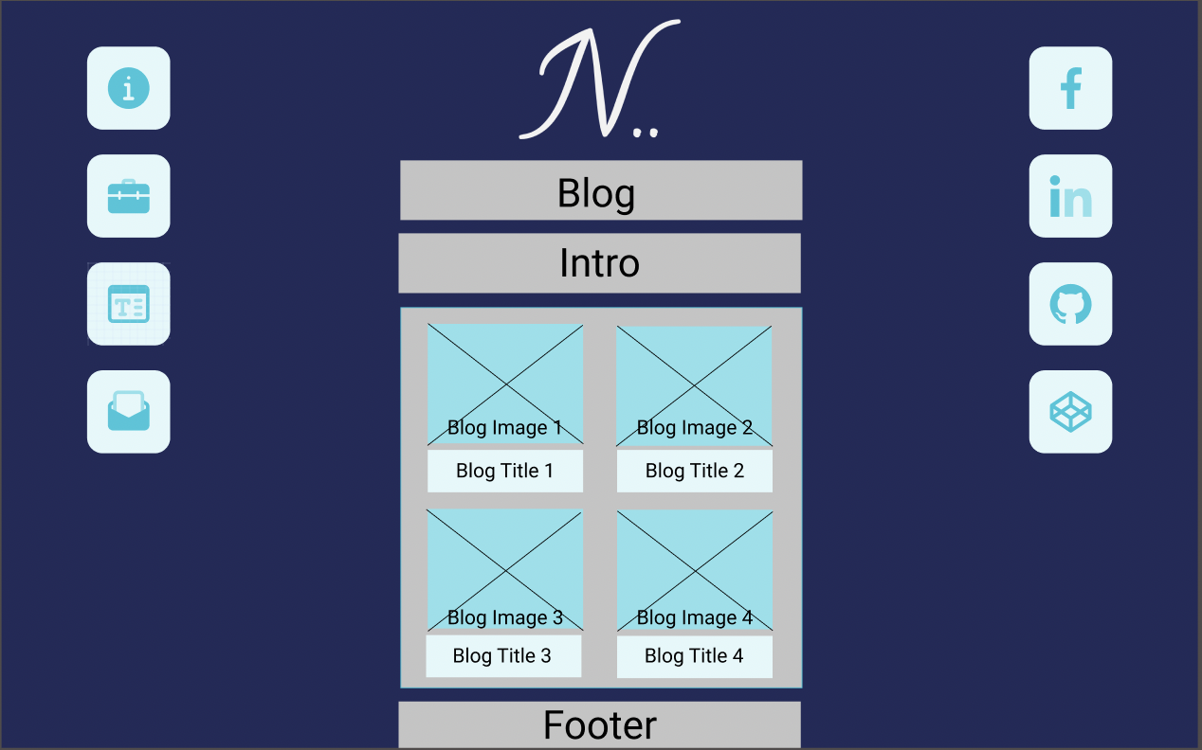
Wireframes @ 1024px or higher
Portfolio
Blog

Slide 10
Review
Challenges:
Layout
Clean CSS
Future updates:
Toggle between dark theme and light theme
More animation for a game-like experience
Favorite Parts:
Layout
Rainbow text

Slide 11
Thank you
By Noe

