Slide 1

Portfolio Slide Deck
By Noe

Slide 2
The Goal
For potential employers and partners to know me and want to work/connect with me.
Portfolio page to show my previous work
About and Blog page to show my details and interests
Contact page for them to email me
Links to my social media
Link to download my resume

Slide 3




Site Map
About
Index
Portfolio
Blog
Contact

Slide 4
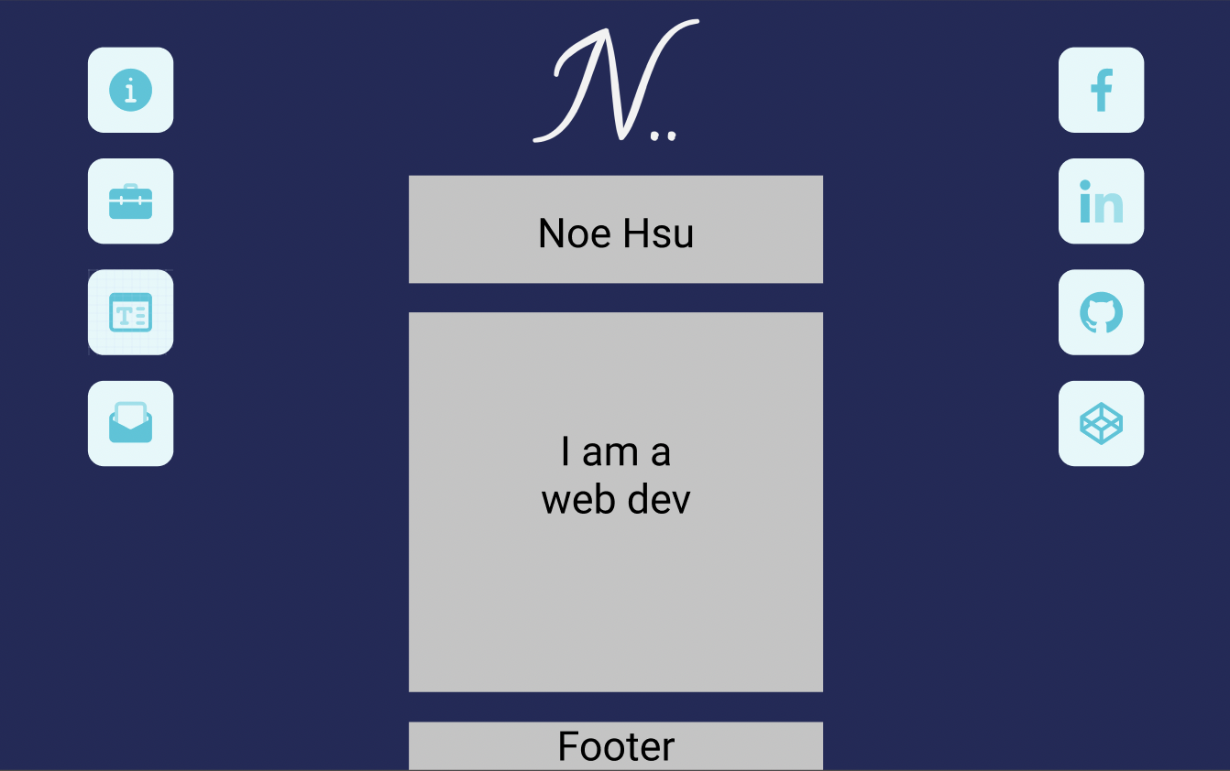
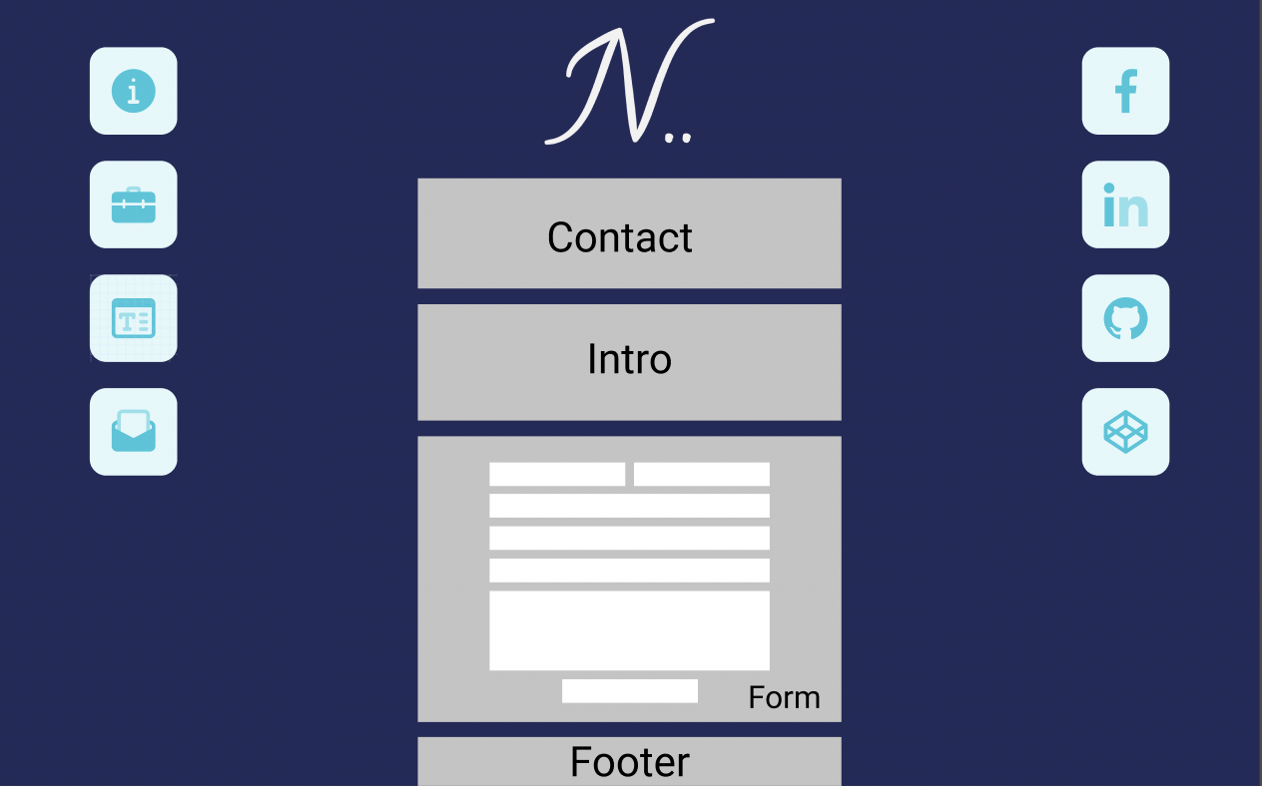
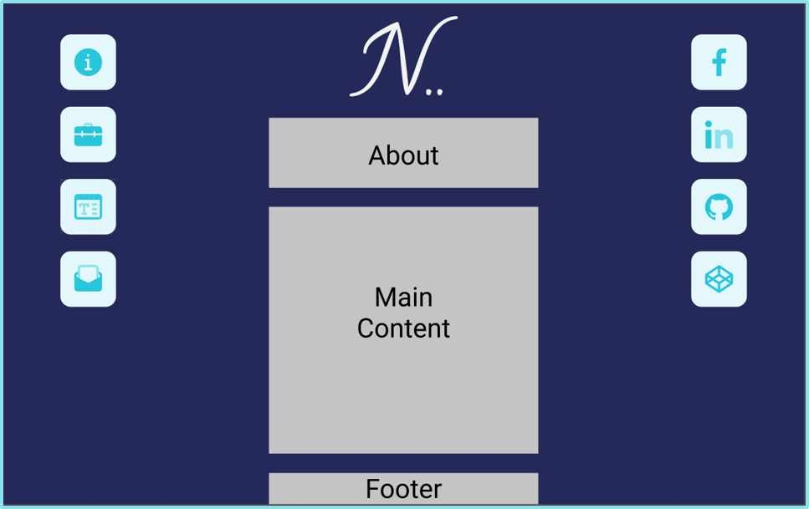
Wireframes @ 1024px or higher
Contact
Home
About

Slide 5
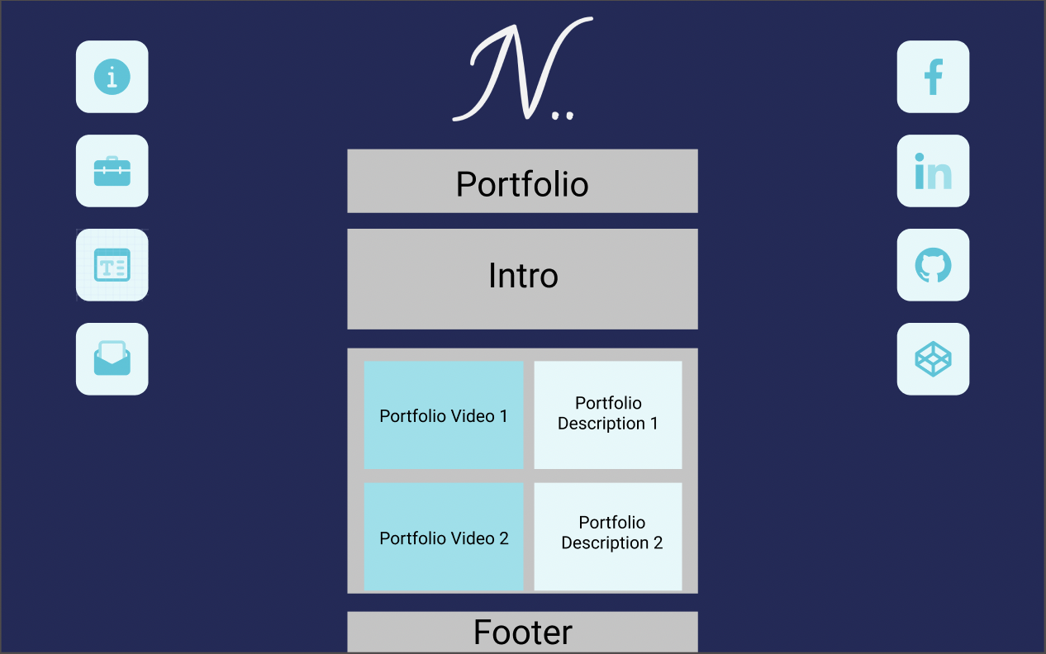
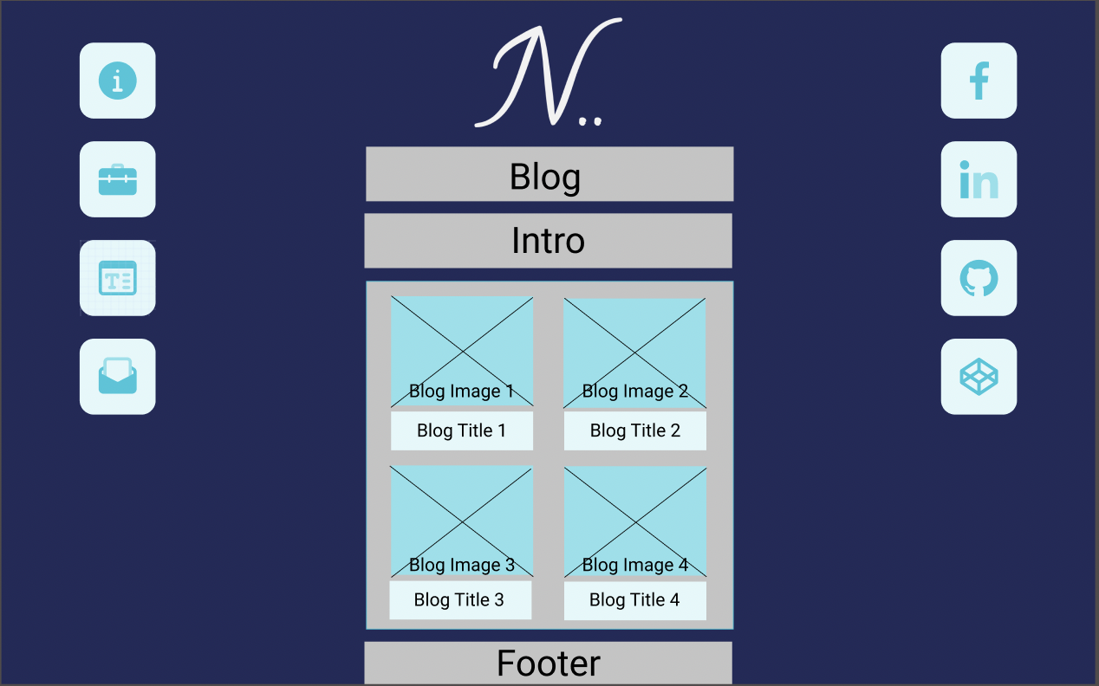
Wireframes @ 1024px or higher
Portfolio
Blog

Slide 6
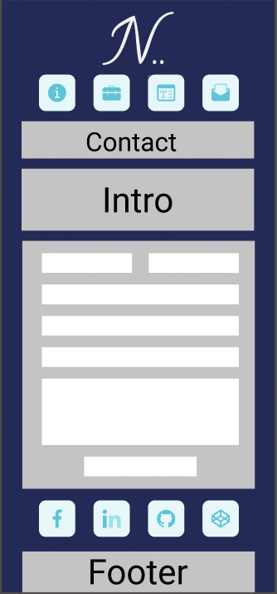
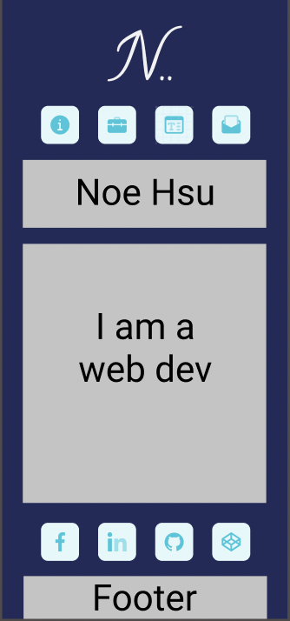
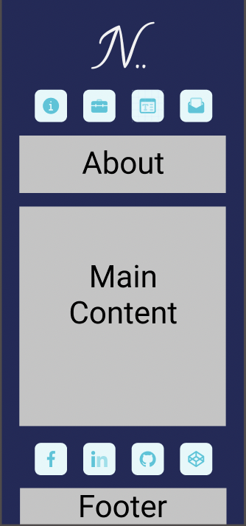
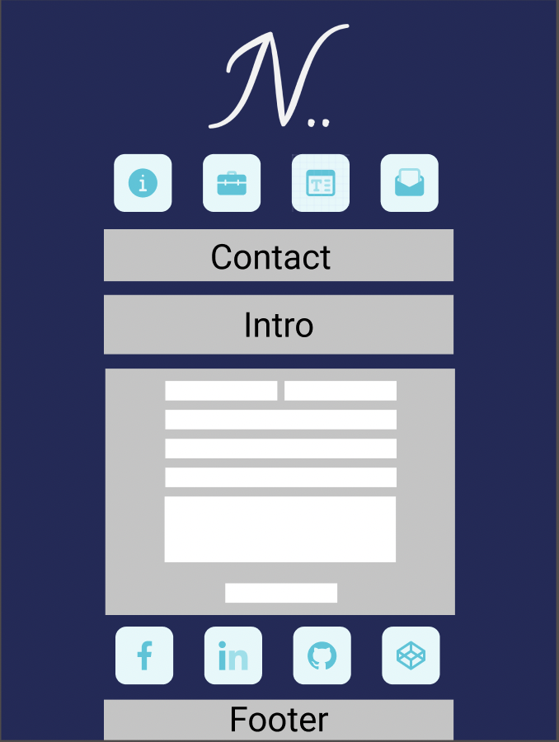
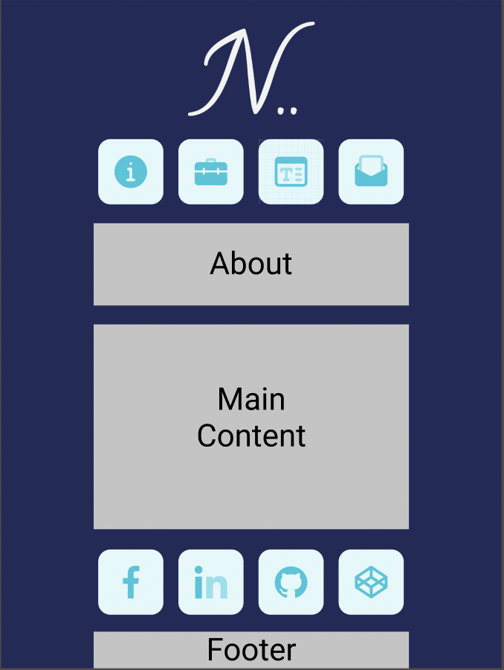
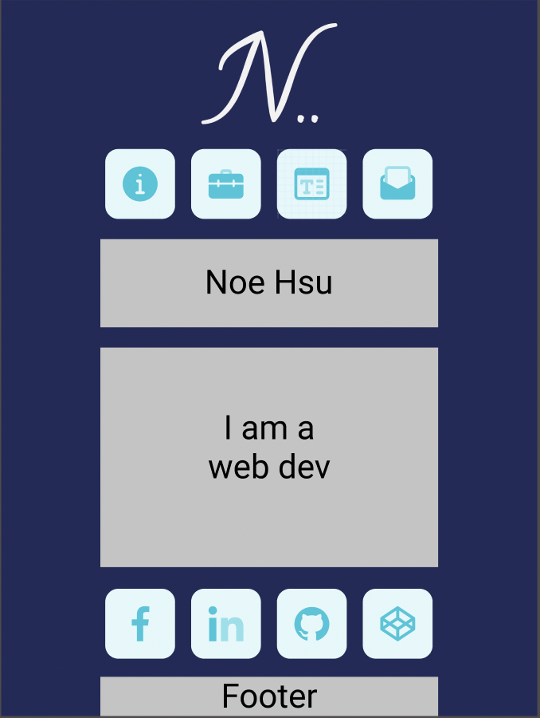
Wireframes @ lower than 1024px
Contact
Home
About

Slide 7
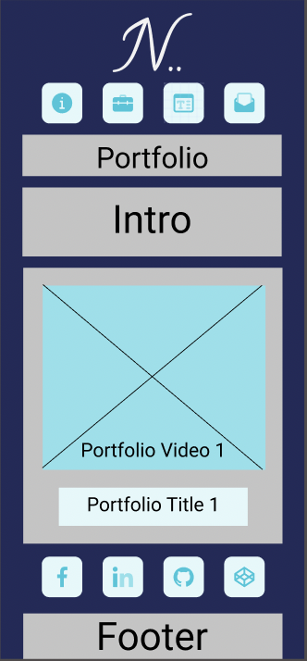
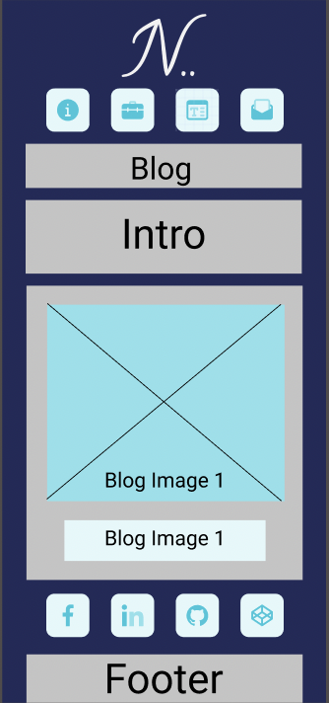
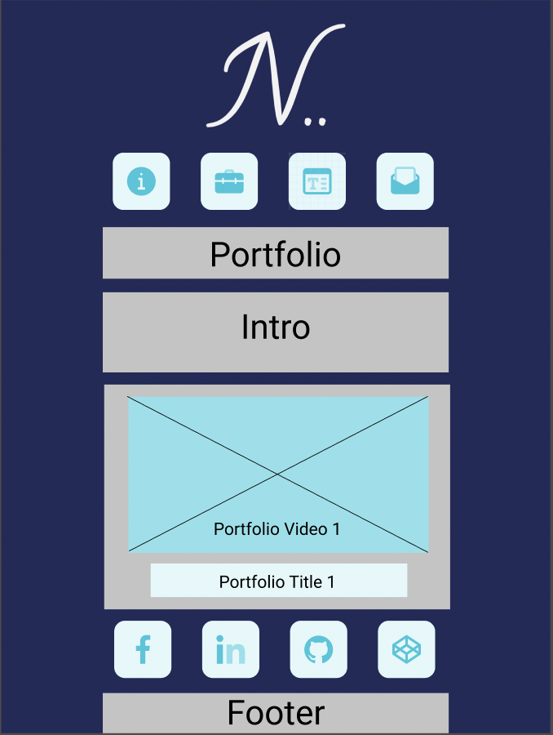

Wireframes @ lower than 1024px
Portfolio
Blog

Slide 8
Design
Simple and hopefully professional
Use of animaton and icons so it is not too boring
Layout
Use of CSS Grid
1 column design for the viewports of smart phones and tablets
Multi column layout for computer screens with nav and side bar moved from top and bottom to left and right
Two columns inside main for portfolio and blog posts

Slide 9
Components Used
<figure>
<img>
<figcaption>
<video>
<form>
<label>
<input>
<textarea>
<button>
<h1>
<h2>
<h3>
<p>
<a>
<section>
<div>
<span>
<header>
<nav>
<main>
<aside>
<footer>

Slide 10
Review
Challenges:
Layout
Clean CSS
Favorite Parts:
Layout
Rainbow text

