Slide 1
Student management system

Slide 2

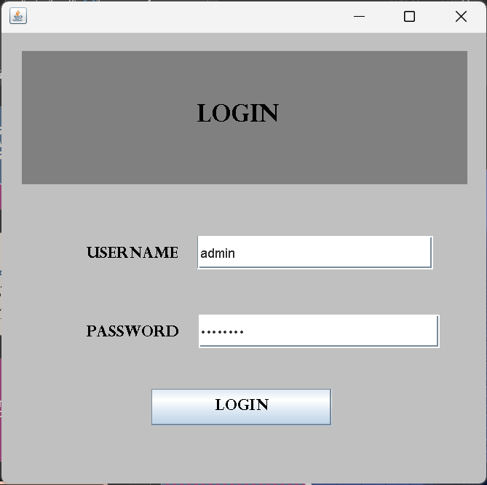
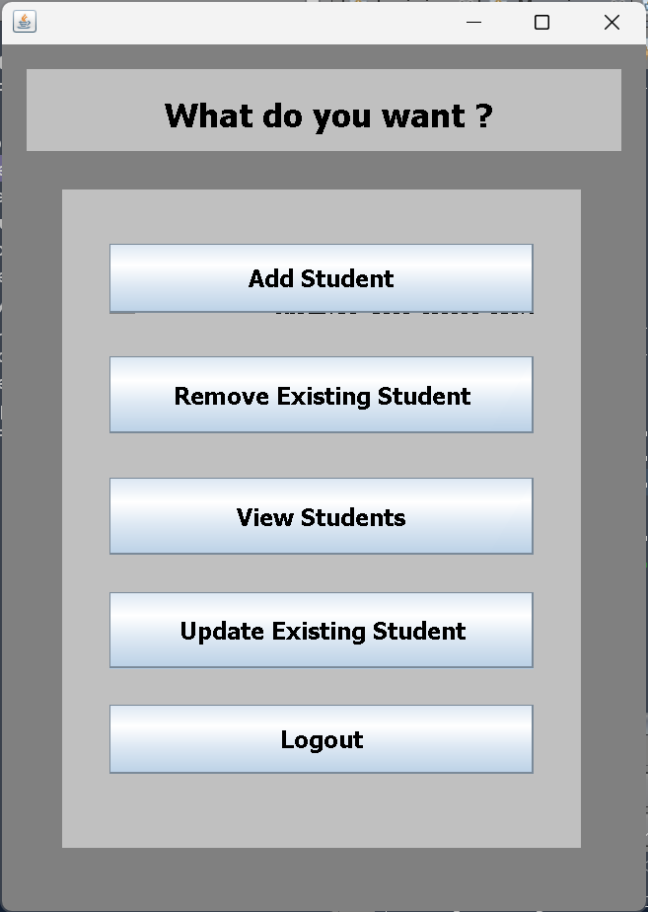
This Java code is a simple Swing GUI application for entering and submitting student details to a MySQL database. It includes basic form validation and a "Cancel" button that opens a menu window.

Slide 3
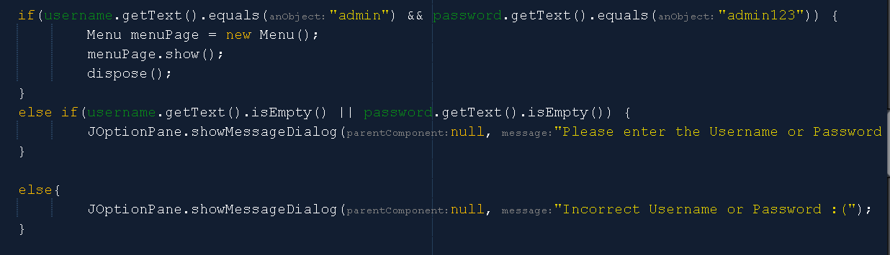
Menu class
This Java code creates a Swing GUI menu for a student management system. It features buttons for adding, removing, viewing, and updating student details, along with a logout option. Each button opens a corresponding window, and the logout button redirects to a login window. The GUI layout is structured using `JDesktopPane`.
Authentication for the admin user:

Slide 4
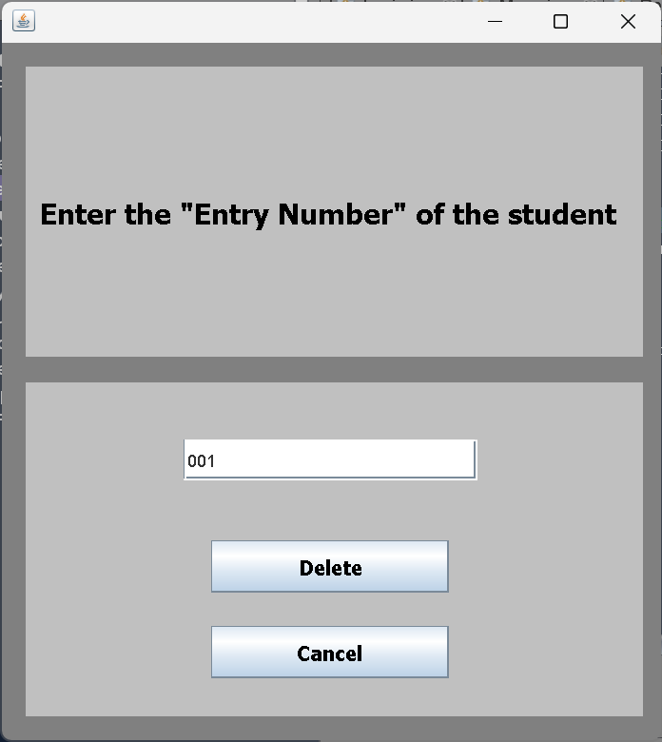
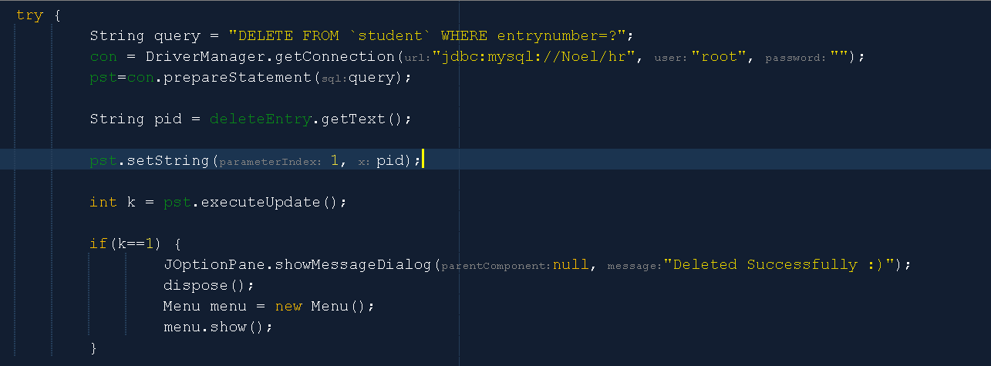
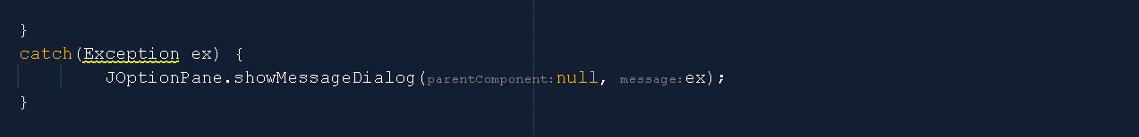
REMOVE STUDENT CLASS
This Java code is a Swing application for removing a student entry from a MySQL database. It features a GUI with input fields for the student's entry number and buttons for deleting the entry or canceling the operation. The code establishes a database connection using JDBC, and upon pressing "Delete," it executes a SQL query to remove the specified student entry. Success triggers a message, and the main menu is displayed using the Menu class. The "Cancel" button returns the user to the main menu without deletion. Overall, it's a concise program for managing student records interactively.

Slide 5
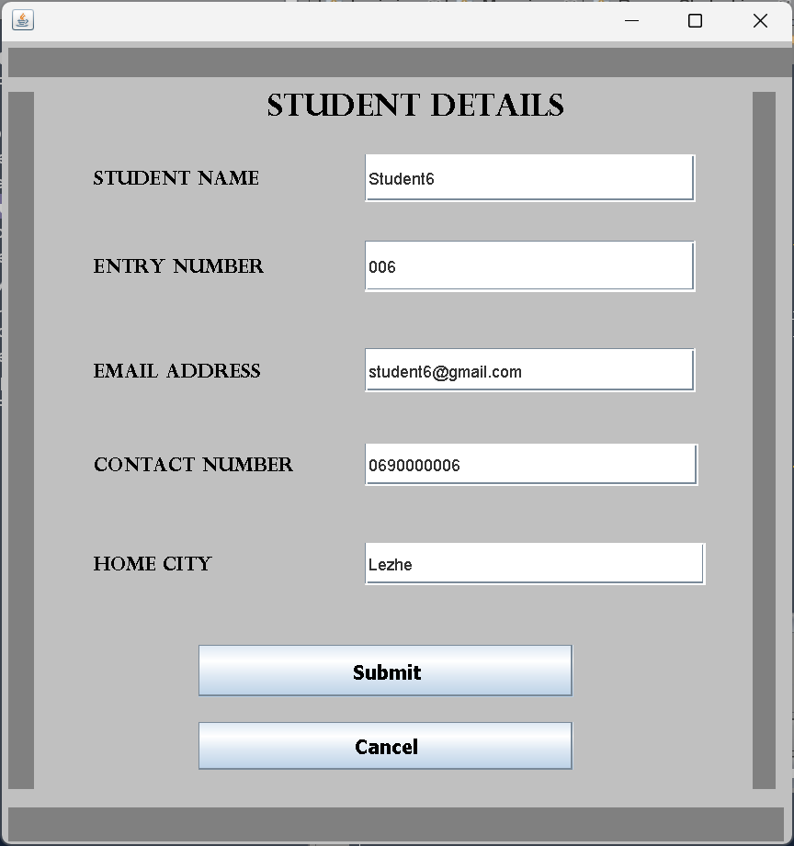
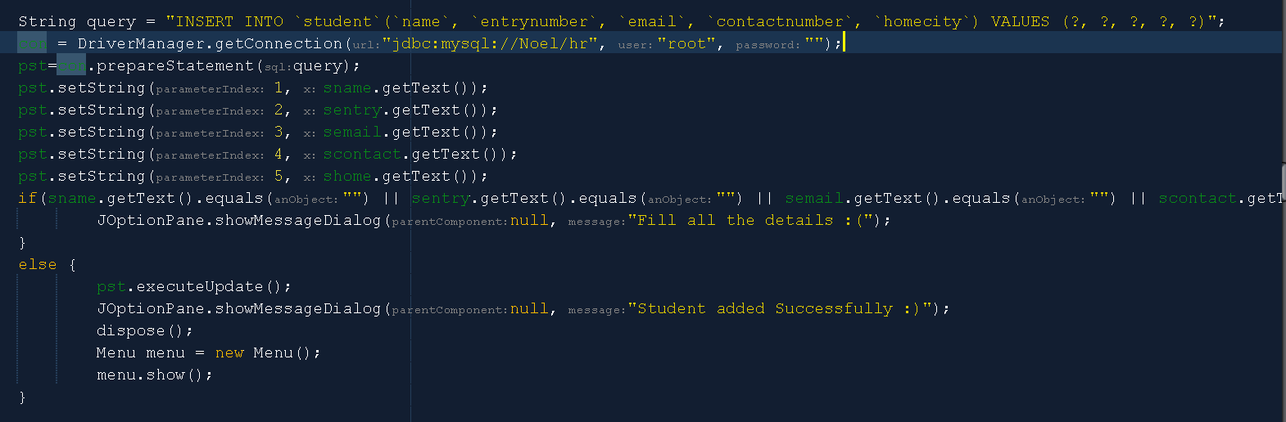
Student class
This Java code is a Swing GUI application for entering student details into a MySQL database. It includes text fields for name, entry number, email, contact number, and home city. The "Submit" button triggers an action to validate and insert the data into the database. If successful, a success message is shown, and the application redirects to the main menu. The code employs GroupLayout for component layout and JDesktopPane for background color settings.

Slide 6
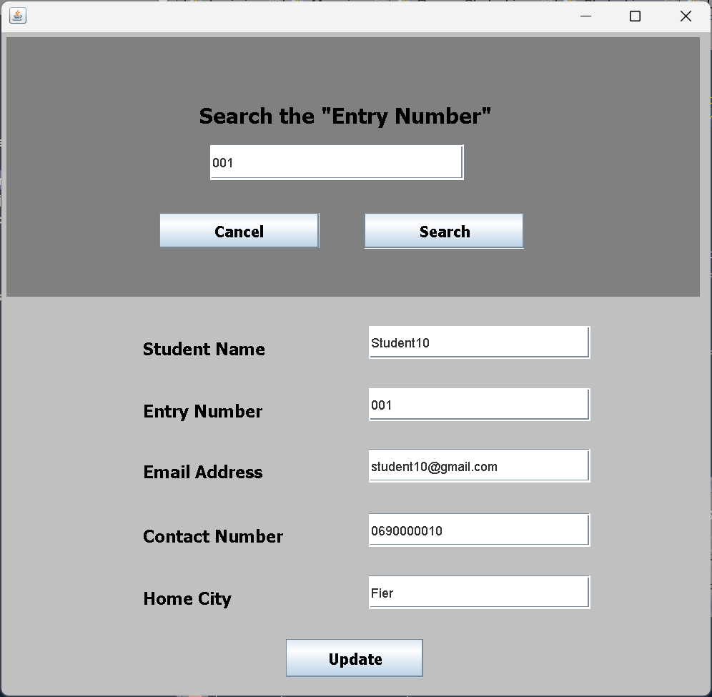
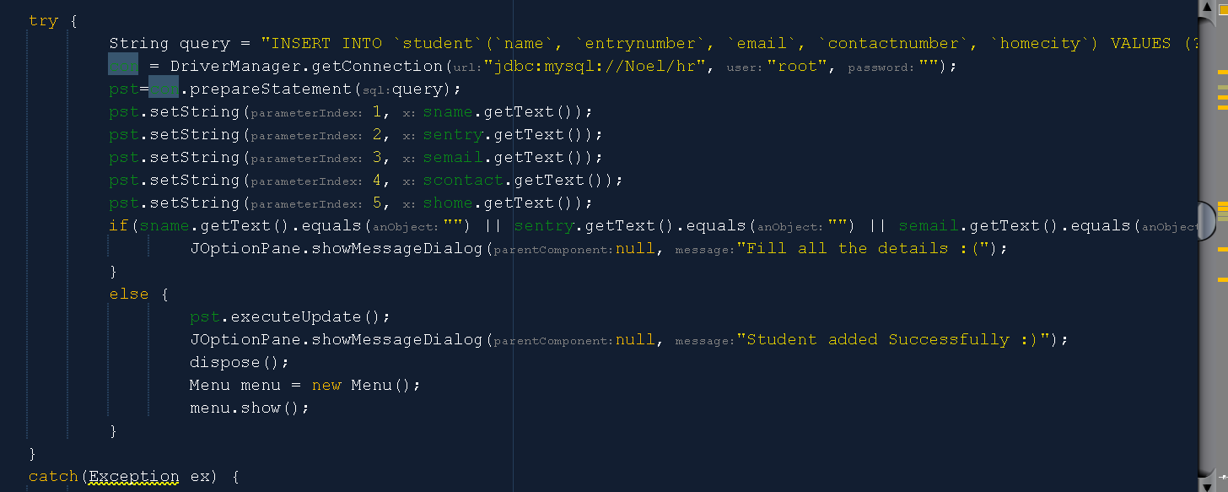
Update class
This Java code is a Swing GUI application for entering student details into a MySQL database. It features fields for student name, entry number, email, contact number, and home city. The "Submit" button triggers an action to validate and insert the data into the database. If successful, a success message is shown, and the application redirects to the main menu. The code employs GroupLayout for component layout and JDesktopPane for background color settings.

Slide 7
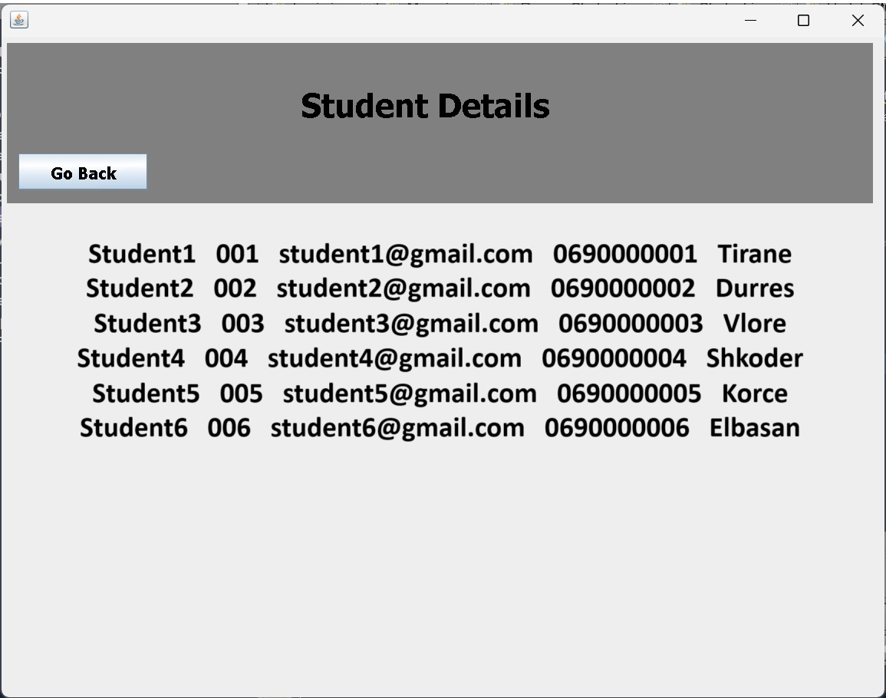
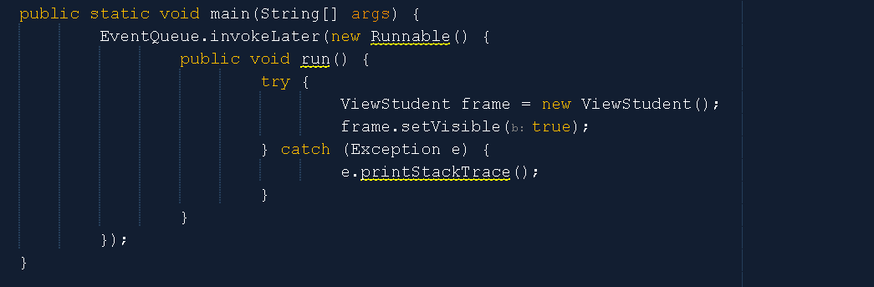
View the list
This Java code represents a simple Swing GUI application named `ViewStudent`. It includes a JFrame with a JDesktopPane as its content pane. The application displays a label "Student Details" with a specific font and size. Additionally, there's a "Go Back" button that, when clicked, instantiates and displays a `Menu` window while closing the current window. The design is minimal, focusing on navigating back to the main menu.

Slide 8
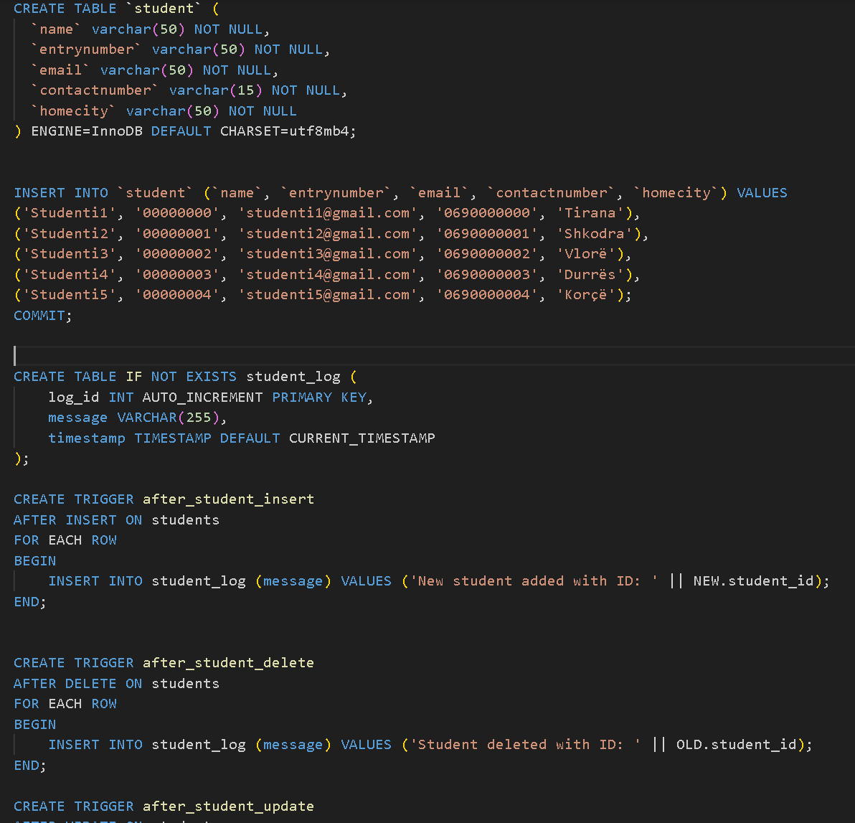
DAtabase
- Insert Trigger: This trigger would be executed when a new record is inserted into the `student` table. It might perform actions such as logging the event, validating data, or updating other related tables.
- Delete Trigger: This trigger would be executed when a record is deleted from the `student` table. It might involve actions like removing associated data from other tables, updating logs, or sending notifications.
- Update Trigger: This trigger would be executed when an existing record is modified in the `student` table. It could involve actions such as checking for data consistency, updating timestamps, or triggering additional business logic.
or assistance!

Slide 9
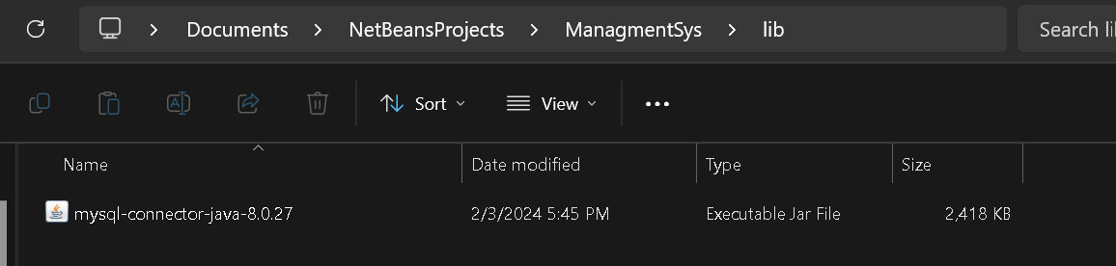
Connection to the database
String url = "jdbc:mysql://Noel:3306/hr";
String username = “hr";
String password = “hrhr";
Connection connection = DriverManager.getConnection(url, username, password);
MySQL Connector/J Driver:
The MySQL Connector/J is a JDBC driver for MySQL databases.
It provides a Java-based interface to interact with MySQL databases.
It handles the communication between your Java application and the MySQL database server.
Port 3306 is the default port used by MySQL database servers. When connecting a Java project to a MySQL database, you typically need to provide the following information:

