Slide 1
Project

Slide 2
This project is a Management System developed to streamline operations. It focuses on user authentication, CRUD operations, and profile management.
Technologies used:
- PHP
- HTML
- CSS

Slide 3
The use case diagram outlines the interactions between users and the system. Key actors include the admin and end-users, each performing specific roles.

Slide 4
Sequence diagrams illustrate the processes for CRUD operations and user authentication, detailing system responses and workflows.

Slide 5
Key features of the system include:
- User Login and Registration
- Password Reset Functionality
- CRUD Operations for Management
- Secure Logout Process

Slide 6
The system is built using PHP and follows a modular structure:
- login.php: Handles user authentication.
- register.php: Manages new user registrations.
- reset-password.php: Implements password reset functionality.
- CRUD operations are distributed across other scripts.

Slide 7
This Management System is designed for efficiency and security. Future improvements could include:
- Enhanced UI/UX design
- Additional role-based access controls
- Integration with external APIs for scalability.

Slide 8
This project focuses on user authentication, CRUD operations, and profile management. It implements secure PHP practices and ensures a smooth user experience.

Slide 9
1. The user enters credentials.
2. The system verifies credentials against the database.
3. On success, a session is created for the user.
4. On failure, an error message is displayed.

Slide 10
Example:
if (password_verify($inputPassword, $storedPassword)) {
$_SESSION['user'] = $username;
header('Location: dashboard.php');
} else {
echo 'Invalid credentials';
}

Slide 11
1. The user provides registration details.
2. The system validates input and checks for duplicates.
3. On success, stores hashed password and details in the database.

Slide 12
Example:
$hashedPassword = password_hash($password, PASSWORD_DEFAULT);
$query = 'INSERT INTO users (username, password) VALUES (?, ?)';
mysqli_stmt_execute($stmt);

Slide 13
1. Create: Add new records.
2. Read: Retrieve and display records.
3. Update: Modify existing records.
4. Delete: Remove records.

Slide 14
Example:
CREATE:
$query = 'INSERT INTO items (name, value) VALUES (?, ?)';
READ:
$query = 'SELECT * FROM items';
UPDATE:
$query = 'UPDATE items SET value = ? WHERE id = ?';
DELETE:
$query = 'DELETE FROM items WHERE id = ?';

Slide 15
This system ensures secure and efficient management of user data. Future improvements can include role-based access and API integrations.

Slide 16
This project is a comprehensive management system that facilitates user authentication, CRUD operations, and profile management.
Key Objectives:
- Secure user authentication
- Efficient data management
- User-friendly interface.

Slide 17
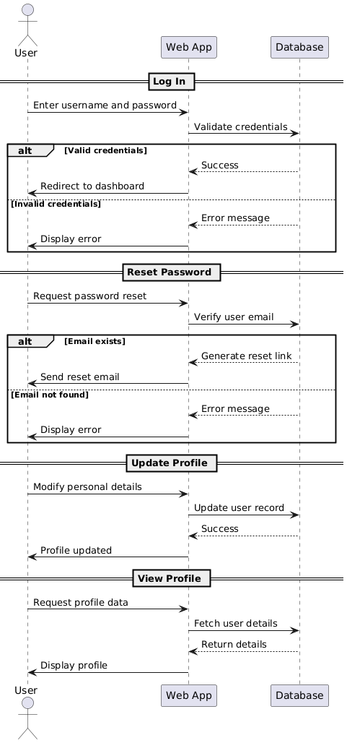
Use Case Diagram

Slide 18
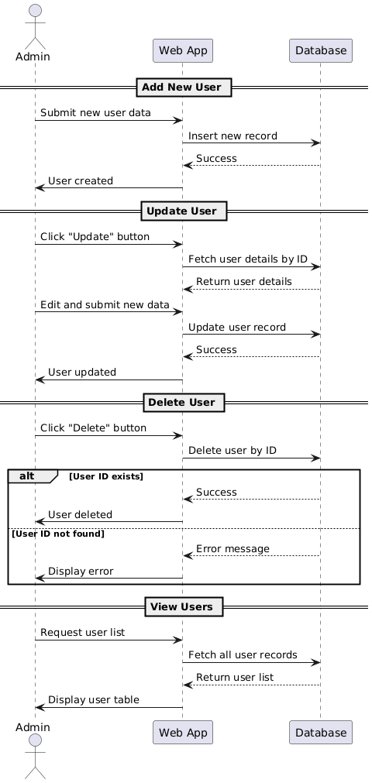
Sequence Diagram

