Slide 1
CHAPTER FOUR
Internet of Things
Mulugeta G..

Slide 2
Contents
Definition of the term IOT
History of IOT
Advantage and disadvantage of IOT
Explain how IOT works
Architecture of IOT
Application areas of IOT

Slide 3
Overview of Internet of Things
The most important features of internet of things (IoT) include:
Artificial intelligence
Connectivity
Sensors
Active engagement and
Small device
Notes:
Technological evolution is a theory of radical
transformation of society through technological development.

Slide 4
Overview of Internet of Things
Artificial intelligence
IoT makes anything virtually “smart”, meaning it enhances every aspect of life with the power of data collection, artificial intelligence algorithms, and networks
Connectivity
new enabling technologies for networking and specially IOT networking , mean networks are no longer exclusively tied to major provides therefore IOT creates these small networks between its system devices.
Sensors
IOT loses its distinction without sensors
They act as defining instruments that transform from standard passive network of device in to an active system cabling of real world integration.
Notes:
Technological evolution is a theory of radical
transformation of society through technological development.

Slide 5
Overview of Internet of Things
Active engagement
IOT introduce a new paradigm for active content , product ,or service engagement rather than passive engagement.
Small device
Those devices has become smaller, cheaper and more powerful over time so IOT exploits purpose built small devices to deliver its precision, scalability, and versatility.
Notes:
Technological evolution is a theory of radical
transformation of society through technological development.

Slide 6
Definitions of IOT
Several groups defined IOT using different definitions
1. According to the internet architecture boards definition :-
IOT is networking of smart objects, means a huge number of devices intelligently communicating in the presence of internet protocol that cannot be directly operated by human beings but exist as components in building vehicles or the environment.
2. According to the internet engineering task force (IETF) organizations
IOT is the networking of smart objects in which smart objects have some constraints such as limited bandwidth ,power, and processing accessibility for achieving interoperability among smart objects.

Slide 7
Definitions of IOT
3. According to the IEEE communications category magazines definition:-
IOT is framework of all things that have a representation of the presence of the internet in such a way that new applications and services enable the interaction in the physical and virtual world in the form of machine to machine (M2M)communication in the cloud.
4. According to the oxfords definition
IOT is the interaction of everyday objects computing devices through the internet that enables the sending and receiving of useful data.
The term Internet of things defines according to the 2020 conceptual frame work is expressed through simple formula such as:-
IOT=services + data +networks + sensors

Slide 8
Definitions of IOT
Generally, IOT is the network of physical objects or “things” embedded with electronics , software and network connectivity , which enables these to collect and exchange data.
Is also a system of interrelated computing devices, mechanical and digital machines, objects, animals or people that are provided with unique identifiers and the ability to transfer data over a network without requiring human-to-human or human-to-computer interaction
IOT is a network of devices that can sense, accumulate and transfer data over the internet without any human intervention.

Slide 9
Definitions of IOT
Simply stated, the Internet of Things consists of any device with an on/off switch connected to the Internet including anything such as:-
Ranging from cellphones to building maintenance to the jet engine of an airplane
Medical devices, such as a heart monitor implant or a biochip transponder in a farm animal can transfer data over a network and are members of the IOT.
The IOT consists of a gigantic network of internet-connected “things” and devices.
E.g. Ring, a doorbell that links to your smartphone, provides an excellent example of a recent addition to the Internet of Things means Ring signals you when the doorbell is pressed and lets you see who it is and to speak with them.

Slide 10
Areas where IOT is applicable
In connected industry
In smart-city
In using smart-home
In smart-energy
In connected car
In the smart agriculture
In connected building and campus
In the health care
In Logistics and other domains

Slide 11
IOT systems allow users to achieve deeper automation, analysis, and integration within a system.
It also improve the reach of these areas and their accuracy.
IOT utilizes existing and emerging technology for sensing, networking, and robotics.
IOT exploits recent advances in software, falling hardware prices, and modern attitudes towards technology
Its new and advanced elements bring major changes in the delivery of products, goods, and services; and the social, economic, and political impact of those changes.

Slide 12
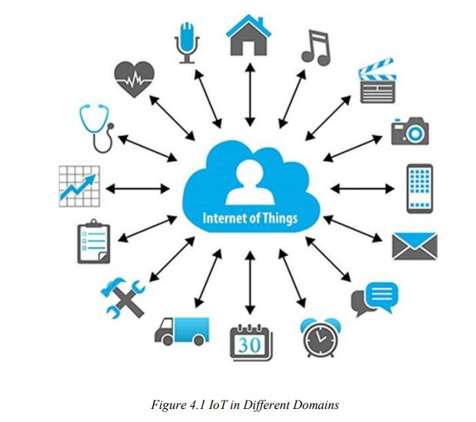

Slide 13
History of IOT
The Internet of Things has not been around for very long.
since the early 1800s there have been visions of machines communicating with one another.
In 1830s and 1840s Machines have been providing direct communications since the telegraph (the first landline) was developed.
In June 3, 1900, Described as “wireless telegraphy,” the first radio voice transmission took place, providing another necessary component for developing the Internet of Things.
In 1950s The development of computers began .
In 1962 The Internet, itself a significant component of the IOT, started out as part of DARPA (Defense Advanced Research Projects Agency).
In 1969 evolved into ARPANET.

Slide 14
History of IOT
The traditional fields of automation (including the automation of buildings and homes), wireless sensor networks, GPS, control systems, and others, all support the IoT.
Kevin Ashton, the Executive Director of Auto-ID Labs at MIT, was the first to describe the Internet of Things, during his 1999 speech.
Kevin Ashton stated that Radio Frequency Identification (RFID) was a prerequisite for the Internet of Things. He concluded if all devices were “tagged,” computers could manage, track, and inventory them.
To some extent, the tagging of things has been achieved through technologies such as digital watermarking, barcodes, and QR codes.

Slide 15
Advantages of IOT
Advantages of IoT span across every area of lifestyle and business Here is a list of some of the advantages that IoT has to offer:
Improved Customer Engagement − Current analytics suffer from blind-spots and significant flaws inaccuracy; and as noted, engagement remains passive. IoT completely transforms this to achieve richer and more effective engagement with audiences
Technology Optimization − The same technologies and data which improve the customer experience also improve device use, and aid in more potent improvements to technology. IoT unlocks a world of critical functional and field data.

Slide 16
Advantages of IOT
Reduced Waste − IoT makes areas of improvement clear. Current analytics give us superficial insight, but IoT provides real-world information leading to the more effective management of resources.
Enhanced Data Collection − Modern data collection suffers from its limitations and its design for passive use. IoT breaks it out of those spaces and places it exactly where humans really want to go to analyze our world. It allows an accurate picture of everything.

Slide 17
Disadvantage of IOT
As the number of connected devices increases and more information is shared between devices, the potential that a hacker could steal confidential information also increases.
If there’s a bug in the system, it’s likely that every connected device will become corrupted.
Since there’s no international standard of compatibility for IoT, it’s difficult for devices from different manufacturers to communicate with each other.
Enterprises may eventually have to deal with massive numbers maybe even millions of IoT devices and collecting and managing the data from all those devices will be challenging.

Slide 18
Challenges of IOT
Security − IoT creates an ecosystem of constantly connected devices communicating over networks. The system offers little control despite any security measures. This leaves users exposed to various kinds of attackers.
Privacy − The sophistication of IoT provides substantial personal data in extreme detail without the user's active participation.
Flexibility − Many are concerned about the flexibility of an IoT system to integrate easily with another. They worry about finding themselves with several conflicting or locking systems.

Slide 19
Challenges of IOT
Complexity − Some find IoT systems complicated in terms of design, deployment, and maintenance given their use of multiple technologies and a large set of new enabling technologies.
Compliance − IoT, like any other technology in the realm of business, must comply with regulations. Its complexity makes the issue of compliance seem incredibly challenging when many consider standard software compliance a battle.

Slide 20
How does it work
An IoT ecosystem consists of web-enabled smart devices that use embedded processors, sensors and communication hardware to collect, send and act on data they acquire from their environments.
IoT devices share the sensor data they collect by connecting to an IoT gateway or another edge device where data is either sent to the cloud to be analyzed or analyzed locally.
Sometimes, these devices communicate with other related devices and act on the information they get from one another Those devices do most of the work without human intervention, although people can interact with the devices.
For instance, to set them up, give them instructions or access the data.
The connectivity, networking and communication protocols used with these web-enabled devices largely depend on the specific IoT applications deployed.

Slide 21
Architecture of IoT
In general, an IoT device can be explained as a network of things that consists of hardware, software, network connectivity, and sensors.
The architecture of IoT devices comprises four major components
Sensing
Network
Data processing and
Application layers

Slide 22
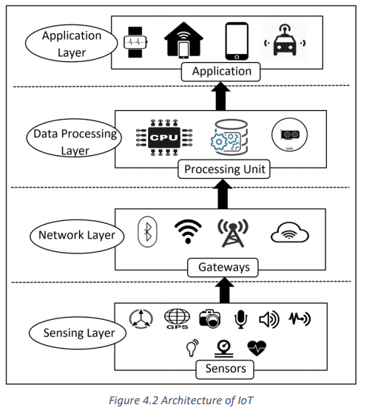

Slide 23
1. Sensing Layer
The main purpose of the sensing layer is
To identify any phenomena in the devices
To obtain data from the real world.
This layer consists of several sensors.
Sensors in IoT devices are usually integrated through sensor hubs.
A sensor hub is a common connection point for multiple sensors that accumulate and forward sensor data to the processing unit of a device.
Actuators can also interfere to change the physical conditions that generate the data.
Example on actuator is shut off a power supply, adjust an airflow valve, or move a robotic gripper in an assembly process.

Slide 24
There are three kinds of sensors in IOT device they are
A. Motion Sensors
They can measure the change in motion as well as the orientation of the devices.
There are two types of motions one can observe in a device: linear and angular
Linear motion refers to the linear displacement of an IoT device
Angular motion refers to the rotational displacement of the device.
B. Environmental Sensors
Sensors such as light sensors, pressure sensors etc are embedded in IoT devices to sense the change in environmental parameters in the devices peripheral.
Its primary purpose is to help the devices to take autonomous decisions according to the changes of a device’s peripheral
For instance, environment sensors are used in many applications to improve user experience, home automation systems, smart locks, smart lights,

Slide 25
C. Position sensors
Deal with the physical position and location of the device.
The most common position sensors used in IoT devices are Magnetic sensors and Global Positioning System (GPS) sensors.
Magnetic sensors are usually used as digital compass and help to fix the orientation of the device display
Global Positioning System is used for navigation purposes in IoT devices.
2. Network Layer
Acts as a communication channel to transfer data, collected in the sensing layer, to other connected devices.
In IoT devices, the network layer is implemented by using diverse communication technologies to allow data flow between other devices within the same network.
e.g. Wi-Fi, Bluetooth, Zigbee, ZWAVE, LoRa, cellular network, etc.

Slide 26
3. Data Processing Layer
Consists of the main data processing unit of IoT devices
It takes data collected in the sensing layer and analyses the data to make decisions based on the result.
In some IoT devices (e.g., smartwatch, smart home hub, etc.), the data processing layer also saves the result of the previous analysis to improve the user experience.
This layer may share the result of data processing with other connected devices via the network layer.

Slide 27
4. Application Layer
Implements and presents the results of the data processing layer to accomplish different applications of IoT devices.
It’s a user-centric layer that executes various tasks for the users.
There exist diverse IoT applications, which includes
Smart transportation
Smart home
Personal care
Healthcare, etc.

Slide 28
Device and Network
Connected devices are part of a scenario in which every device talks to other related devices in an environment to automate home and industrial tasks, and to communicate usable sensor data to users, businesses and other interested parties.
IoT devices are meant to work in concert for people at home, in industry or in the enterprise.
The devices can be categorized into three main groups: Consumer, Enterprise and Industrial.
Consumer connected devices include smart TVs, smart speakers, toys, wearables, and smart appliances.
Industrial and Enterprise IoT devices include smart meters, commercial security systems and smart city technologies such as those used to monitor traffic and weather conditions

Slide 29
IOT tools and platforms
There are many vendors in the industrial IoT platform marketplace, offering remarkably similar capabilities and methods of deployment
These IoT platform solutions are based on IoT and cloud technology.
They can be used in areas of smart home, city, enterprise, home automation, healthcare or automotive.
IoT Platform includes:
KAA: Manage unlimited number of connected devices
SiteWhere: run any number of IoT applications on single SiteWhere instance
ThingSpeak: collect data in private channels
Zetta: supports a wide rage of hacker boards

Slide 30
Applications of IOT
Agriculture
Consumer Use
Insurance
Healthcare
Manufacturing
Retail
Transportation
Utilities

Slide 31
1. IoT Based Smart Home
Smart Home initiative allows subscribers to remotely manage and monitor different home devices from anywhere via smartphones or over the web with no physical distance limitations.
These “smart” devices have the potential to share information with each other given the permanent availability to access the broadband internet connection.
Components those are included in smart home development
Remote Control Appliances: Switching on and off remotely appliances to avoid accidents and save energy.
Weather: Displays outdoor weather conditions such as humidity, temperature, pressure, wind speed and rain levels with the ability to transmit data over long distances.

Slide 32
Smart Home Appliances: Refrigerators with LCD screen telling what’s inside, food that’s about to expire, ingredients you need to buy and with all the information available on a smartphone app and also washing machine.
Safety Monitoring: cameras, and home alarm systems making people feel safe in their daily life at home.
Intrusion Detection Systems: Detection of window and door openings and violations to prevent intruders.
Energy and Water Use: Energy and water supply consumption monitoring to obtain advice on how to save cost and resources, & many more.

Slide 33
2. IOT based smart city
The development of smart grids, data analytics, and autonomous vehicles will provide an intelligent platform to deliver innovations in energy management, traffic management, and security, sharing the benefits of this technology throughout society.
Components those are included in smart city development
Structural Health: Monitoring of vibrations and material conditions in buildings, bridges and historical monuments.
Lightning: intelligent and weather adaptive lighting in street lights.
Smart Parking: Real-time monitoring of parking spaces available in the city making residents able to identify and reserve the closest available spaces
Waste Management: Detection of rubbish levels in containers to optimize the trash collection routes. Garbage cans and recycle bins with RFID tags allow the sanitation staff to see when garbage has put out.

Slide 34
3. IOT based smart Farming
Green Houses: Control micro-climate conditions to maximize the production of fruits and vegetables and its quality.
Compost: Control of humidity and temperature levels in alfalfa, hay, straw, etc. to prevent fungus and other microbial contaminants.
Offspring Care: Control of growing conditions of the offspring in animal farms to ensure its survival and health.
Field Monitoring: Reducing spoilage and crop waste with better monitoring, accurate ongoing data obtaining, and management of the agriculture fields, including better control of fertilizing, electricity and watering.
Animal Farming/Tracking: Location and identification of animals grazing in open pastures or location in big stables, Study of ventilation and air quality in farms and detection of harmful gases from excrements.

Slide 35
End of chapter Four
?
Next: Chapter Five: Augmented Reality

