Slide 1
Health and Wellness
By:
Arandilla, Noel
Arbuis, Richellou

Slide 2
Introduction: About the system
This health and wellness System focuses on the latest trends in health, nutrition, physical activity, and wellness. From stress management and sleep to overall wellbeing, we will explore personal health, health related attitudes and beliefs, and individual health behaviors.

Slide 3
Major Modules
Bmi calculation
Track weight
Exercise recommendation
Admin – Add, Update & Delete exercise
Admin - Create announcements
User – Register & Login

Slide 4
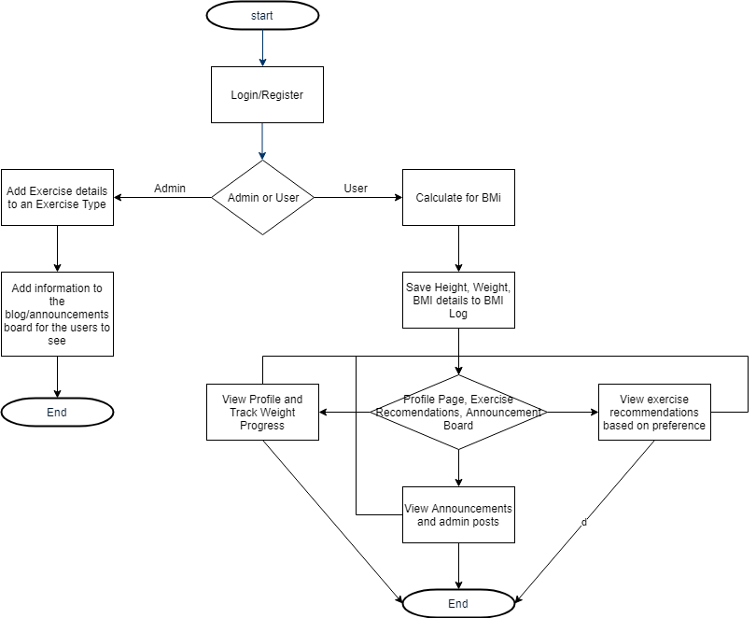
System Flow

Slide 5
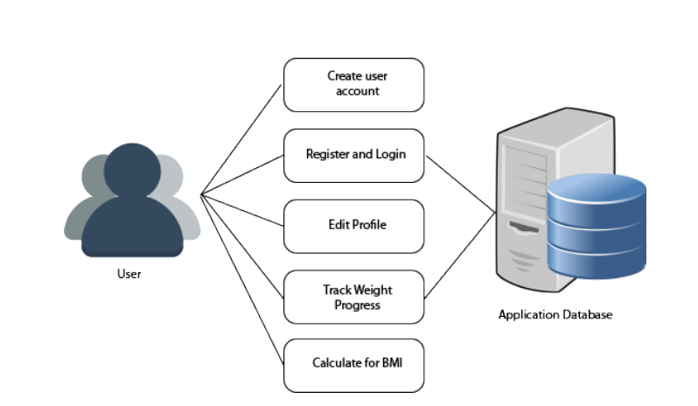
Use Case Diagram

