Slide 1
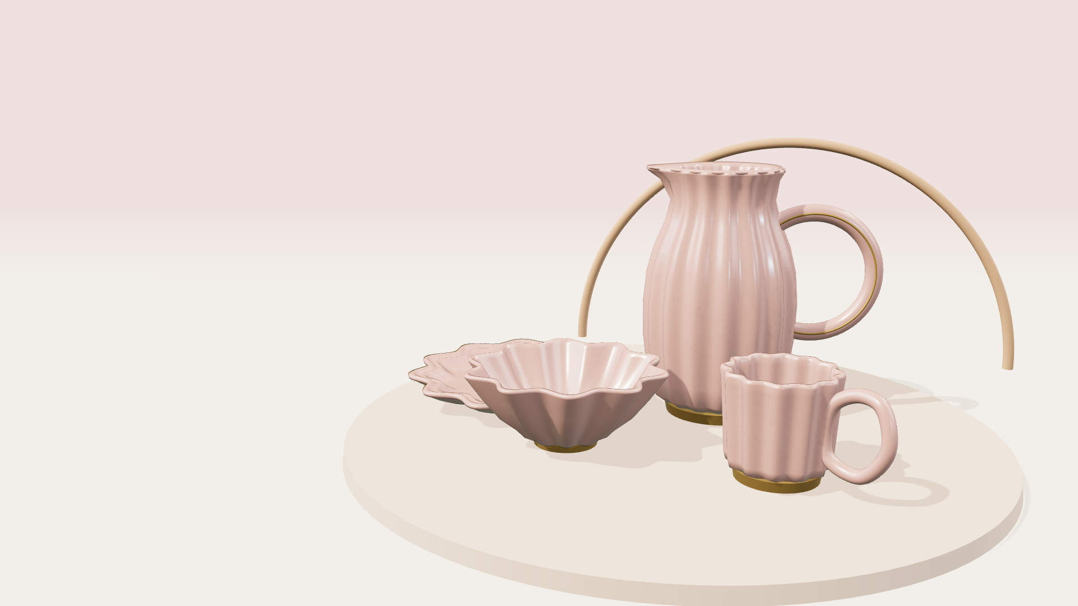
HUWA
TABLE CHARM
Petal & Pearl.
Table Charm.
Scalloped porcelain and champagne details
for everyday rituals and thoughtful gifts.
PRODUCT CONCEPT / COLLECTION 001
Notes:
HUWA Table Charm is a product concept created for this presentation. Dimensions, capacities, finishes, and price points are proposals for design review.

Slide 2
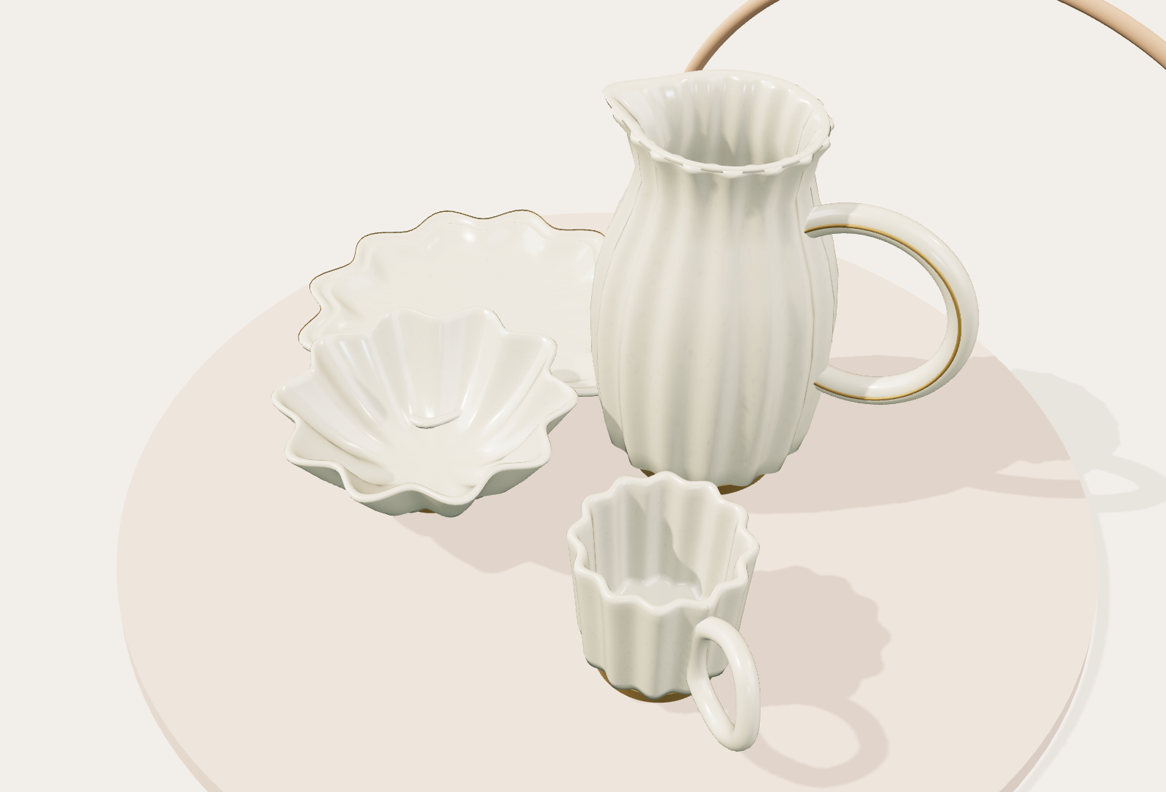
01 / COLLECTION IDEA
A softer collection with character.
Table Charm gives an everyday table a clear visual language: a petal contours, a ribbon handle, and a champagne foot that makes each piece feel grounded.
FORM LANGUAGE
Petal rims soften the silhouette. Curved handles make each piece feel personal.
The geometry stays recognizable when it is stacked, mixed, or seen in a small thumbnail.
A collection is strongest when every piece
looks related before it looks identical.
HUWA / TABLE CHARM
02
Notes:
HUWA Table Charm is a product concept created for this presentation. Dimensions, capacities, finishes, and price points are proposals for design review.

Slide 3
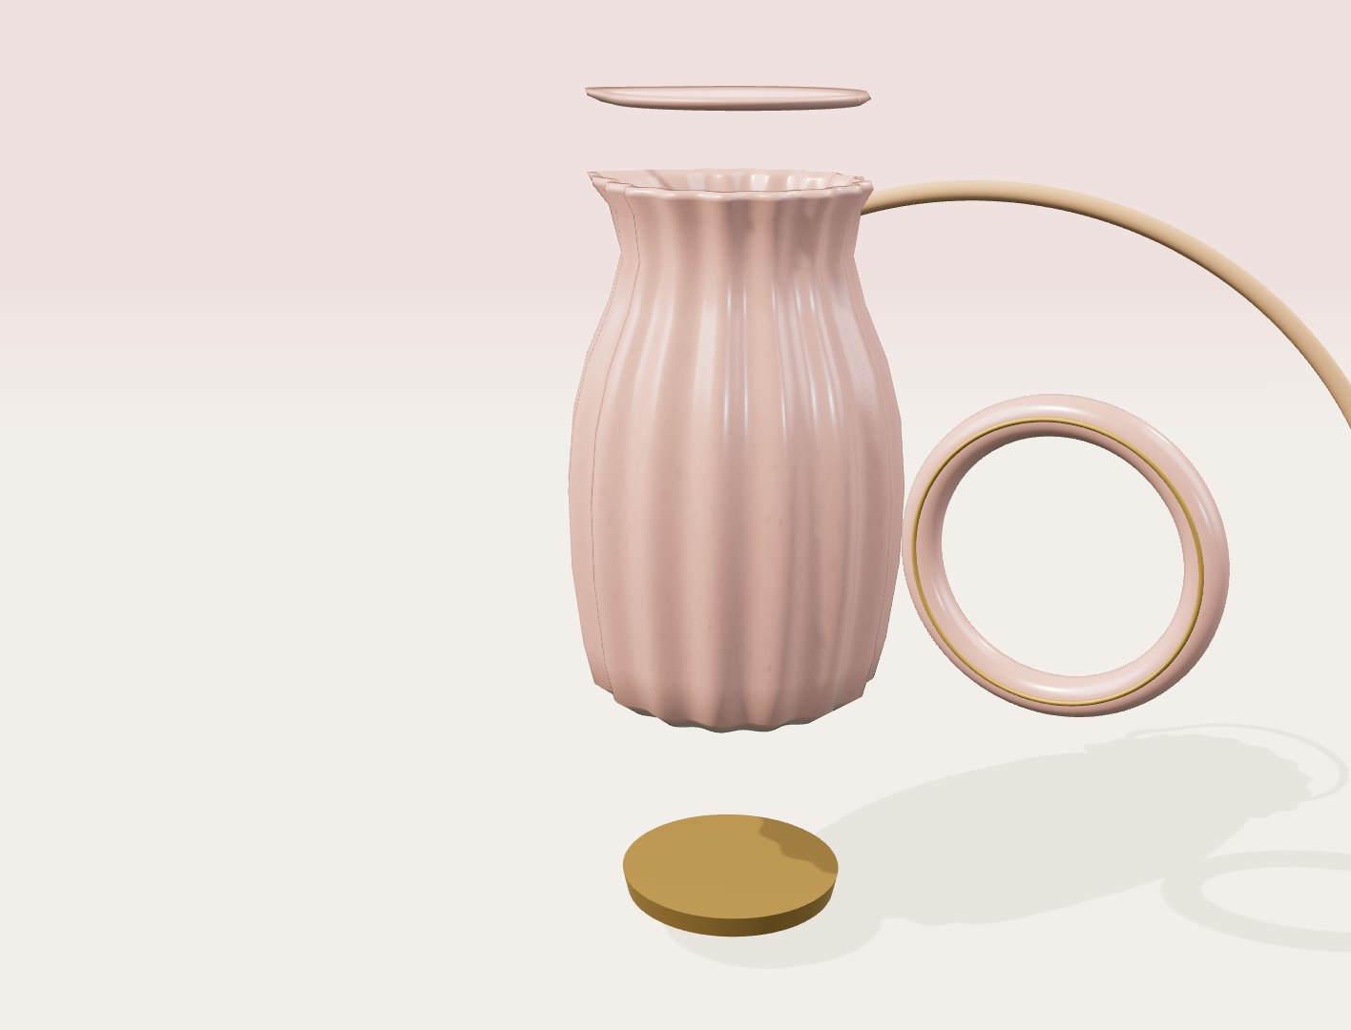
02 / OBJECT ANATOMY
Bloom Carafe
The hero object is a pitcher with a strong silhouette and a generous, circular grip.
01
petal wall
Sixteen soft flutes catch light in the glaze.
02
sculpted loop
A generous grip with a delicate champagne inset.
03
foot ring
A darker base that keeps the form visually planted.
HUWA / OBJECT STUDY
03
Notes:
HUWA Table Charm is a product concept created for this presentation. Dimensions, capacities, finishes, and price points are proposals for design review.

Slide 4
03 / FAMILY SYSTEM
Four pieces for a lovely table.
The collection works as a family because the proportions change while the underlying moves stay constant.
BLOOM CARAFE
RIBBON CUP
PETAL BOWL
PEARL PLATE
Pitcher
Cup
Bowl
Plate
270 mm
105 mm
190 mm
270 mm
Pour + display
Daily ritual
Shared comfort
Anchor the table
The same language can scale from an object on a pedestal to a full table setting.
HUWA / TABLE CHARM
04
Notes:
HUWA Table Charm is a product concept created for this presentation. Dimensions, capacities, finishes, and price points are proposals for design review.

Slide 5
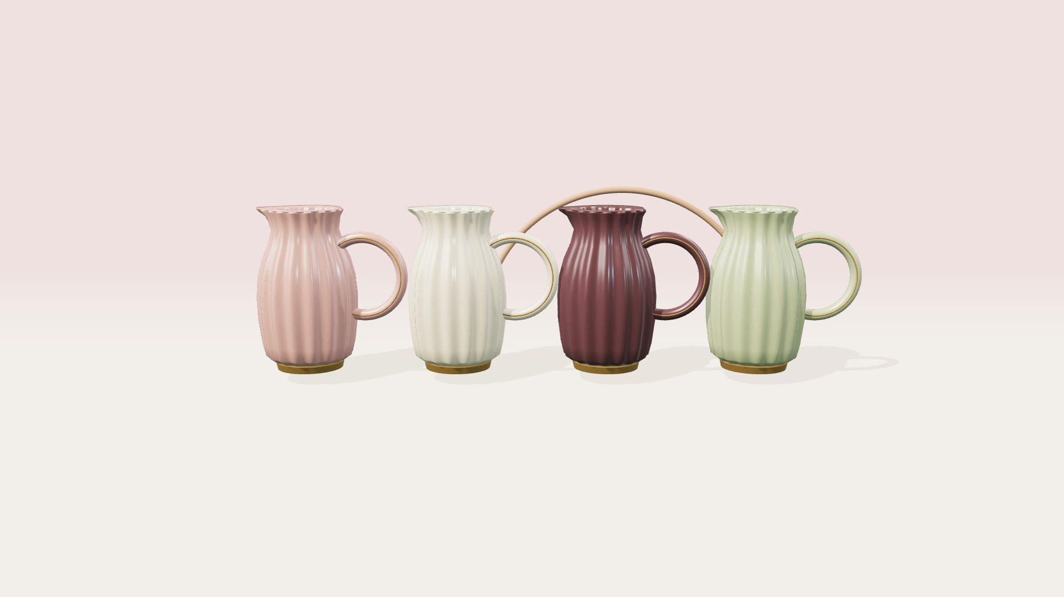
04 / MATERIAL SYSTEM
Colour does the storytelling.
The same geometry shifts character through glaze, foot ring, and light. Four finishes create an expandable product system.
ROSE
PEARL
MULBERRY
PISTACHIO
soft blush for everyday rituals
warm porcelain with champagne
rich glaze for evening settings
gentle green for a fresh table
01
02
03
04
Finish is the fastest route from one object to four moods.
HUWA / TABLE CHARM
05
Notes:
HUWA Table Charm is a product concept created for this presentation. Dimensions, capacities, finishes, and price points are proposals for design review.

Slide 6
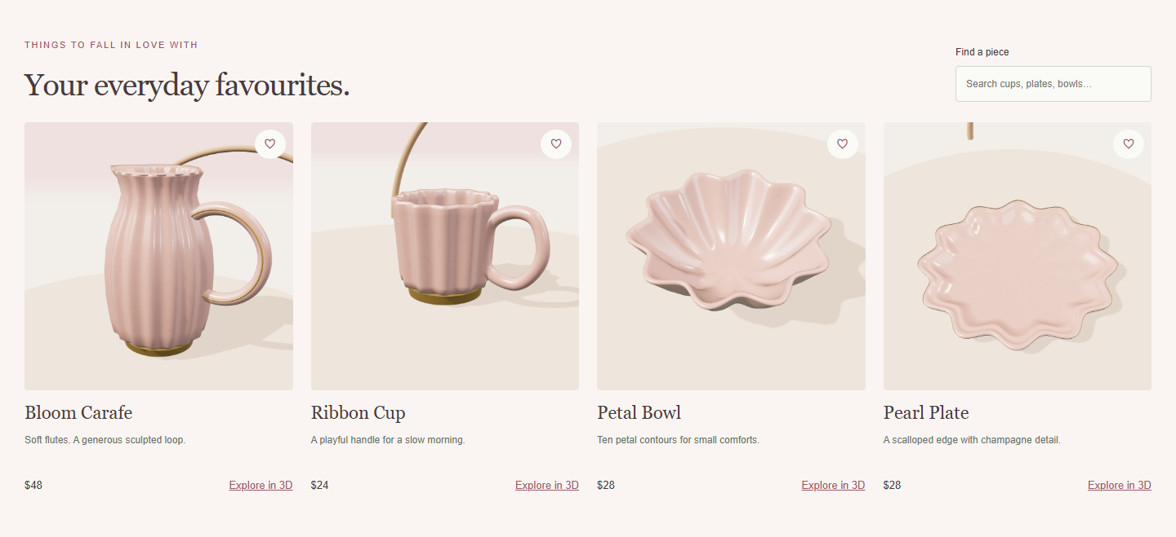
05 / COMMERCE EXPRESSION
Make the product
feel touchable.
The shopping experience supports personal style, gifts, and complete table settings.
PRODUCT PAGE MOMENT
Find a favourite.
Save it for later.
Explore it in 3D.
Searchable products with a wishlist that remembers your favourites.
HUWA / DIGITAL EXPERIENCE
06
Notes:
HUWA Table Charm is a product concept created for this presentation. Dimensions, capacities, finishes, and price points are proposals for design review.

Slide 7
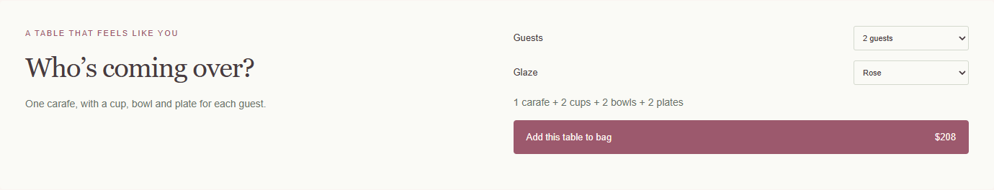
06 / TABLE SETTING BUILDER
A table for the people you love.
Choose the guest count and a glaze. The store calculates each piece and the total.
A table for four
1 carafe + 4 cups + 4 bowls + 4 plates
Concept price: $368 USD. Customers can remove pieces from the bag.
HUWA / TABLE CHARM
07
Notes:
Original concept store. Illustrative USD prices: carafe $48, cup $24, bowl $28 and plate $28. A setting for four costs $48 + 4 × ($24 + $28 + $28) = $368. Local browser storage remembers the shopping bag and wishlist. Payments and orders are not connected.

Slide 8
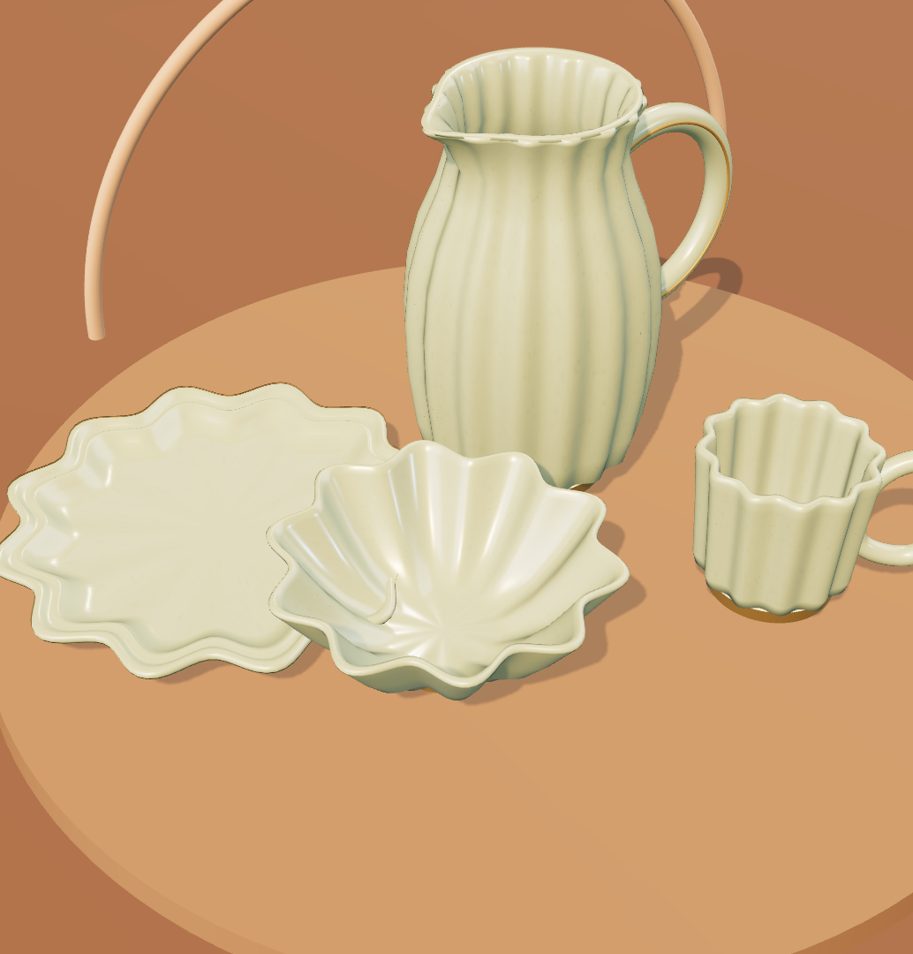
TABLE CHARM
A little beauty.
Every day.
HUWA / COLLECTION 001
Next decision
Prototype the scalloped rim,
then test the glaze and handle.
Concept presentation · October 2026
08
Notes:
HUWA Table Charm is a product concept created for this presentation. Dimensions, capacities, finishes, and price points are proposals for design review.

