Slide 1

G2M Case Study
Virtual Internship
23-Mar-2024

Slide 2
Background –G2M(cab industry) case study
XYZ is a private firm in US. Due to remarkable growth in the Cab Industry in last few years and multiple key players in the market, it is planning for an investment in Cab industry and as per their Go-to-Market(G2M) strategy they want to understand the market before taking final decision.
Objective: To provide actionable insights to help XYZ firm in identifying the right company for making investment.
The analysis has been divided into four parts:
Data Understanding
Forecasting profit and number of rides for each cab type
Finding the most profitable Cab company
Recommendations for investment

Slide 3
Data Exploration
Timeframe of the data: 2016-01-31 to 2018-12-31
Total number of rows is 359,392
Approach:
Conduct exploratory data analysis (EDA) to understand the distribution and characteristics of the datasets.
Formulate hypotheses to test relationships between different variables and cab company profitability.
Perform statistical tests and data visualizations to validate or reject the hypotheses.
Use predictive modeling techniques to forecast future trends and growth opportunities.
Cab_Data.csv
Customer_ID.csv
Transaction_ID.csv
City.csv
Master cab data

Slide 4
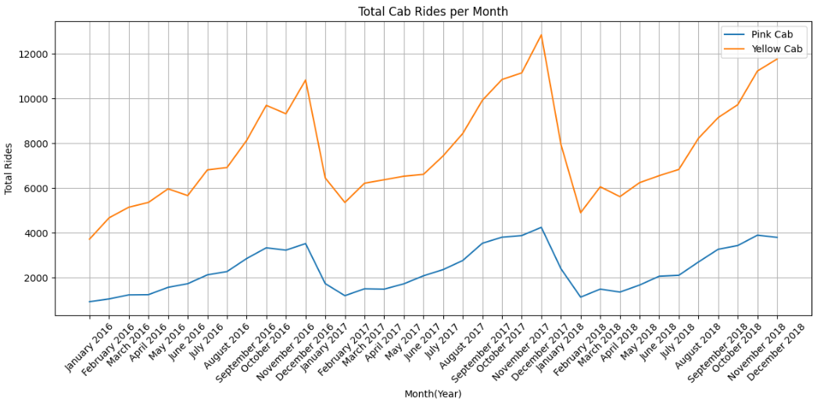
Profit Analysis
Total Cab Rides per Month

Slide 5
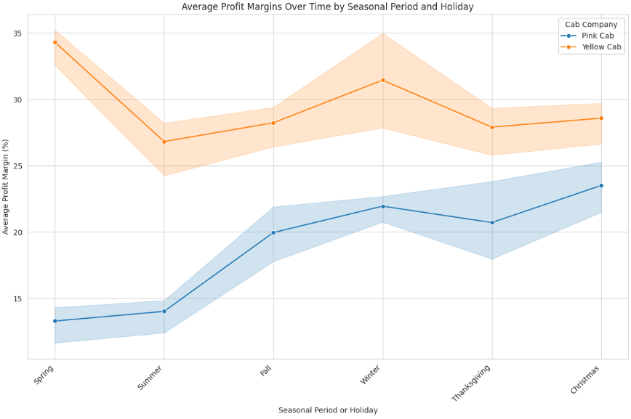
Average Profit Margins Over Time

Slide 6
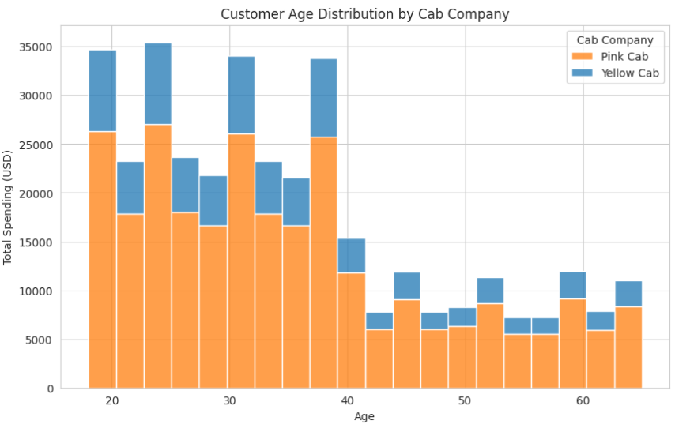
Customer Age Distribution by Cab Company

Slide 7
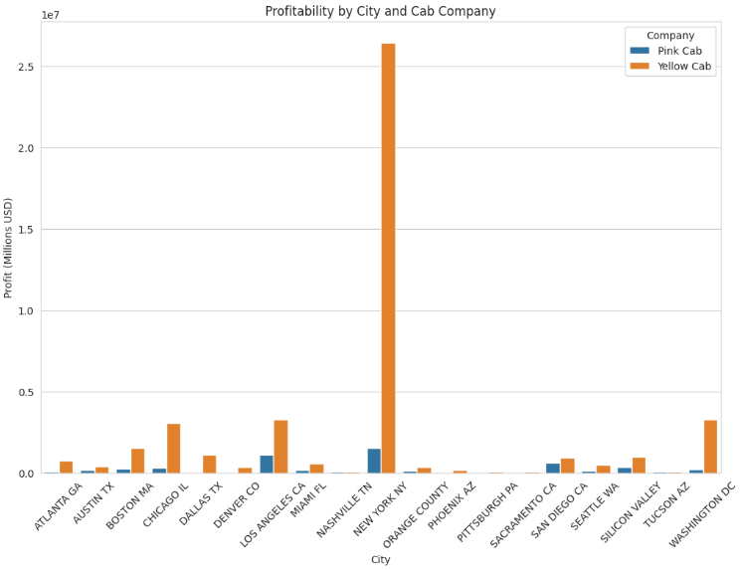
Profitability by City and Cab Company

Slide 8
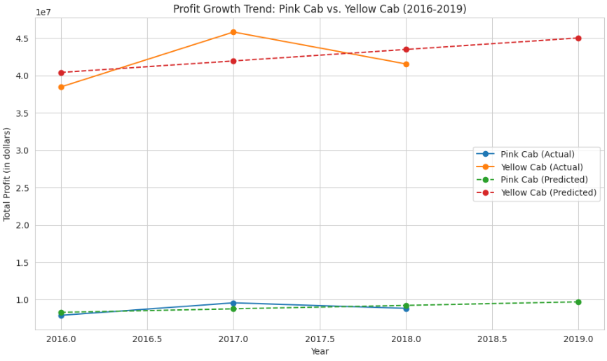
Forecasting Profit Growth in 2019

Slide 9
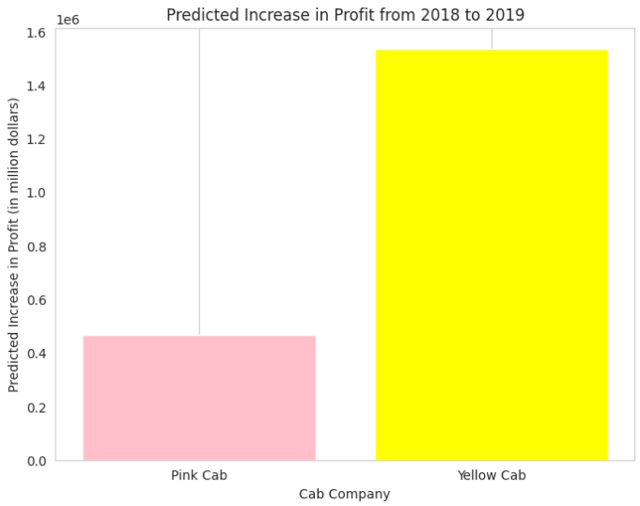
Forecasting of no. of rides for 2019

Slide 10
Recommendations
We have evaluated both the cab companies on following points and found Yellow cab better than Pink cab:
Total Rides : Yellow cab has higher number of rides per month, as compared to Pink Cab.
Age wise Reach : Yellow cab has customer in all age group and it’s been observed that it’s even popular in 60+ age group as equally as its in 18-25 age group, compared to Pink Cab.
Seasonal Profitability: Both companies experienced fluctuations throughout the year although Yellow Cab demonstrated higher profitability during peak seasons compared to Pink Cab.
City Profitability :Yellow Cab has more profitability across all cities, especially in New York, compared to Pink Cab.
Predicted Growth : Both companies will experience profit growth in 2019, with Yellow Cab experiencing more profit growth than Pink Cab.
On the basis of above points , we recommend Yellow cab for the investment.

Slide 11
Thank You

