Slide 1


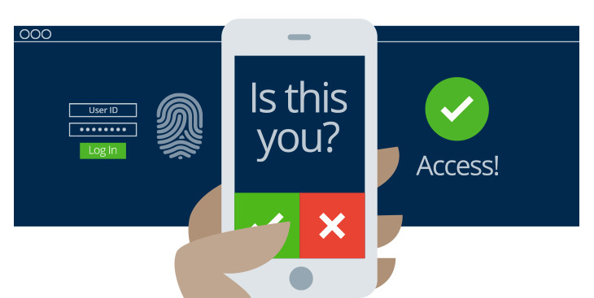
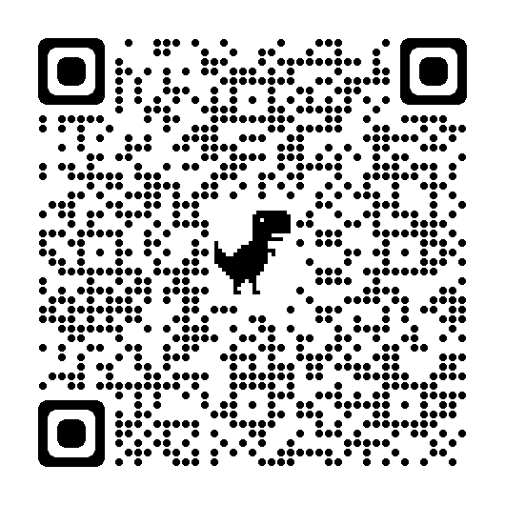
Muti-Factor Authentication (MFA)
Secure your accounts and information!
Prove your Identity in multiple ways
Make a hacker’s job extremely hard
Gain peace of mind that only you can access your data
IS-1003 Summer 2023
George-IS1003-lab08

