Slide 1
Employment Data Analysis
By Ann Nelson, Noelle Brown, and William Gonzalez

Slide 2
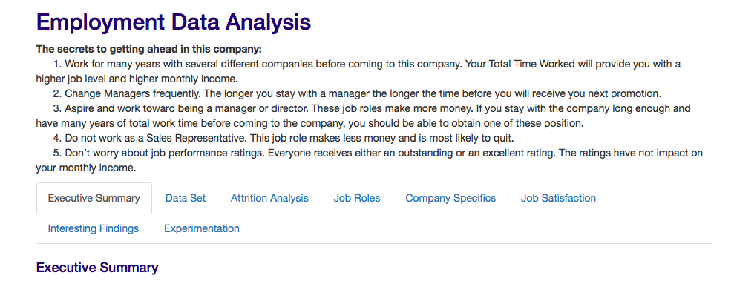
Our Project

Slide 3
Initial Observations
Only 16% attrition in the data
BusinessTravel, OverTime, JobInvolvement, PerformanceRating, seem to be unbalanced. All other Variables seem balanced
YearsAtCompany, YearsInCurrentRole, YearsSinceLastPromotion, YearsWithCurrManager may be skewed

Slide 4
Attrition Analysis
An analysis of the top factors that lead to voluntary employee turnover

Slide 5
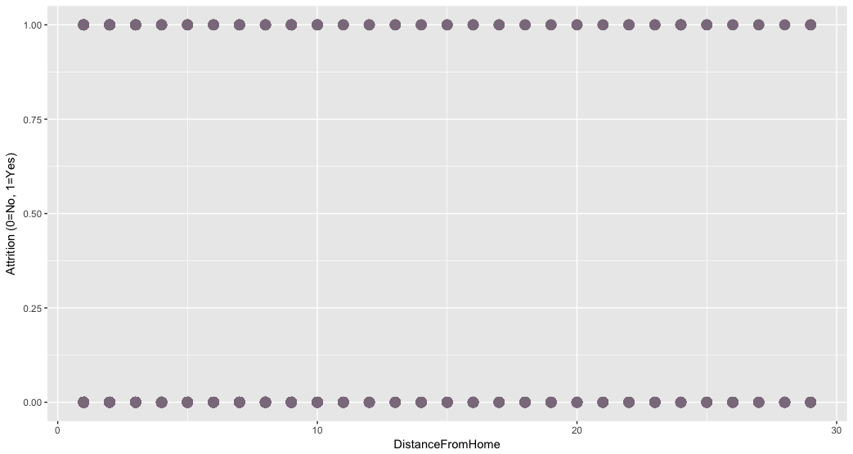
Regression Analysis

Slide 6
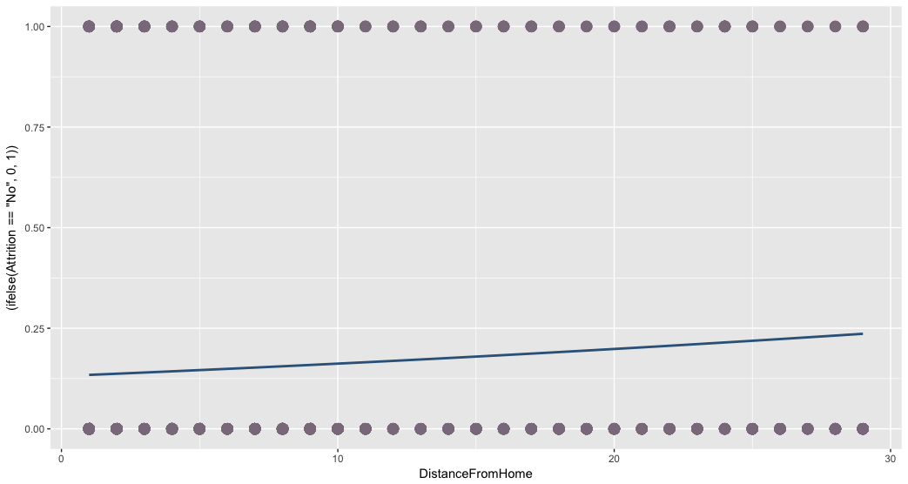
Linear Regression Continuous vs Binary

Slide 7
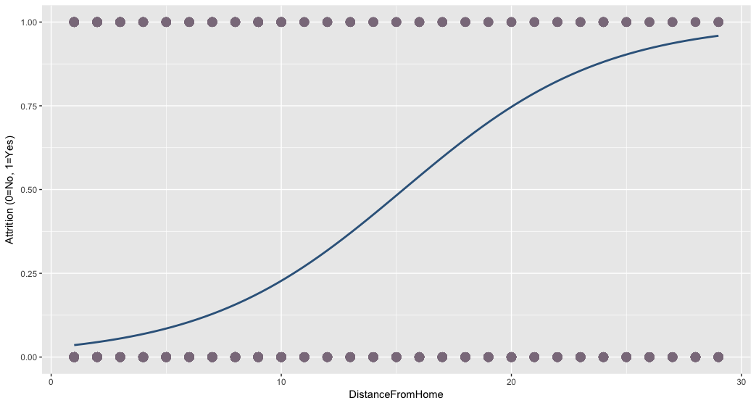
Logistic Regression Logit function

Slide 8
Model Fitting: Logistic Regression Experimentation
Split the data into training and test data
Define null + full models for the training data
Run ANOVA
Fitting the model using STEP
Create Final Training Model with top variables (lowest p-value).
Test Final Training Model Against Test data to determine the accuracy of the model.
Obtain Odd Ratio of covariences

Slide 9
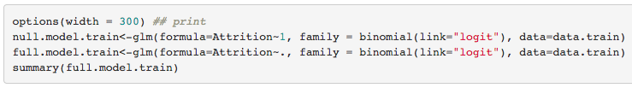
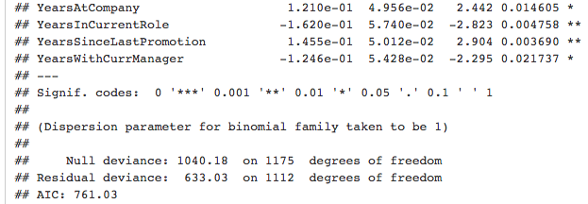
Model Fitting: Logistic Regression Experimentation 1. Split data 80/20 2. Define Null & Full Models

Slide 10
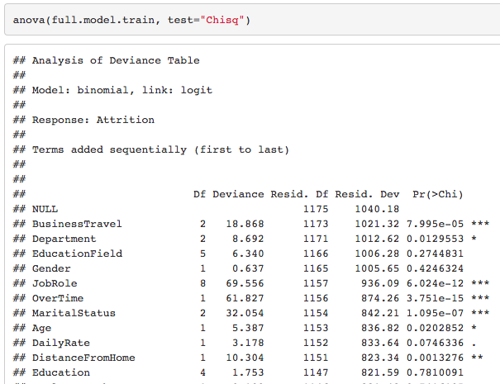
Model Fitting: Logistic Regression Experimentation 3. Run ANOVA

Slide 11
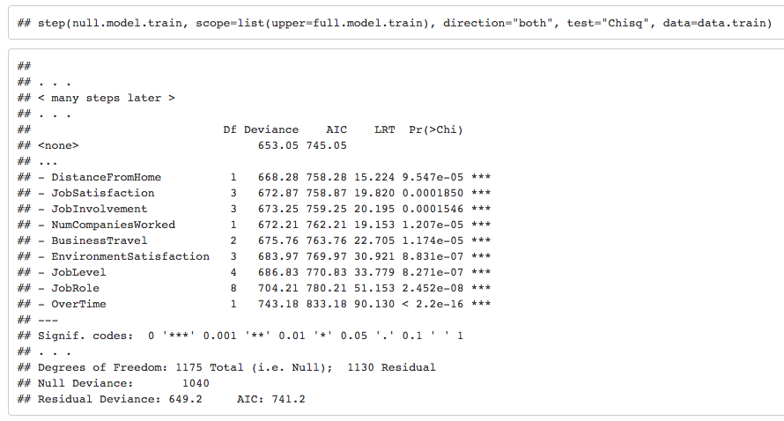
Model Fitting: Logistic Regression Experimentation 4. Fitting the model using STEP

Slide 12
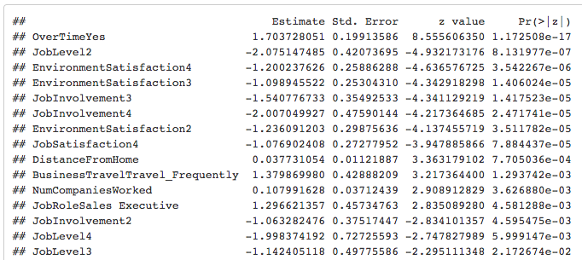
Model Fitting: Logistic Regression Experimentation 5. Create final training model with top variables

Slide 13
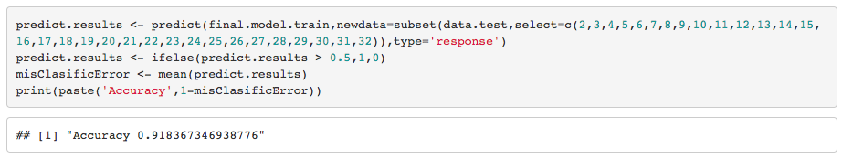
Model Fitting: Logistic Regression Experimentation 6. Run the model against test data to determine accuracy 7. Run the Model against All data

Slide 14
Top factors that lead to attrition
Factor | Odds Ratio of Leaving
Sales Representative | 8.367
Work Overtime | 5.343
Travel Frequently | 4.787
Laboratory Technician | 3.69
Human Resources | 3.455
Sales Executive | 3.15
Travel Rarely | 2.216
Research Scientist | 1.769
Manager | 1.555
Number of Companies Worked | 1.119
Distance from Home | 1.036

Slide 15
Key Findings
Sales Representatives (8 times more likely to have Attrition than any other category)
Working Overtime (5 times more likely)
Travel frequently (4 times more likely)
Job Roles like Lab technician and HR are more likely to leave

Slide 16
Job Roles
Job Role Specific Trends
Note: All analysis has been performed on employees only (No attrition participants)

Slide 17
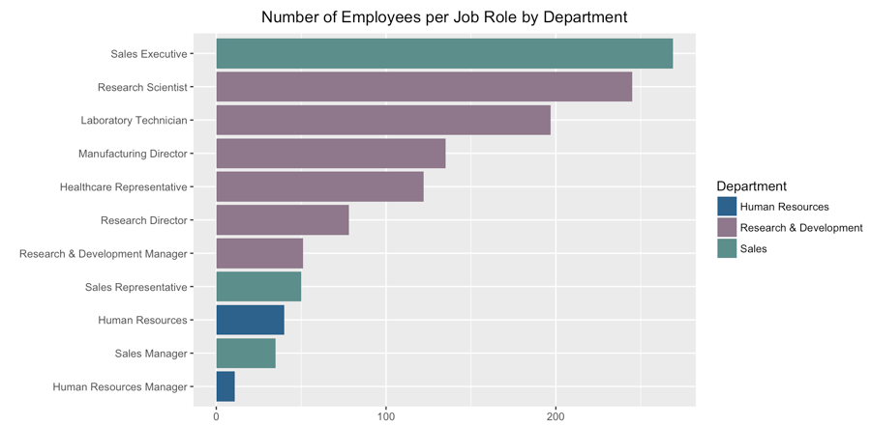
Differences between Job Roles
Linear Regression Modeling
Education Field, Age
Job Involvement
Gender
Job Level
Monthly Income
,Number of Companies Worked
Years At Company
Years with Current Manager

Slide 18
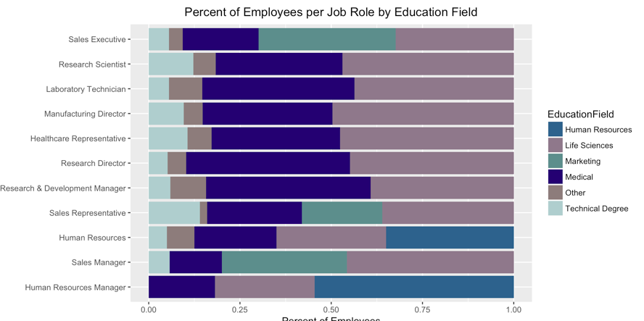
Education

Slide 19
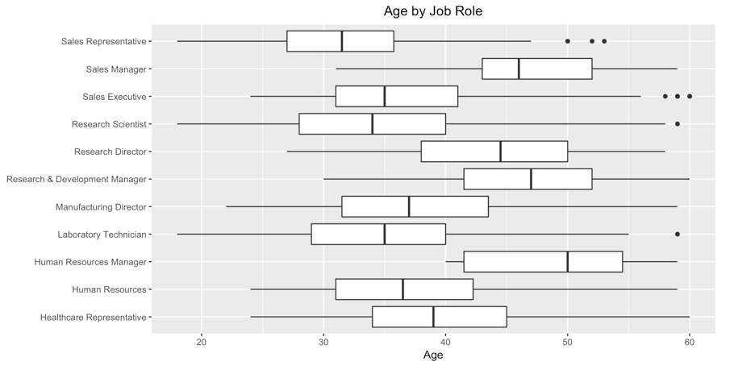
Age

Slide 20
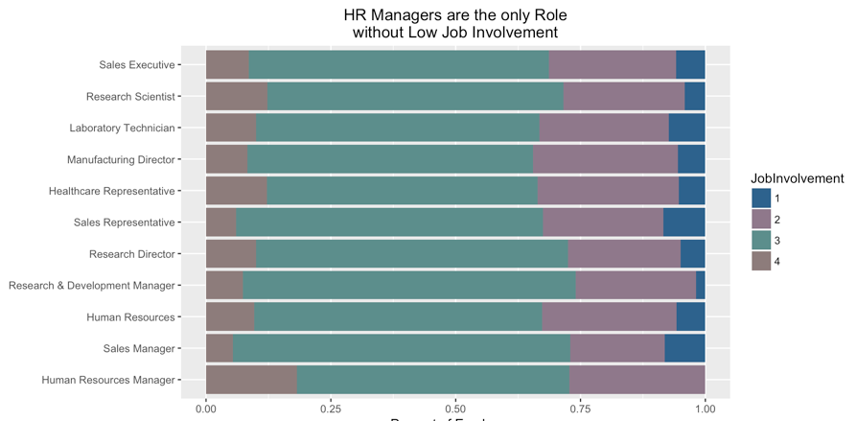
Job Involvement

Slide 21
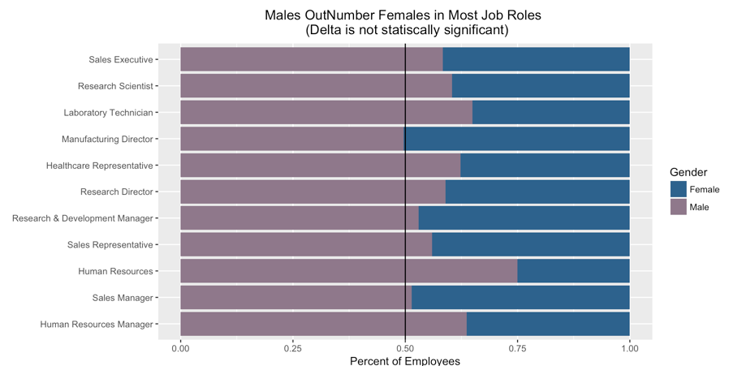
Gender

Slide 22
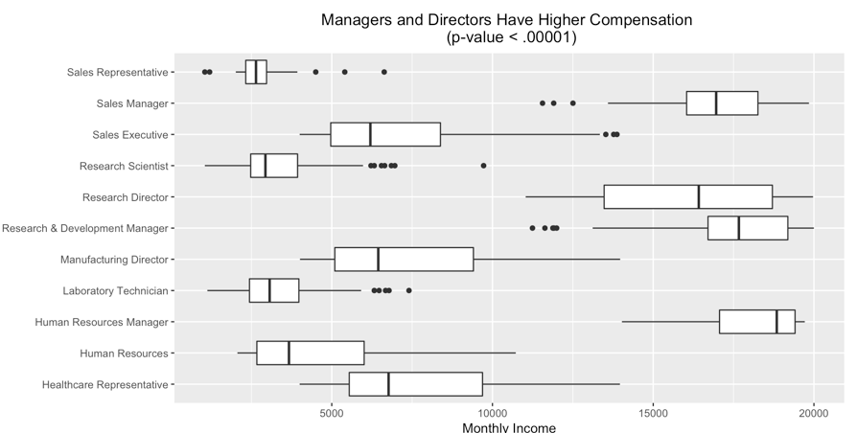
Monthly Income

Slide 23
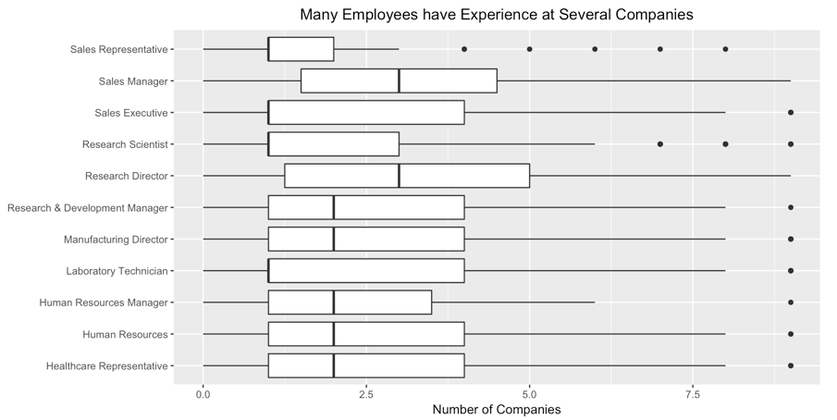
Number of Companies Worked

Slide 24
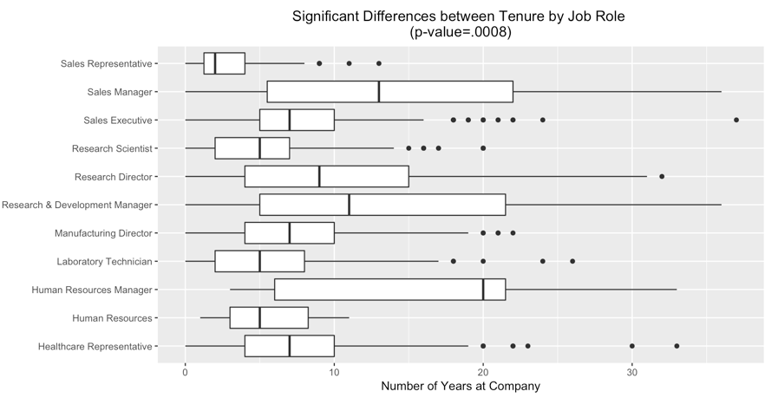
Years at Company

Slide 25
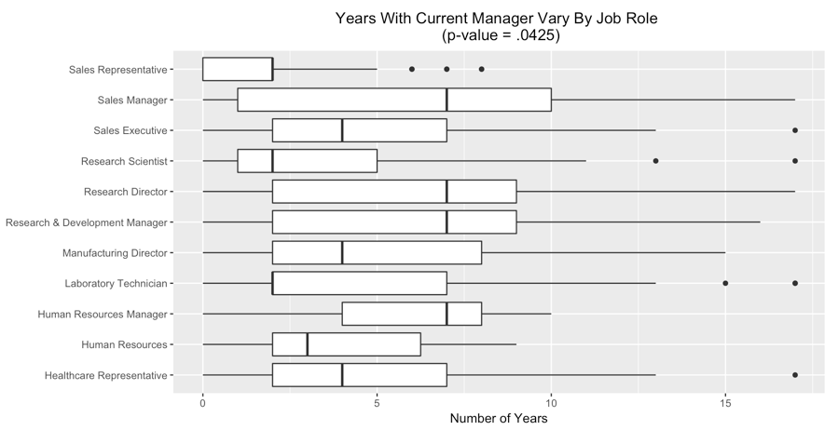
Years with Current Manager

Slide 26
Company Specifics
Company Specific Trends
Note: All analysis has been performed on employees only (No attrition participants)

Slide 27
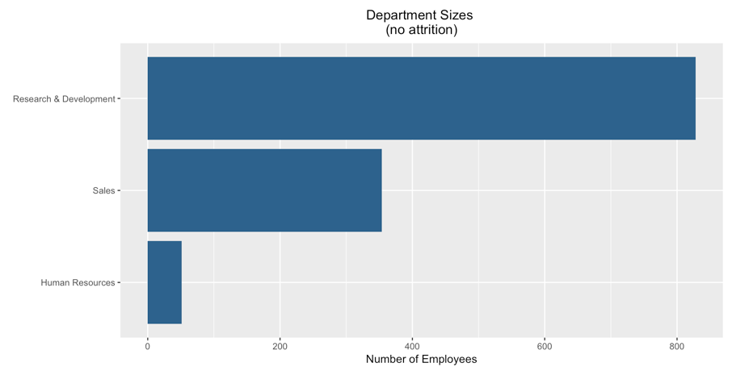

Slide 28
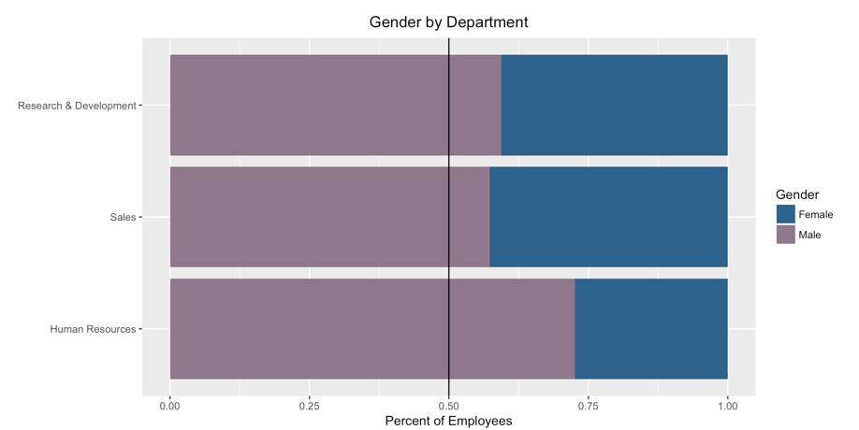

Slide 29
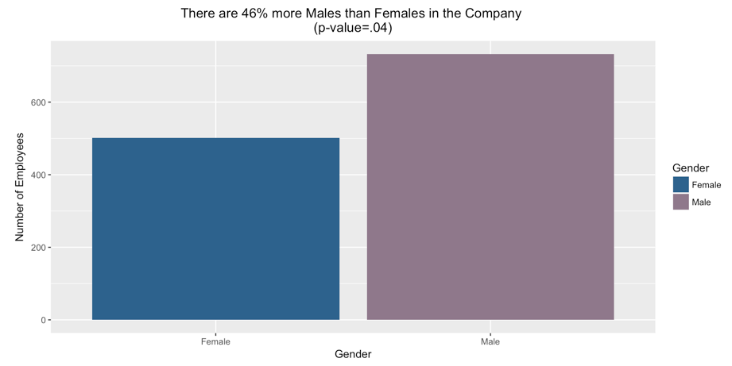

Slide 30
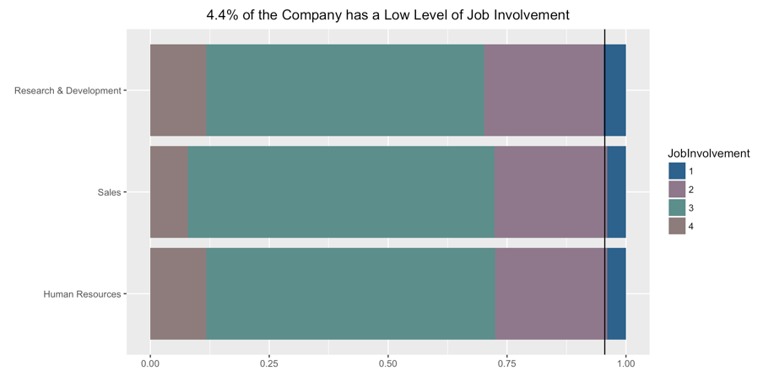

Slide 31
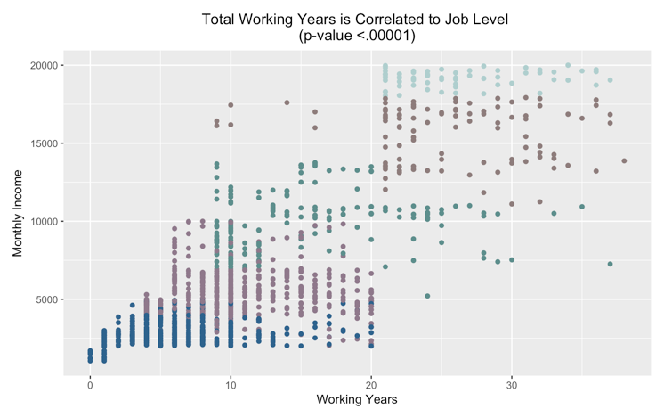

Slide 32
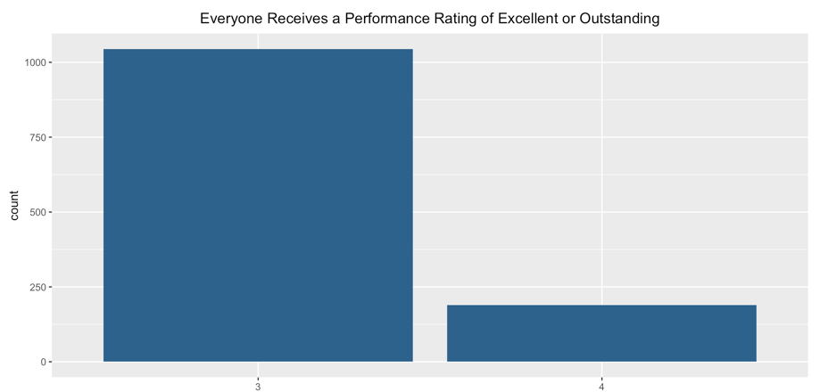

Slide 33
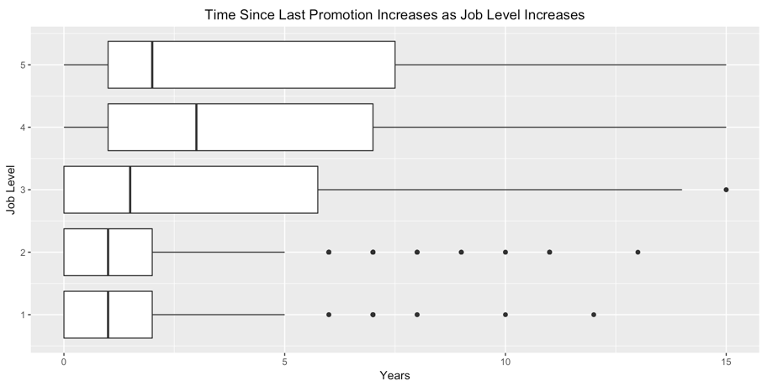

Slide 34
Job Satisfaction
Job Satisfaction Trends
Note: All analysis has been performed on employees only (No attrition participants)

Slide 35
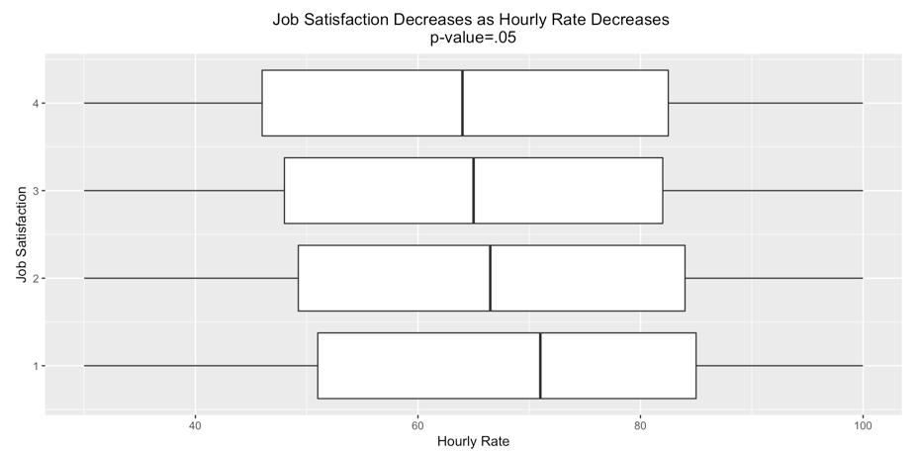

Slide 36
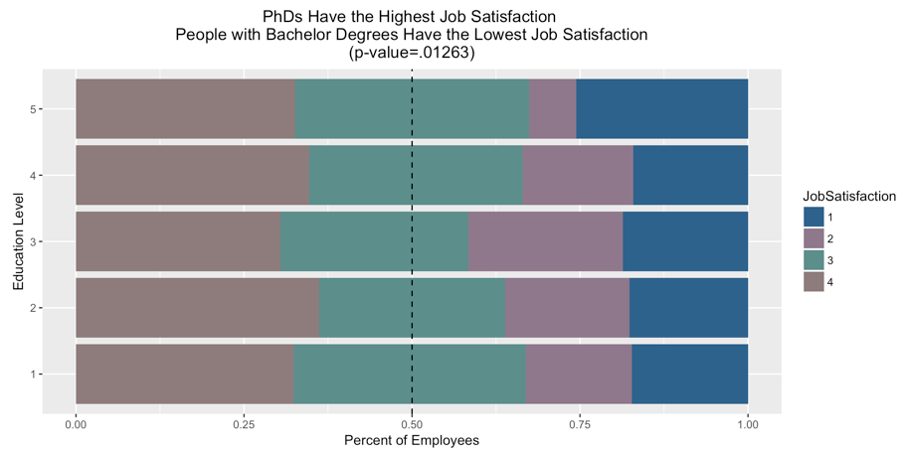

Slide 37
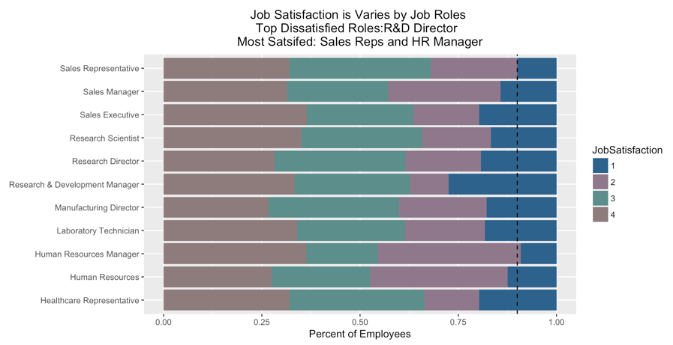

Slide 38
Interesting Findings
Other interesting findings from our analysis

Slide 39
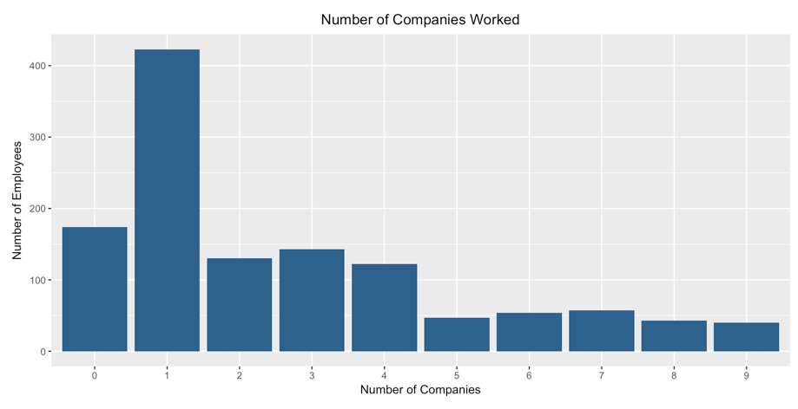

Slide 40
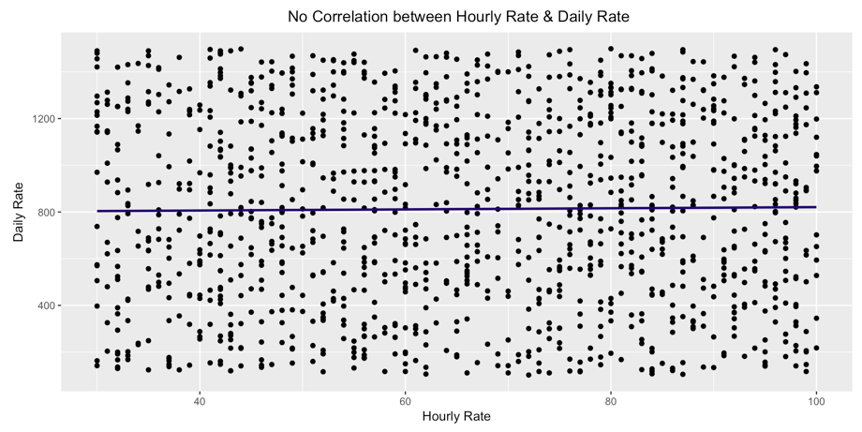
This is similar for Monthly Income vs. Daily Rate, Monthly Rate vs. Daily Rate, & Monthly Income vs. Monthly Rate

