Slide 1
Employment Data Analysis
By Ann Nelson, Noelle Brown, and William Gonzalez

Slide 2
Introduction
An analysis of DDSAnalytics of the top factors that lead to attrition, job specific roles, & other interesting trends

Slide 3
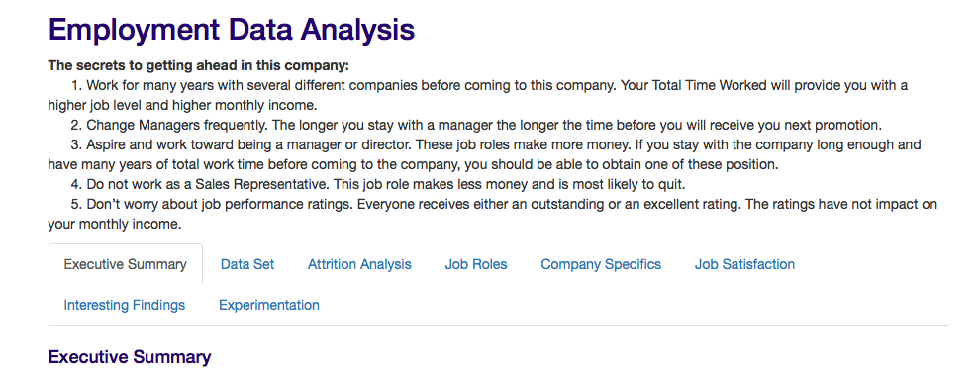
Our Project

Slide 4
Initial Observations
Only 16% attrition in the data
BusinessTravel, OverTime, JobInvolvement, PerformanceRating, seem to be unbalanced. All other Variables seem balanced
YearsAtCompany, YearsInCurrentRole, YearsSinceLastPromotion, YearsWithCurrManager may be skewed
No correlation between Monthly Income vs. Daily Rate, Monthly Rate vs. Daily Rate, & Monthly Income vs. Monthly Rate, etc.

Slide 5
Findings
Top 3 factors that lead to attrition are:
Sales Representative
Working Overtime
Travelling Frequently
Other findings include job specific trends, company specific trends, and other interesting trends

Slide 6
Attrition Analysis
An analysis of the top factors that lead to voluntary employee turnover

Slide 7
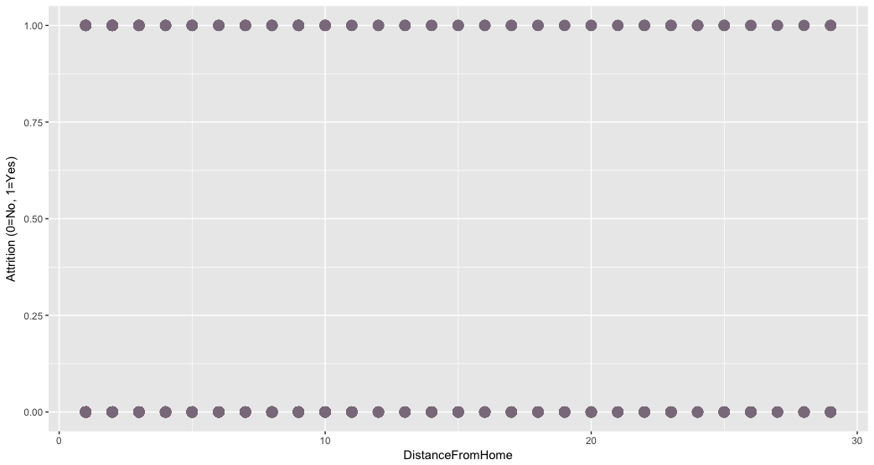
Regression Analysis

Slide 8
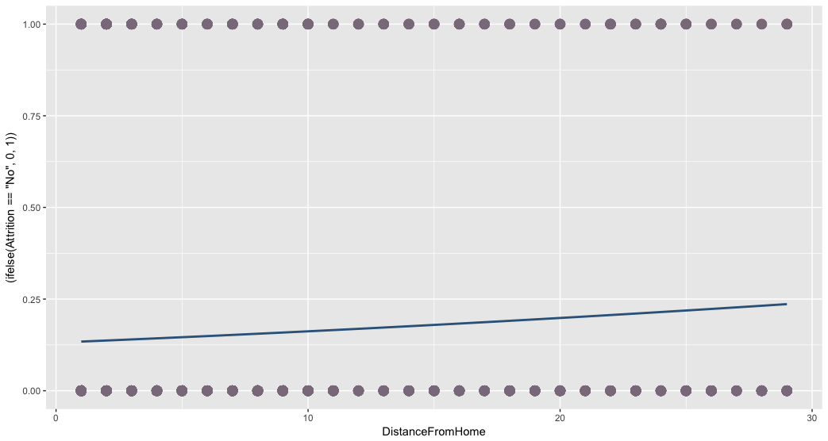
Linear Regression Continuous vs Binary

Slide 9
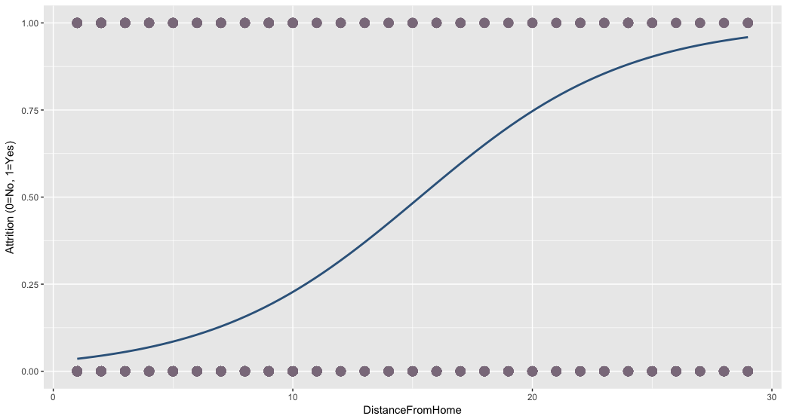
Logistic Regression Logit function

Slide 10
Model Fitting: Logistic Regression Experimentation
Split the data into training and test data
Define null + full models for the training data
Run ANOVA
Fitting the model using STEP
Create Final Training Model with top variables (lowest p-value).
Test Final Training Model Against Test data to determine the accuracy of the model.
Obtain Odd Ratio of covariences

Slide 11
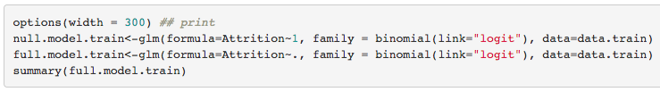
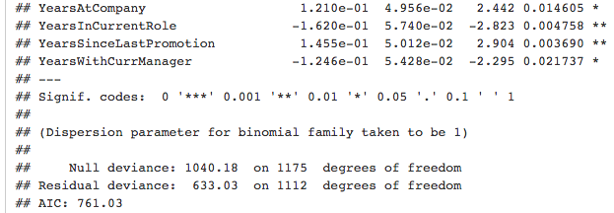
Model Fitting: Logistic Regression Experimentation 1. Split data 80/20 2. Define Null & Full Models

Slide 12
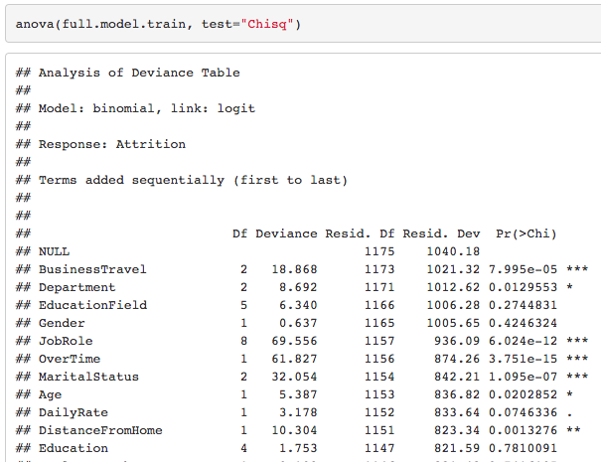
Model Fitting: Logistic Regression Experimentation 3. Run ANOVA

Slide 13
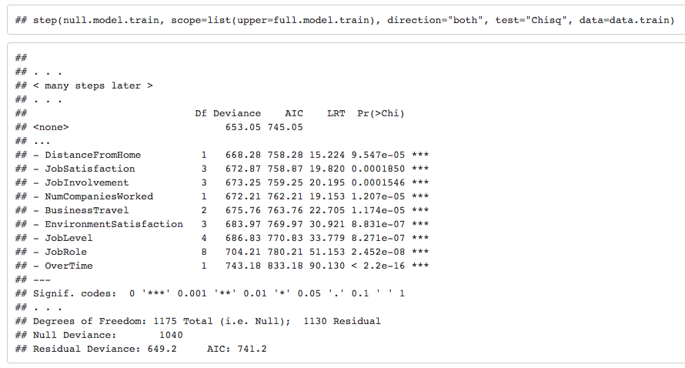
Model Fitting: Logistic Regression Experimentation 4. Fitting the model using STEP

Slide 14
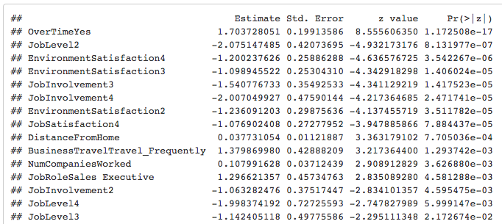
Model Fitting: Logistic Regression Experimentation 5. Create final training model with top variables

Slide 15
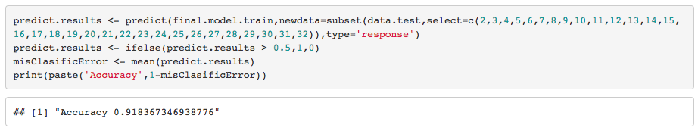
Model Fitting: Logistic Regression Experimentation 6. Run the model against test data to determine accuracy 7. Run the Model against All data

Slide 16
Top factors that lead to attrition
Factor | Odds Ratio of Leaving
Sales Representative | 8.367
Work Overtime | 5.343
Travel Frequently | 4.787
Laboratory Technician | 3.69
Human Resources | 3.455
Sales Executive | 3.15
Travel Rarely | 2.216
Research Scientist | 1.769
Manager | 1.555
Number of Companies Worked | 1.119
Distance from Home | 1.036

Slide 17
Key Findings
Sales Representatives (8 times more likely to have Attrition than any other category)
Working Overtime (5 times more likely)
Travel frequently (4 times more likely)
Job Roles like Lab technician and HR are more likely to leave

Slide 18
Job Roles
Job Role Specific Trends
Note: All analysis has been performed on employees only (No attrition participants)

Slide 19
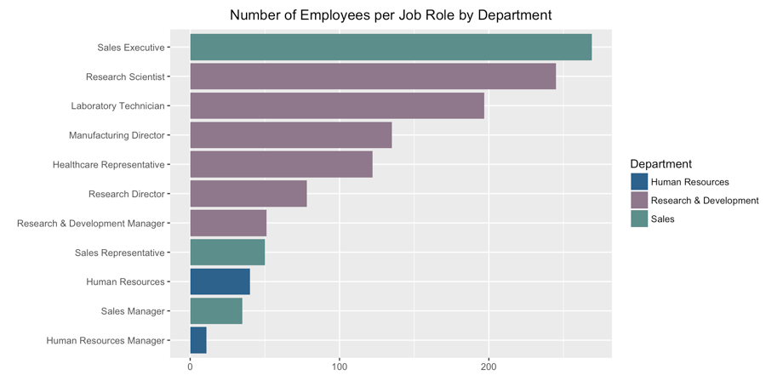
Differences between Job Roles
Linear Regression Modeling
Education Field, Age
Job Involvement
Gender
Job Level
Monthly Income
,Number of Companies Worked
Years At Company
Years with Current Manager

Slide 20
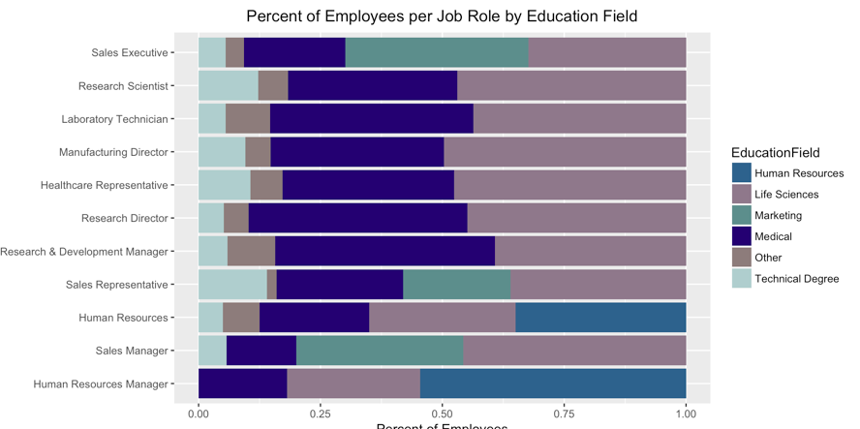
Education

Slide 21
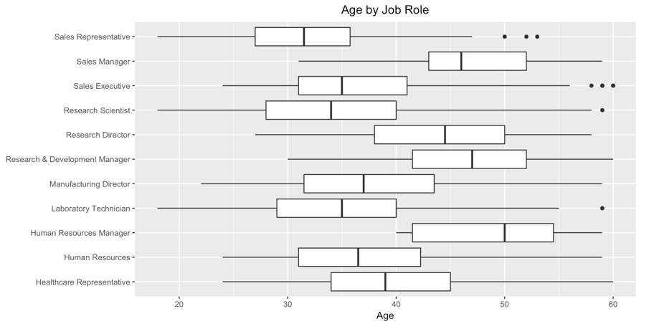
Age

Slide 22
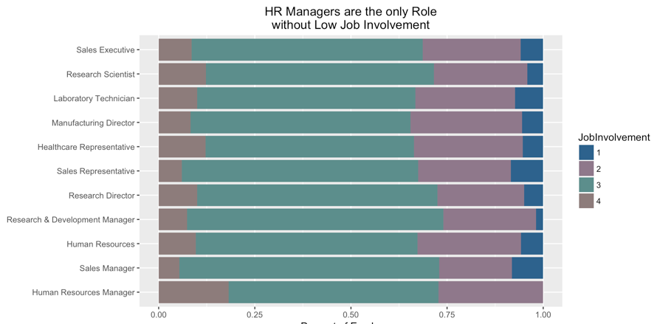
Job Involvement

Slide 23
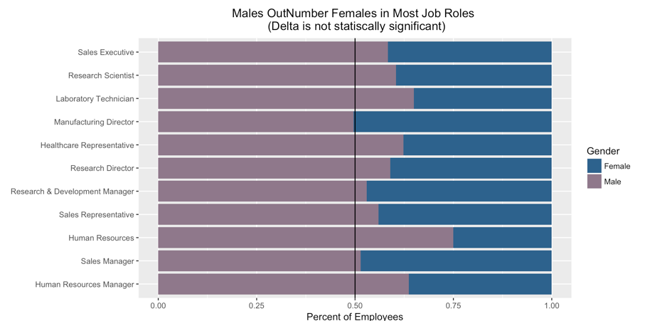
Gender

Slide 24
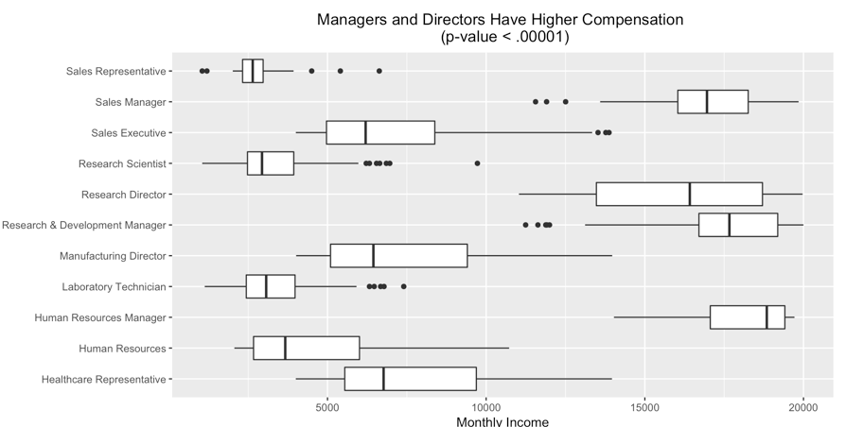
Monthly Income

Slide 25
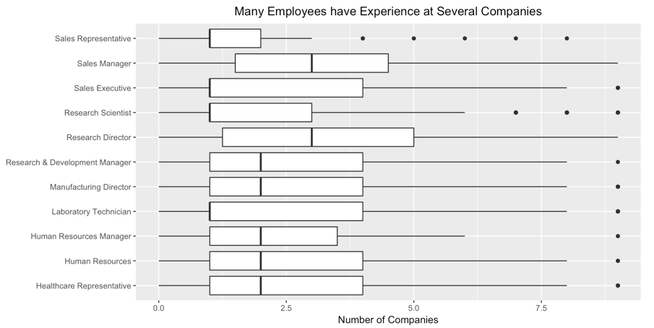
Number of Companies Worked

Slide 26
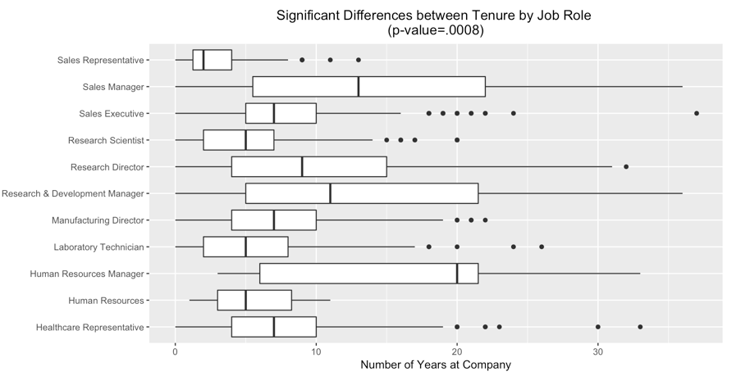
Years at Company

Slide 27
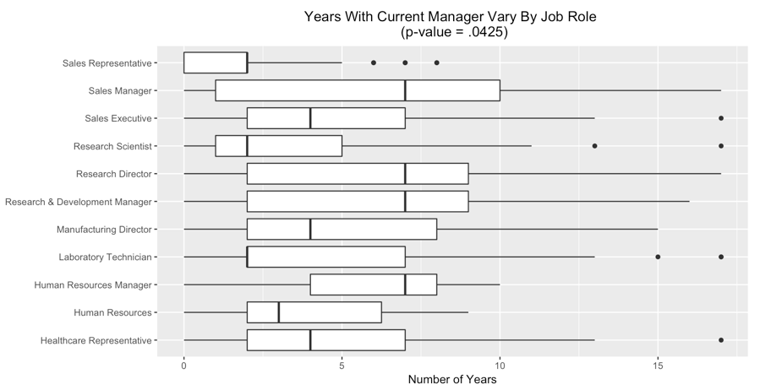
Years with Current Manager

Slide 28
Company Specifics
Company Specific Trends
Note: All analysis has been performed on employees only (No attrition participants)

Slide 29
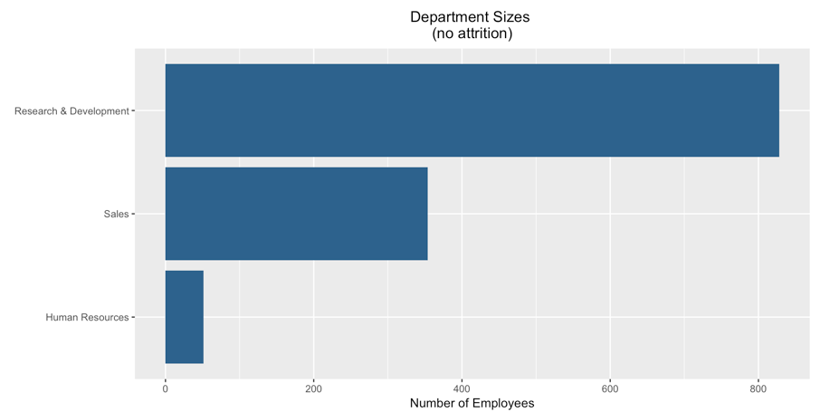

Slide 30
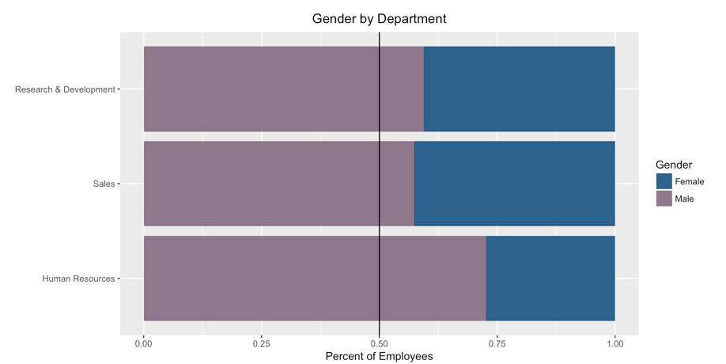

Slide 31
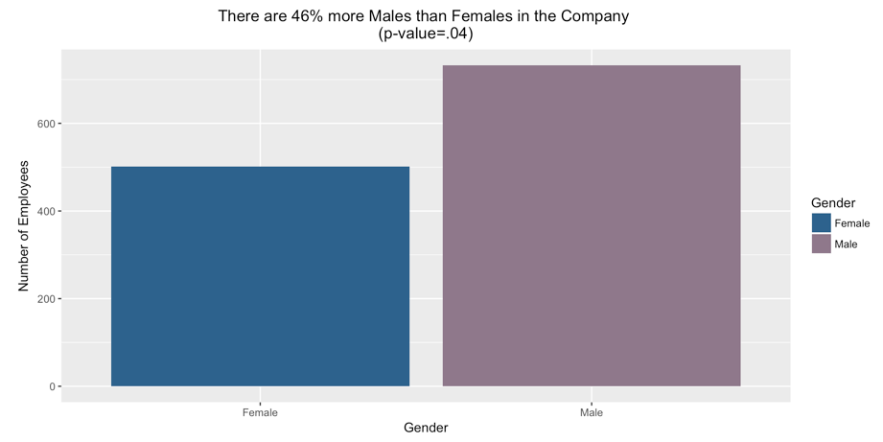

Slide 32
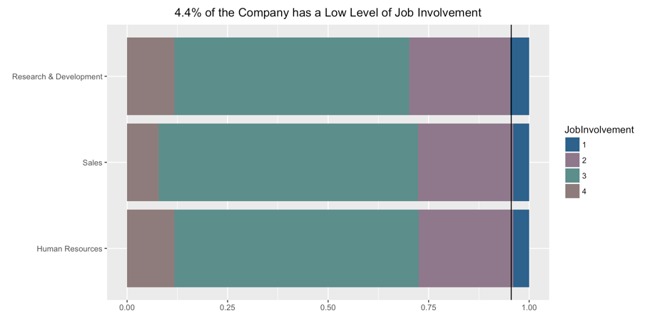

Slide 33
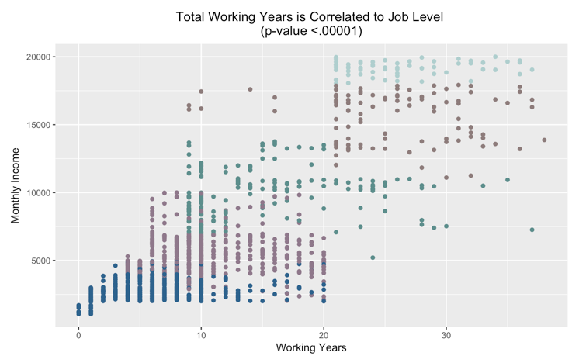

Slide 34
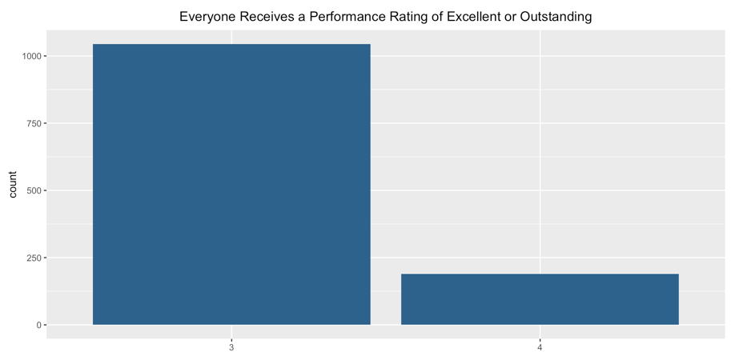

Slide 35
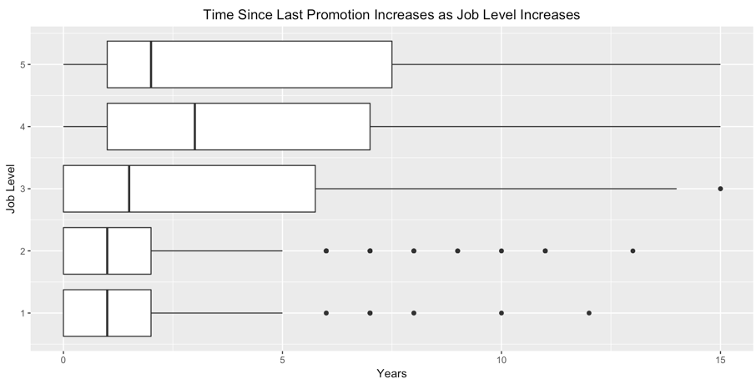

Slide 36
Job Satisfaction
Job Satisfaction Trends
Note: All analysis has been performed on employees only (No attrition participants)

Slide 37
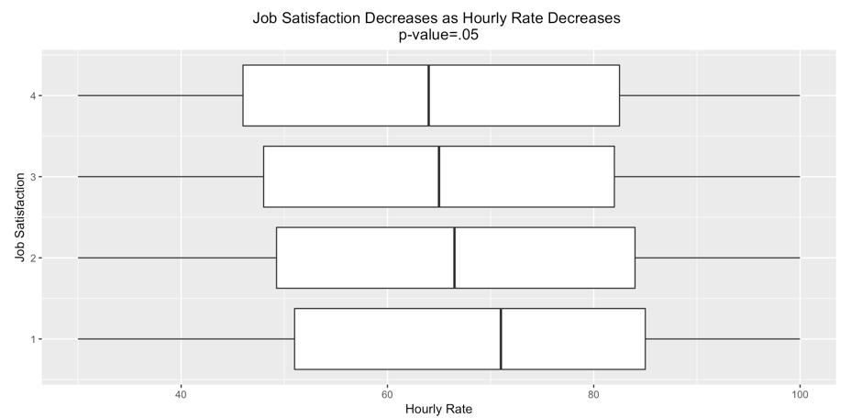
Job Satisfaction Increases with Decreasing Hourly Salary

Slide 38
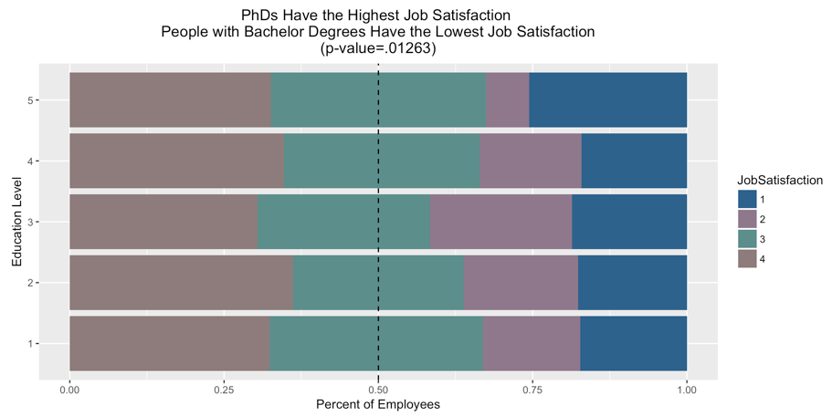

Slide 39
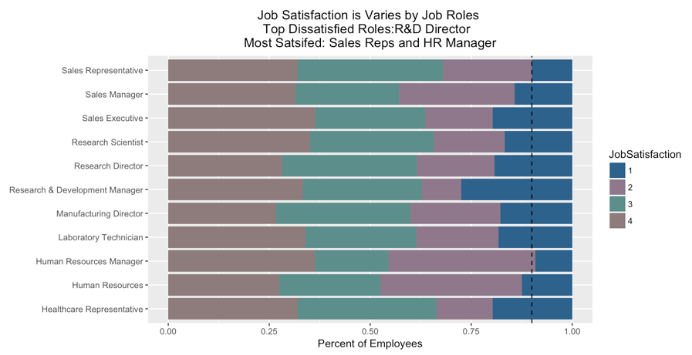

Slide 40
Interesting Findings
Other interesting findings from our analysis

Slide 41
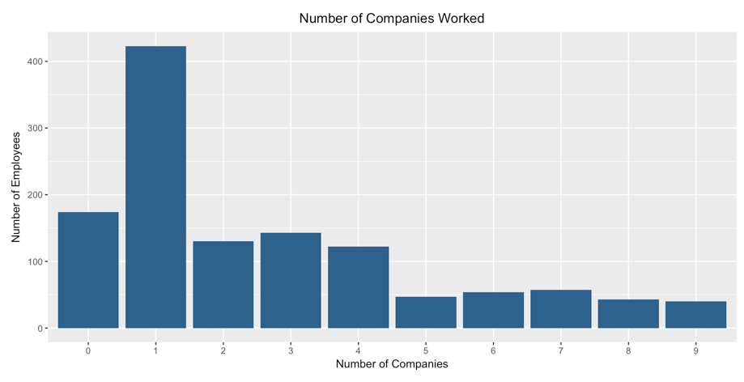

Slide 42
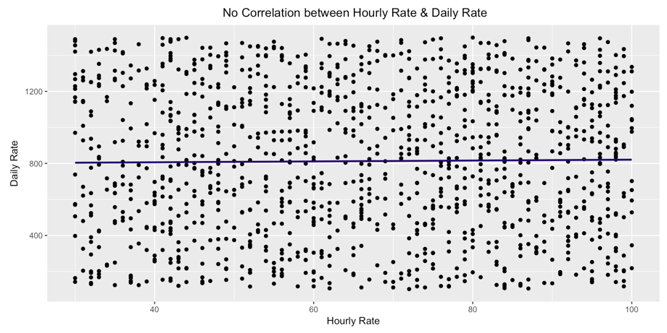
This is similar for Monthly Income vs. Daily Rate, Monthly Rate vs. Daily Rate, & Monthly Income vs. Monthly Rate

