Slide 1
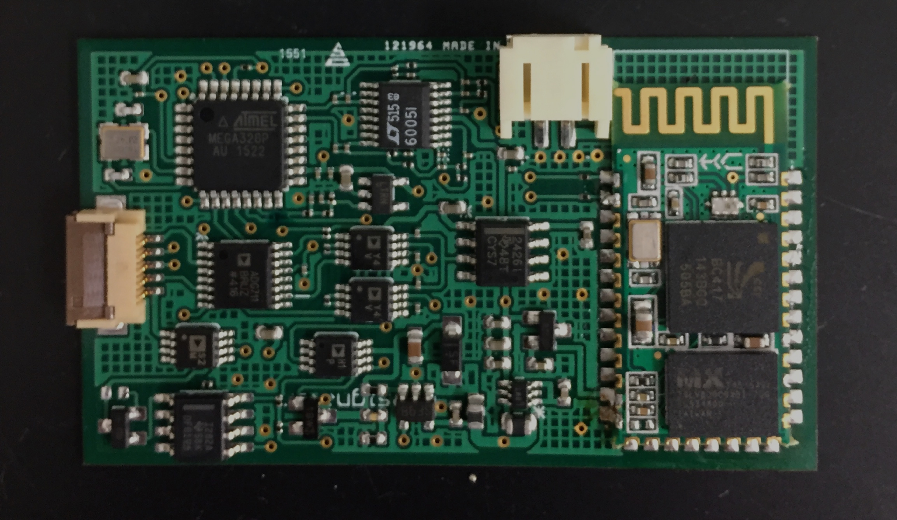
ATMega328P
Instrumentation
Amplifier +
filters
Bluetooth
Analog switches
Regulators
Current DAC

