Slide 1
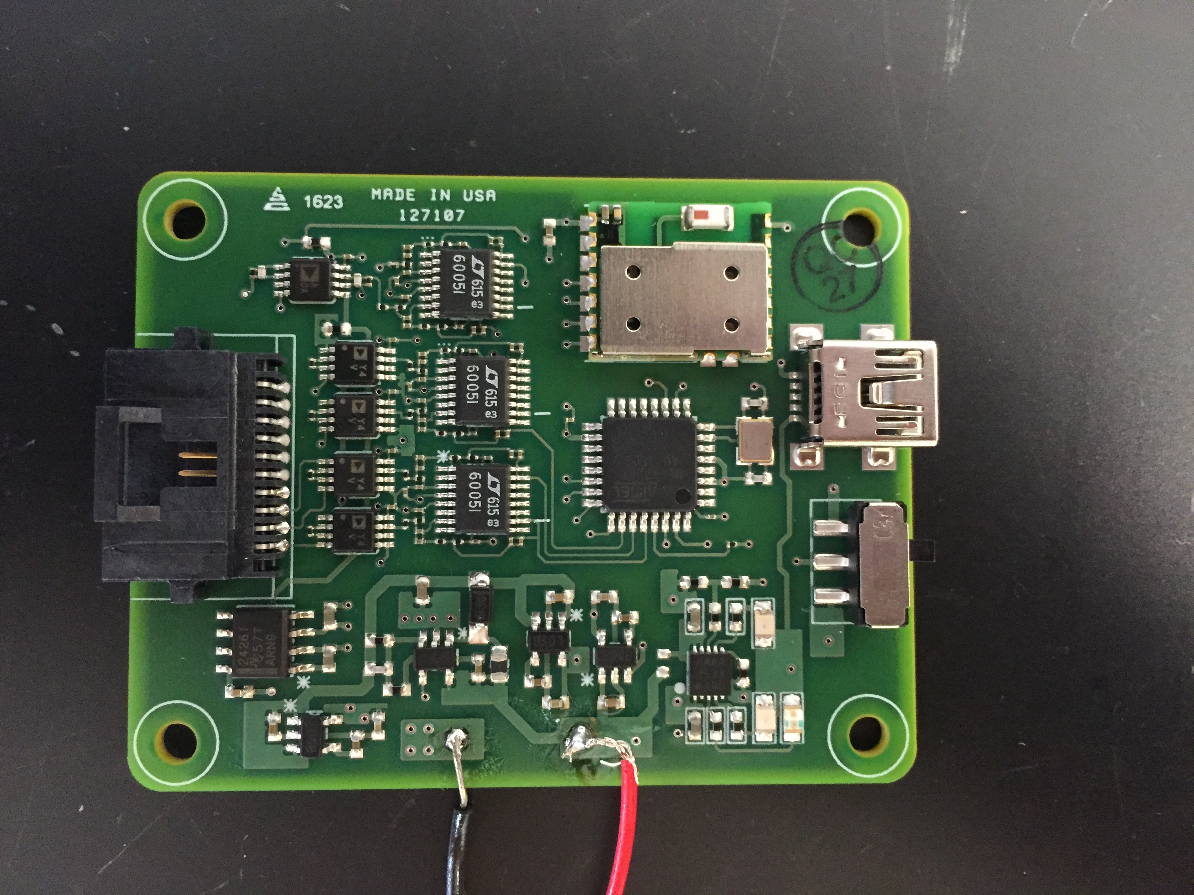
Current channels
Bluetooth
Voltage
channels
ATMega328P
ON/OFF switch
Charger
Regulators

