Slide 1
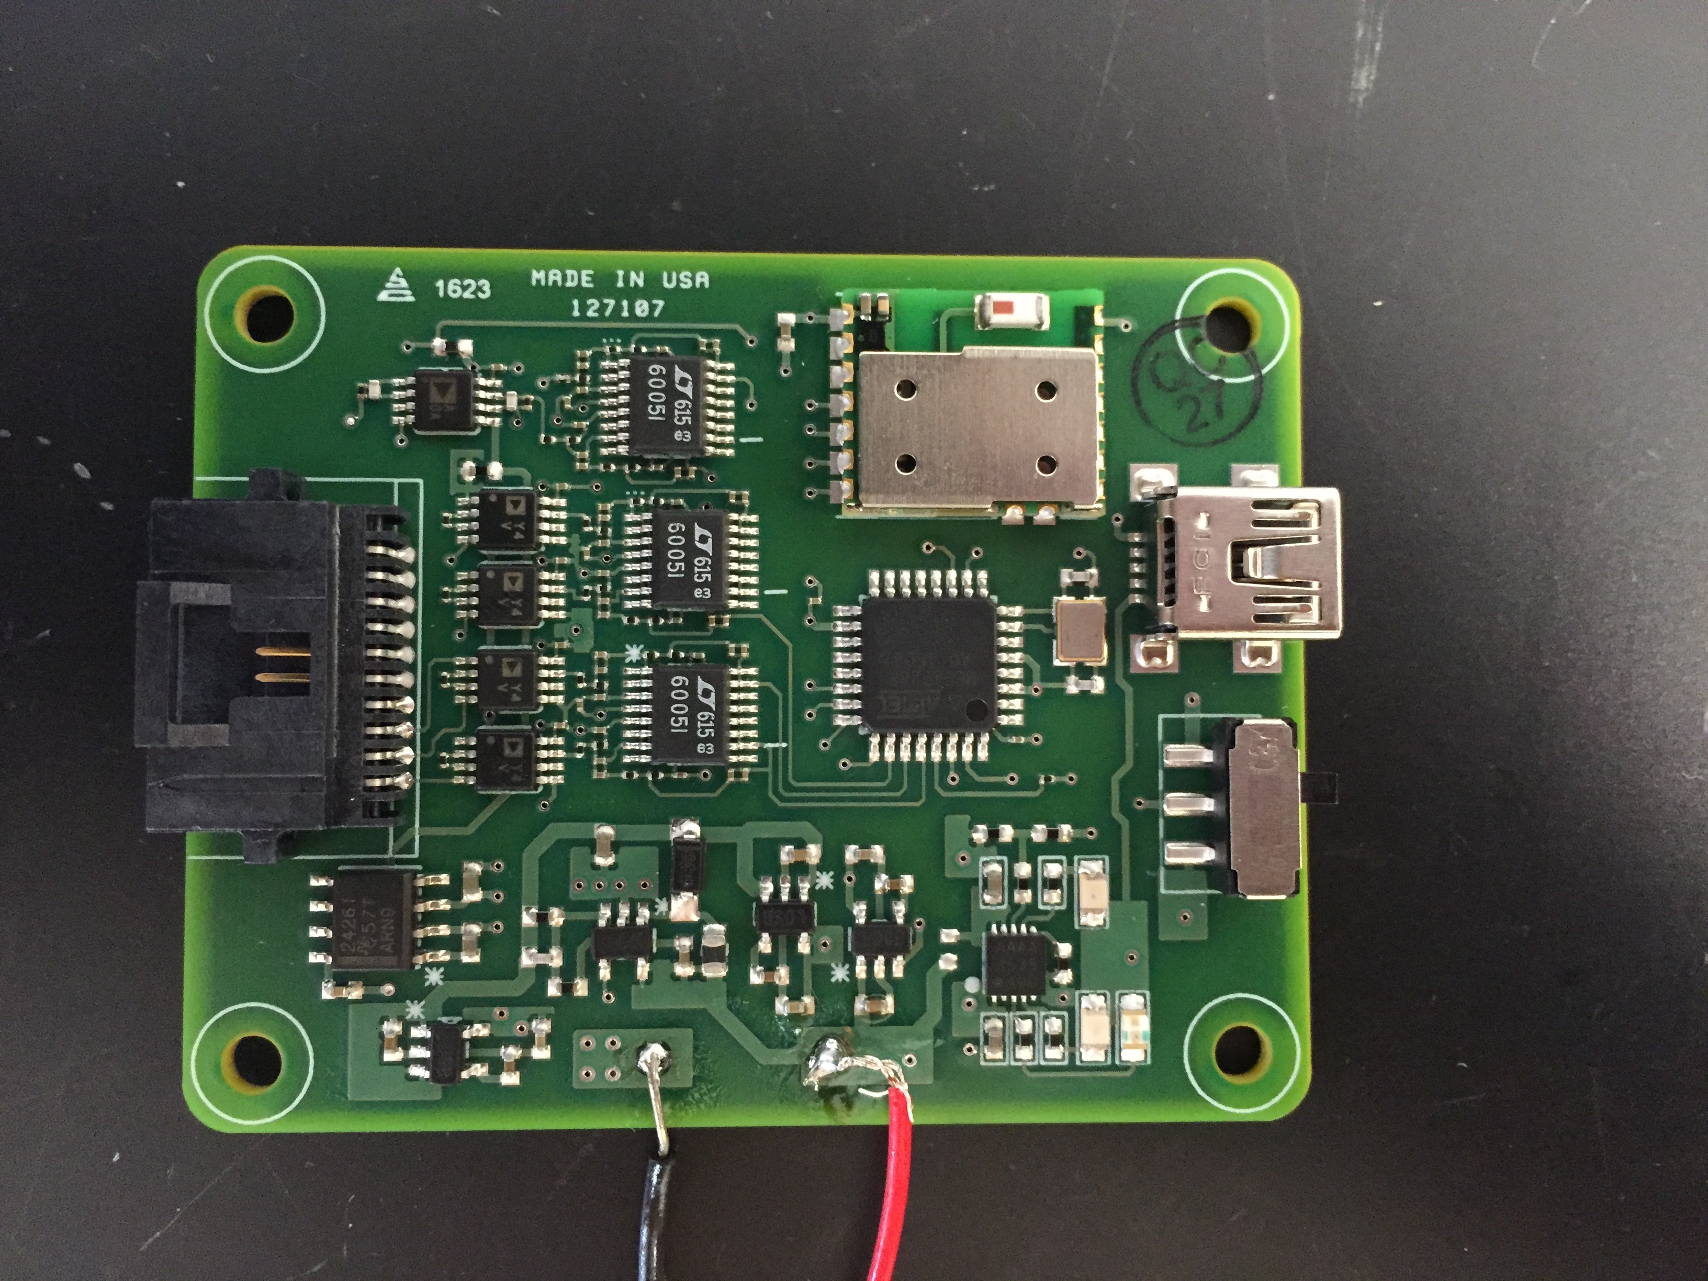
R6
R5
JUMPER

