Slide 1
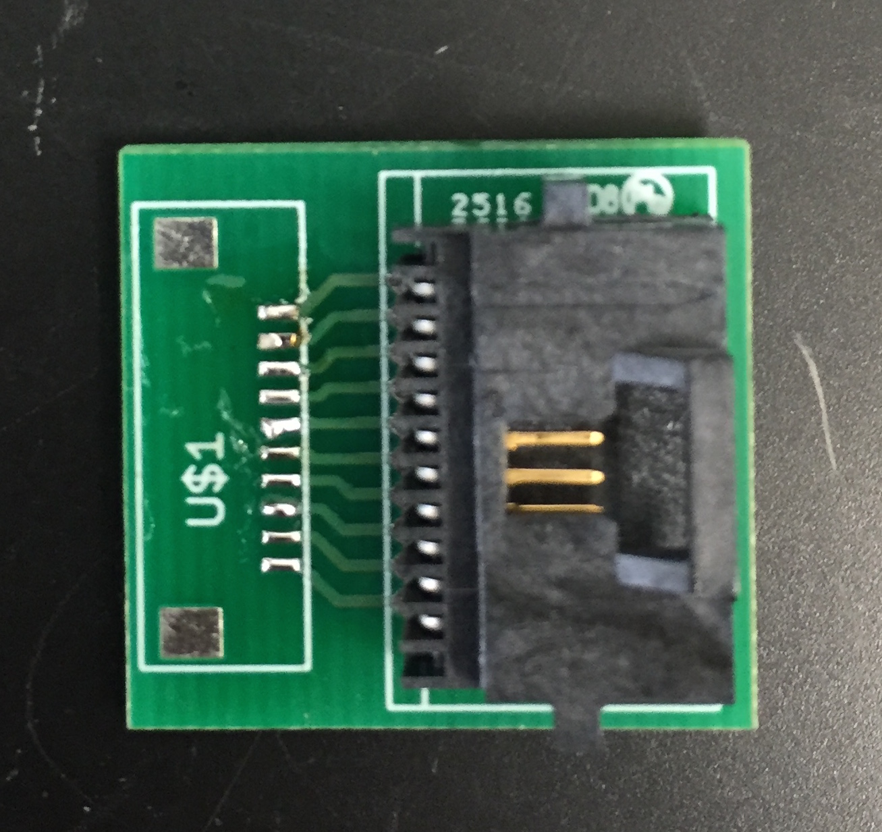
10-pin connector
FPC

