Slide 1
Collecting Data from Large Online Platforms
Using APIs, Web Scraping and DSA Applications
MethodsNET Summer School
29.06 – 03.01, 09:00 – 15:15
A201
Instructor:
Dr. Noëlle Sophie Lebernegg
noelle.lebernegg@wur.nl

Slide 2
Agenda for today…
Course overview and requirements
Introductions
Brief overview of access regimes
API Basics and first request
In-class exercise

Slide 3
Collecting Platform Data: Course Overview
Goal
Learn how to collect, document, and critically assess data from online platforms.
By the end of the week, participants can design and critique a reproducible platform data collection workflow.

Slide 4
Collecting Platform Data: Course Overview
Methods
Application Programming Interface (APIs)
Static web scraping
Browser automation
Platform/transparency tools
AI-assisted collection

Slide 5
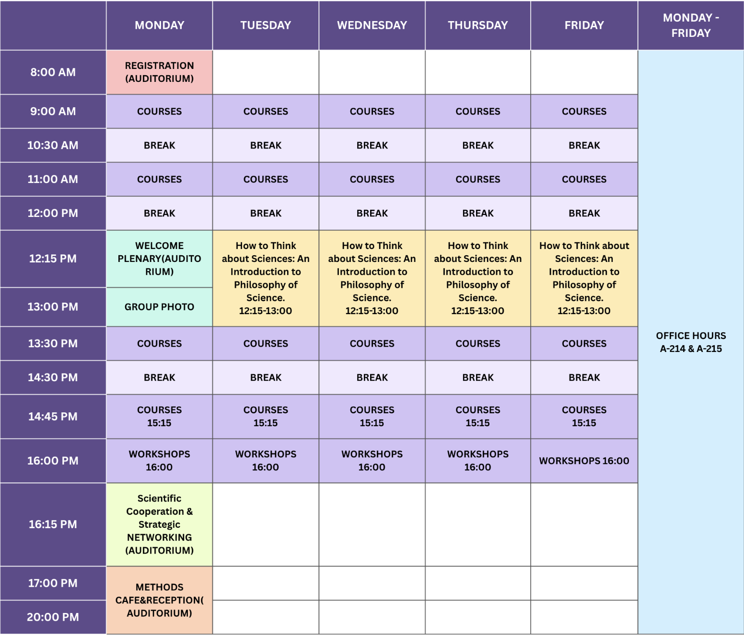
The Times

Slide 6
Requirements
2 ECTS
Attendance: 90%, i.e., a maximum of 2h can be missed
Daily assignments
Additional 2 ECTS
Final Submission

Slide 7
Daily Assignments
Submit in class exercises by end of each day
.py or .ipynb files only
Submission via Moodle

Slide 8
Final Submission
Submit a small, well-documented workflow that collects data from an online source relevant to your research.
Your submission should include:
a short research question / collection goal
one chosen data source and access route
runnable Python script or notebook
raw and processed data
provenance note: where the data came from, how collected, parameters/selectors, date, outputs
short reflection on data quality, limitations, ethics, and access conditions

Slide 9
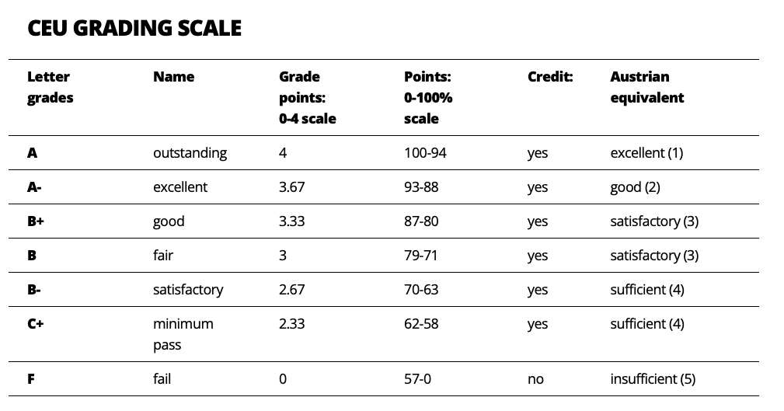
Grading

Slide 10
Course Material on GitHub
https://github.com/noellelebe/methodsNET_vlop-course-materials
Notes:
https://github.com/noellelebe/methodsNET_vlop-course-materials

Slide 11
Questions?

Slide 12
Introduction
Name and affiliation
Research area / current project
Your experience with Python / APIs / scraping
One thing you hope to get out of the course
One platform, website, or data source you are interested in
What kind of data you would like to collect or access
…

Slide 13
What is an Access Regime?
Access regime refers to how data access is organized
Varies by:
The technical route: such as API, scraping, dashboard, download
The rules: such as terms of service, eligibility, law, terms, regulation, data protection
The limits: such as fields, rate limits, time periods, and records are available
Notes:
An access regime is the technical, legal, and institutional arrangement through which researchers can get access to data.
An access regime is the combination of:
technical access: API, website, dashboard, download
institutional access: approval, account, researcher status
legal access: terms, regulation, data protection
methodological access: what fields, time periods, and records are available

Slide 14
Why Access Regimes Matter
What we can study depends on:
what platforms make visible
what interfaces allow us to collect
what gets filtered, ranked, hidden, or removed
what laws and terms permit
what technical systems return

Slide 15
Main Access Routes in this Course
Open or public APIs
Platform research APIs
Web scraping
Browser automation
AI-assisted collection workflows
Transparency databases
DSA-based researcher access

Slide 16
Application Programming Interface (APIs)
APIs allow software to request structured data from a system.
Examples:
Wikipedia / MediaWiki API
YouTube Data API
TikTok Research API
Reddit API
OpenAI API

Slide 17
Application Programming Interface (APIs)
Strengths:
structured responses
explicit parameters
reproducible requests
often easier to document
…
Limitations:
platform decides fields and limits
rate limits and authentication
missing deleted/hidden/ranked content
API data may not match user experience
…
Notes:
DOM = browser’s internal tree representation of a webpage.

Slide 18
Platform Research Tools
Platform-provided or platform-mediated systems for research/transparency access
Examples:
Meta Content Library
TikTok Research API
YouTube Data API
platform transparency dashboards
downloadable platform reports

Slide 19
Web Scraping
With web scraping, we can collect data from web pages
Useful when:
there is no suitable API
the public interface itself matters
data are visible in HTML
…

Slide 20
Web Scraping
Strengths:
observes browser-facing content
flexible across websites
can capture layout/context
…
Limitations:
fragile selectors
dynamic pages may hide content from requests
pages can change without warning
legal/ethical constraints
…

Slide 21
Transparency Databases and Ad Libraries
Transparency tools provide structured public or regulatory data
Examples:
DSA Transparency Database
Meta Ad Library
Google Ads Transparency Center
TikTok Commercial Content Library
LinkedIn Ad Library

Slide 22
Transparency Databases and Ad Libraries
Strengths:
designed for transparency
often searchable
useful for moderation or advertising research
Limitations:
partial reporting
platform-defined categories
missing context
varying quality and completeness

Slide 23
DSA-Based Researcher Access
The Digital Services Act (DSA) creates access mechanisms for studying systemic risks.
Relevant distinction:
public-data access
vetted researcher access to non-public data

Slide 24
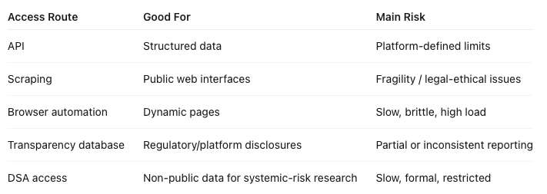
Comparing Access Routes

Slide 25
Questions?

Slide 26
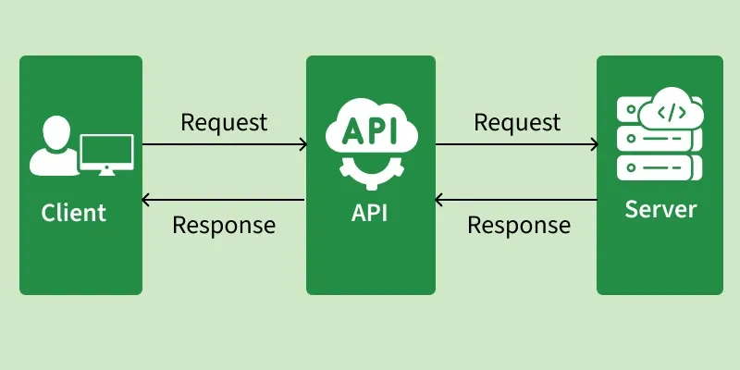
What is an API?
API = Application Programming Interface, i.e., a way for software systems to communicate.
Notes:
In research, APIs can help us collect structured data from platforms, databases, or services.

Slide 27
How APIs Work
APIs operate through a request response cycle between a client and a server
Request: The client sends a request to an API endpoint (URI).
Processing: The API forwards the request to the server.
Response: The server processes and sends back the requested data.
Delivery: The API returns the server’s response to the client.

Slide 28
Anatomy of an API request
An API request usually includes:
Endpoint: where the request goes
Method: what kind of request, e.g. GET or POST
Parameters: what we ask for
Headers: metadata about the request
Authentication: key/token if required

