Slide 1
Collecting Data from Large Online Platforms
From Notebook to Practical Workflow
MethodsNET Summer School
29.06 – 03.01, 09:00 – 15:15
A201
Instructor:
Dr. Noëlle Sophie Lebernegg
noelle.lebernegg@wur.nl

Slide 2
Agenda for today…
Turning one-off collectors into workflows that can be rerun, audited, monitored, and explained
From Notebook to “automatable” script (.ipynb → .py)
From Script to Workflow
Reproducibility
Practicality
Notes:
One-off script: runs in the current environment, writes a table, depends on memory to explain what happened.
Reproducible workflow: records inputs, parameters, raw evidence, outputs, logs, checks, code state, and limits.
Today’s shift: not more scraping tricks, better collection operations.
Main question: what must surround a collector before anyone schedules it?

Slide 3
From Notebook to “automatable” script
1. Notebook vs. Runnable Script (i.e., .ipynb vs. .py)
Notebooks are good for explanation and classroom inspection.
Scripts are better for repeatable collection work.
Scheduled and command-line processes should call (.py) scripts, not notebooks.

Slide 4
From Notebook to “automatable” script
2. From Manual Script To Automatable Script
runs top-to-bottom without manual edits
ideally, functions instead of loose copied blocks
accepts settings as arguments
gives clear errors when something breaks
Notes:
Readability: one can see the workflow at a glance.
Reusability: you can call extract_quotes() on page 1, page 2, page 3, etc.
Testing/checking: you can test one part without running the whole scraper.
Debugging: if extraction breaks, you know where to look.
Automation: the scheduled script can run the same reliable steps every time.
Less copy-paste: if the extraction logic changes, you update it in one place.

Slide 5
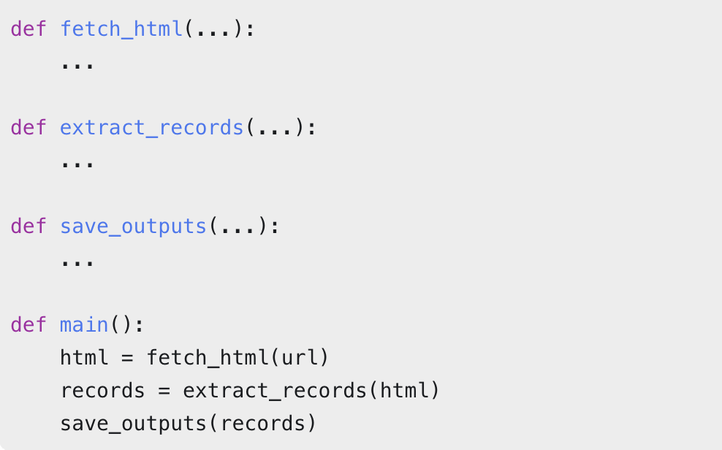
From Notebook to “automatable” script
From Manual Script To Automatable Script

Slide 6
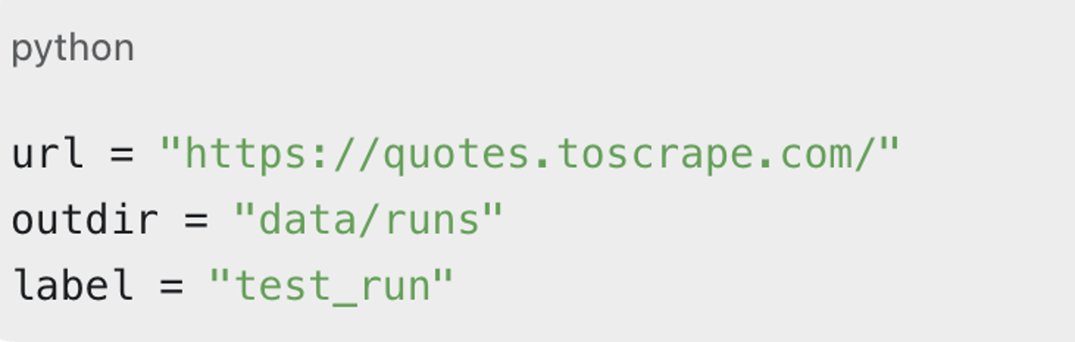
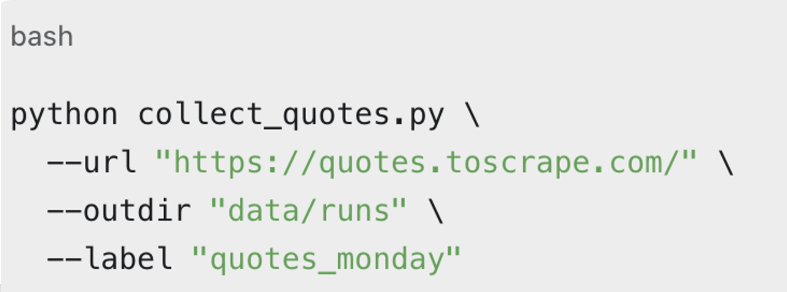
From Notebook to “automatable” script
From Manual Script To Automatable Script

Slide 7
From Script to Workflow: Reproducibility
Command: command-line arguments
Inputs: e.g., URLs, queries, config, credentials policy
Code: script path, Git commit, Git status
Environment: Python and package versions
Evidence: raw HTML, JSON, screenshots, logs
Outputs: processed tables and reports
Limits: failures, exclusions
Notes:
Configuration
Write a Manifest/Provenance

Slide 8
From Script to Workflow: Reproducibility
Configuration: Plan before the run
Inputs: e.g., URLs, queries, config, credentials policy
Access: User-Agent, credentials/secrets, limits
Code: script path, Git commit, Git status
…
Notes:
- Command: script or notebook command to run
- Inputs: endpoint, query, page size, output folder
- Access policy: User-Agent, credentials/secrets policy, limits
- Expected outputs: raw evidence, processed table, reports
- Checks to apply: required columns, minimum rows, missing values

Slide 9
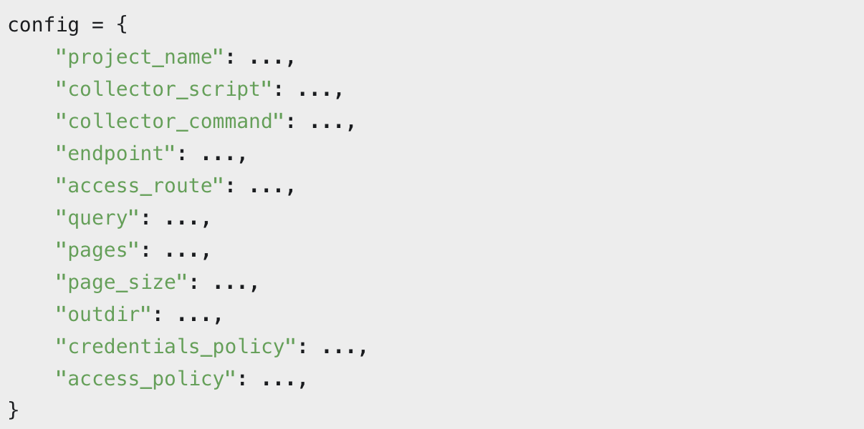
From Script to Workflow: Reproducibility
Configuration:

Slide 10
From Script to Workflow: Reproducibility
Manifest/Provenance: Record after the run
Parameters: config file, query, page size, number of pages, command arguments.
Evidence: raw HTML, JSON, screenshots, logs
Outputs: raw files, processed tables, reports, file sizes, checksums.
Notes: limitations, assumptions, warnings, failures, exclusions
…
Notes:
Configuration
Write a Manifest/Provenance

Slide 11
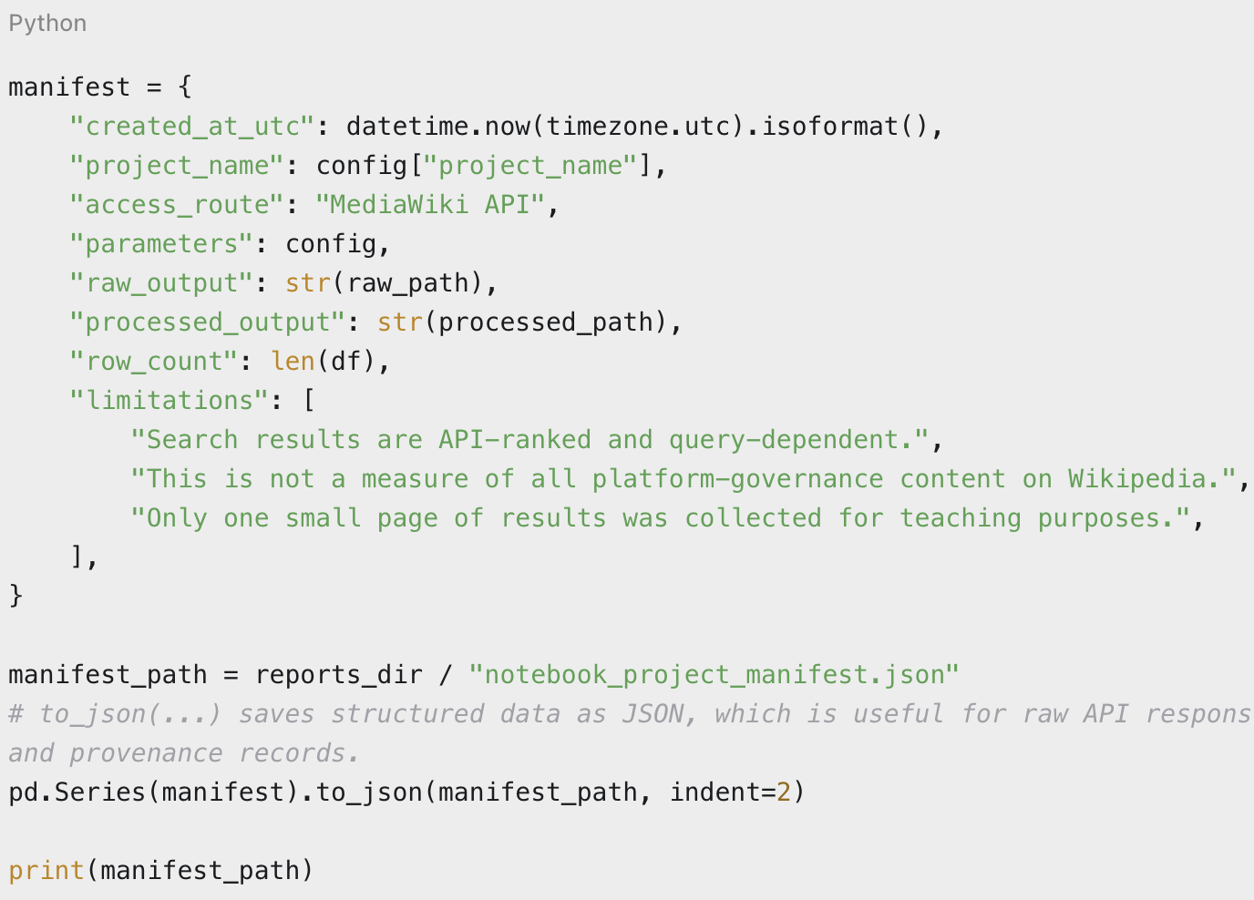
From Script to Workflow: Reproducibility
Manifest/Provenance:

Slide 12
From Script to Workflow: Practical Collection Workflow
Run folders: one folder per execution
Logging: what happened during a run
Versioning: which code, Python version, and package versions produced the output
Monitoring: whether the run produced plausible output
Scheduling: when and how the collector should run

Slide 13
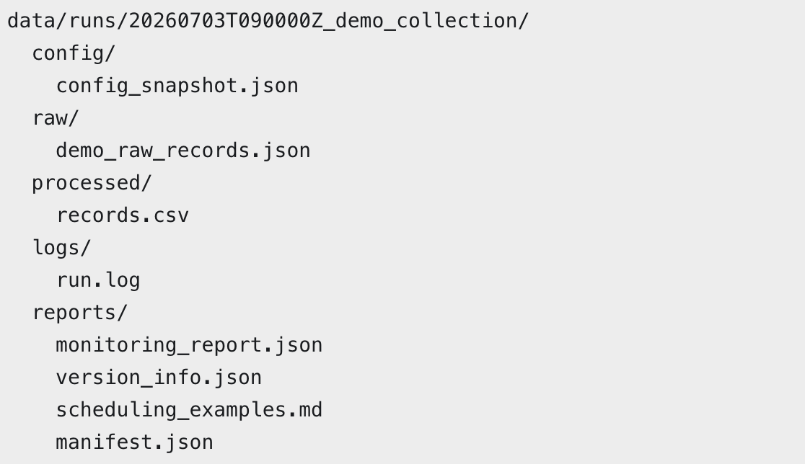
Run Folders

Slide 14
Logging
Logging means keeping notes of what happened during the run
when the run started and ended
which collector/config was used
where raw and processed outputs were written
how many records were collected
warnings about empty results, failed requests, missing fields, or selector changes
errors that need inspection.
Notes:
One folder means one inspectable execution.
Raw and processed files stay separate.
Reports explain the run without opening the code.
Runs can be compared when something changes.

Slide 15
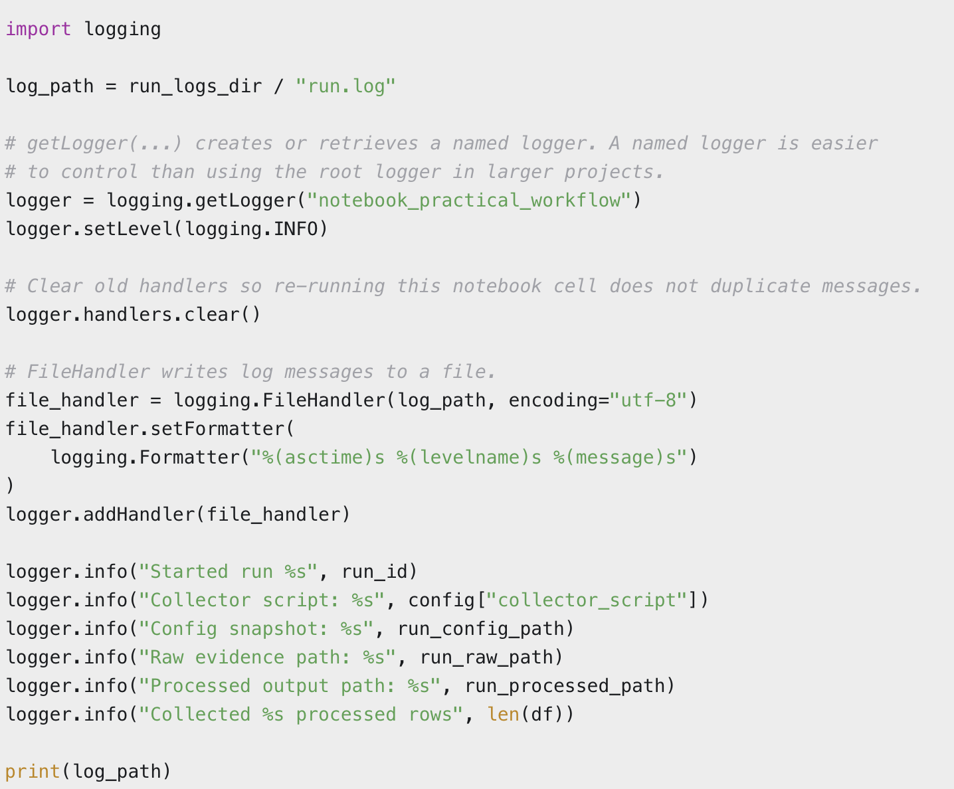
Logging
Notes:
One folder means one inspectable execution.
Raw and processed files stay separate.
Reports explain the run without opening the code.
Runs can be compared when something changes.

Slide 16
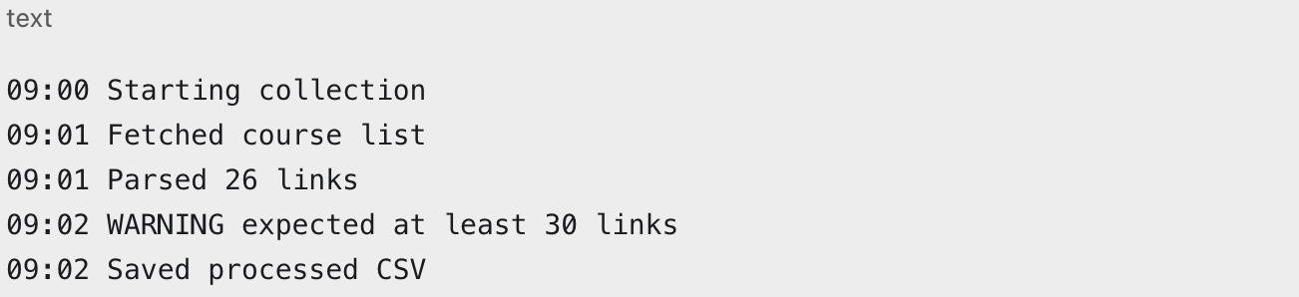
Logging
Logging means keeping notes of what happened during the run
Notes:
One folder means one inspectable execution.
Raw and processed files stay separate.
Reports explain the run without opening the code.
Runs can be compared when something changes.

Slide 17
Monitoring
Did the collector produce output that looks operationally plausible?
Did we get zero rows?
Are required columns missing/empty?
Did we get many 403, 404, or 429 status codes?
Did a selector stop matching?
Did the output file actually get written?
Notes:
One folder means one inspectable execution.
Raw and processed files stay separate.
Reports explain the run without opening the code.
Runs can be compared when something changes.

Slide 18
Versioning
Versioning records the computational context
script name
Python version
package versions
command-line arguments
Git commit/git status
Notes:
One folder means one inspectable execution.
Raw and processed files stay separate.
Reports explain the run without opening the code.
Runs can be compared when something changes.

Slide 19
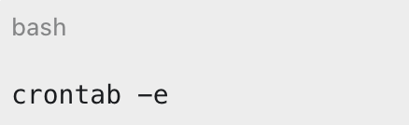
Scheduling via Cron
Scheduling means running a collector automatically at a defined time.
Cron is a scheduler on Linux/macOS
Edit scheduled commands via command-line (Terminal):
Notes:
One folder means one inspectable execution.
Raw and processed files stay separate.
Reports explain the run without opening the code.
Runs can be compared when something changes.

Slide 20
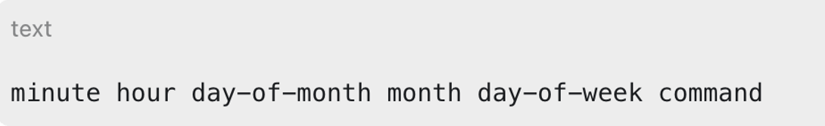
Scheduling via Cron
1. Edit scheduled commands via command-line (Terminal):
2. Cron Syntax:
Notes:
One folder means one inspectable execution.
Raw and processed files stay separate.
Reports explain the run without opening the code.
Runs can be compared when something changes.

Slide 21
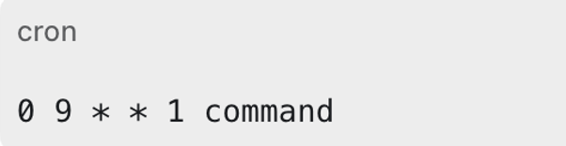
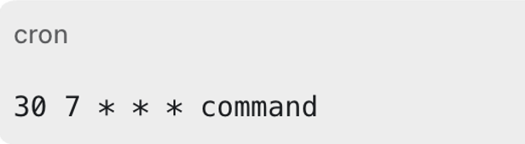
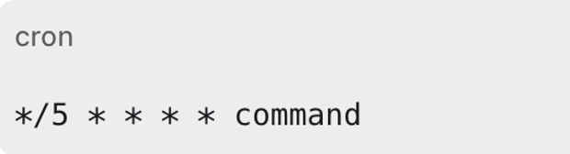
run at minute 0, hour 9, every day-of-month, every month, on weekday 1 = Monday
run every day at 07:30
run every 5 minutes.

Slide 22
Scheduling via Cron
Example:
0 9 * * 1 run every Monday at 09:00
cd methodsNET move into the project folder
python ... run the workflow script
>> logs/... append output to a log file
2>&1 send errors to the same log file
Notes:
One folder means one inspectable execution.
Raw and processed files stay separate.
Reports explain the run without opening the code.
Runs can be compared when something changes.
every minute
every hour
every day of the month
every month
every day of the week
* * * * * cd /Users/noelle/Documents/methodsNET && \
python scripts/runnable_workflows/01_api_wikipedia.py \
--query "digital services act" \
--pages 1 \
--page-size 2 \
--extract-chars 300 \
--run-label wiki_every_minute \
--outdir data/runs \
>> data/wikipedia_api_cron.log 2>&1

Slide 23
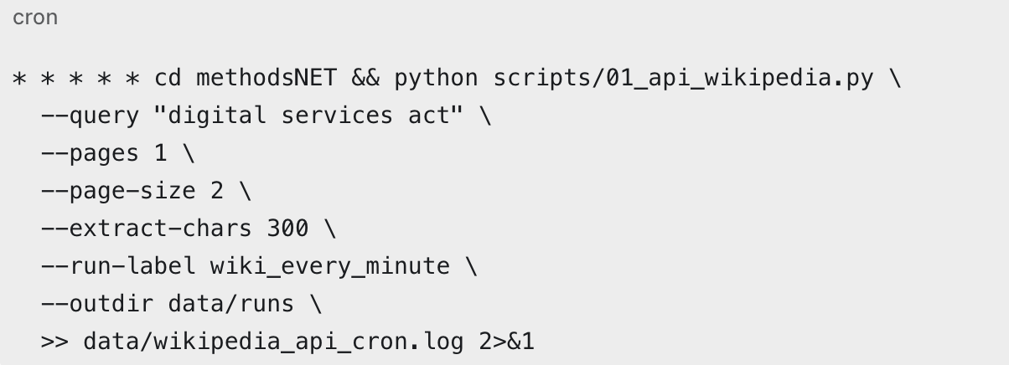
Scheduling via Cron
* * * * * run once every minute
cd methodsNET move into the project folder first
python ... run the Wikipedia API workflow script
--query search term sent to the API
--pages number of search-result batches
--page-size number of search results per batch
--extract-chars article text length to request
--run-label readable label in the run-folder name
--outdir where timestamped run folders are written
>> ... append terminal output to a cron log
2>&1 send errors to the same log file
Notes:
One folder means one inspectable execution.
Raw and processed files stay separate.
Reports explain the run without opening the code.
Runs can be compared when something changes.
every minute
every hour
every day of the month
every month
every day of the week
* * * * * cd /Users/noelle/Documents/methodsNET && python3 scripts/runnable_workflows/01_api_wikipedia.py --query "digital services act" --pages 1 --page-size 2 --extract-chars 300 --run-label wiki_every_minute --outdir data/runs >> data/wikipedia_api_cron.log 2>&1
* * * * cd /Users/noelle/Documents/methodsNET &&
/opt/anaconda3/bin/python3
/Users/noelle/Documents/methodsNET/scripts/runnable_workflows/01_api_wikipedia.py --query "digital services act" --pages 1 --page-size 2 --extract-chars 300 --run-label wiki_every_minute --outdir data/runs
/Users/noelle/Documents/methodsNET/scripts/runnable_workflows

Slide 24
Scheduling via Cron
Edit scheduled commands via command-line (Terminal):
crontab –e
add cronjob
close crontab and save cronjob with ESC → :wq
Notes:
One folder means one inspectable execution.
Raw and processed files stay separate.
Reports explain the run without opening the code.
Runs can be compared when something changes.

Slide 25
Exercise
Create a .py file with any kind of workflow,
can be some random function or a runnable workflow as shown in any *simple.py runnable file on github
Make it ”automatable”
Include monitoring checks and logging
Create a versioning file
Create a manifest/provenance and/or configuration file
Set up a cronjob
Let it run

