Slide 1
Collecting Data from Large Online Platforms
Using APIs, Web Scraping and DSA Applications
MethodsNET Summer School
29.06 – 03.01, 09:00 – 15:15
WHERE?
Instructor:
Dr. Noëlle Sophie Lebernegg
noelle.lebernegg@wur.nl

Slide 2
Agenda for today…
Today’s goal:
send an API request (we use the MediaWiki API as example)
inspect the response
understand JSON
turn search results into a table
follow pagination
retrieve page-level data

Slide 3
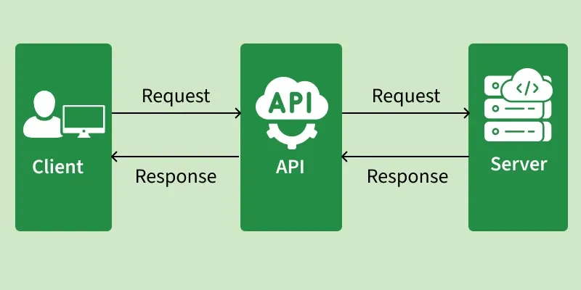
What is an API?
API = Application Programming Interface, i.e., a way for software systems to communicate.
Notes:
In research, APIs can help us collect structured data from platforms, databases, or services.

Slide 4
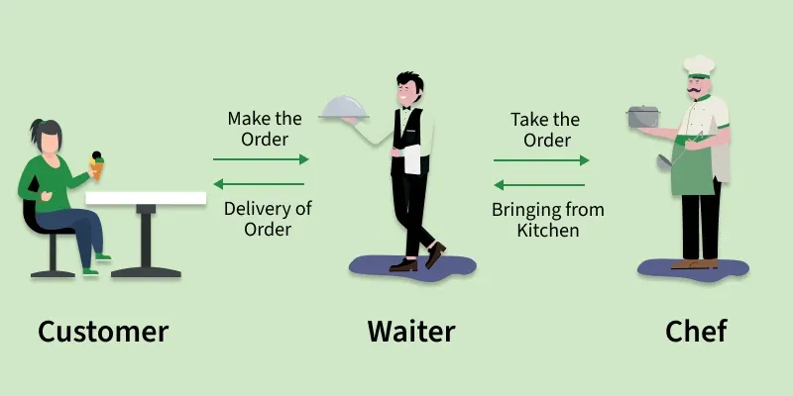
What is an API?
API = Application Programming Interface, i.e., a way for software systems to communicate.
Notes:
Images taken from: https://www.geeksforgeeks.org/software-testing/what-is-an-api/
Imagine you’re at a restaurant:
You (the client) place an order with the waiter.
The waiter (the API) conveys your request to the chef (the server).
The chef prepares the food (processes the request) and gives it to the waiter.
The waiter delivers it back to your table (response).

Slide 5
How APIs Work
APIs operate through a request response cycle between a client and a server
Request: The client sends a request to an API endpoint (URI).
Processing: The API forwards the request to the server.
Response: The server processes and sends back the requested data.
Delivery: The API returns the server’s response to the client.

Slide 6
Anatomy of an API request
An API request usually includes:
Endpoint: where the request goes
Method: what kind of request, e.g. GET or POST
Parameters: what we ask for
Headers: metadata about the request
Authentication: key/token if required
e.g., MediaWiki API: https://en.wikipedia.org/w/api.php

Slide 9
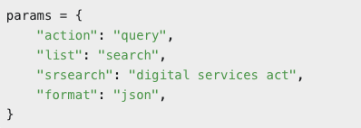
Parameters to specify requests
Use the query action
Return search results
Search for “digital services act”
Return JSON

Slide 10
Parameters to specify requests
Other parameters are, for example
search term
result limit
language
date range
sorting
filters
content type
Notes:
Changing parameters changes the dataset.
Examples:
search term
result limit
language
date range
sorting
filters
content type

Slide 11

Headers and User Agents
A User-Agent identifies the script.
Good practice:
identify automated requests honestly
use timeouts
respect rate limits
follow API documentation
Notes:
MORE about headers?!
Identify your script honestly (user-agent)
Use a timeout.
Respect rate limits.
Read the documentation.

Slide 12
The Response Object
Contains..
response.url
response.status_code
response.headers
response.text
Notes:
Line breaks in code!

Slide 13
Status Codes
Common HTTP status codes:
200 = OK
400 = bad request
401 = authentication needed
403 = forbidden
404 = not found
429 = too many requests
500+ = server-side problem

Slide 14
Status Codes
Common HTTP status codes:
200 = OK
400 = bad request
401 = authentication needed
403 = forbidden
404 = not found
429 = too many requests
500+ = server-side problem
Good habit:
If the response status is OK (i.e., 200), nothing happens..
If the response status code indicates an error, then this stops the script and raises an error

Slide 15

JSON Payload
Other parameters are, for example
search term
result limit
language
date range
sorting
filters
content type
Notes:
Changing parameters changes the dataset.
Examples:
search term
result limit
language
date range
sorting
filters
content type

Slide 16
APIs: First Access Route

Slide 17
APIs: First Access Route

Slide 18
APIs: First Access Route

