Slide 1
HTML Workshop
The Basic Of HTML

Slide 2
Topics covered
Introduction to web development
Front-end development
Back-end development
Html vs Html & CSS
HTML elements
Head elements
Body elements
Example

Slide 3
Introduction to web development
AKA web programming
Social networking sites (Facebook) / e-commerce sites (Amazon)
2 broad divisions of web development:
Front-end development / client-side development (Browser)
Back-end development / server-side development (Server)
http://www.codeconquest.com/what-is-coding/web-programming/

Slide 4
Front-end development
Able to view when loading a web application
content, design & how you interact with it
Hyper Text Markup Language (HTML)
‘marking up text’ to turn into a web page
Cascading Style Sheets (CSS)
code for setting style rules for appearance of web pages
JavaScript
widely used → add functionality & interactivity to web pages
http://www.codeconquest.com/what-is-coding/web-programming/

Slide 5
Back-end development
Business logic and data persistent
How do you sell your product on e-commerce website?
How do you search and buy product?
How to determine the hot product?
Advertisement?
Examples: PHP, Node.js, Python
http://www.codeconquest.com/what-is-coding/web-programming/

Slide 6
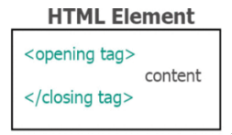
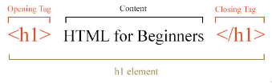
how do we create new HTML element?

Slide 7
Tag and element
Tags:
This is a opening tag. <p>
This is a closing tag. </p>
This is a self-closing tag. <br/>
Elements:
This is an element. <p></p>
We call it <p> element
Tags create Elements
Tags create Elements, Elements create your websites.

Slide 8
Main Root
Element | Description
<html> | The root (top-level element) of an HTML document (root element).
https://developer.mozilla.org/en-US/docs/Web/HTML/Element

Slide 9
Head elements
Provides general information (metadata) about the document, including its title and links to its scripts and stylesheets
<title>, <link>, <meta>, <script>
Hidden from the user
<head> <title>Home</title> </head>

Slide 10
Body elements
The content of an HTML document
Can be only one <body> element in a document
Able to view by users
<body> <h1>Welcome To My Website</h1> <img src="images/profile_pic.jpg"> <p>Hello, Nice to meet you</p> </body>

Slide 11
Document metadata
Element | Description
<link> | Specifies relationships between the current document and an external resource. This element is most used to link to style sheets.
<meta> | Metadata that cannot be represented by other HTML meta-related elements, like <base>, <link>, <script>, <style> or <title>.
<style> | Contains style information for a document, or part of a document.
<title> | Defines the title of the document, shown in a browser's title bar or on the page's tab.

Slide 12
Sectioning root
Element | Description
<body> | Content of an HTML document. There can be only one <body> element in a document.

Slide 13
Content sectioning
Element | Description
<footer> | Contains information about the author of the section, copyright data or links to related documents.
<header> | Introductory content, typically a group of introductory or navigational aids. It may contain some heading elements but also other elements like a logo, a search form, an author name, and so on.

Slide 14
<h1>, <h2> <h3>, <h4> <h5>, <h6> | Six levels of section headings. <h1> is the highest section level and <h6> is the lowest.
<hgroup> | Multi-level heading for a section of a document. It groups a set of <h1>–<h6> elements.
<nav> | Provide navigation links, either within the current document or to other documents. Common examples: menus, tables of contents, and indexes.
<section> | A standalone section — which doesn't have a more specific semantic element to represent it — contained within an HTML document.

Slide 15
Text content
Element | Description
<bloackquote> | The enclosed text is an extended quotation. Rendered visually by indentation.
<dd> | Provides the details about or the definition of the preceding term (<dt>) in a description list (<dl>).
<dl> | A description list. The element encloses a list of groups of terms (specified using the <dt> element) and descriptions (provided by <dd> elements). Common used to display a list of key-value pairs.

Slide 16
<dt> | Display a term in a description or definition list, and as such must be used inside a <dl> element.
<div> | Generic container for flow content. It has no effect on the content or layout until styled using CSS.
<li> | An item in a list. It must be contained in a parent element: an ordered list (<ol>), an unordered list (<ul>), or a menu (<menu>). In menus and unordered lists, list items are usually displayed using bullet points. In ordered lists, they are usually displayed with an ascending counter on the left, such as a number or letter.
<main> | Dominant content of the <body> of a document, portion of a document or application. Contents in <main> related to or expands upon the central topic of a document, or the central functionality of an application.

Slide 17
<ol> | Ordered list of items, typically rendered as a numbered list.
<ul> | Unordered list of items, typically rendered as a bulleted list.
<p> | A paragraph of text.

Slide 18
Inline text semantics
Element | Description
<a> | Anchor element which use for hyperlink to other web pages, files, locations within the same page, email addresses or other URLs
<b> | Bold
<br> | A line break in text (carriage-return). Useful for writing a poem or an address, where the division of lines is significant.
<em> | Marks text that has stress emphasis
<i> | Display words in italic

Slide 19
<mark> | Text which is marked or highlighted for reference or notation purposes
<small> | Text font size one size smaller (for example, from large to medium, or from small to x-small) down to the browser's minimum font size.
<strong> | Bold
<span> | Generic inline container for phrasing content. Used to group elements for styling purposes (using the class or id attributes).

Slide 20
Image & multimedia
Element | Description
<audio> | Embed sound content in documents. May contain one or more audio sources, use src attribute or the <source> element: browser will choose the most suitable one.
<img> | Embeds an image into the document
<video> | Embeds a media player which supports video playback into the document

Slide 21
Table content
Element | Description
<caption> | Specifies the caption (or title) of a table in the first child of the <table>
<table> | Represents tabular data, information presented in a two-dimensional table comprised of rows and columns of cell containing data
<col> | A column within a table
<td> | Cell of a table that contains data
<th> | A cell as header of a group of table cells
<tr> | A row of cells in a table

Slide 22
forms
Elements | Description
<button> | A clickable button
<fieldset> | Used to group several controls as and labels within a web form
<form> | A document section that contains interactive controls for submitting information to a web server
<input> | Use to create interactive controls for web-based forms to accept data from the user
<label> | A caption for an item in a user interface

Slide 23
<legend> | Caption of the content of its parent <fieldset>
<option> | Menu items in popups and other lists of items in an HTML document
<select> | A control that provides a menu of options:
<textarea> | Multi-line plain0text editing control

Slide 24
Practical TIme

Slide 25
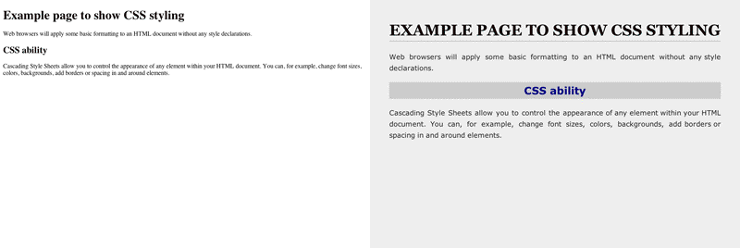
Html vs html & css

Slide 26
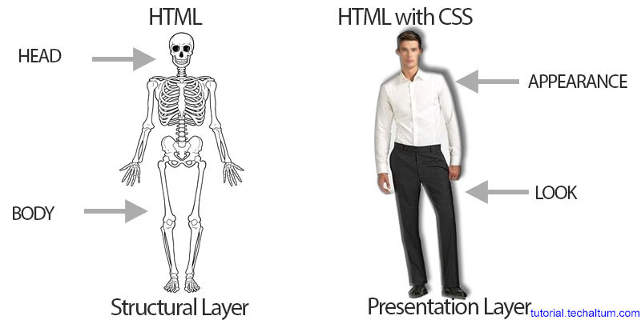
HTML & CSS metaphor

