Slide 1
AppLaunch
AppLaunch
WebLaunch

Slide 2
HTML Workshop
The Basic Of HTML

Slide 3
Rules
Thou shall asketh thy question if thou hast one
Thou shall not laugh at questions of others
The world existeth no stupid questions
Existeth only people who brave not to asketh
Do unto other as thou would do unto thyself
Thou shalt convenant to follows the common rules

Slide 4
Introduction to web development
AKA web programming
Social networking sites (Facebook) / e-commerce sites (Amazon)
2 broad divisions of web development:
Front-end development / client-side development (Browser)
Back-end development / server-side development (Server)
http://www.codeconquest.com/what-is-coding/web-programming/

Slide 5
Front-end development
Able to view when loading a web application
content, design & how you interact with it
Hyper Text Markup Language (HTML)
‘marking up text’ to turn into a web page
Cascading Style Sheets (CSS)
code for setting style rules for appearance of web pages
JavaScript
widely used → add functionality & interactivity to web pages
http://www.codeconquest.com/what-is-coding/web-programming/

Slide 6
Back-end development
Business logic and data persistent
How do you sell your product on e-commerce website?
How do you search and buy product?
How to determine the hot product?
Advertisement?
Examples: PHP, Node.js, Python
http://www.codeconquest.com/what-is-coding/web-programming/

Slide 7
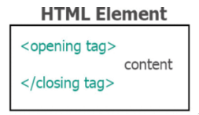
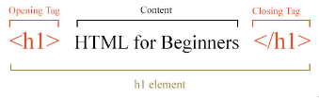
how do we create new HTML element?

Slide 8
Tag and element
Tags:
This is a opening tag. <p>
This is a closing tag. </p>
This is a self-closing tag. <br/>
Elements:
This is an element. <p></p>
We call it <p> element
Tags create Elements
Tags create Elements, Elements create your websites.

Slide 9
Main Root
Element | Description
<html> | The root (top-level element) of an HTML document (root element).
https://developer.mozilla.org/en-US/docs/Web/HTML/Element

Slide 10
Head elements
Provides general information (metadata) about the document, including its title and links to its scripts and stylesheets
<title>, <link>, <meta>, <script>
Hidden from the user
<head> <title>Home</title> </head>

Slide 11
Body elements
The content of an HTML document
Can be only one <body> element in a document
Able to view by users
<body> <h1>Welcome To My Website</h1> <img src="images/profile_pic.jpg"> <p>Hello, Nice to meet you</p> </body>

Slide 12
Document metadata
Element | Description
<link> | Specifies relationships between the current document and an external resource. This element is most used to link to style sheets.
<meta> | Metadata that cannot be represented by other HTML meta-related elements, like <base>, <link>, <script>, <style> or <title>.
<style> | Contains style information for a document, or part of a document.
<title> | Defines the title of the document, shown in a browser's title bar or on the page's tab.

Slide 13
Sectioning root
Element | Description
<body> | Content of an HTML document. There can be only one <body> element in a document.

Slide 14
Content sectioning
Element | Description
<footer> | Contains information about the author of the section, copyright data or links to related documents.
<header> | Introductory content, typically a group of introductory or navigational aids. It may contain some heading elements but also other elements like a logo, a search form, an author name, and so on.

Slide 15
<h1>, <h2> <h3>, <h4> <h5>, <h6> | Six levels of section headings. <h1> is the highest section level and <h6> is the lowest.
<hgroup> | Multi-level heading for a section of a document. It groups a set of <h1>–<h6> elements.
<nav> | Provide navigation links, either within the current document or to other documents. Common examples: menus, tables of contents, and indexes.
<section> | A standalone section — which doesn't have a more specific semantic element to represent it — contained within an HTML document.

Slide 16
Text content
Element | Description
<bloackquote> | The enclosed text is an extended quotation. Rendered visually by indentation.
<dd> | Provides the details about or the definition of the preceding term (<dt>) in a description list (<dl>).
<dl> | A description list. The element encloses a list of groups of terms (specified using the <dt> element) and descriptions (provided by <dd> elements). Common used to display a list of key-value pairs.

Slide 17
<dt> | Display a term in a description or definition list, and as such must be used inside a <dl> element.
<div> | Generic container for flow content. It has no effect on the content or layout until styled using CSS.
<li> | An item in a list. It must be contained in a parent element: an ordered list (<ol>), an unordered list (<ul>), or a menu (<menu>). In menus and unordered lists, list items are usually displayed using bullet points. In ordered lists, they are usually displayed with an ascending counter on the left, such as a number or letter.
<main> | Dominant content of the <body> of a document, portion of a document or application. Contents in <main> related to or expands upon the central topic of a document, or the central functionality of an application.

Slide 18
<ol> | Ordered list of items, typically rendered as a numbered list.
<ul> | Unordered list of items, typically rendered as a bulleted list.
<p> | A paragraph of text.

Slide 19
Inline text semantics
Element | Description
<a> | Anchor element which use for hyperlink to other web pages, files, locations within the same page, email addresses or other URLs
<b> | Bold
<br> | A line break in text (carriage-return). Useful for writing a poem or an address, where the division of lines is significant.
<em> | Marks text that has stress emphasis
<i> | Display words in italic

Slide 20
<mark> | Text which is marked or highlighted for reference or notation purposes
<small> | Text font size one size smaller (for example, from large to medium, or from small to x-small) down to the browser's minimum font size.
<strong> | Bold
<span> | Generic inline container for phrasing content. Used to group elements for styling purposes (using the class or id attributes).

Slide 21
Image & multimedia
Element | Description
<audio> | Embed sound content in documents. May contain one or more audio sources, use src attribute or the <source> element: browser will choose the most suitable one.
<img> | Embeds an image into the document
<video> | Embeds a media player which supports video playback into the document

Slide 22
Table content
Element | Description
<caption> | Specifies the caption (or title) of a table in the first child of the <table>
<table> | Represents tabular data, information presented in a two-dimensional table comprised of rows and columns of cell containing data
<col> | A column within a table
<td> | Cell of a table that contains data
<th> | A cell as header of a group of table cells
<tr> | A row of cells in a table

Slide 23
forms
Elements | Description
<button> | A clickable button
<fieldset> | Used to group several controls as and labels within a web form
<form> | A document section that contains interactive controls for submitting information to a web server
<input> | Use to create interactive controls for web-based forms to accept data from the user
<label> | A caption for an item in a user interface

Slide 24
<legend> | Caption of the content of its parent <fieldset>
<option> | Menu items in popups and other lists of items in an HTML document
<select> | A control that provides a menu of options:
<textarea> | Multi-line plain0text editing control

Slide 25
Practical TIme

Slide 26
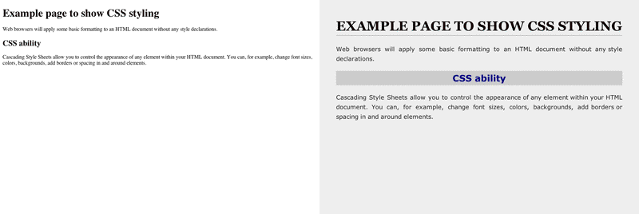
Html vs html & css

Slide 27
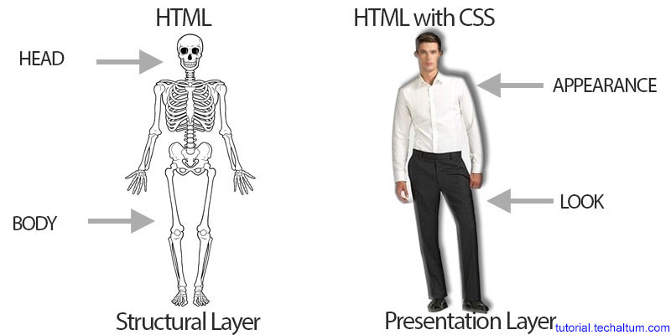
HTML & CSS metaphor

