Slide 1
Introduction to REST REpresentational State Transfer
Noel Mc Grath

Slide 2
Agenda
Constrains approach
Key principles approach
Get a Cup of Coffee

Slide 3
What REST is not !
It is not a framework
It is not a technology
It is not a standards specification

Slide 4
REST is an architecture style as documented and described by Roy Fielding .. which specifies a set of architecture constraints
“REST is a coordinated set of architectural constraints that attempts to minimize latency and network communication while at the same time maximizing the independence and scalability of component implementations.”

Slide 5
What is REST
Roy defined the REST style after the Web
Resources and resource representation
How the web works with humans to machine-to-machine interactions.
Progress by transitioning from one state to another, just like a state machine.
Possible states not known in advance.

Slide 6
Constraints
Client-Server
Stateless
Caching
Uniform Interface
Layered System
Code-On-Demand

Slide 7
Client-Server
Separation of concerns is the principle behind the client-server constraints
Improve the portability of the user interface across multiple platforms
Allows the components to evolve independently

Slide 8
Stateless
Each request from client to server must contain all of the information necessary to understand the request
Servers should be able to forget a client instantly

Slide 9
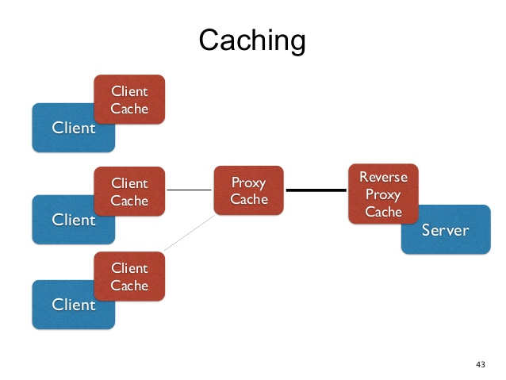
Caching
“I don’t want to hit the origin server every time I make a request”
Improves efficiency, scalability and user perceived performance

Slide 10
Uniform Interface
Here’s the big one.
Fielding decided there should be a “uniform interface”: that everyone on the Web had to use the exact same API. This means that everyone has to use the same programming interface.

Slide 11
Uniform Interface cont..
Connectors and Components
Connectors understand how that one API works(HTTP protocol)
Identification of Resources (URIs)
Resource Representation(Media types)
Self-Descriptive Messages(Header + Body)
Hypermedia(Links)

Slide 12
Layered System
Many intermediaries between client and server
Scaling and performance
Add or remove hardware at any time without any downtime

Slide 13
Code on demand
REST allows client functionality to be extended by downloading and executing code
Allowing features to be downloaded after deployment improves system extensibility

Slide 14
Key principles approach
Give every “resource” an ID
Link things together
Use standard methods
Resources with multiple representations
Communicate stateless

Slide 15
Give every “resource” an ID
URI - Rely on one that has already been defined, works pretty well on global scale, and is understood by practically anybody
http://example.com/customers/1234

Slide 16
Link things together
HATEOAS(“Hypermedia as the engine of application state)
<order self=’http://example.com/
customers/1234’ >
<amount>23</amount>
<product ref=’http://example.com/products/4554’ />
<customer ref=’http://example.com/customers/1234’ />
</order>

Slide 17
Use standard methods
Uses existing standards - HTTP
GET – safe, idempotent, cacheable
PUT - idempotent
POST
DELETE - idempotent
HEAD
OPTIONS

Slide 18
Example
http://localhost:9999/restapi/books
GET – get all books
POST – add a new book
http://localhost:9999/restapi/books/{id}
GET – get the book whose id is provided
PUT – update the book whose id is provided
DELETE – delete the book whose id is provided

Slide 19
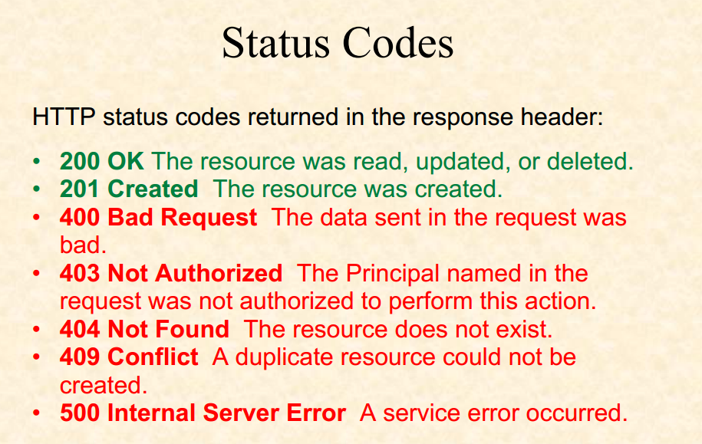

Slide 20
Resources with multiple representations
How does a client know how to deal with the data it retrieves?
REQUEST
POST/news/ HTTP/1.1
Host: example.org
Accept: application/json
Content-type: application/json
….
RESPONSE
HTTP/1.1 201 Created
Content-Type : application/json
...

Slide 21
Communicate stateless
REST mandates that state be either turned into resource state or kept on the client
Scalability - not dependent on talking to the same server

Slide 22
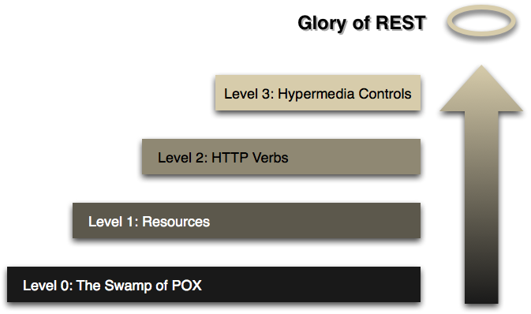
REST and Constraints
Your mileage may vary
http://martinfowler.com/articles/richardsonMaturityModel.html

Slide 23
Resources
InfoQ eMag REST
http://www.infoq.com/minibooks/emag-rest
InfoQ Explores REST
http://www.infoq.com/minibooks/emag-03-2010-rest
Roy T. Fielding Ph.D. thesis
Architectural Styles and the Design of Network-based Software Architectures
http://www.ics.uci.edu/~fielding/pubs/dissertation/rest_arch_style.htm
Rest in Practise book
http://shop.oreilly.com/product/9780596805838.do

Slide 24
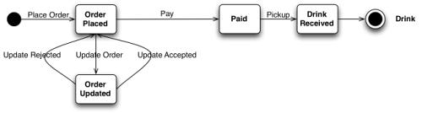
How to GET a Cup of Coffee

