Slide 1
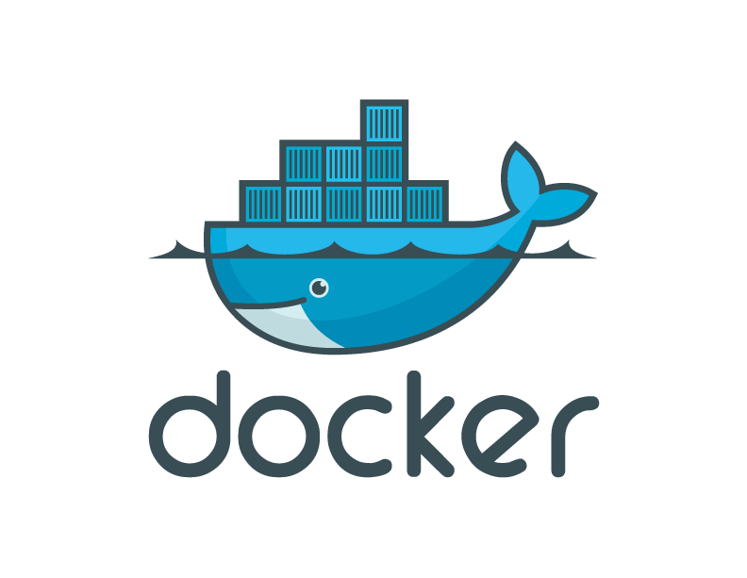
Introduction to Docker

Slide 2
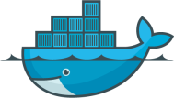
Contents
Introduction to Docker and containers
Docker v VM’s
Q & A
Demo

Slide 3
Docker Timeline
January 2013 Docker started as internal project inside dotCloud
March 2013 Docker released to public
February 2014 Docker 0.8 released
Production ready at 1.0

Slide 4
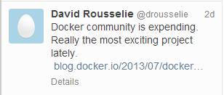

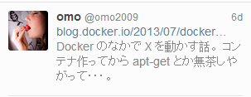
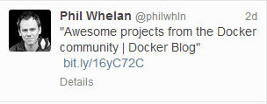

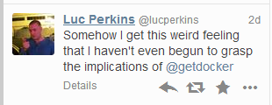
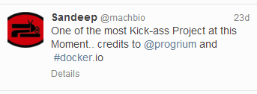
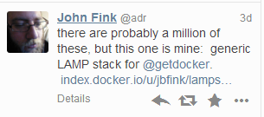
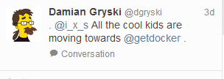
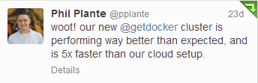
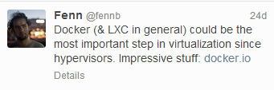
In the 7 months since we launched
>140,000 container pulls
>6,700 github stars
>180 non-employee contributors
>150 projects built on top of docker
UIs, mini-PaaS, Remote Desktop….
1000’s of Dockerized applications
Memcached, Redis, Node.js…and Hadoop
Integration in Jenkins, Travis, Chef, Puppet, Salt, Vagrant and OpenStack
Meetups arranged around the world…with organizations like Ebay, Cloudflare, Yandex, and Rackspace presenting on their use of Docker

Slide 5
What is Docker ?
Docker is an open-source project to easily create
lightweight, portable, self-sufficient containers
from any application that will run virtually anywhere.

Slide 6
LIGHTWEIGHT
Based on Linux containers
Minimal overhead (cpu/io/network)
Uses layered filesystem to save space (AUFS
- Another Union File System )
Uses a copy-on-write filesystem to track changes

Slide 7
PORTABLE
Can run on any Linux system that supports LXC (today).
0.7 release includes support for RedHat/Fedora family. Raspberry pi support.
Future plans to support other container tools (lmctfy, etc.)
Possible future support for other operating systems (Solaris, OSX, Windows?)

Slide 8
SELF-SUFFICIENT
A Docker container contains everything it needs to run:
Minimal Base OS
Libraries and frameworks
Application code

Slide 9
How does Docker work?
Docker extends Linux Containers, or LXC,
with a high level API providing a lightweight virtualization solution
that runs processes in isolation
Docker consists of:
Docker server daemon which is responsible for managing all the containers
Docker command line client which controls the server daemon.
Docker image repository is the place to find and browse docker images. It is available at https://index.docker.io/.

Slide 10
How does Docker work?
Docker extends Linux Containers,
with a high level API providing a lightweight virtualization solution
that runs processes in isolation
Docker consists of:
Docker server daemon which is responsible for managing all the containers
Docker command line client which controls the server daemon.
Docker image repository is the place to find and browse docker images. It is available at https://index.docker.io/.

Slide 11
LinuX Containers(LXC)
“LXC" refers to capabilities of the Linux kernel
(specifically namespaces and control groups)
which allow sandboxing processes
from one another,
and controlling their resource allocations.

Slide 12
Docker functionality on top of containers
Guaranteed portable deployment of applications
Application-centric
Versioning
Reuse
Sharing

Slide 13
Why all the excitement?

Slide 14

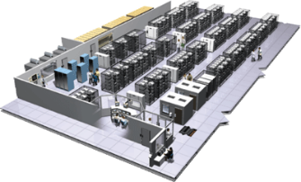
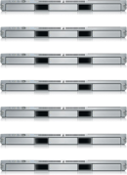
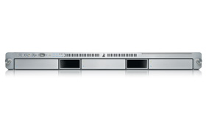
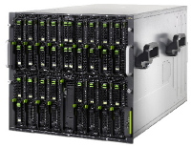

The Challenge
User DB
Static website
postgresql + pgv8 + v8
Queue
Analytics DB
nginx 1.5 + modsecurity + openssl + bootstrap 2
Do services and apps interact appropriately?
Redis + redis-sentinel
hadoop + hive + thrift + OpenJDK
Multiplicity of Stacks
Background workers
Web frontend
Python 3.0 + celery + pyredis + libcurl + ffmpeg + libopencv + nodejs + phantomjs
Ruby + Rails + sass + Unicorn
API endpoint
Python 2.7 + Flask + pyredis + celery + psycopg + postgresql-client
Production Cluster
Development VM
Public Cloud
Multiplicity of hardware environments
QA server
Can I migrate smoothly and quickly?
Disaster recovery
Customer Data Center
Contributor’s laptop
Production Servers

Slide 15
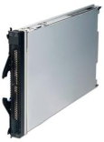
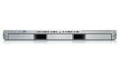
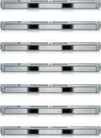

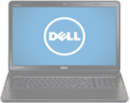
The Matrix From Hell
? | ? | ? | ? | ? | ? | ?
? | ? | ? | ? | ? | ? | ?
? | ? | ? | ? | ? | ? | ?
? | ? | ? | ? | ? | ? | ?
? | ? | ? | ? | ? | ? | ?
? | ? | ? | ? | ? | ? | ?
Static website
Web frontend
Background workers
User DB
Analytics DB
Queue
 | Development VM | QA Server | Single Prod Server | Onsite Cluster | Public Cloud | Contributor’s laptop | Customer Servers

Slide 16
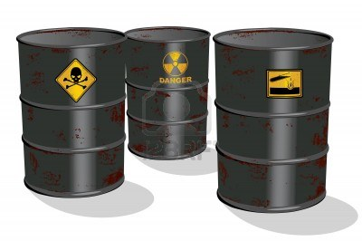
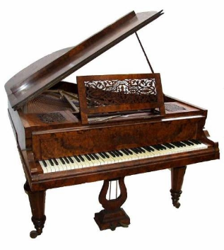

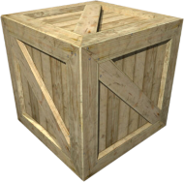
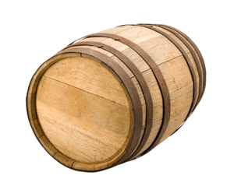
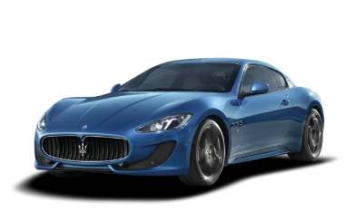
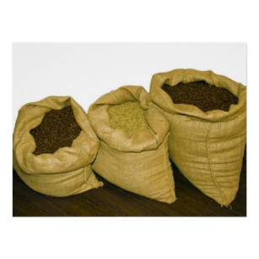



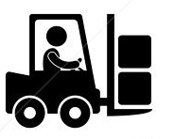
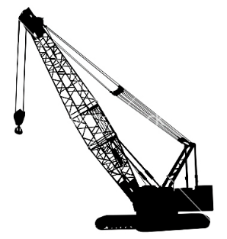
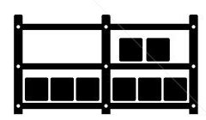

Cargo Transport Pre-1960: Another Matrix from Hell
Do I worry about how goods interact (e.g. coffee beans next to spices)
Multiplicity of Goods
Multipilicity of methods for transporting/storing
Can I transport quickly and smoothly
(e.g. from boat to train to truck)

Slide 17

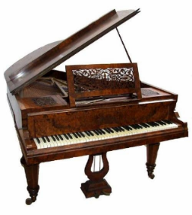

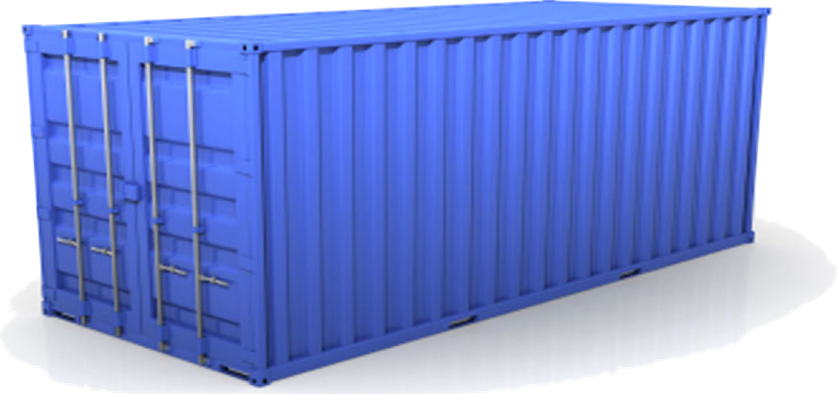
Solution: Intermodal Shipping Container
Do I worry about how goods interact (e.g. coffee beans next to spices)
Multiplicity of Goods
A standard container that is loaded with virtually any goods, and stays sealed until it reaches final delivery.
…in between, can be loaded and unloaded, stacked, transported efficiently over long distances, and transferred from one mode of transport to another
Can I transport quickly and smoothly
(e.g. from boat to train to truck)
Multiplicity of methods for transporting/storing

Slide 18
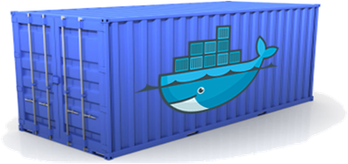
Docker is a shipping container system for code
Static website
User DB
Web frontend
Queue
Analytics DB
Do services and apps interact appropriately?
Multiplicity of Stacks
An engine that enables any payload to be encapsulated as a lightweight, portable, self-sufficient container…
…that can be manipulated using standard operations and run consistently on virtually any hardware platform
Multiplicity of hardware environments
Can I migrate smoothly and quickly
Development VM
QA server
Customer Data Center
Public Cloud
Production Cluster
Contributor’s laptop

Slide 19

Docker eliminates the matrix from Hell
Static website
Web frontend
Background workers
User DB
Analytics DB
Queue
 | Development VM | QA Server | Single Prod Server | Onsite Cluster | Public Cloud | Contributor’s laptop | Customer Servers

Slide 20
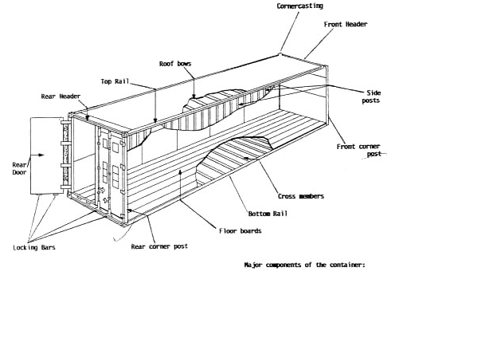
Why it works—separation of concerns
Dan the Developer
Worries about what’s “inside” the container
His code
His Libraries
His Package Manager
His Apps
His Data
All Linux servers look the same
Oscar the Ops Guy
Worries about what’s “outside” the container
Logging
Remote access
Monitoring
Network config
All containers start, stop, copy, attach, migrate, etc. the same way

Slide 21
Why Developers Care
Build once…(finally) run anywhere*
A clean, safe, hygienic and portable runtime environment for your app.
No worries about missing dependencies, packages and other pain points during subsequent deployments.
Run each app in its own isolated container, so you can run various versions of libraries and other dependencies for each app without worrying
Automate testing, integration, packaging…anything you can script
Reduce/eliminate concerns about compatibility on different platforms, either your own or your customers.
Cheap, zero-penalty containers to deploy services? A VM without the overhead of a VM? Instant replay and reset of image snapshots? That’s the power of Docker
* With the 0.7 release, we will support any x86 server running a modern Linux kernel (3.2+ generally. 2.6.32+ for RHEL 6.5+, Fedora, & related)

Slide 22
Why Devops Cares?
Configure once…run anything
Make the entire lifecycle more efficient, consistent, and repeatable
Increase the quality of code produced by developers.
Eliminate inconsistencies between development, test, production, and customer environments
Support segregation of duties
Significantly improves the speed and reliability of continuous deployment and continuous integration systems
Because the containers are so lightweight, address significant performance, costs, deployment, and portability issues normally associated with VMs

Slide 23
Containers vs. VMs
App
A
App
A’
App
B
Containers are isolated,
but share OS and, where
appropriate, bins/libraries
Bins/
Libs
Bins/
Libs
Bins/
Libs
VM
Guest
OS
Guest
OS
Guest
OS
…result is significantly faster deployment, much less overhead, easier migration, faster restart
Guest
OS
Guest
OS
App A
App A’
App B
App B’
App B’
App B’
Container
Docker
Hypervisor (Type 2)
Bins/Libs
Bins/Libs
Host OS
Host OS
Server
Server

Slide 24
Why are Docker containers lightweight?
VMs
Containers
App
A
App
A
App
A’
App
A
App
A
App Δ
Bins/
Libs
Bins/
Libs
Bins/
Libs
Bins/
Libs
Bins/
Guest
OS
Guest
OS
Guest
OS
Guest
OS
Original App
(No OS to take
up space, resources,
or require restart)
Copy of
App
No OS. Can
Share bins/libs
Modified App
Copy on write capabilities allow
us to only save the diffs
Between container A and container
A’
VMs
Every app, every copy of an
app, and every slight modification
of the app requires a new virtual server

Slide 25
What are the basics of the Docker system?
Container A
Docker Public Index
(or
Private
Registry)
Index
Push
Search
Pull
Source Code Repository
Run
Build
Dockerfile
For
A
Container A
Container B
Container C
Docker
Docker Engine
Host 1 OS (Linux)
Host 2 OS (Linux)

Slide 26
Changes and Updates
Docker
Container
Image Registry
App
A
Push
App Δ
Bins/
Libs
Bins/
Base
Container
Image
Container Mod A’
Container Mod A’’
App Δ
Update
App
A
Bins/
App
A’’
Bins/
Libs
Bins/
Libs
Bins/
Docker Engine
Docker Engine
Host is now running A’’
Host running A wants to upgrade to A’’. Requests update. Gets only diffs

Slide 27
Want to learn more:
www.docker.io:
Documentation
Getting started: interactive tutorial, installation instructions, getting started guide,
About: Introductory whitepaper: http://www.docker.io/the-whole-story/
Github: dotcloud/docker
IRC: freenode/#docker
Google groups: groups.google.com/forum/#!forum/docker-user
Twitter: follow @docker

