Slide 1
OpenSDS-installer/salt

Slide 2
Salt Overview
YAML/Jinja2/SLS
salt Participant Interface (Object Model Based)
CLI
Top Model
Component
Salt Interface
Realized Model
Component
Salt
Component
GNU/Linux Host
Component

Slide 3
Solution Design
YAML/Jinja2/SLS
Salt Formulas
OpenSDS
CLI
Auth
site.j2
devstack
packages
Dock
Salt Pillar Data
firewalld
Salt States
Database
lvm
Salt Interface
nbp
iscsi
salt
docker
dashboard
etcd
let
RedHat, Debian, Suse
golang
Controller
mysql
Future ….

Slide 4
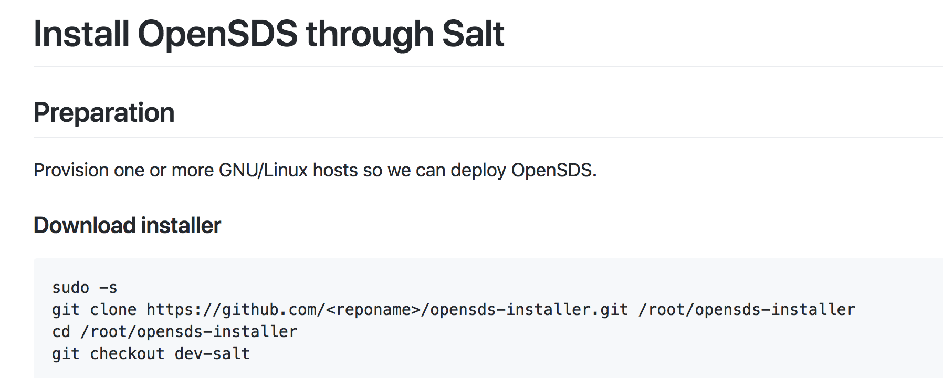

Slide 6
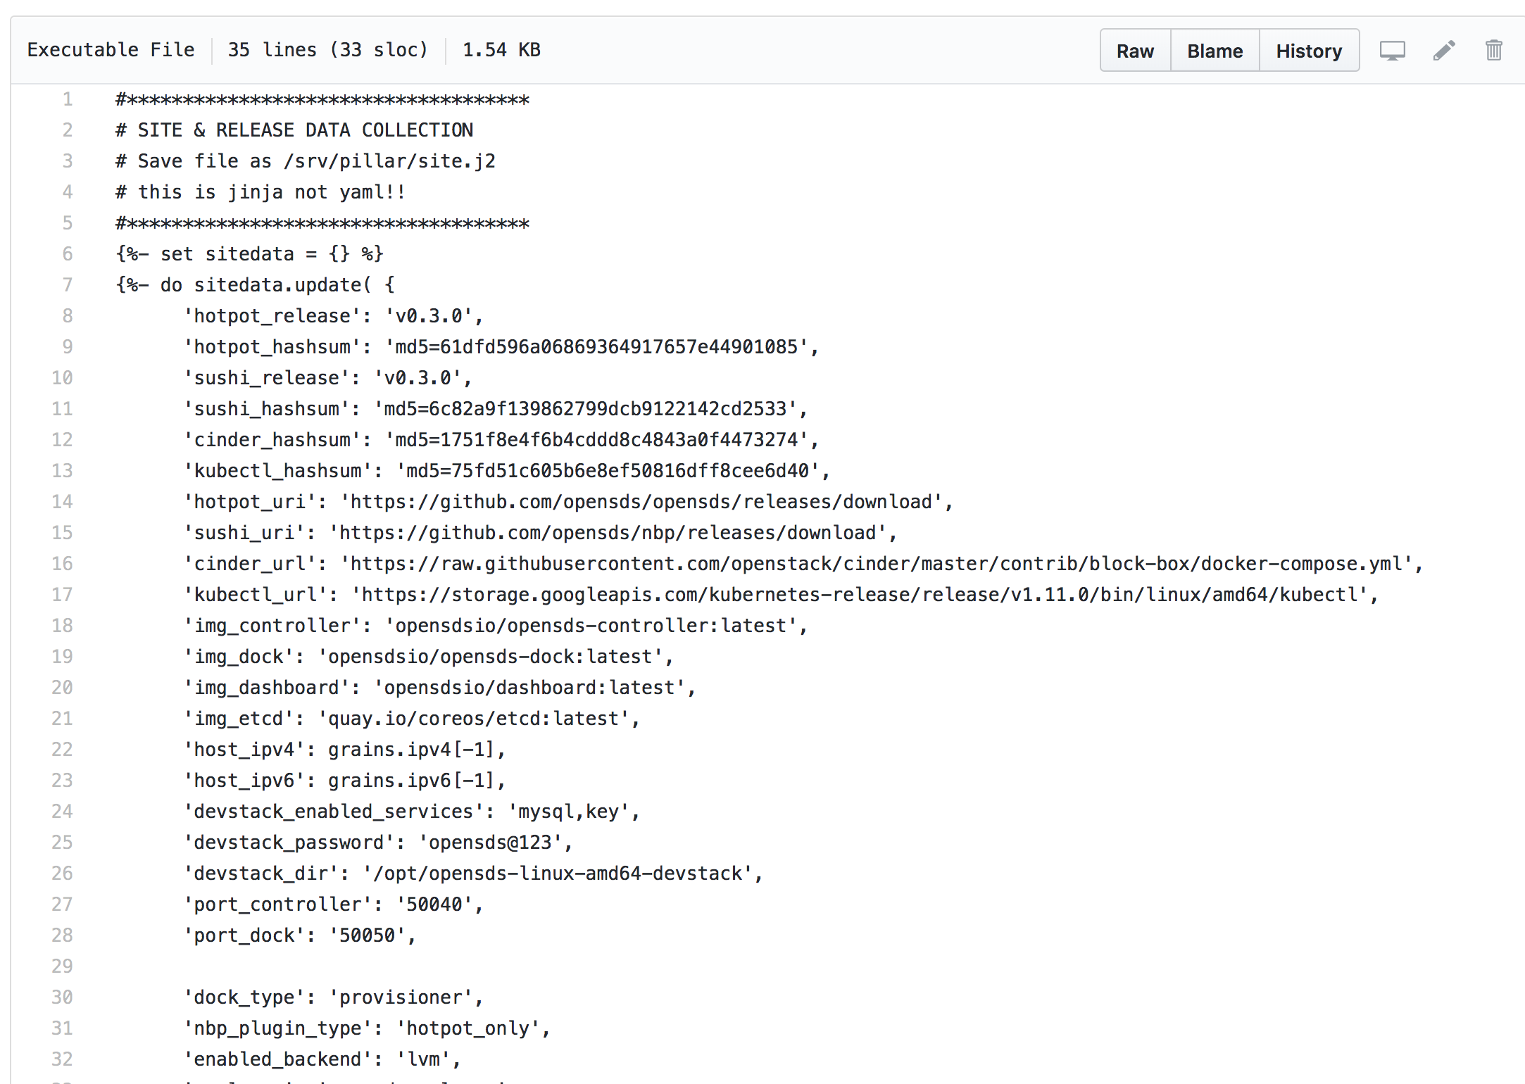
Site Data Collection

Slide 7
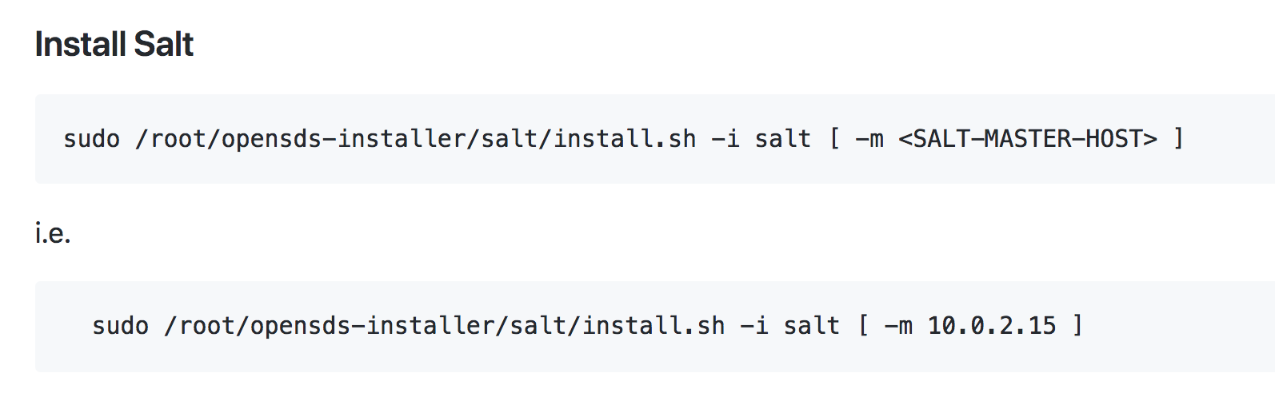

Slide 8
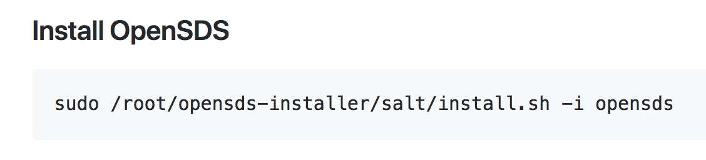

Slide 9
Sample Output (Centos 7.5)
https://github.com/opensds/opensds-installer/files/2413222/Demo_Installer_Centos7_log.txt

