Slide 1
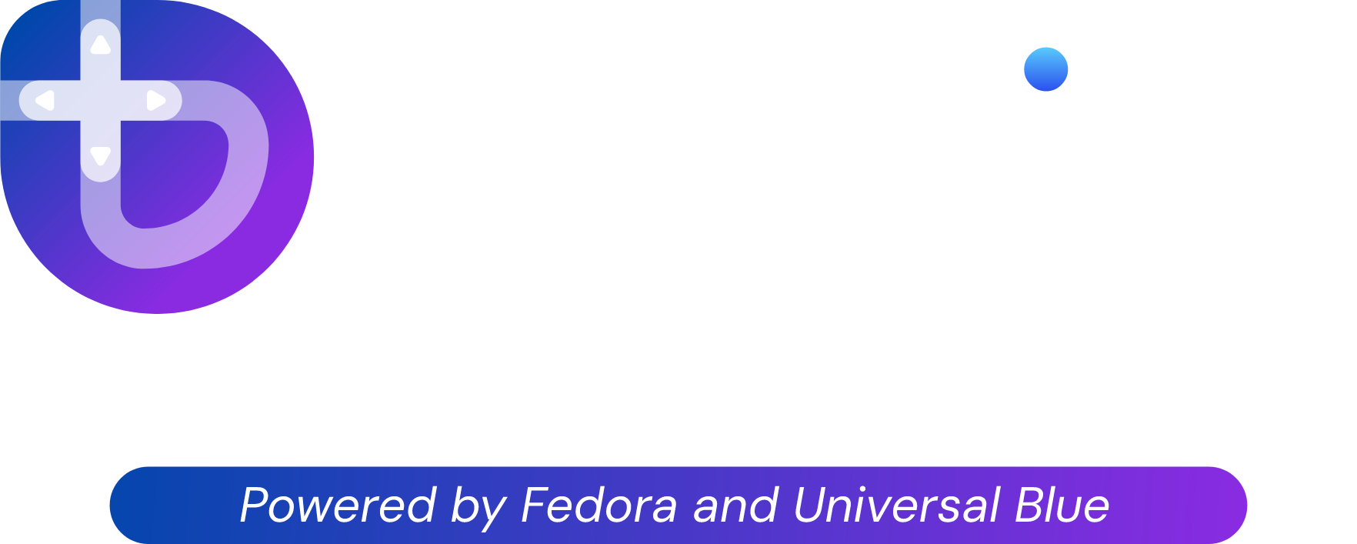
Presented by Noel Miller

Slide 2
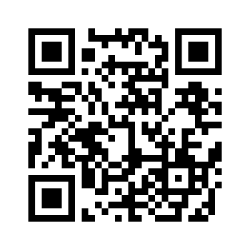
Grab a Copy of this Presentation!
https://github.com/noelmiller/bazzite_presentation
Notes:
Create a QR Code

Slide 3
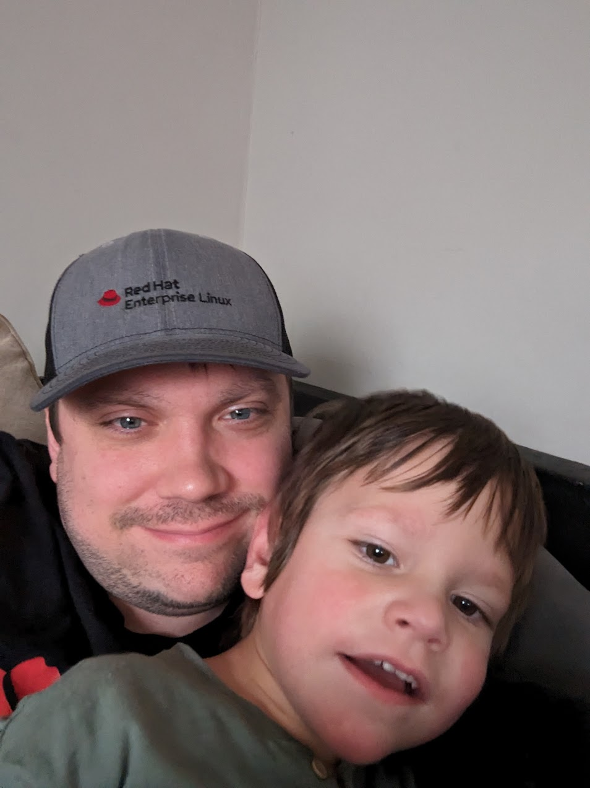
About me
Noel Miller!
Been gaming for a while
Project Manager and Core Contributor at Universal Blue
Work at Red Hat
Use Bazzite as my primary OS
Love spending time with my family (and pets)
Big Metal Head

Slide 4
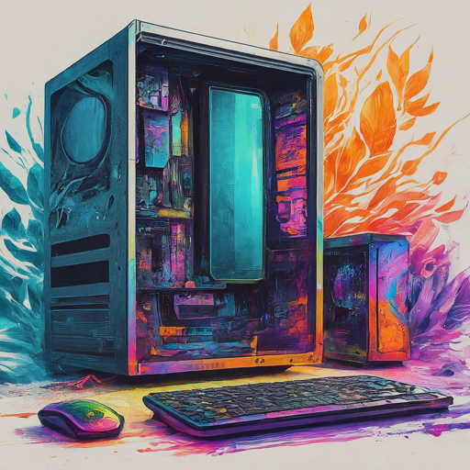
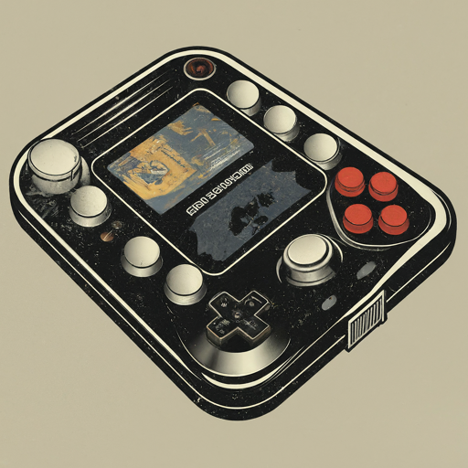
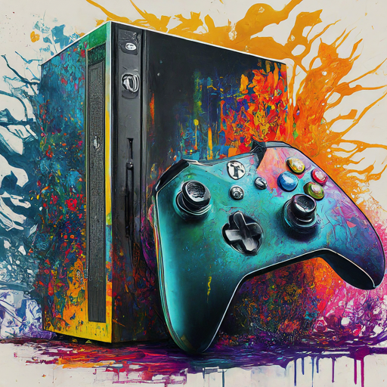
State of PC, Console, and Handheld Gaming
Everything is a PC now
Consoles are great, purpose built experiences
Nintendo Switch and Steam Deck changed everything
Good PCs have become more affordable
Steam and Proton has made gaming on Linux possible

Slide 5

What is Bazzite?
Built on Fedora Atomic and Universal Blue
Excellent gaming experience on your desktop, laptop, and handheld
Familiar experience to a gaming console
First class support for gaming using Steam

Slide 6
Bazzite Features
Automated updates
Easy Rollback
Driver Support Built-in
Game Controllers
GPU Drivers
Desktop Environment Options
Gnome (MacOS-like)
KDE (Windows-like)
Steam is preinstalled

Slide 7

Bazzite vs Windows
Community Owned
Completely free to use
Smaller on disk install size
Easy Rollback
Drivers are built-in
Optimized for all device types
Desktop
Laptop
Handheld
Owned by a large corporation
Requires you to pay for a license
Larger on disk size
Difficult to rollback
Requires you to install drivers for best experience
Only optimized for desktops and laptops

Slide 8
LIVE DEMO TIME!

Slide 9
Questions?

Slide 10
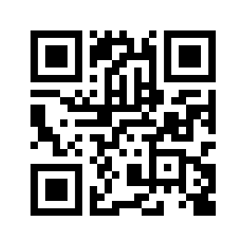
Join the Community!
Bazzite: https://bazzite.gg
Universal Blue: https://universal-blue.org
Discord: https://discord.gg/HbUWTNcm
Notes:
Create a QR Code

Slide 11
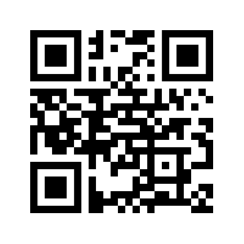
Where can you find me?
https://linktr.ee/noelmiller
Notes:
Create a QR Code

